Slide 1

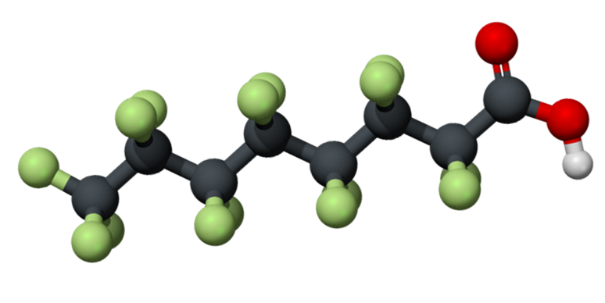
Adventures in PFAS (Crazy) Candy Land
Kirby Tyndall, PhD, DABT
Senior Associate Toxicologist
August 8, 2025
PFAS Session
Everlasting Gobstoppers

Slide 2

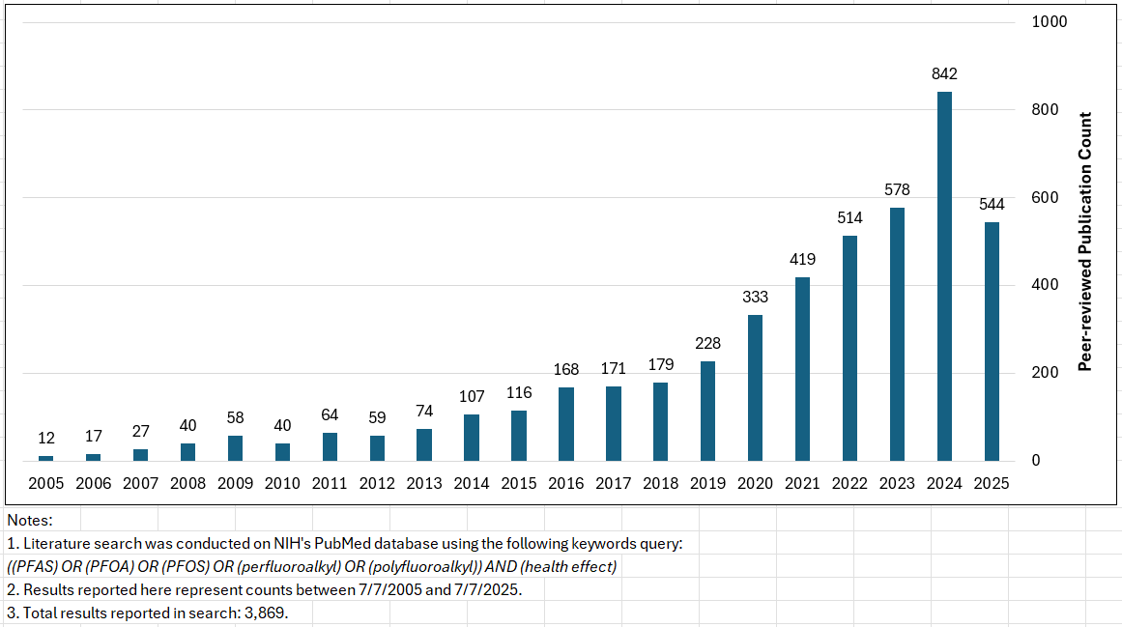
Just How Crazy is PFAS Candy Land?
Increase in PFAS Publications over Time
National Primary Drinking Water Regulations (Maximum Contaminant Levels; MCLs)
CERCLA designation
Proposed RCRA Listing
TSCA Reporting Requirements
Biosolids Risk Assessment
Draft Human Health Ambient Water Quality Criteria
National Ambient Water Quality Criteria (aquatic life)
TRI Reporting for Additional PFAS
…Add your personal favorite
Likely that number of publications will increase throughout 2025

Slide 3
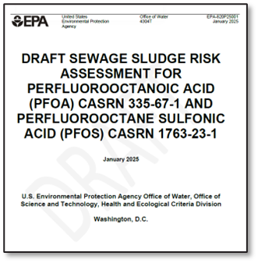

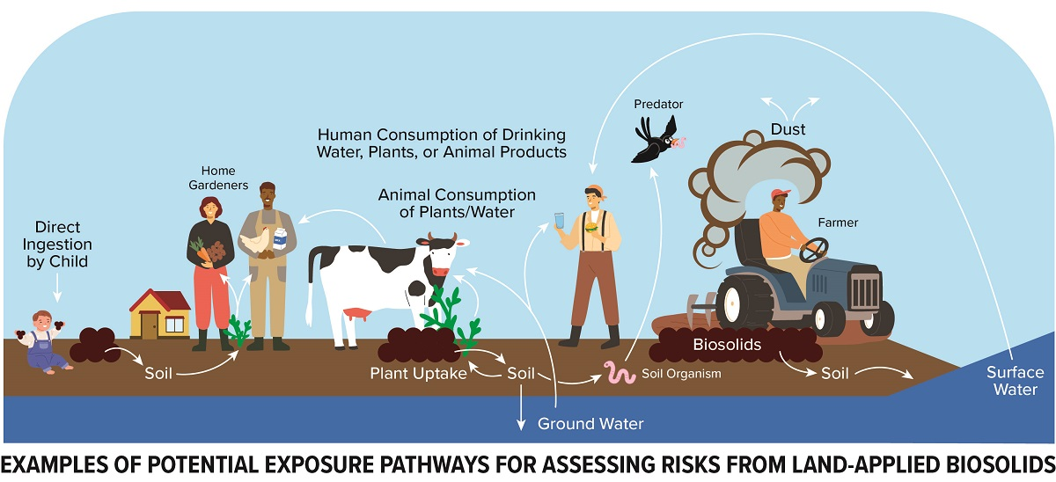
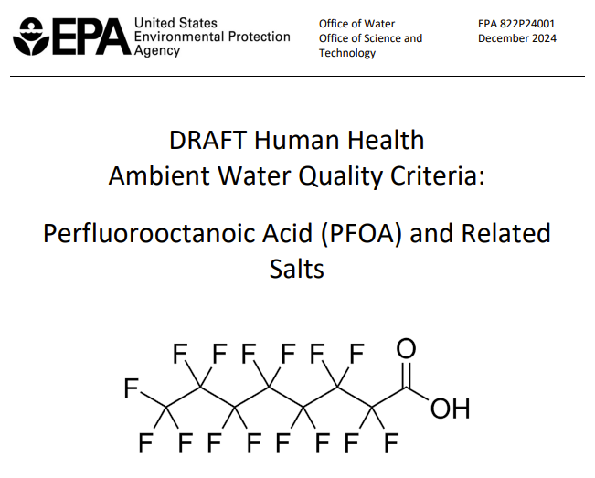

Evolving Science, Regulations, Awareness
Final Regulatory Determination for MCLs
  PFOA/PFOS MCLs at Practical Quantitation Limit
PFAS | Final MCL (ppt)
PFOA, PFOS | 4.0
PFNA, PFHxS, GenX | 10
From: PFAS and Biosolids: What Wastewater Pros Need to Know | California Water Environment Association
  Hazard index of 1 for mixtures of PFNA, PFBS, Gen-X, PFHxS
  Five years to comply (2029)
  Contain NEW non-cancer and cancer toxicity values
  Underlying tox values are used for other risk-based regulations

Slide 4






No Consensus Opinion on PFOA/PFOS Exposure &
Association or Causation of Adverse Health Outcomes
Human studies show
associations with…
“limited or no evidence for any causal link… and any human disease”
Effects on immune system
Elevated cholesterol
Decreased birth weight
Cancer (“likely”)
vs.
“The available epidemiological studies suggest associations … ; however, cause-and-effect relationships have not been established…“
“…no evidence for a link between exposure to PFASs and cancer risk.”
PFOA = “carcinogenic to humans”
PFOS = “possibly carcinogenic to humans”

Slide 5
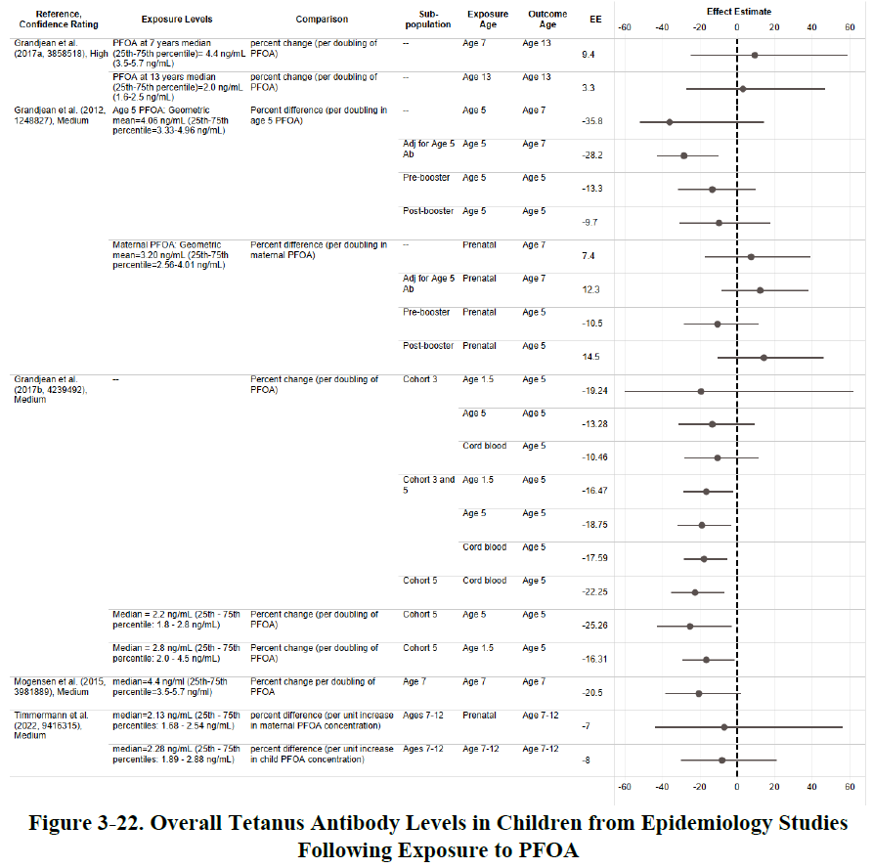

Why the Inconsistency?
1. Inconsistent Science Interpretations
One of many decisions made related to choosing endpoint of concern with epi (18 health systems), animal (15 health systems) and mechanistic data and evaluating quality of study.
2. Regulatory Program/Policy
Selection of Key Studies (Animal Bioassay or Human Epidemiology)
Selection of Critical Endpoint
Point of Departure in exposure-response relationship
Uncertainty Factors
Drinking Water (MCLs)
Surface Water (AWQCs)
Risk-based Screening Values (RSLs)
Fish Advisories
Human Health Toxicity Assessment for Perfluorooctanoic Acid (PFOA) | US EPA

Slide 6
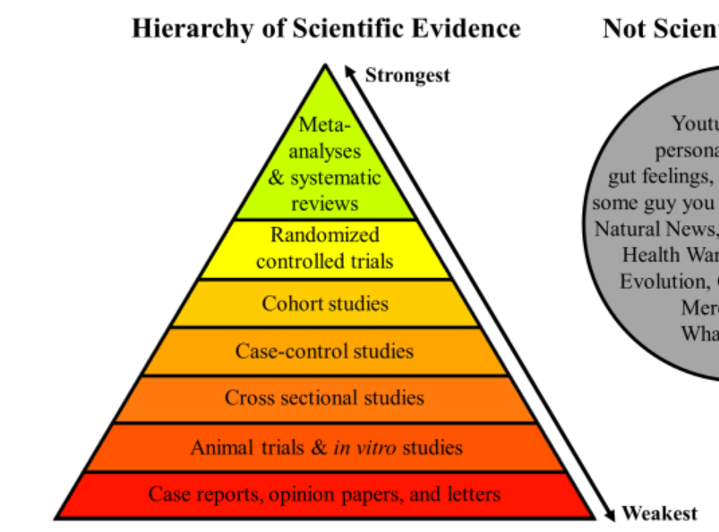

Controversy Exists for All Human Health Endpoints
Inconsistent data
True “adversity” of endpoints
Reverse causation and/or confounding
Largely negative and/or weak
Inconsistent, chance of bias/confounding
Human relevance uncertain
Source: The Logic of Science Available: https://thelogicofscience.files.wordpress.com/2016/01/hierarchy-of-evidence2.png

Slide 7
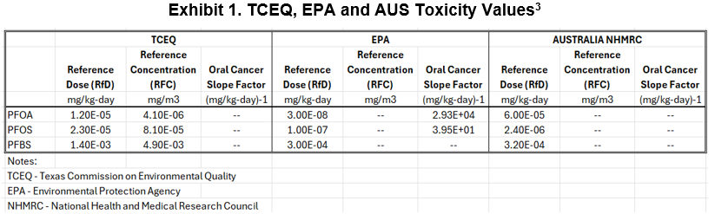
Results of Inconsistency…
Different science policy decisions
Very different interpretations of the PFOA/PFOS toxicity
Challenges with risk communication
Varying Regulatory Values
TCEQ is in the process of updating PFAS tox values and expect to issue draft for public comment/review by end of 2025.

Slide 8

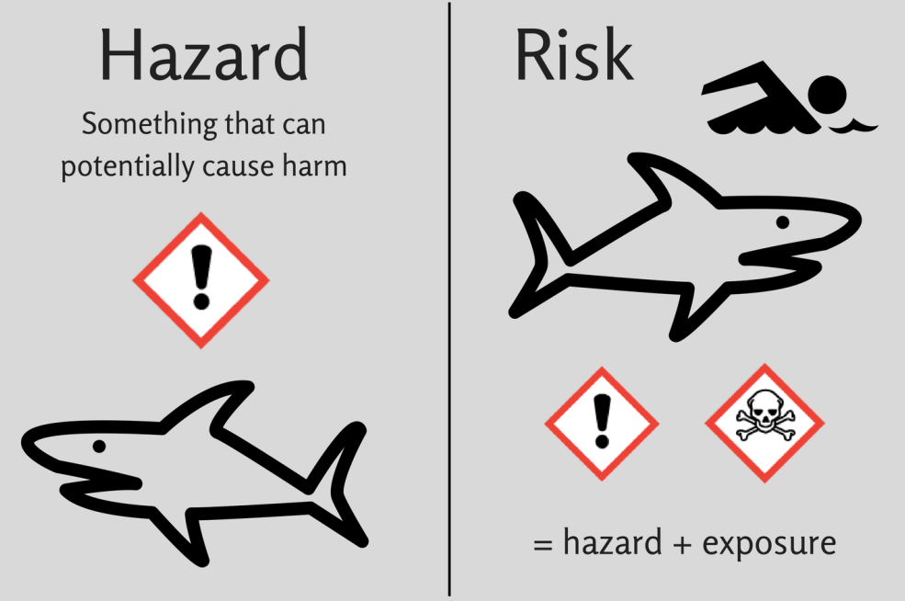
What is the Real Risk to Humans from PFAS?
Risk is the foundation for making decisions that protects public health and the environment
Risk = Toxicity x Exposure
What are the chemical’s harmful effects?
What is the relationship between dose level and health effects?
How will receptors contact the chemical?
What is the magnitude, frequency, and duration of contact?
What is the likelihood of harmful effects in a population (including sensitive subpopulations)?
Toxicity is often used synonymously with hazard identification
Image generated by Copilot

Slide 9
Navigating in PFAS Candy Land
Are PFAS A Problem?
It’s More Than Just PFOA/PFOS and Drinking Water
No Consensus on PFOA/PFOS Toxicity
Public health benefits of PFAS toxicity values are highly uncertain
Consumer Products
Dynamic Science and Regulations
State legislation at forefront
Depends on which PFAS
Not all PFAS are the same
Depends on legal/regulatory paradigm
Due Diligence
Alternatives Assessments??
Property Redevelopment
Unclear what actions EPA will take in near future
Litigation trends setting precedent

Slide 10

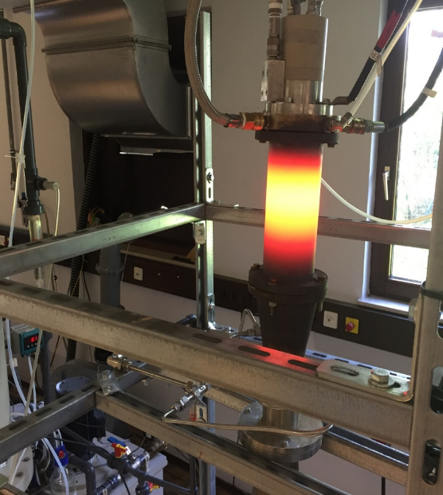
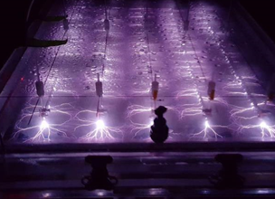
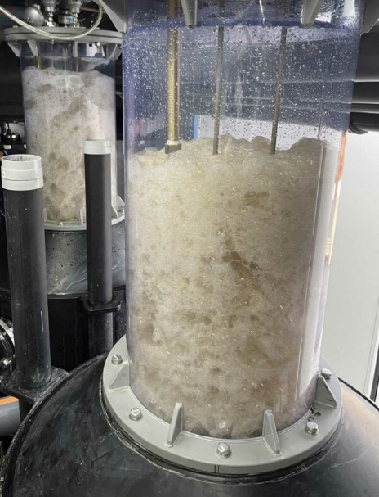
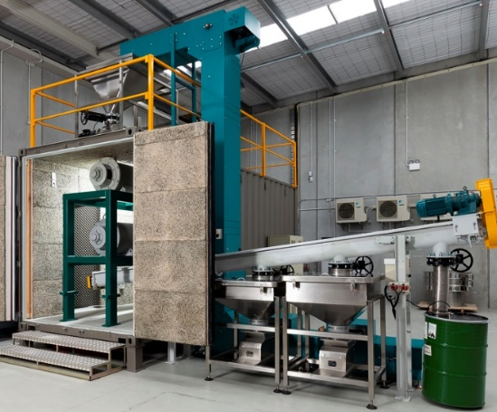
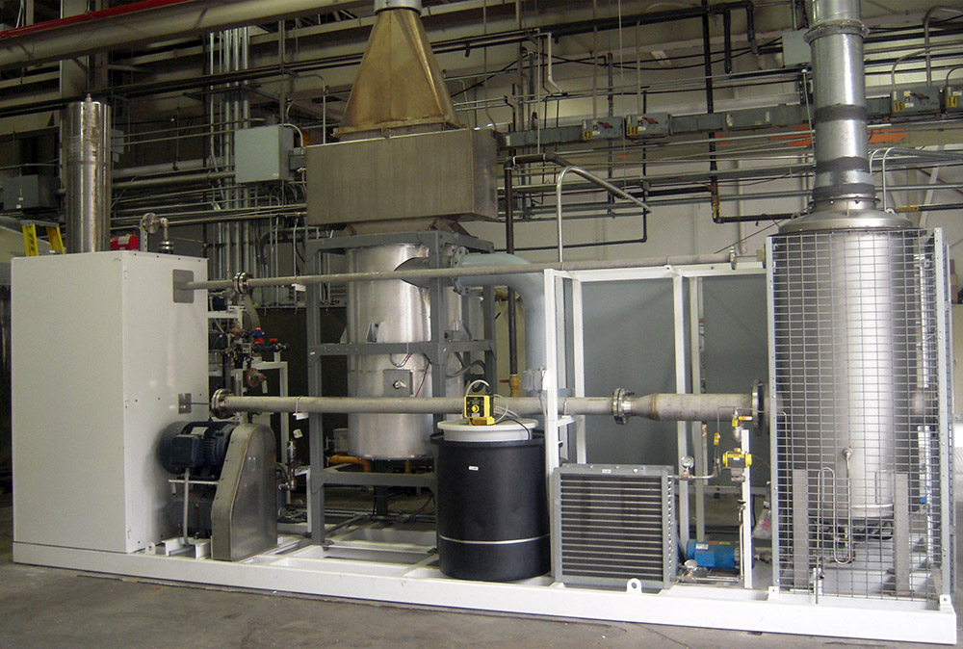
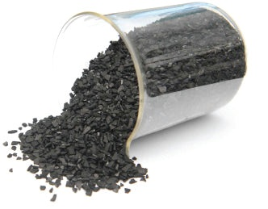
What Solutions Do We Have?
PFAS are not “forever chemicals”
“Assortment” of treatment technologies & approaches for PFAS are available
Significant advancements are being made in numerous fields
Destruction: Plasma
Destruction: Thermal Plasma
Separation: Foam Fractionation
Concentration: Sorbents
Destruction: Ball Milling
Destruction: Supercritical Water Oxidation

Slide 11

THANK YOU
Science · Strategy · Solutions
Kirby Tyndall, PhD, DABT
khtyndall@gsienv.com

