Slide 1

TRRP UPDATE
Texas Environmental Superconference
August 7, 2025
Kenneth S. Tramm, PhD, PE, PG, CHMM
Modern Geosciences

Slide 2


2
Nutrition Facts
Serving size | 20 m
What is TRRP? | 5%
TRRP’s Goal & Annual Updates | 5%
Current Challenges | 25%
Institutional Knowledge | 10%
Addressing Uncertainty | 5%
Stakeholder Input | 10%
The “Background” Problem | 50%
New TRRP Memo | 20%
This is provided for informational purposes only. Please do not harm the messenger. This in not legal or technical advice. But we are glad you are here and hope together we can make TRRP more efficient.
2025
Advocacy Award

Slide 3

3
What is the Texas Risk Reduction Program?
Risk-based rule to address releases of hazardous materials 30 TAC §350
“culmination of an unprecedented level of public input”
“provides flexibility in calculating site-specific cleanup levels”
“tiered approach incorporating risk assessment techniques to help focus investigations, to determine appropriate Protective Concentration Levels, and to set reasonable response objectives.”
“to complete the movement away from background as a regulatory standard.”
Tier 3: Very Site Specific
Tier 2: Site Specific
Tier 1:
Very Generic
TRRP PCLs
TCEQ (to EPA): “Unnecessary regulatory oversight and red tape should be avoided in the corrective action process as little is gained but inefficiency…” [TRRP is about] “dropping the historical ‘process over results’ philosophy”
TX Reg: September 17, 1999

Slide 4
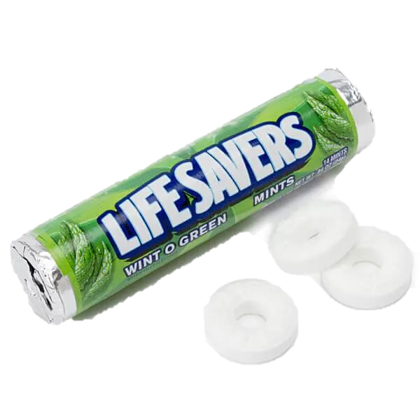
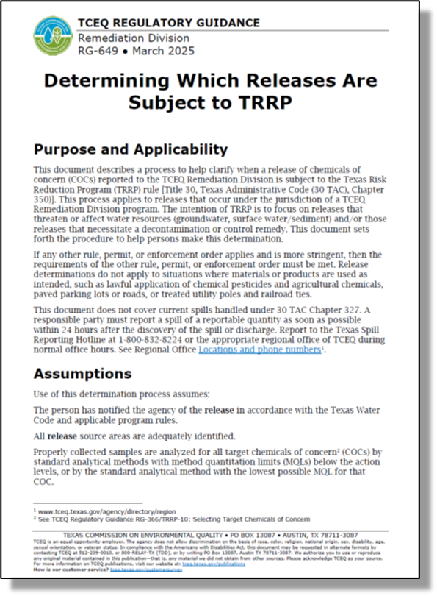
TRRP Updates: PCLs and Guidance (Feb/Mar 2025)
4
Carbon Tetrachloride and Tert-butyl alcohol:  by up to 87%
PFDoA, Beryllium, and Nitrobenzene  by up to 8%
Dioxin (as 2,3,7,8-TCDD TEQs)  by over 1,780%
Two New Regulatory Guidance (RG) Documents
§350.76 amended to address modern risk approaches for Dioxin/Dioxin-like PCBs -effective February 6, 2025, 49 TexReg 663
RG-648
Dioxin Update and TEQ Calculator
RG-649
Update to the TRRP Memo

Slide 5
Current Challenges: Institutional Knowledge Loss
5
“TCEQ’s vacancies, turnover, and loss of expertise are not sustainable, and key staff shortages may delay economic development.”
2022
TCEQ’s “turnover rate has created an unfortunate reality where over 50% of staff have less than four years of experience. Concurrently, 30% of our current workforce is eligible to retire in this biennium.”
2024
Ref: TCEQ Biennial Reports

Slide 6

Current Challenges: Uncertainty
6
Improved stakeholder involvement and updated guidance needed.
TRRP Steering Committee
Vapor Intrusion?
RG-648 & RG-649
VI Guidance
No VI Guidance
Ecological Risk
Ref:
Review of TCEQ TRRP Regulatory Guidance (January 2000 to December 2024)
VI Guidance notation includes State-based guidance directing use of EPA or ITRC protocols
Re: RG-366/TRRP-1 to 34, RG-263, RG-648, RG-649
Note: TRRP-5, 6, 9, 11, 15H, 20, 26, 30, 31 not issued

Slide 7

Regulatory Challenges: Impact from Staffing/Guidance Issues
7
                Inconsistent Review: Staff applying independent and novel criteria. Some reviewers unfamiliar with rule requirements, underpinning science, or precedent. Decreasing ‘flexibility’ (“red tape”) and added time.
                Lost Confidence: Commercial real estate sees moving targets, unnecessary time/expense, and added uncertainty in TRRP projects (VCP or Corrective Action).
                Declining Participation: VCP entrance is in decline and review times are increasing
                Growing Resistance to Stakeholder Input: Example – The “Background” Problem - a policy impeding brownfield redevelopment
                1,500+ pro bono hours applied to help
Texas grew by 58%
VCP Application Rate vs
Average VCP APAR Review Times
Texas Population
1996: 19M
2024: 30M
Ref: US Census
Data sets: VCP 1800-2000 (2005-06), VCP 2800-3000 (2016-19), and VCP 3200-3300 (2021-23)
Sources: TCEQ Central Registry – Correspondence Tracking; VCP Database (as of 05/14/25) (Review time in calendar days); TX Reg: April 12, 1996 (TCEQ response on review time – “staff will make every attempt to review a submittal within 45 days”

Slide 8
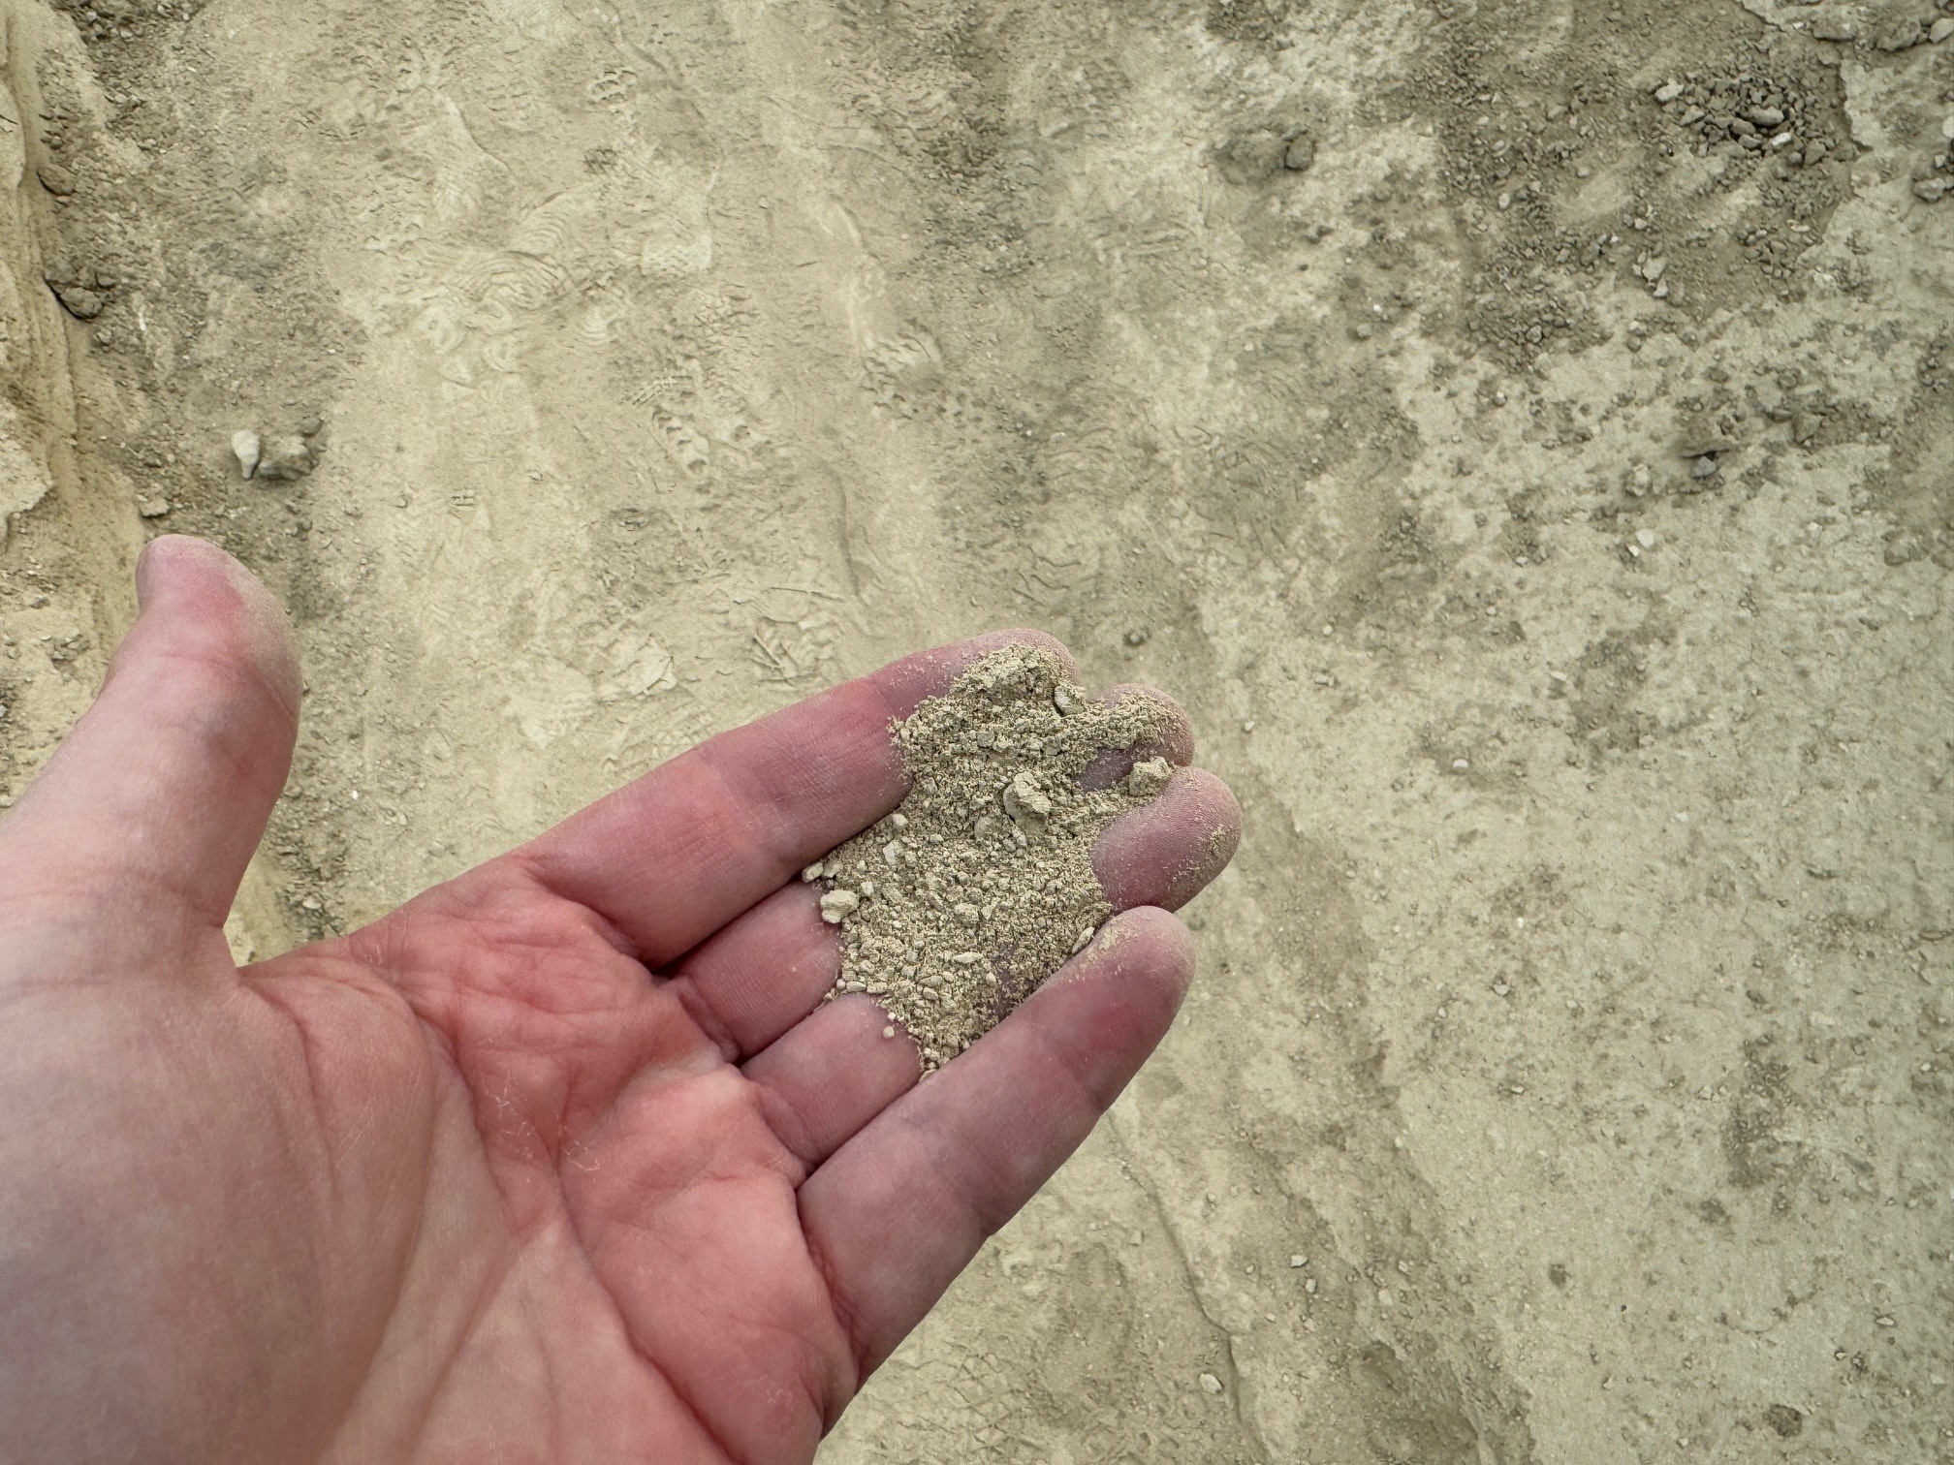
8
The “Background” Problem
2025
Advocacy Award

Slide 9
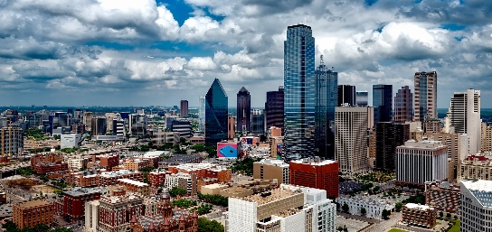







Example: Dallas, Texas
9
§350
You collected five soil samples to evaluate for a suspected metals release.
Lead results range from 16 to 30
Arsenic results range from 7 to 15
Do you have a release?
Where to look?
Risk Criteria: TRRP Tier 1 PCL Tables
Background: Texas-Specific Soil Background Concentrations
TRRP Memo (RG-649)
Risk Criteriaª
Background^{b}
Screening Value
Arsenic
5.0
5.9
5.9
Lead
3.0
15
15
All lead and arsenic concentrations are above screening values.
So, we have releases?
All concentrations in mg/kg
a – Critical Tier 1 PCL (^{GW}Soil) – Feb 2025
b – Texas-Specific Soil Background Concentration (TSSBC)] – §350.51(m)

Slide 10
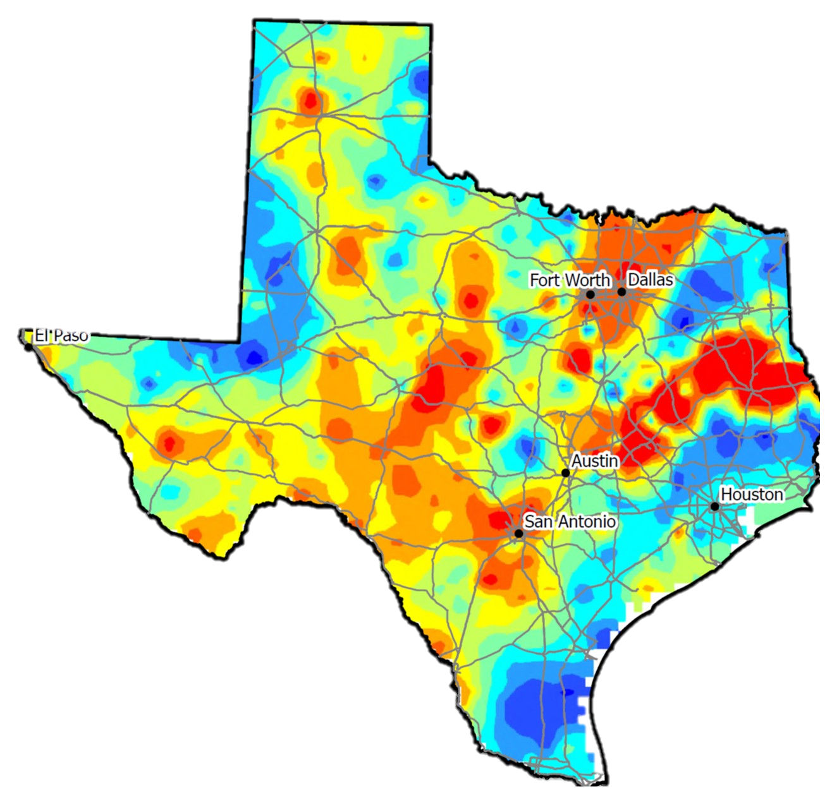
Example: It’s a little more complicated
10
Median
5.9
All Yellow, Orange and Red could exceed “Background”
Background Threshold Value
17
Arsenic
USGS 2013
All concentration in mg/kg
https://mrdata.usgs.gov/ds-801 (Horizon A depicted)
https://www.epa.gov/land-research/proucl-software
https://doi.org/10.21663/EEG-D-24-00009

Slide 11
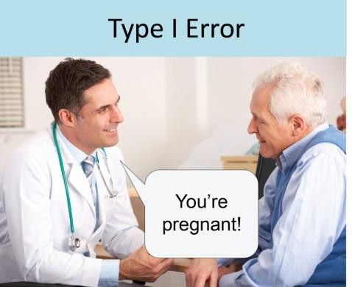
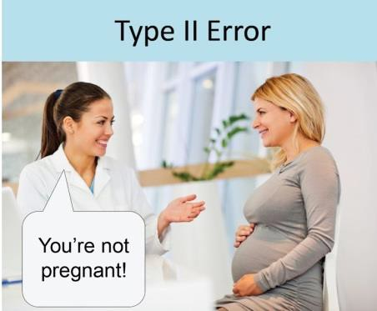
11
Regulatory Challenges: How ‘background’ should work?
TRRP specifies using the 95th percentile for background¹ within screening. Not the median (50th percentile).
Said another way, we should only have a 5% Type I Error (False Positive) rate per §350.79(2)(A)(iii).
Not This
This
concentration
False Positives
1- §350.78 (c), the background concentration is the Critical PCL if greater than the lowest PCL or MQL.
False
Positive
False
Negative
EPA 2020 and ITRC 2022

Slide 12

Regulatory Challenges: Examples
12
“Arsenic Background Evaluation - TRRP does not allow for the use [of] the United States Geological Survey…” (2019) VCP
False: TRRP DOES NOT prohibit USGS use. TRRP actually uses USGS data.
“Please be advised, the Texas-specific soil background concentrations provided in 30 TAC §350.51(m) are the accepted background concentrations under TRRP.” (2023) VCP
False: RG-382 (IOP Guidance) prohibits use of 350.51(m) values this way.
“Soil samples collected beneath the USTs at the site had lead concentrations that exceeded the Texas-Specific Soil Background Concentration…delineate the contamination to below background concentrations…” (2024). LPST (# assigned for lead alone)
What exceedance? There is no PST Action Level for lead.
Also, why is TCEQ using “background as a regulatory standard”?

Slide 13
Real-World Challenges: Hindering Redevelopment
13
Real-world projects affected by False Positive issues in last 6 months. No releases.
Mesquite
Roadway Project
As > TSSBCs.
Stalled project until regional background study completed.
Haltom City
$10M Industrial Sales Center
As > TSSBCs.
Stalled project until regional background study completed.
$150k
2 mo. project delay
$12+k
3 months
Longview
$14M Industrial Acquisition
As > TSSBCs.
Stalled project until regional background study completed.
$15+k
3 months
El Paso
AI Data Center Due Diligence
As & Pb > TSSBCs.
Stalled project until regional background study completed.
$20+k
2 months
San Angelo
New Retail
Ba > TSSBCs.
Stalled project until TCEQ concurrence obtained.
$30+k
5+ months
Houston
Property Transaction
Pb > TSSBCs.
Stalled project until regional background study completed.
$12+k
3 months
San Antonio
Trail/Park Acquisition
As & Pb > TSSBCs.
Stalled project until regional background study completed.
$25+k
4 months
Each event delays projects, threatens loss of local jobs and tax revenue, impacts risk perception, and are completely avoidable.

Slide 14
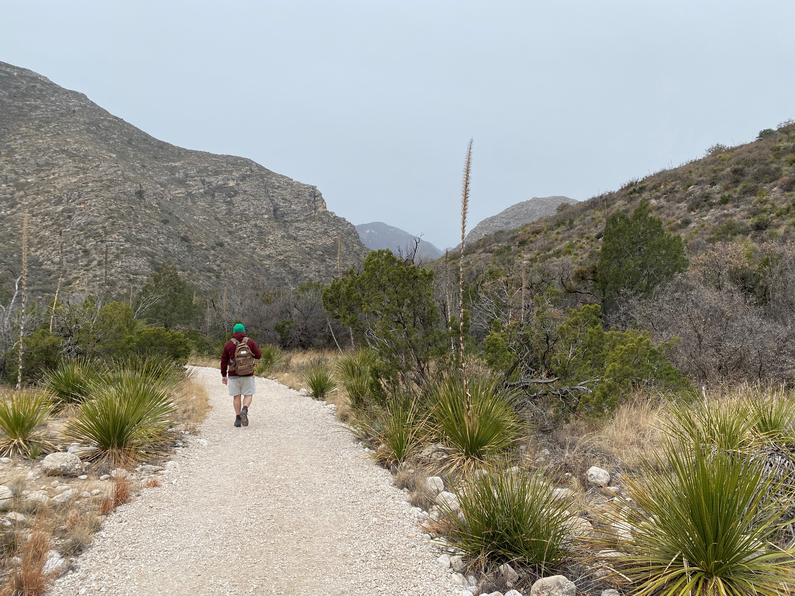
❺
14
Things we learned on our journey

Slide 15
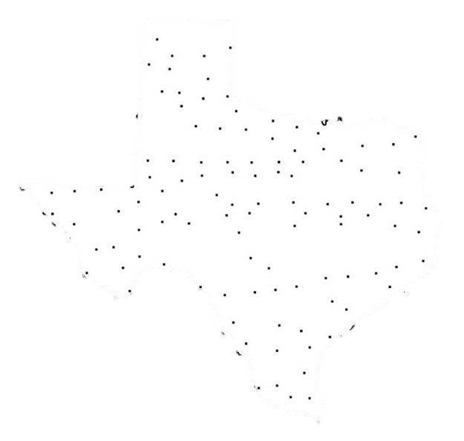
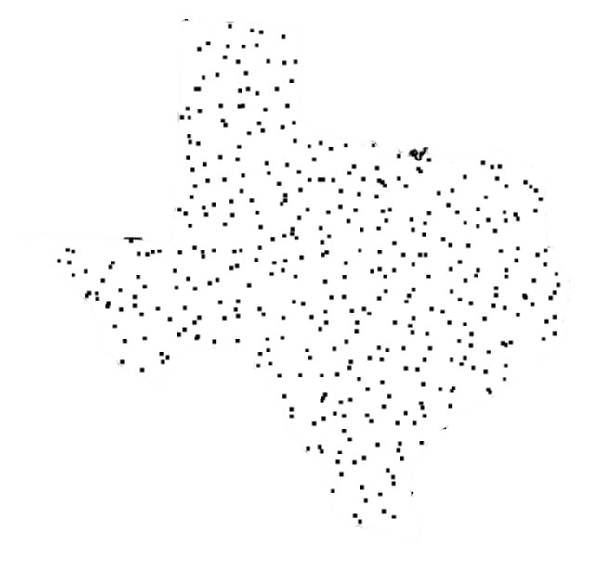
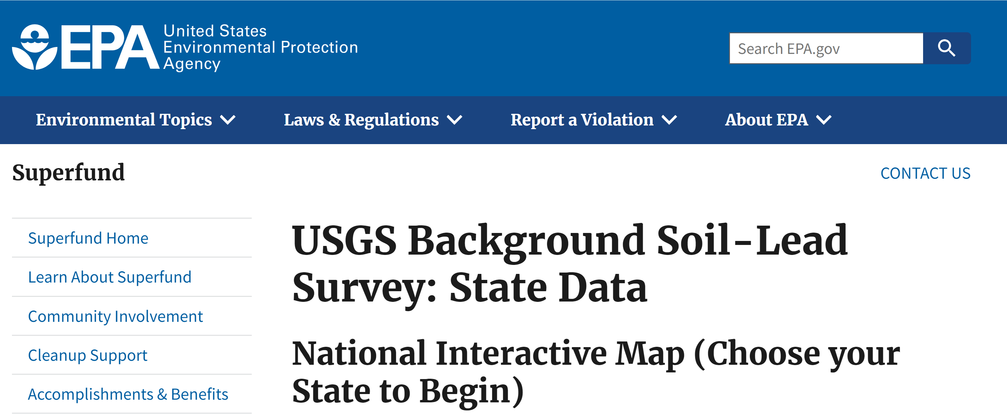

❶We Learned: There is better data
15
In 2013 USGS published¹ data with a 10-fold resolution improvement. This USGS data is now used by other states and the USEPA² to develop background threshold values (BTVs)
Used by TCEQ for MEDIAN Values
Should be used for BTVs
USGS 1981: Up to 119 samples
USGS 2013: Up to 1,237 samples
Both studies completed by USGS
Note: TRRP cites USGS PP 574-F (1975). But TRRP uses USGS OFR 81-197 (1981).
1- https://mrdata.usgs.gov/ds-801
EPA Region 4: USGS data is “amazing” and “allows direct comparison” for regional understanding. Even too conservative for some Urban Areas -2018
2- https://www.epa.gov/superfund/usgs-background-soil-lead-survey-state-data
2025: GA just used USGS data for As BTV
Note: USGS efforts have a higher resolution and more stringent laboratory requirements than that of EPA Methods allowed by TCEQ.

Slide 16
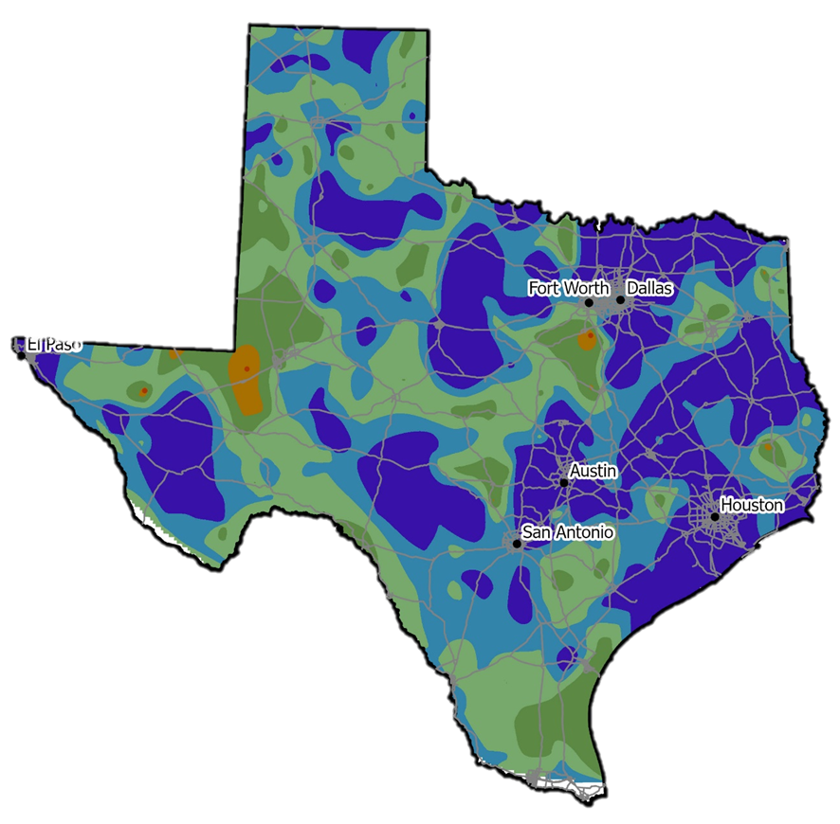
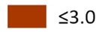
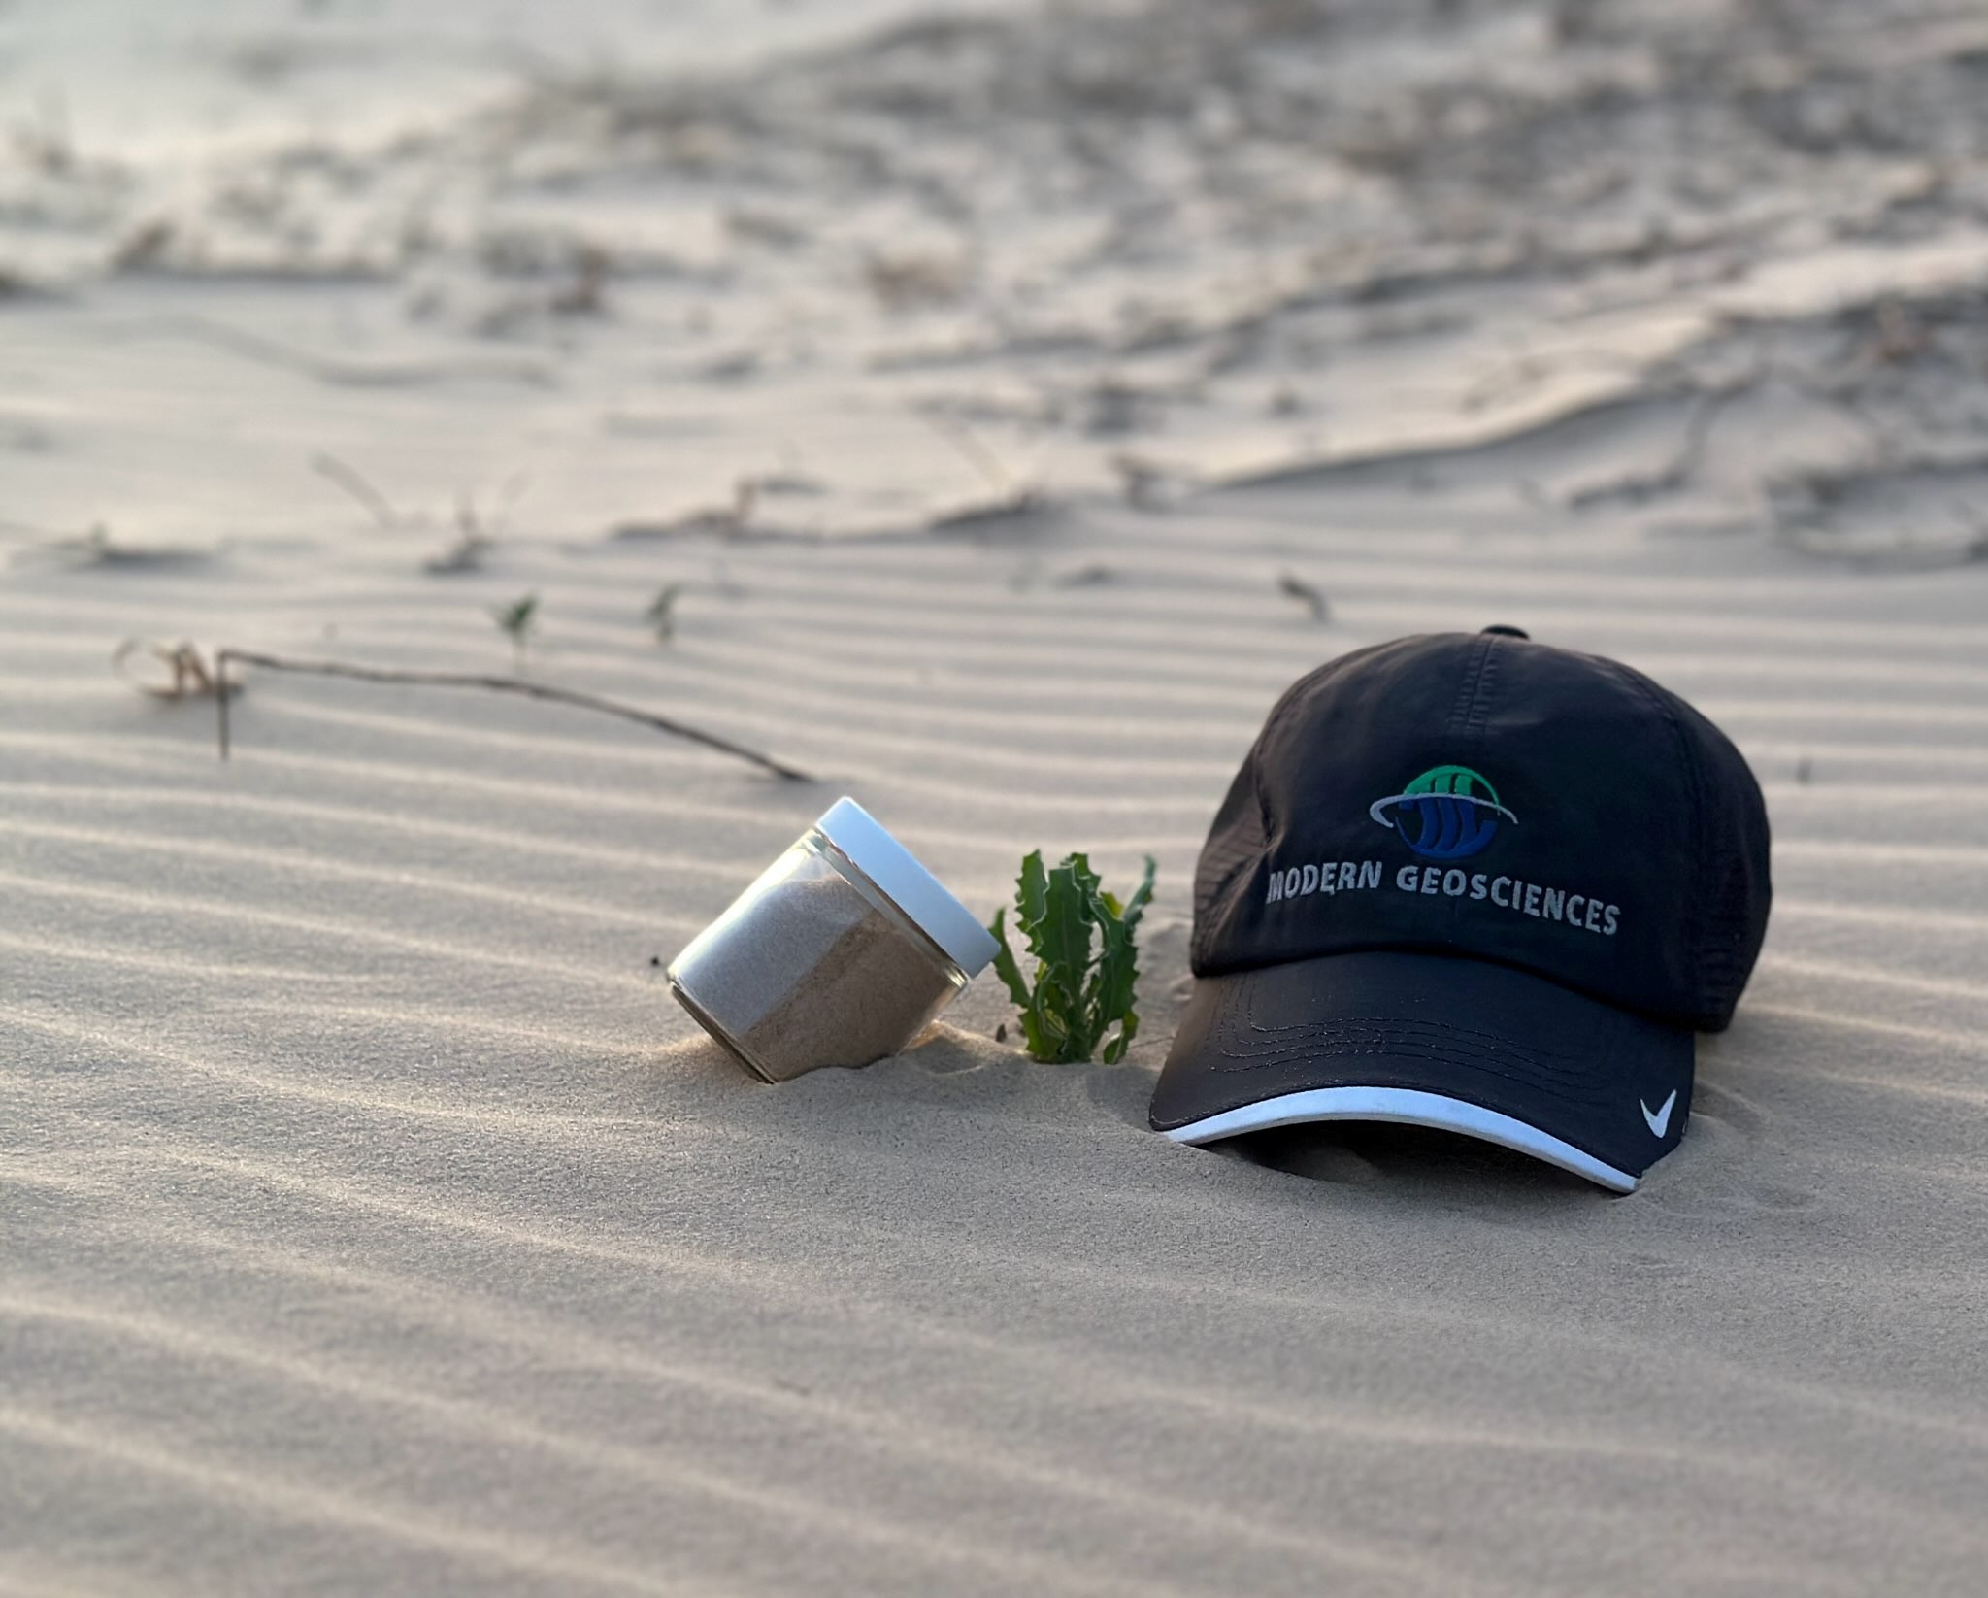
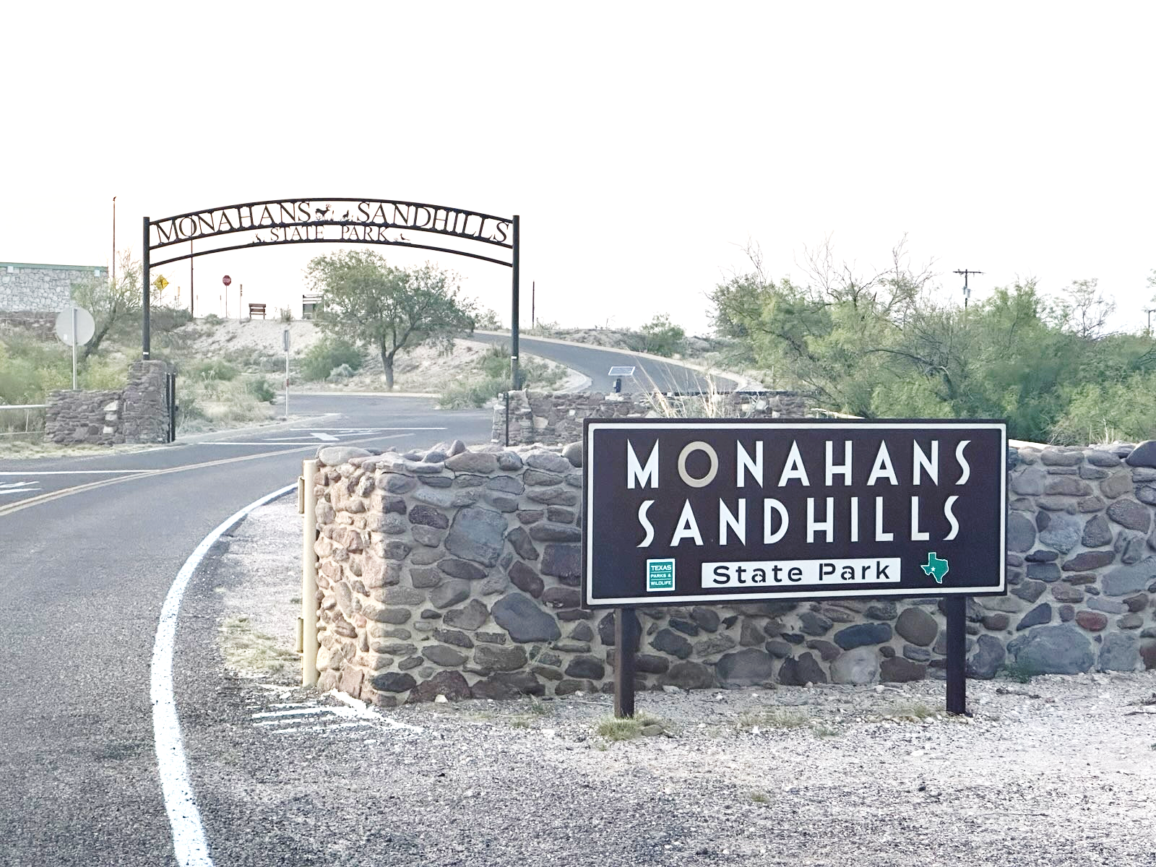
❷We Learned: Texas is out of step
16
Why is Texas using risk criteria 60x lower than EPA? ¹
Re: soil-to-groundwater pathway for lead (GWP Value).
A PCL of 3 mg/Kg is lower than 99.7% of Texas soil²
False Positives
Why? TCEQ’s risk model is more conservative than EPA recommends
15?
All presented in mg/kg for 0.5-acre source
1- OK, NM, AR utilize EPA’s Regional Screening Levels (May 2025)
2- https://doi.org/10.21663/EEG-D-24-00009 [all apply the appropriate DAF/LDF]

Slide 17
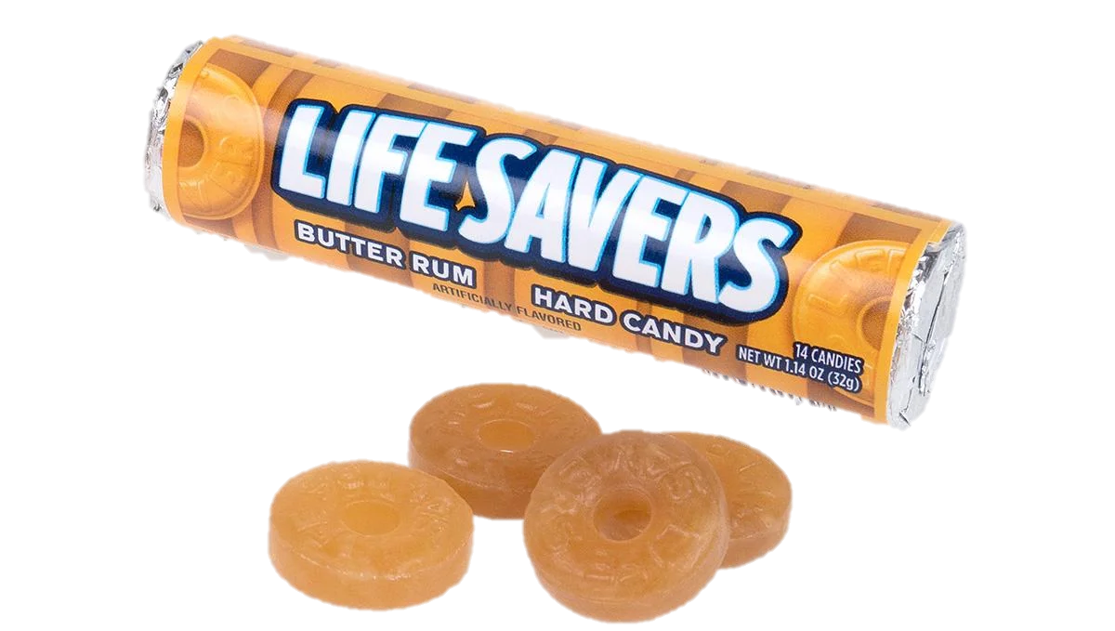
17
❸We Learned: Significant cost and confusion
City of Dallas (March 2023)
“the current median-based background ... leads to confusion..(and) costs for additional assessment, soil management, disposal, and reporting…when no actual release has occurred.”
Estimated Annual Impact: At least $250,000
City of Grand Prairie (April 2023)
“evaluation is desperately needed to establish realistic background levels and correct the misuse of funds and efforts to disprove a release.”
Across just six responding cities, an estimated $10.4M minimum of wasted funds suggested during the first 20 years of this ongoing policy

Slide 18
18
❸We Learned: Significant cost and confusion
Trammell Crow Company (July 2024)
TCEQ’s “approach to screening metals is a bit out of step with the rest of the country.” Screening in “naturally occurring conditions as being a release. The result is not only added project costs and delays, but also uncertainty, which is one of the worst words to deal with as a developer.”
City of Austin (October 2024)
“These values reinforce negative stigmas often associated with brownfield sites …has led to lender uncertainty, additional investigation costs, and project redevelopment delays often 90-days or more.”
April 2024
“Not Very Texas of Texas.”
Feedback from the Oak Ridge National Laboratory Risk Assessment Information System instructors on learning of the median “background” and conservative risk modeling decisions below EPA criteria.

Slide 19
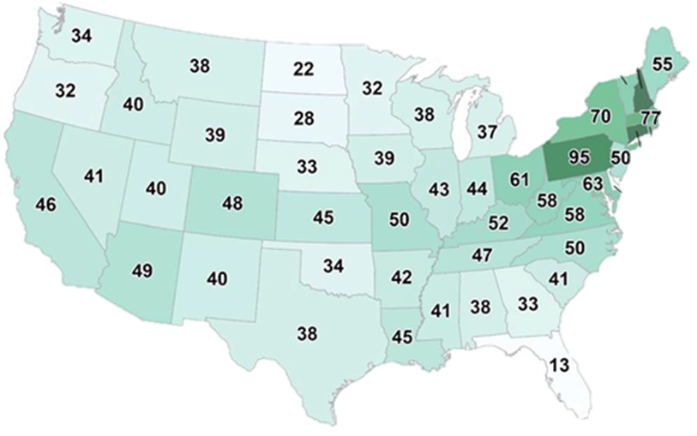
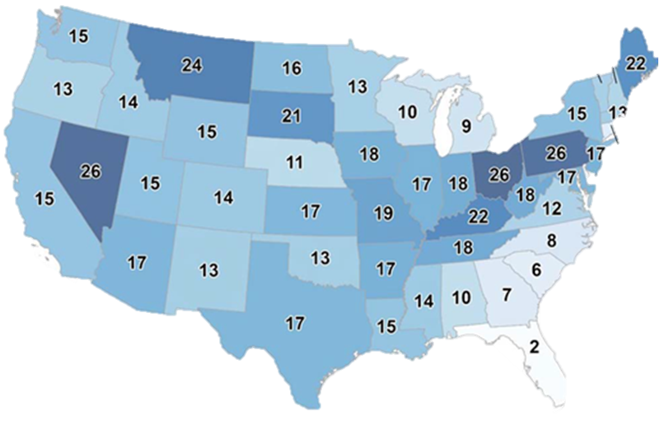

❹We Learned: TRRP already has flexibility for BTVs
19
30 TAC §350.51(l) allows “statistical or geostatistical methods to determine representative concentrations of COCs:
  at the affected property or within areas representative of site-specific background conditions”
Defensible “geostatistically-derived” Regional BTVs
2013 USGS Data
15 As; 30 Pb does not look like a release
Defensible State-wide BTVs
Metal | GWP | TSSBC
Arsenic | 5 | 5.9
Lead | 3 | 15
State
17
38
DFW
19.5
36
Aus
15
39
Hou
9
38
SA
18.2
37
mg/kg

Slide 20
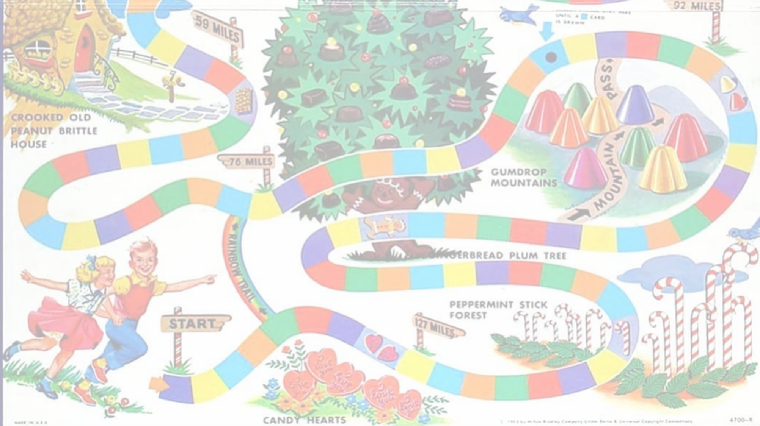

❺We Learned: A lot of folks agree
20
Back the BTV
#mediansomean
TCEQ Chairman meeting in Nov. 2024
Note: All suggested BTVs (lead & arsenic) are well below those allowed for lawn or home garden application under 30 TAC §312.43(a) (1) and (3) [e.g., Arsenic of 41 mg/Kg or Lead of 300 mg/Kg]

Slide 21
Suggestions:
21
Update Tier 1 PCLs for the 13 metals affected¹. Offer pH 6.8 PCLs just like TCEQ added for mercury in 2001.
Update the TRRP Memo ( now RG-649) to allow Licensed Professionals² to utilize USGS data for realistic BTVs³, reference peer-reviewed BTVs, & allow more leaching demonstrations (Tier 2 and 3 options) for ^{GW}Soil PCLs
Create a TRRP Ombudsman and/or restart the TRRP Steering Committee to bridge the institutional knowledge gap – lessen uncertainty and ensure flexibility (renew stakeholder input)
1- EPA Soil Screening Guidance (source of TRRP K_{d} Table) – “Where site-specific soil pH values are not available, values corresponding to a pH of 6.8 should be used”
2-Texas Professional Engineers and Professional Geoscientists
3- Utilize the conservative method outlined here: https://doi.org/10.21663/EEG-D-24-00009

Slide 22
Updated TRRP Memo (RG-649; March 2025)
22
Change: Added approach to calculate ^{GW}Soil PCL or “Action Level” for screening without reporting
Unchanged: Did not simplify screening. Continues required use of MEDIAN values in screening as “background”
- unless experienced professionals engaged for numerical/risk modeling efforts.

Slide 23
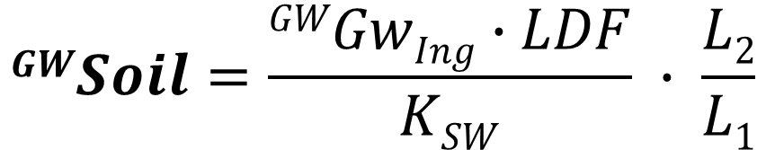
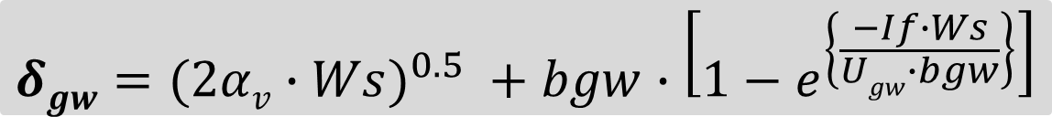
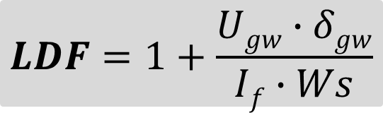
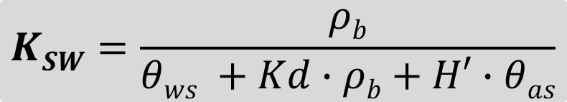
Change:
Lead up to 30 ppm
No report
Sample
Site-specific “Action Level” calculation needs use of §350.75(b)(1)
PCL/“site-specific” BTV requires experienced professional
Currently No BTVs
> TSSBC
of 15
☑Passes
$$GWSoil=\frac{GWGwIng∙LDF}{KSW} ∙ \frac{L2}{L1}$$
> ^{GW}Soil
of 3
“Action Level” of 179
$$KSW=\frac{ρb}{θws +Kd∙ρb+H′∙θas}$$
Per EPA:
Soil: Loamy
pH: 6.8
$$LDF=1+\frac{Ugw∙δgw}{If∙Ws}$$
This approach is unlikely to help you with arsenic
$$δgw=(2αv∙Ws)^{0.5} +bgw∙\left[1−e^{\left\{\frac{−If∙Ws}{Ugw∙bgw}\right\}}\right]$$

Slide 24
24
Added Confusion: July 23, 2025 Webinar
More revisions coming
Only allowing some portions of the ^{GW}Soil PCL formula – what of interim projects?
Created new soil pH data use/testing limitations contrary to existing guidance^{ǂ} (prioritizing handheld meter estimates over laboratory analysis and existing NRCS data?) - without issuing guidance on the field collection requirements
Confirmed much of the screening added requires a licensed professional
Confirmed an expected 90-day response expectation for TRRP Memo inquires
Confirmed there was essentially no outside stakeholder involvement
Continued misrepresentation of “background” with regard to release determinations. Suggesting application of a median value as background was required (even outside of TRRP)
ǂ TCEQ (2001) Establishing Critical Protective Concentration Levels
(PCLs) for Lead-Affected Soils: pH values “may be estimated from literature studies such as U.S. Soil Conservation Service (SCS) surveys” and see TRRP Q&A (TCEQ 2004)
EPA: “often field conditions cannot be controlled and may be unfavorable for accurate analyses. The methods are generally meant to be used in a laboratory setting under controlled conditions. In the laboratory, we recommend performing the analysis within a few hours of receipt, and not the next day.”

Slide 25
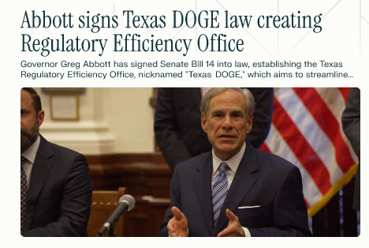



Final Thoughts:
25
Caution (Use the TRRP Memo Wisely)
  Need to be Conservative to avoid differing opinions later among licensed professionals and possibly TCEQ.
  Future of TRRP?
    We Need Less Uncertainty: Suggest updated Tier 1 PCL look up values, use of USGS data for ^{ǂ}realistic BTVs and add new guidance.
    We Need More Stakeholder Input: Suggest adding a TRRP Ombudsman and TRRP Steering Committee.
    Will the Texas Regulatory Efficiency Office (September 2025) or Bigger. Better. Texas. Economic Development Strategic Plan streamline the regulatory process? Will this improve VCP participation?
ǂ- EPA (2022): “If many onsite values need to be compared with a BTV, the recommended upper limit to use is the UTL or upper simultaneous limit (USL) to control the false positive error rate (Type I Error Rate).”

Slide 26
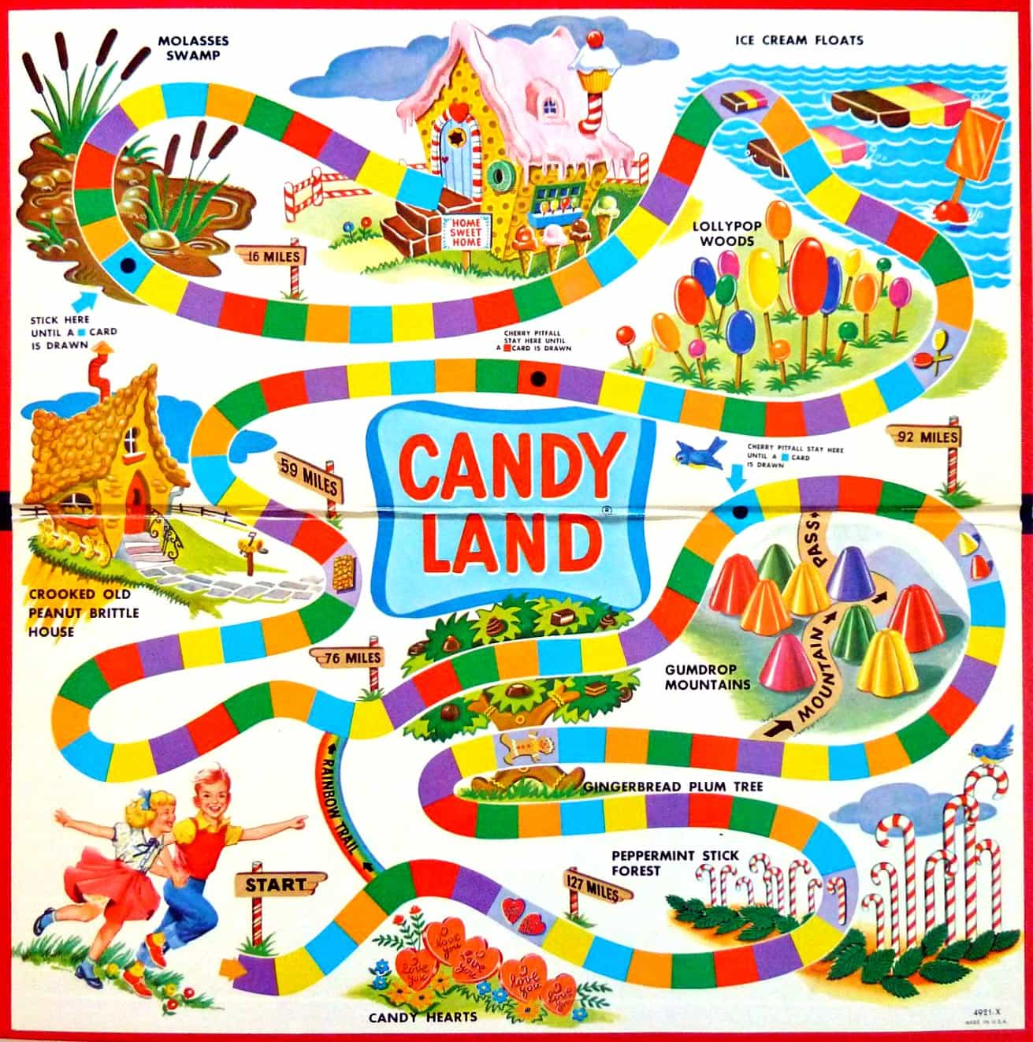

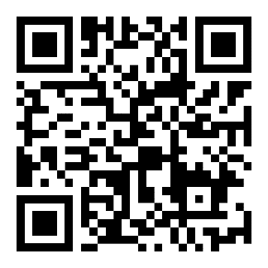

TRRP
LAND
Thank You!
Modern Geosciences
Kenneth S. Tramm, PhD, PE, PG, CHMM
ktramm@moderngeosciences.com

