Slide 1
Defending PFAS Lawsuits
37th Annual Texas Environmental Superconference
Jimmy Slaughter, Principal
Amber Ahmed, Of Counsel
August 8, 2025

Slide 2
Context for Growing PFAS Litigation: Tort Suits and Regulatory Actions
Tort suits against PFAS manufacturers since early 2000s
Public misunderstanding of risk and causation
CERCLA Hazardous Substances Designation
SDWA MCL Designation
EPA Risk Assessment for PFAS in biosolids
State regulatory actions and lawsuits

Slide 3


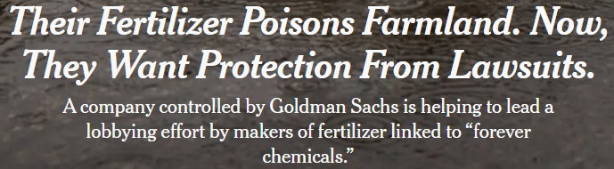
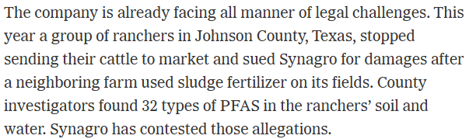

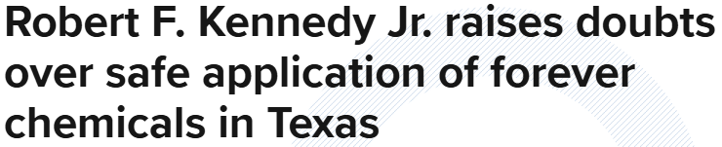
Media Assumes and Advocates Significant PFAS Toxicity
“Dark Waters” (2019)

Slide 4
Why Concerns over PFAS in Environment?
PFAS ubiquitous through decades of use in textiles, packaging, cookware, many products
Groundwater/drinking water impacts feared
Some migration to groundwater in ppt level occurs in shallow groundwater scenarios, could migrate to wells
Plant uptake, meat, and milk
Biosolids can have PFAS in ppb levels, higher than effluent

Slide 5
Health Effects of PFAS Speculative
Compounds have been widespread in humans for generations with no showing of significant impacts
Many government agencies worldwide have questioned linkage to health impacts
Cancer link unproven
Epidemiology weak
Science driven by Plaintiffs’ bar, media, and rush to regulate, and aggressive risk assessment

Slide 6
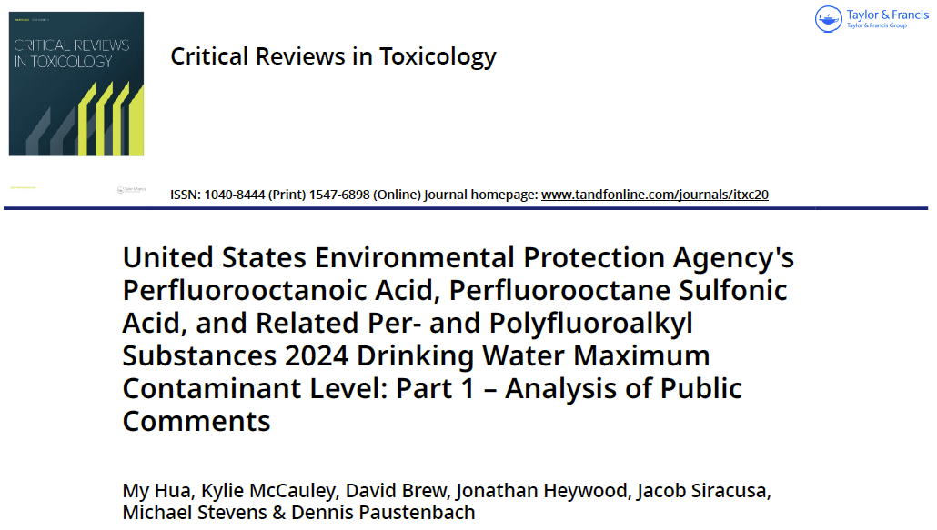
Paustenbach Literature Survey Finds PFAS Risks Overblown
Science EPA relied on flawed
Studies fall far short of showing causation of illness
Precautionary principle used, aggressive risk assessment

Slide 7
Criticism of EPA Risk Assessment
“The human studies only weakly support, if at all, the designation of PFOA as a “likely carcinogen”. Our recommendation [is] for reassessment of the [health advisory] for PFOS and PFOA, including reassessment of the human potential for cancer as well.” (Perez 2023)
“EPA should participate in a multinational/scientific expert process to reach a consensus on realistic protective values for PFAS. EPA also needs to increase its transparency and carry out external peer reviews and cost-benefit analysis on all Health Advisories, not just on regulations, to ensure that resources are not being wasted on low-risk issues.” (Cotruvo 2023)
“We evaluated these classifications, considering the epidemiology, experimental animal, and mechanistic evidence. It is our opinion that the IARC Working Group overstated the available evidence for the carcinogenicity of PFOA and PFOS. Epidemiology studies have shown weak and inconsistent associations across studies. Studies reporting increased incidences of tumors in experimental animals exposed to PFOA or PFOS had statistically significant results that were driven by the presence of benign adenomas.” (Drury NL, Prueitt RL, Beck BD, 2024)

Slide 8
Major Federal Initiatives on PFAS
Hazardous substance designation under CERCLA (Superfund) – Challenge in DC Circuit
Setting of MCLs for PFAS under Safe Drinking Water Act – Challenge in DC Circuit
EPA risk assessment for PFAS in biosolids underway – Comments due August 15

Slide 9
Trump Administration Reiterates Commitment to PFAS Regulation (but more slowly)
EPA stayed moved to stay cases challenging the CERCLA Hazardous Substance designation of PFAS and MCL for PFAS; some retrenchment in EPA position
But on April 28 EPA Administrator Zeldin broadly reiterated Biden EPA goals on PFAS regulation
PFAS rules omitted from Zeldin’s March 12 deregulatory announcement
2025 Texas Environmental Superconference
9

Slide 10
Expansion of PFAS Lawsuits
Over 300 lawsuits filed since 2018, focus on manufacturers and fire fighting foam (AFFF, high PFAS)
Scores of states and cities total have sued seeking remediation costs, natural resources damages, etc. Manufacturers have paid huge settlements to drinking water utilities
Most lawsuits are focused on AFFF and contamination of nearby drinking water but claims are expanding

Slide 11
AFFF Personal Injury MDL
Kidney and liver cancer claims set for trial October 2024 in South Carolina federal court
Expert discovery underway on claims for liver and thyroid cancer, ulcerative colitis
Plaintiffs must show general and specific causation of disease, reliability of science

Slide 12
Consumer Protection Claims re PFAS
Texas v. 3M
  Deceptive Trade Practices Act claims
  AG responsibility to enforce consumer protection laws
False advertising claims
  false representations (e.g., stating their products are "all natural," "healthy," or "clean"), or
  omissions (that companies should have disclosed that their products contained PFAS, but failed to do so)

Slide 13
Alessi v. Synagro (Johnson County)
Allegations concern a routine land application in late 2022 – early 2023 near Grandview, TX
Claim that PFAS somehow moved to Plaintiffs’ land and caused impacts on property, livestock, and human health
Class A EQ Fort Worth biosolids pellets
Current Status
Nov. 18, 2024: Plaintiffs refiled in Texas following dismissal in Maryland
Jan. 23, 2025: Plaintiffs amended lawsuit to encompass property owners near land application sites in ten counties – class action
Feb. 21, 2025: Synagro removed to federal court, moves to dismiss, Complaint amended
April 25, 2025: Synagro moves to dismiss under derivative governmental immunity and Texas Right to Farm Act
July 10, 2025: Amicus filed by City of Fort Worth, Trinity River Authority, City of Austin

Slide 14
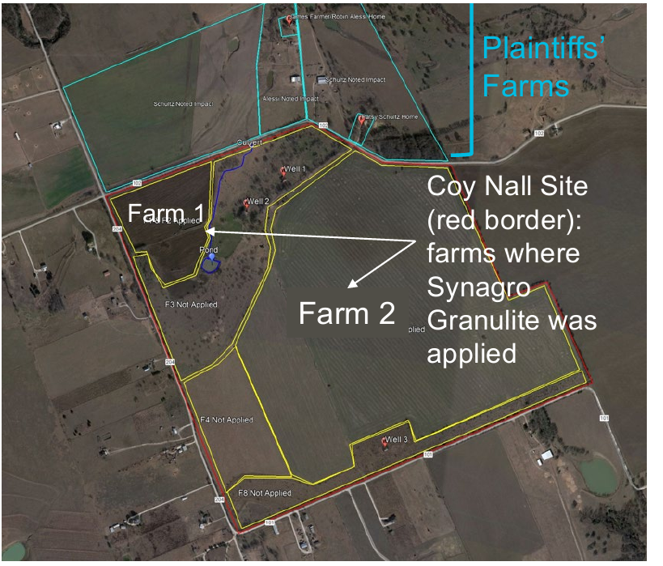
Alessi Claims are Implausible
L
Foremost: Little evidence of health or environmental risk from PFAS at typical low exposure levels
PFAS in land applied biosolids move slowly to groundwater and in minute amounts
Plant uptake and animal exposure to PFAS in biosolids are minute; little evidence that PFAS kills cattle
Synagro recently released study results undermining claims; different PFAS on Pls’ property and very low amounts on land applied fields
2025 Texas Environmental Superconference
14

Slide 15
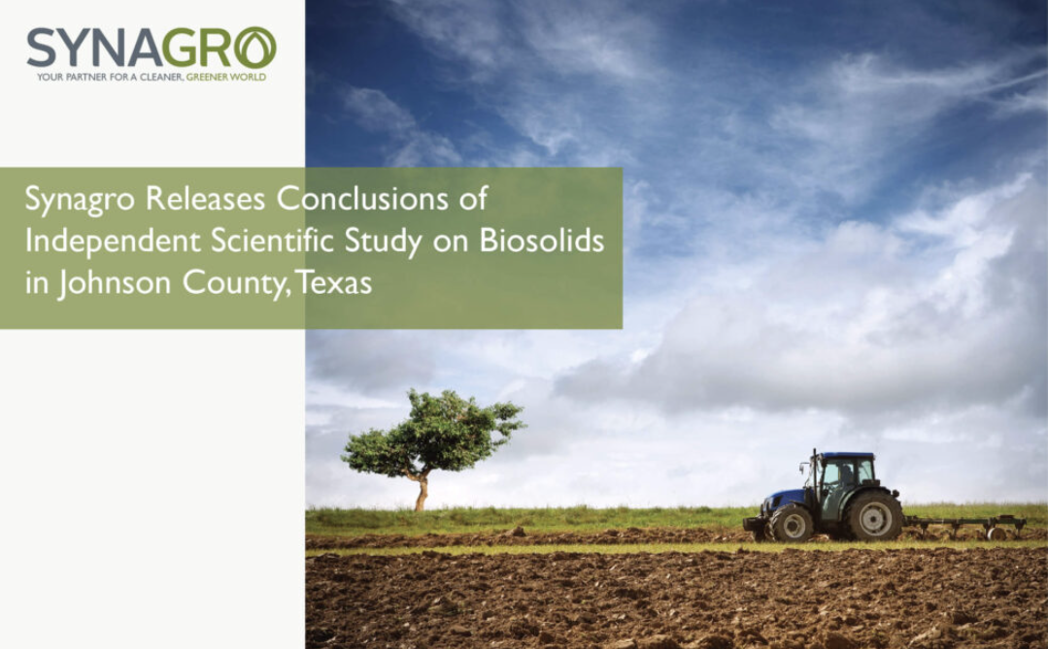
Alessi v. Synagro: Synagro Motion
to Dismiss
Texas Right to Farm Act protects farming and supporting activities, including the use of organic bulk fertilizers like biosolids, from tort lawsuits:
  No nuisance action or other action to restrain an agricultural operation may be brought against an agricultural operation that has lawfully been in operation and substantially unchanged for one year or more prior to the date on which the action is brought
Plaintiffs’ products liability claim fails to overcome Texas law’s presumption for federally regulated products
2025 Texas Environmental Superconference
15

Slide 16
eNGO Citizen Suits
Citizen Suits Under Clean Water Act/Coosa River Basin Initiative v. City of Calhoun (N.D.Ga.)
  Citizen suit filed by advocacy group alleging that land application caused PFAS discharges in violation of the CWA, RCRA
  Alleges that land application led to unpermitted discharges of PFAS that entered surface waters via runoff and groundwater; City settled and ended land application
  There are numerous defenses to these allegations. Land applying biosolids is allowed under the CWA and RCRA
Tennessee Riverkeeper v. Waste Connections, 769 F.Supp.3d 784 (M.D. TN 2025) (RCRA claims focused on PFAS dismissed)

Slide 17
Mass Natural Fertilizer v. NEFCO et al. (Worcester, MA)
Contribution claim for PFAS cleanup costs under Massachusetts Superfund law
Former composting site with paper and industrial residuals, plus limited biosolids
Drinking water wells downgradient of site
Toxic tort suit in progress on adjacent property

Slide 18
Defenses
Fight Misinformation
Engage the media
Regulatory and legislative support
Communication with regulators like TCEQ, Office of the Texas Chemist
Educating the Legislature on PFAS tox and exposure science
Assess Statutory Protections
CERCLA
Texas tort protections
Attack Causation
Plaintiffs must show general and specific causation of disease, reliability of science
Preemption arguments
-- Fertilizer exemption
Right to Farm laws

Slide 19


Questions?
  Thank you!
Jimmy Slaughter
Amber Ahmed
Principal, Washington, DC
Of Counsel, Austin, Texas
jslaughter@bdlaw.com
aahmed@bdlaw.com
+1.202.789.6040
+1.512.391.8018

