Slide 1


89th Legislative Session Update

Slide 2



Basic Facts of the 89th Legislative Session
  Session Lasted 140 Days (Jan. 14 – June 2)
  Last Day for Governor to Sign or Veto Bills – June 22
    28 Bills Vetoed by Governor
  Freshman: Senate (3) / House (32)
  13.9% of bills filed passed
    Total: 1213 (passed) / 8719 (filed)
    Senate: 594 (passed) / 3075 (filed)
    House: 619 (passed) / 5644 (filed)
  Previous Session Bill Passage: 88th (15.4%)/ 87th (15.5%)

Slide 3

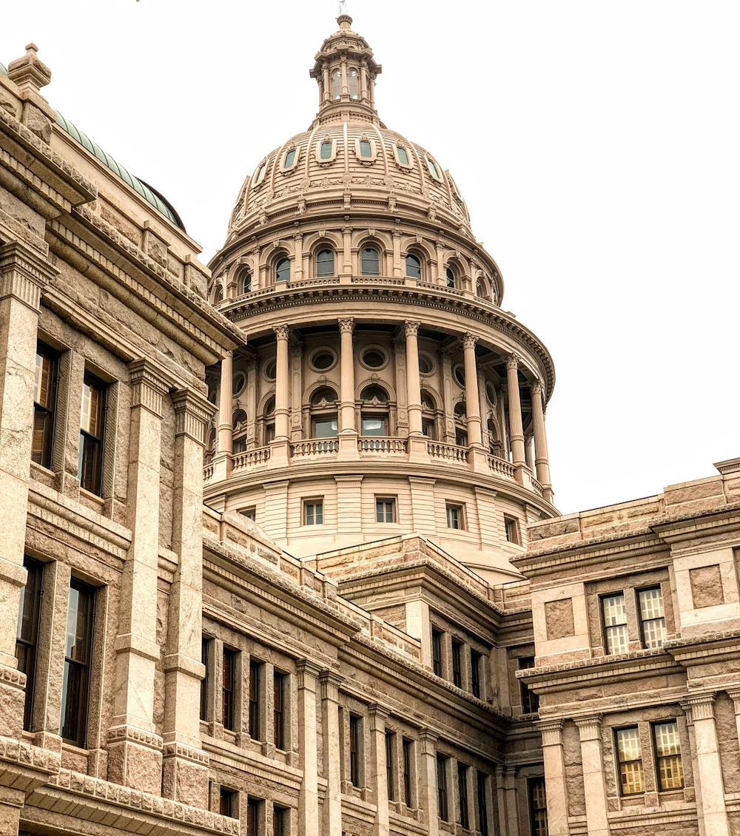
89th Legislative Session Major Issues
  Property Tax
  Water
    “Texas-Size Investment in Water”
  Electric Grid
  School Choice
  Teacher Pay
  Bail Reform
  Border Security
  Economic Development
    Data Centers/Bitcoin Facilities

Slide 4
89th Legislative Session Special Session
Governor Abbott placed the below relevant issues on the Special Session Docket:
  Flood Warning Systems: Legislation to improve early warning systems and other preparedness infrastructure in flood-prone areas throughout Texas.
  Flood Emergency Communication System: Legislation to strengthen emergency communications and other response infrastructure in flood-prone areas throughout Texas.
  Relief Funding for Hill Country Flooding: Legislation to provide relief funding for response to and recovery from the storms which began in early July 2025, including local match funding for jurisdictions eligible for FEMA public assistance.
  Natural Disaster Preparation & Recovery: Legislation to evaluate and streamline rules and regulations to speed preparedness for and recovery from natural disasters.

Slide 5

89th Legislative Session Special Session Cont’d
Governor Abbott placed the below relevant bills that were vetoed or filed without signature on the Special Session agenda for further consideration:
  SB 648 (West) Relating to recording requirements for certain instruments concerning real property.
  SB 1758 (Birdwell) Relating to the operation of a cement kiln and the production of aggregates near a semiconductor wafer manufacturing facility.
  Water Project Incentives: Legislation, similar to SB 1253 (Perry) that authorizes political subdivisions to reduce impact fees for builders who include water conservation and efficiency measures.

Slide 6

A Texas Sized Investment in Water
  HB 500 (Bonnen)
    Provides $2.5 billion in one-time, new funding to TWDB.
    Passed: Signed by Governor on 6/22/25 (Effective Immediately).
  SB 7 (Perry/Harris)
    provides funding for new water supply and existing water infrastructure.
    Adds flood mitigation projects; projects under the State Water Implementation Fund (SWIFT); water and wastewater reuse projects; and shovel ready reservoirs as available uses for “new water fund”.
    The House and Senate were able to agree on a 50-50 ratio for the funding split between new water supply projects and existing infrastructure projects.
    SB 7 enables HJR 7, the accompanying constitutional amendment which provides $1 billion in annual funding to the Texas Water Fund.
    Passed: Signed by Governor on 6/20/25 (Effective 9/1/25).

Slide 7

AIR Legislation
  SB 2321 (King) Relating to the regulation of emissions by the Texas Commission on Environmental Quality during an event affecting electric demand or grid reliability. Passed: Signed by Governor on 6/20/25 (Effective 9/1/25)
  Numerous bills filed regarding the following topics which did not pass:
    Cumulative Impacts
    Aggregate operations/Concrete Batch Plants
    Environmental Justice

Slide 8

WASTE Legislation
  HB 3071 (Geren) Relating to cancellation of certain solid waste disposal permits issued by the Texas Commission on Environmental Quality. Passed: Filed without Governor’s Signature on 6/20/25 (Effective Immediately).
  HB 5057 (Landgraf) Relating to exclusive contracts for municipal solid waste management services. Passed: Signed by Governor on 6/20/25 (Effective Immediately).
  SB 2078 (Kolkhorst) . Relating to the regulation of composting in certain counties; authorizing a civil penalty. Passed: Filed without Governor’s Signature on 6/22/25 (Effective 9/1/25).
  HB 1227 (Gates) Relating to municipal solid waste management services contracts; limiting the amount of a fee. Did Not Pass.

Slide 9

REGULATORY Legislation
  SB 2203 (Birdwell) Relating to the certification of discovery issues to the Texas Commission on Environmental Quality in contested cases referred to the State Office of Administrative Hearings by the commission. Did Not Pass.
  SB 565 (Perry) Relating to a compliance agreement for the suspension of an enforcement action against a regional water supply, sewer, wastewater treatment, or solid waste disposal service for certain violations. Passed: Signed by Governor on 6/20/25 (Effective 9/1/25).
  SB 3074 (Birdwell) Relating to communications between the Texas Commission on Environmental Quality and the governor, the lieutenant governor, or a member of the legislature. Did Not Pass.
  Over 20 bills filed that did not pass which would have impacted the TCEQ regulatory/SOAH process.

Slide 10


Thank You!
Shea Pearson
spearson@hillcopartners.com

