Slide 1
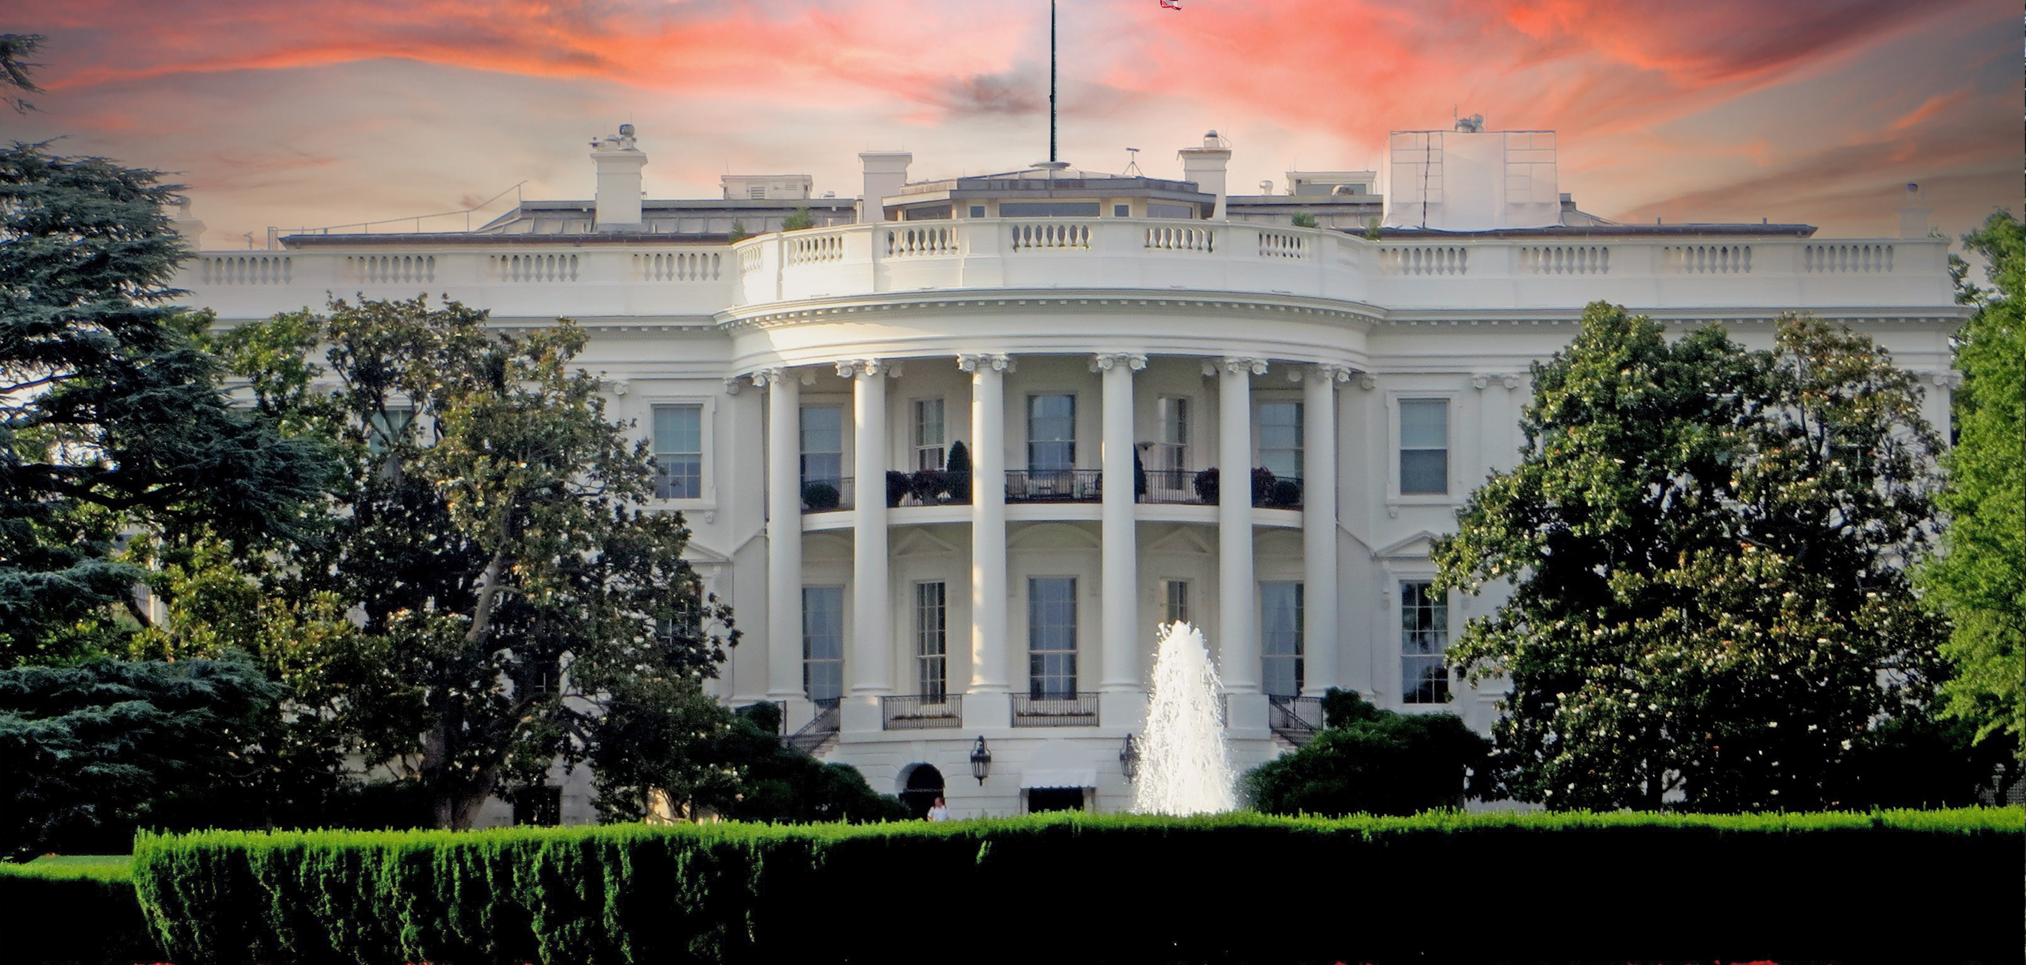
Federal Permitting: Resetting, Streamlining, Expediting
37th Annual Texas Environmental Superconference
August 6, 2025
Ann D. Navaro Jason A. Hill
Partner Partner
Bracewell LLP Holland & Knight

Slide 2
Energy Project Permitting: Executive Order 14156
Declares national energy emergency
Requires agencies to identify and exercise lawful emergency authorities to expedite generation of energy sources, including oil and gas products, minerals, geothermal
Requires Army to identify actions that may be subject to emergency treatment under permitting regulations and NWPs (CWA 404, RHA 10, MPRSA 103)
Directs use of ESA emergency consultation procedures
Convening of the ESA Committee (“God Squad”)

Slide 3
Actions by Agencies Pursuant to EO 14156
USACE – Each USACE District adopted written emergency permitting procedures. Examples:
  Enbridge Line 5 Project, Port Arthur LNG Texas Connector Project
  Many others
DOI – Adopted emergency written procedures for NEPA, ESA, and NHPA requirements. examples:
  Velvet-Wood Uranium and Vanadium Mine
  Ormat Technologies Geothermal Projects
  Hurricane Creek coal mine in Tennessee (approved 7/2025, application 8/2023)
ACHP – advice on use of emergency authorities for NHPA 106
FERC -- ??

Slide 4
State of Washington v. Trump
15 State coalition argues EO 14156 is unlawful
Filed May 9
Claims against USACE and ACHP for violations of APA and their underlying statutes by implementing emergency procedures
May add claims against DOI

Slide 5
Other Federal Permitting Developments: CWA
WOTUS
CWA 401
EPA and Army Guidance, “WOTUS Notice: The Final Response to SCOTUS” (March 12, 2025) (comment period closed)
EPA and Army Memo, “Proper Implementation of ‘Continuous Surface Connection’ Under the Definition of ‘Waters of the U.S.’ Under the Clean Water Act” (March 12, 2025)
EPA Memo, “Clarification regarding the Application of Clean Water Act Section 401 Certification” (May 21, 2025)
Notice of public listening sessions; request for public comment (comment period closes August 6, 2025)
* Proposed 2026 NWPs issued

Slide 6
Other Federal Permitting Developments: NEPA
Executive Branch
Legislative & Judicial Branches
Rescission of CEQ NEPA regulations
Agency Interim Final Rules rescinding/amending agency-specific NEPA regulations
Agency issuance of NEPA procedures/handbooks
USACE regulatory program NEPA regulations
Seven County Infrastructure Coalition
Big Beautiful Bill: 1-year Environmental Impact Statement and 180-day Environmental Assessment if 125% of cost is paid to CEQ

Slide 7

CEQ Permitting Technology Action Plan
Requires permitting agencies to:
Adopt software for tracking lifecycle of project reviews
Use tools incorporating decision logic to decide outcomes for lower complexity reviews
Require applicants to submit data packages in a consistent format with metadata
Publish timeline data for milestones for agency actions as well as project sponsor actions
90-day timeline established for agencies to begin implementation of the Action Plan (August 28, 2025)

Slide 8

Practical Takeaways & Questions

