Slide 1
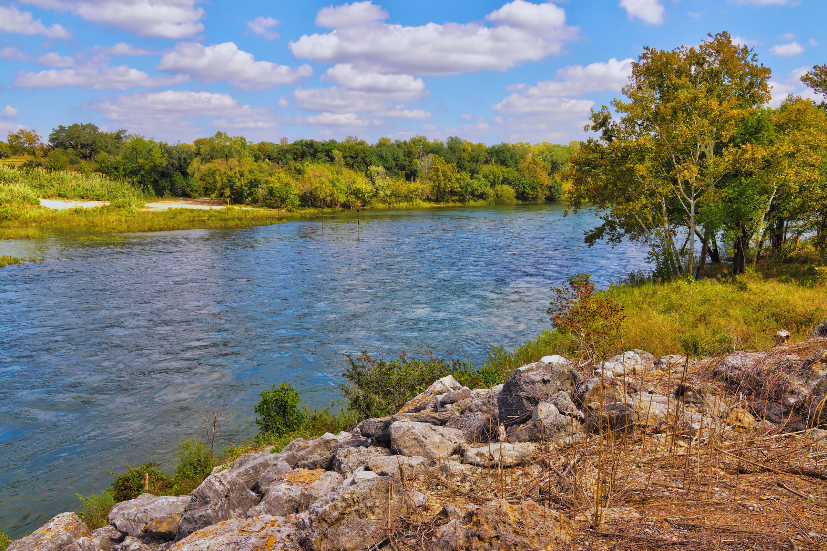


Texas Groundwater Conservation Districts
CARLOS RUBINSTEIN, RSAH20, LLC
NATASHA J. MARTIN, GRAVES DOUGHERTY HEARON & MOODY
CASEY M. COOPER, TERRILL & WALDROP

Slide 2
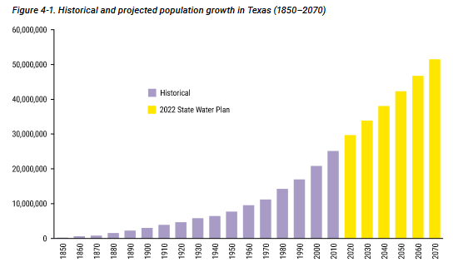

Slide 3
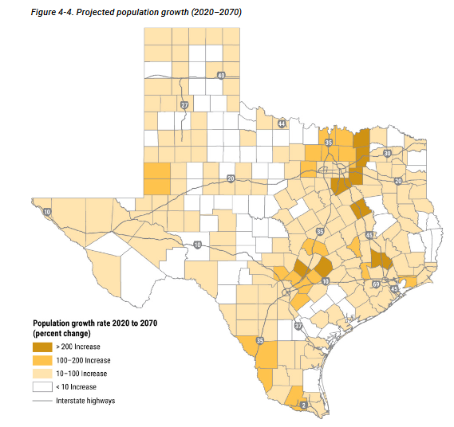
(TWDB, State Water Plan, 2022).

Slide 4
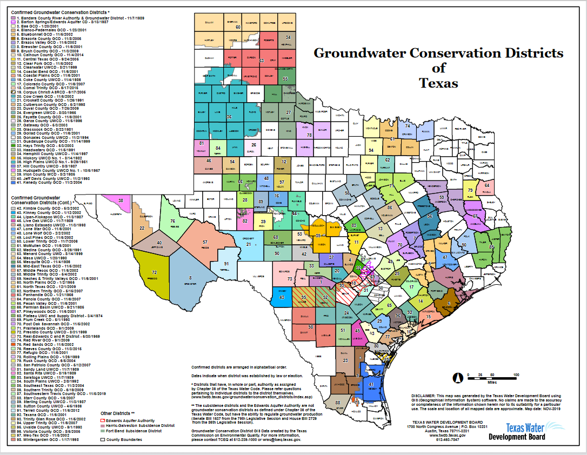
(TWDB, 2024).

Slide 5
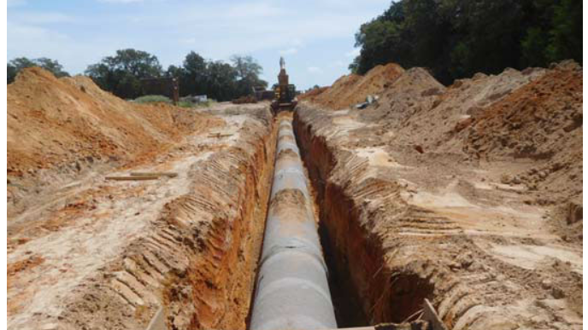

Slide 6
THANK YOU!

