Slide 1
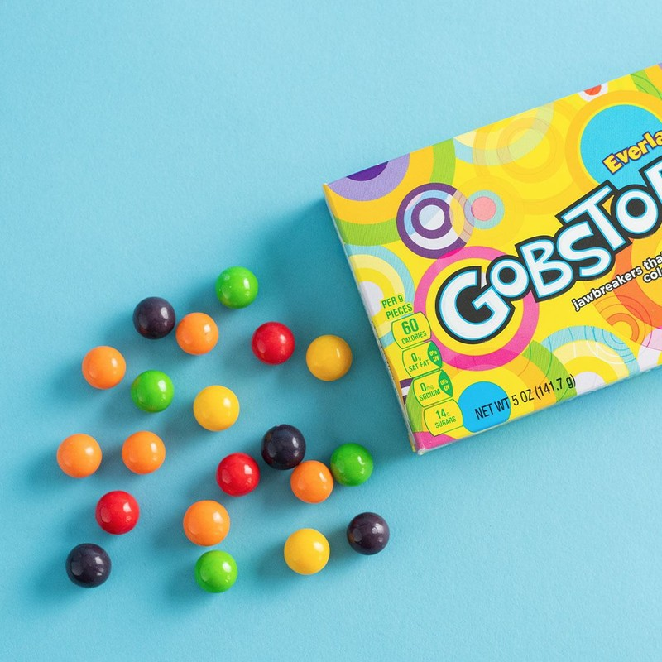
The Many Layers and Flavors of PFAS

Slide 2
Agenda
  Brief History
  Chemical Structures
  PFAS – Good and Bad
  How Small are Those Numbers?
  PFAS “Industries” and Examples
  Teflon and Freon
  Problems
  Strategies

Slide 3
Per-and Polyfluoroalkyl Substances (PFAS) History
  First developed in the 1930s and 1940s. One of the first applications was Teflon which was created by DuPont, sort of by accident when they were working on refrigerants.
  Teflon trademarked in 1945 by DuPont.
  Mass production of PFOA (used to manufacture Teflon) by 3M began in 1947.
  In the 1950s, PFAS use was expanded into various industries and consumer products.
  PFOS was discovered by 3M in 1953 and used in products like Scotchgard.
  Aqueous Film Forming Foams (AFFF), a firefighting foam developed by 3M and the Navy in the 1960s (commonly contained PFOS and PFOA as surfactants).
  In the 1970s, occupational studies found detections of some PFAS in the blood of exposed workers.
  Beginning in 1990s, studies showed PFAS in the ppb range in the general human population and now is present in almost all residents of the US and other industrial nations.
  It was not until the 2000s that PFAS were widely documented in the environmental samples, primarily because PFAS testing was not generally available before this time.
  Analytical methods continue to be developed with lower and lower detection limits.

Slide 4
Structures of PFAS Chemicals:
  There are thousands of PFAS chemicals, and not complete agreement on the chemical definition of PFAS. In general, PFAS are chemicals with a 2- to 16-carbon chain with fluorine bonded to all of the carbon atoms.
Perfluorooctanoic acid or PFOA
(used to manufacture Teflon and historically in fire-fighting foams, phase out began in mid 2000s)
Perfluorooctanesulfonic acid or PFOS
(was key ingredient in Scotchgard, used as surfactant in fire-fighting foams phase out began in 2002)
6:2 Fluorotelomersulfonic acid or 6:2-FTS
(created as replacement for PFOS in fire-fighting foams)

Slide 5
What is So Good About PFAS?
  They are resistant to water, oil and staining, and provide those properties to the materials that they are added to (or coated).
    Non-stick cook ware
    Food Packaging (pizza boxes and candy wrappers, maybe even Gobstoppers!)
    Stain-resistant fabrics
  They are slippery and used in coatings, lubricants and surfactants.
  They are heat resistant and especially effective for flammable liquid fires. Aqueous film forming foam (AFFF) creates a foam blanket that cuts off the oxygen to the fuel and prevents flammable vapors from escaping.

Slide 6
What is So Bad About PFAS?
  Very persistent in the environment. Approximate generalized environmental half-lives in groundwater:
    Benzene – 1 year
    Trichloroethene – 10 years
    PFAS – 50 to 100+ years (varies by chemical)
  Cause potential health problems.
    Cancer (kidney and testicular)
    Liver and kidney damage
    Immune system issues
    Reproductive and developmental problems.
    Metabolic dysfunction
  Concentrations that may cause problems are miniscule.
    Concern about data quality and accuracy
    Likely will be found everywhere
    Forced to prove a negative (it is here, but it didn’t come from here)

Slide 7

Just How Little Are the Numbers?
  The Maximum Contaminant Levels (MCLs) for PFOS and PFOA are 4 ng/L (nanograms per liter or parts per trillion).
    This is approximately 72% of one Gobstopper dissolved in all of Lady Bird Lake
  Lady Bird Lake capacity 7,338 acre-ft of water (9 trillion grams)
  Gobstopper 50.1 grams, only need 36 grams, so 72% of one Gobstopper

Slide 8
PFAS Industries
  Chemical Manufacturing (PTFE Coating, surface active agents)
  Solid Waste Landfill
  Sewage Treatment Facilities
  Textile Manufacturing, Textile Coating
  Urethane and Other Foam Products (except polystyrene) Manufacturing (AFFF)
  Airport Operations/Fire Training Centers
  Paper Manufacturing, Food Service, Food Containers, Food Packaging, Corrugated and Solid Fiber Box
  Electroplating, Plating, Polishing, Anodizing, and Coloring
  Paint and Coating Manufacturing
  Plastic Material and Resin Manufacturing
  Tanneries
  Metal Manufacturing, Metal Fabrication
  Semiconductor Industry
  Other Industries (pesticides, medicinal, botanical, national security, leather and hide tanning and finishing, natural gas extraction, poultry processing, animal slaughtering, carpet and upholstery cleaning services, car washes, marines)

Slide 9
Manufacturer of Specialty Additives for the Coatings and Ink Industries

Slide 10
AFFF Tank at Warehouse that Had Already Been Cleaned Out

Slide 11
Teflon and Freon
  Teflon (polytetrafluoroethylene or PTFE) is not (currently) a regulated PFAS chemical. As long as PTFE was not being manufactured at a facility, there should not be a PFAS issue.
  “Freon” is a generic description for a number of refrigerants including both chlorofluorocarbons and hydroflouocarbons.
Freon 134a – 1,1,1,2-Tetrafluorethane. Not a regulated PFAS and should not be in soil or groundwater (except in very unusual situations)

Slide 12
What problems are PFAS causing:
  Confusion regarding the regulations and uncertainty about future regulations.
  Real estate transactions, questions regarding the potential for a PFAS issue based on current or past property usage.
  Delay of regulatory closures, like VCP sites, and additional sampling requirements.
  Significant increase in costs of assessments (PFAS analyses ~$400/sample.
  Cleanups are expensive! (They were developed to withstand heat and so they are hard to destroy. They are slippery, so they don’t stick that well to things like activated carbon.)

Slide 13
PFAS Strategies:
  Avoid looking, if possible. Do the research to support that the activities performed were not likely to have resulted in releases of regulated PFAS chemicals. Just because a facility used PTFE products should not require a PFAS evaluation.
  If testing is required, conduct a thorough background study.
  Consider removal or containment as the first options for any areas requiring remediation.

