Slide 1
2025 Environmental Superconference
Underground Injection Control Segment
David Grounds
Vice President, Regulatory Compliance & QHSE
Pilot Water Solutions

Slide 2
Discussion Topics
New RRC guidelines
Pore pressure concerns
Seismicity
Trade associations and affiliations
Industry path forward

Slide 3
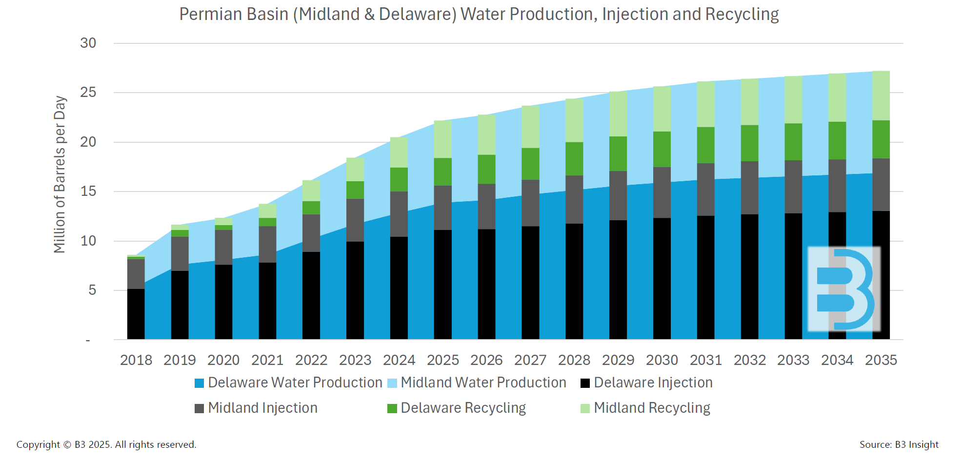
Permian Basin Produced Water Volumes
Growth in Permian water volumes expected to continue

Slide 4
New RRC Guidelines – UIC Permitting
RRC new UIC permitting process for Permian SWD wells
Significant additional research and technical data will be required for permit applications
Potential for significant increases in permit application costs, technical analysis, effort, and extended approval times
Additional permit application data includes:
Frac gradient of top and bottom confinement zones and injection zone
Initial reservoir pressure in proposed injection zone
Disposal fluid density
Map with 2-mile radius AOR showing ALL wells in that AOR, their completion info, casing and cementing info, etc.
Density-sonic log of the interval in the well (or a nearby representative well)
Cumulative permitted max daily permitted volume for all disposal wells within the two-mile AOR
And much more…

Slide 5
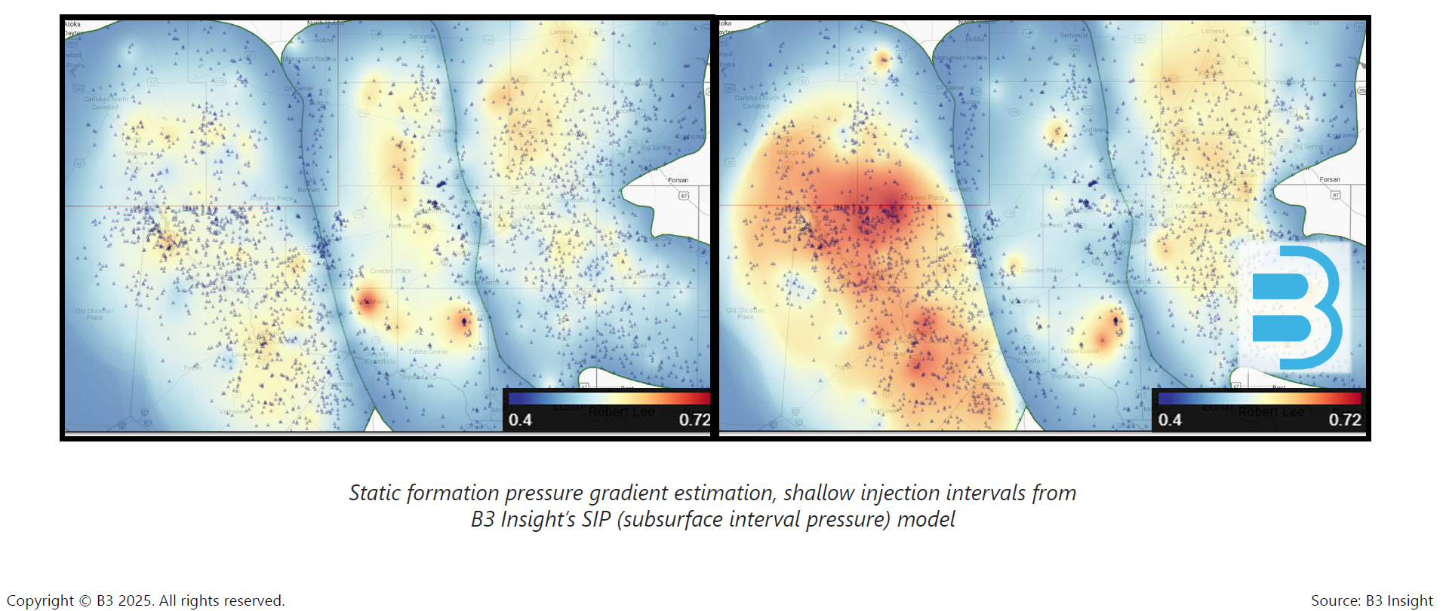
Pore Pressure Issues
2017
2024
Specific pore pressure concerns:
Disposal intervals over-pressure
Reservoirs fill
Breakouts
Confinement
Pore pressure continues to intensify

Slide 6
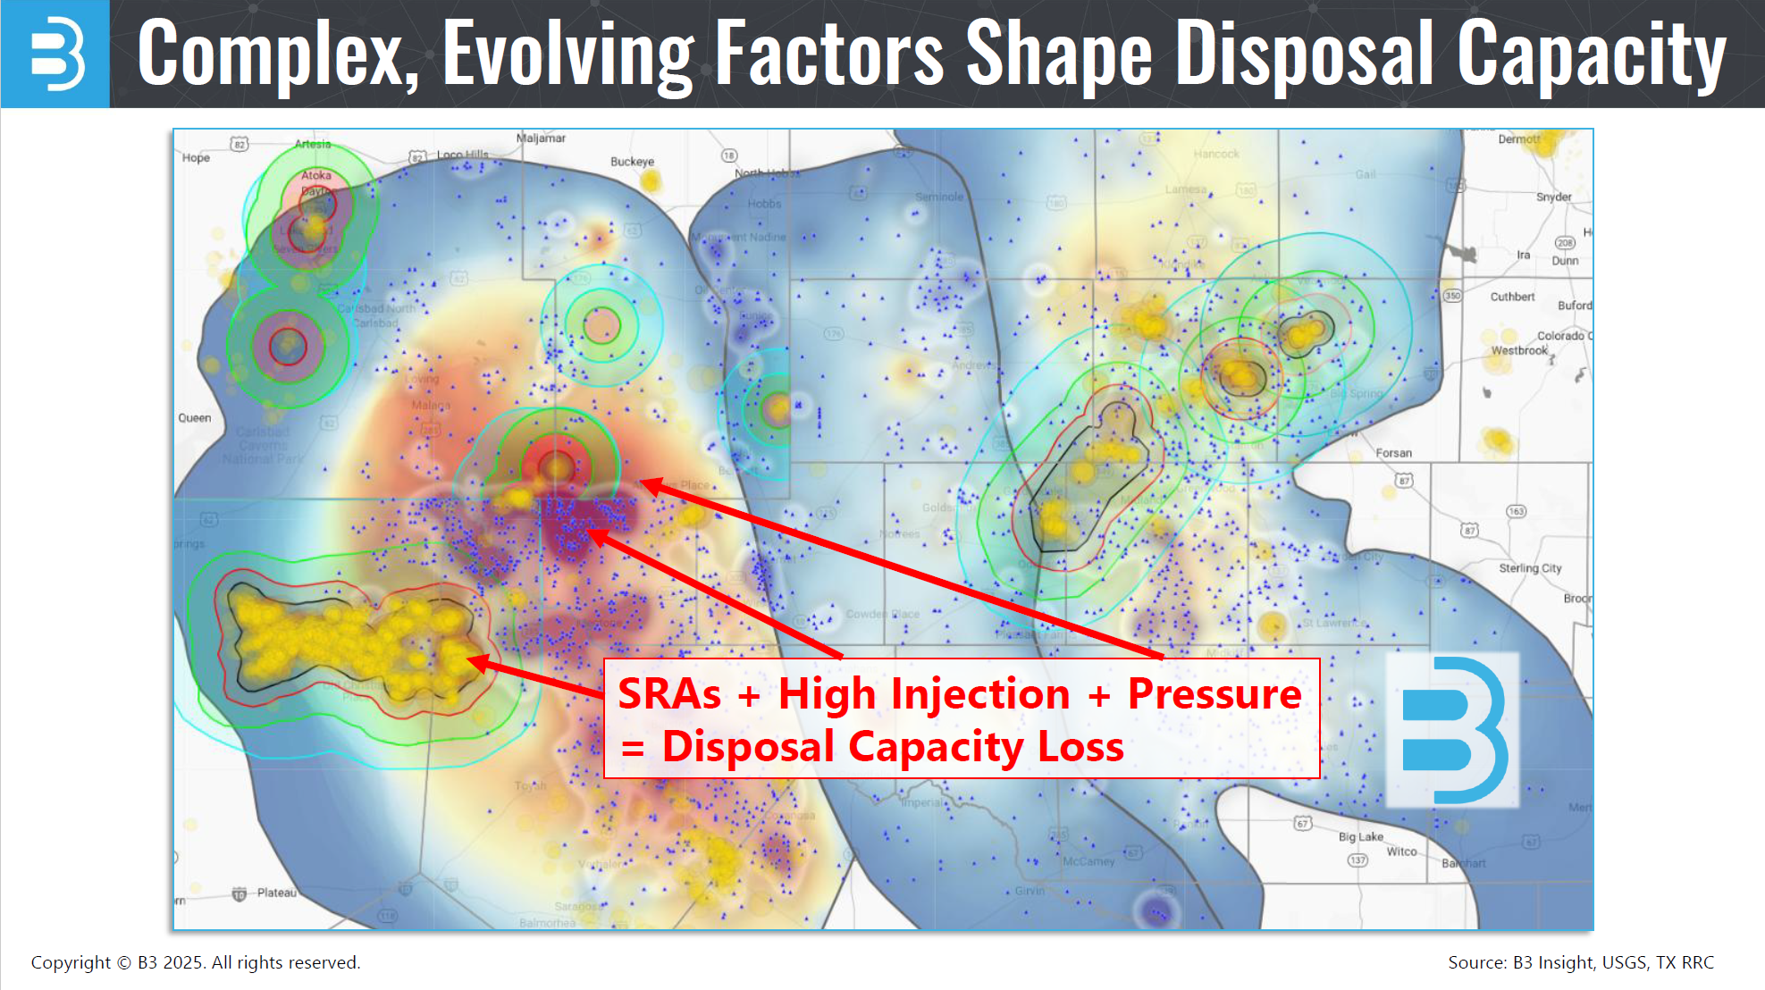
Seismicity
Complex, evolving factors shape disposal capacity

Slide 7









Trade Associations and Affiliations
Trade associations and affiliations critical in helping to shape smart regulation

Slide 8
Industry Path Forward
ALIGNMENT
Speak with a unified voice on key industry issues, making engagement with state regulators more effective and consistent
Work together to provide technical expertise and operational insights that help shape regulations
Educate policymakers and regulators about the complexities of water management, disposal, and recycling
Continue to build trust with regulators, operators, and the public
COLLABORATION
OUTREACH
TRANSPARENCY
Align on challenges and work with regulators to provide thoughtful solutions

Slide 9
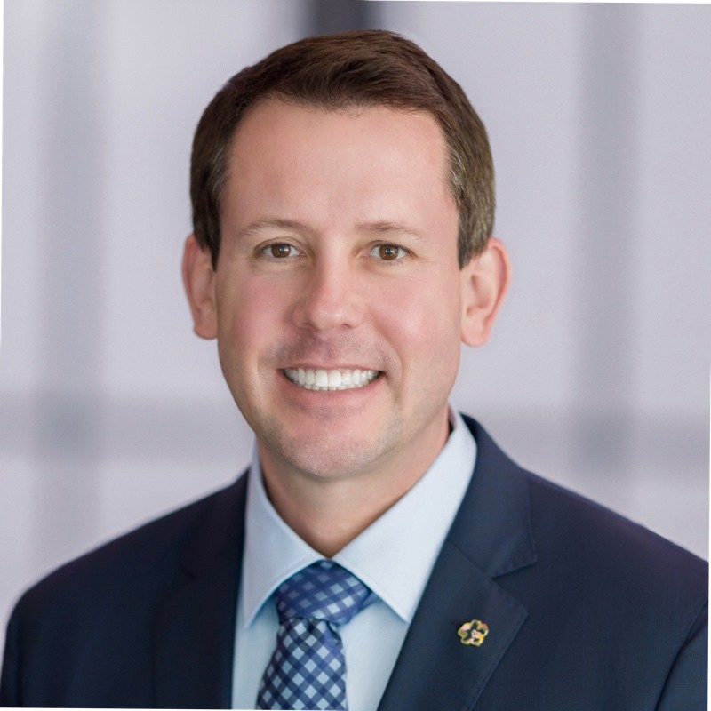
Contact
David Grounds
Vice President, Regulatory Compliance & QHSE
Pilot Water Solutions
david.grounds@pilotwater.com
817-897-0135
linkedin.com/in/david-grounds-124b5a25

Slide 10


