Slide 1
Enforcement Panel – State Perspectives
Craig Pritzlaff
Director, Office of Compliance and Enforcement

Slide 2
OCE Mission Statement
OCE protects public health and the environment by ensuring compliance through
  purposeful investigations,
  meaningful outreach,
  encouragement of voluntary compliance,
  effective enforcement, and
  immediate response to natural and industrial disasters.
We utilize technological advancements to improve compliance monitoring, provide transparent information to the public, and effectively employ agency resources.
Notes:
Office of Compliance and Enforcement Mission and guiding principals
“Compliance First” refers to our goal of ensuring compliance with all requirements including rules, statutes, and authorizations
Refers to our approach – enforcement takes place when compliance efforts aren’t effective
All together (industry, public and agency) in our commitment to protecting the environment

Slide 3
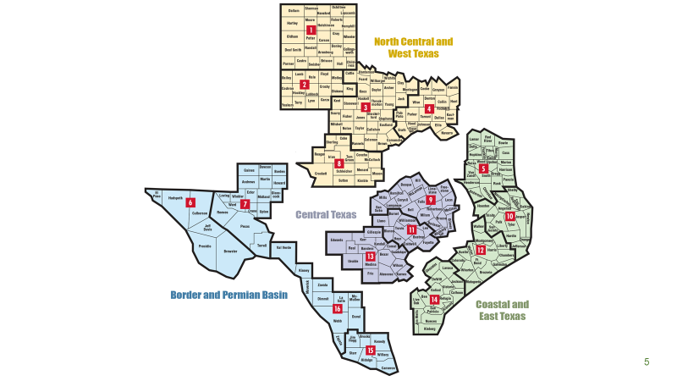
TCEQ Regions and Areas
Notes:
16 offices, RD/AD; some HQ staff : point of spear for Compliance work

Slide 4
Self Audit Program - Disclosures
Notes:
Texas Health and Safety Code, Chapter 1101 Texas Environmental Health and Safety Audit Privilege Act. The purpose of this chapter is to encourage voluntary compliance with environmental and occupational health and safety laws.
a person who makes a voluntary disclosure of a violation of an environmental or health and safety law is immune from an administrative or civil penalty for the violation disclosed.
(a) A disclosure is voluntary for purposes of this subchapter only if:
(1) the disclosure was made:
(A) promptly after knowledge of the information disclosed is obtained by the person making the disclosure; or
(B) not later than the 45th day after the acquisition closing date, if the violation was discovered during an audit conducted before the acquisition closing date by a person considering the acquisition of the regulated facility or operation;
(2) the disclosure was made in writing by certified mail to an agency that has regulatory authority with regard to the violation disclosed;
(3) an investigation of the violation was not initiated or the violation was not independently detected by an agency with enforcement jurisdiction before the disclosure was made using certified mail;
(4) the disclosure arises out of a voluntary environmental or health and safety audit;
(5) the person making the disclosure initiates an appropriate effort to achieve compliance, pursues that effort with due diligence, and corrects the noncompliance within a reasonable time;
(6) the person making the disclosure cooperates with the appropriate agency in connection with an investigation of the issues identified in the disclosure; and
(7) the violation did not result in:
(A) injury or imminent and substantial risk of serious injury to one or more persons at the site; or
(B) off-site substantial actual harm or imminent and substantial risk of harm to persons, property, or the environment.
An audit report is privileged
audit must be completed within a reasonable time not to exceed six months after:
(1) the date the audit is initiated; or
(2) the acquisition closing date, if the person continues the audit under Section 1101.053.
(b) Subsection (a)(1) does not apply to an environmental or health and safety audit conducted before the acquisition closing date by a person that is considering the acquisition of the regulated facility or operation.
Sec. 1101.053. CONTINUATION OF AUDIT BEGUN BEFORE ACQUISITION CLOSING DATE. A person that begins an environmental or health and safety audit before becoming the owner of a regulated facility or operation may continue the audit after the acquisition closing date if the person gives notice under Section 1101.155.

Slide 5
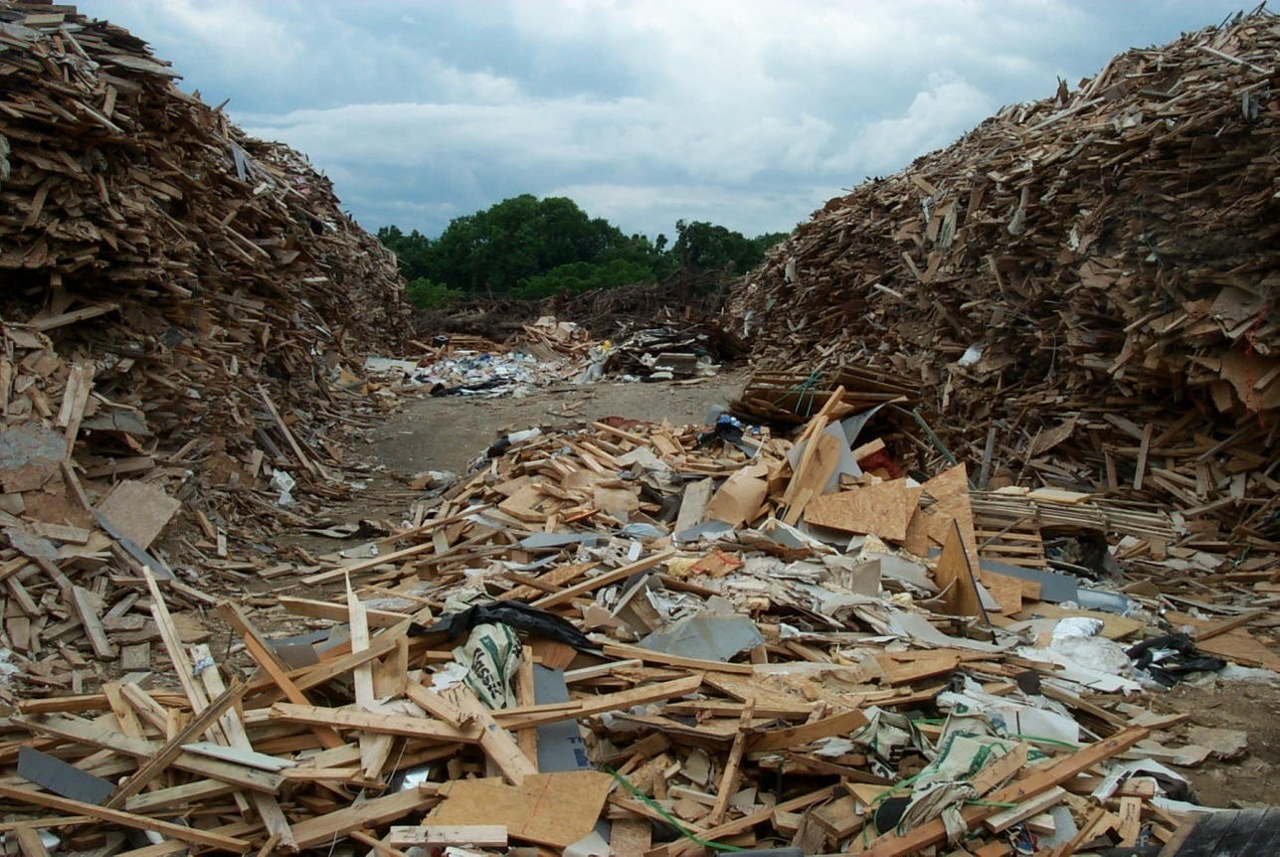
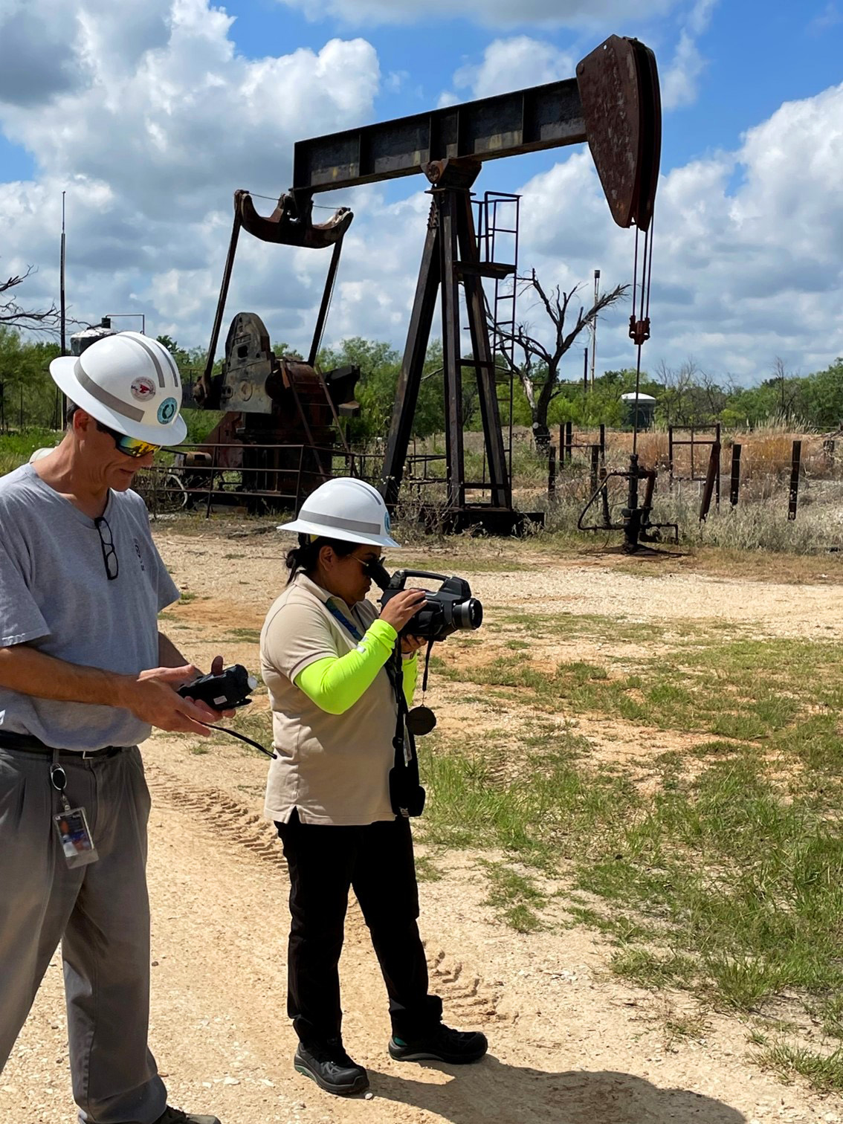
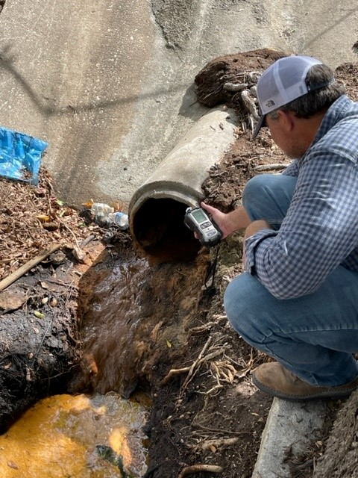
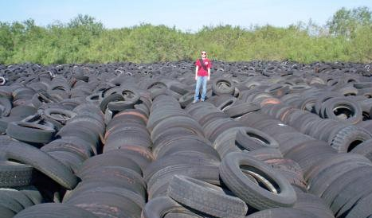
  Air, Water, Waste Investigations
Notes:
The TCEQ performs investigations to ensure that regulated entities are complying with state and federal requirements under the Clean Air, Safe Drinking Water Act, and the Clean Water Acts and to ensure safe management of municipal and industrial solid wastes from generation to disposal. This slide shows examples of the types of waste related investigations we conduct. We evaluate PSTs, scrap tire sites, landfills, recycling facilities, and industrial and hazardous waste generators.

Slide 6
Investigations
Notes:
Region investigations include our 16 regional offices and contractors such as local air programs.
Other investigations include watermaster, drinking water, review of discharge monitoring reports, etc.

Slide 7
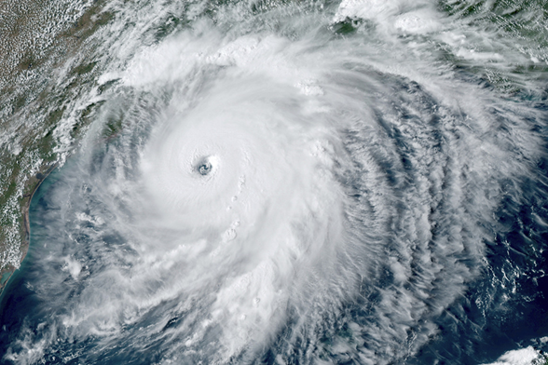
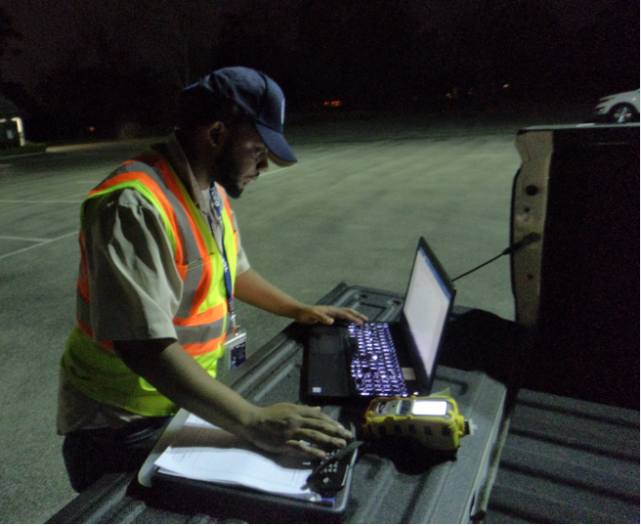
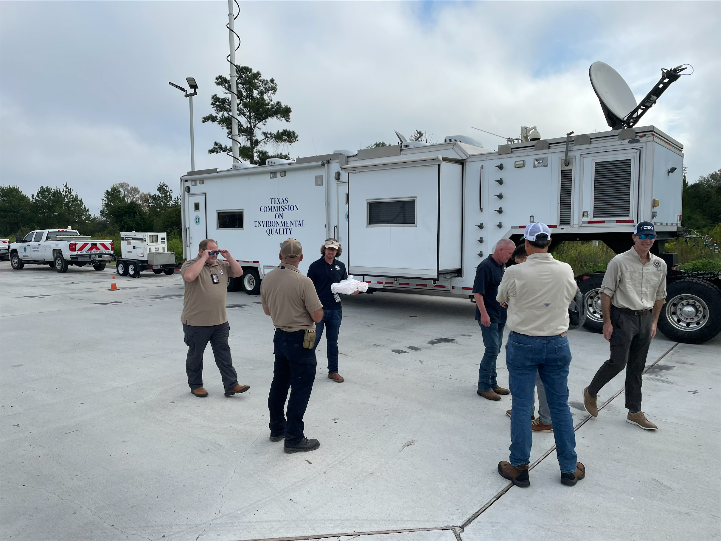
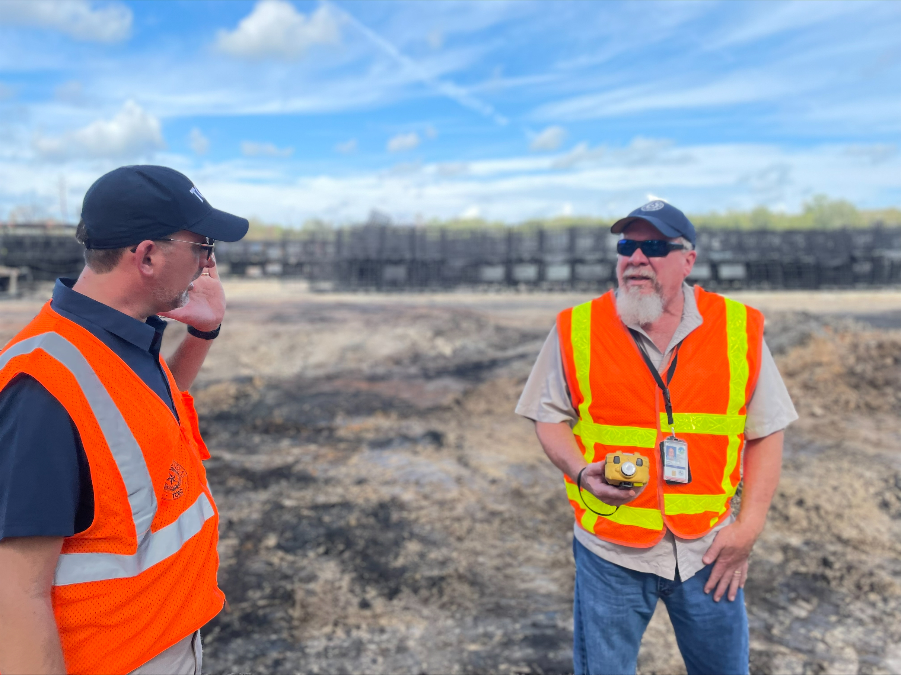
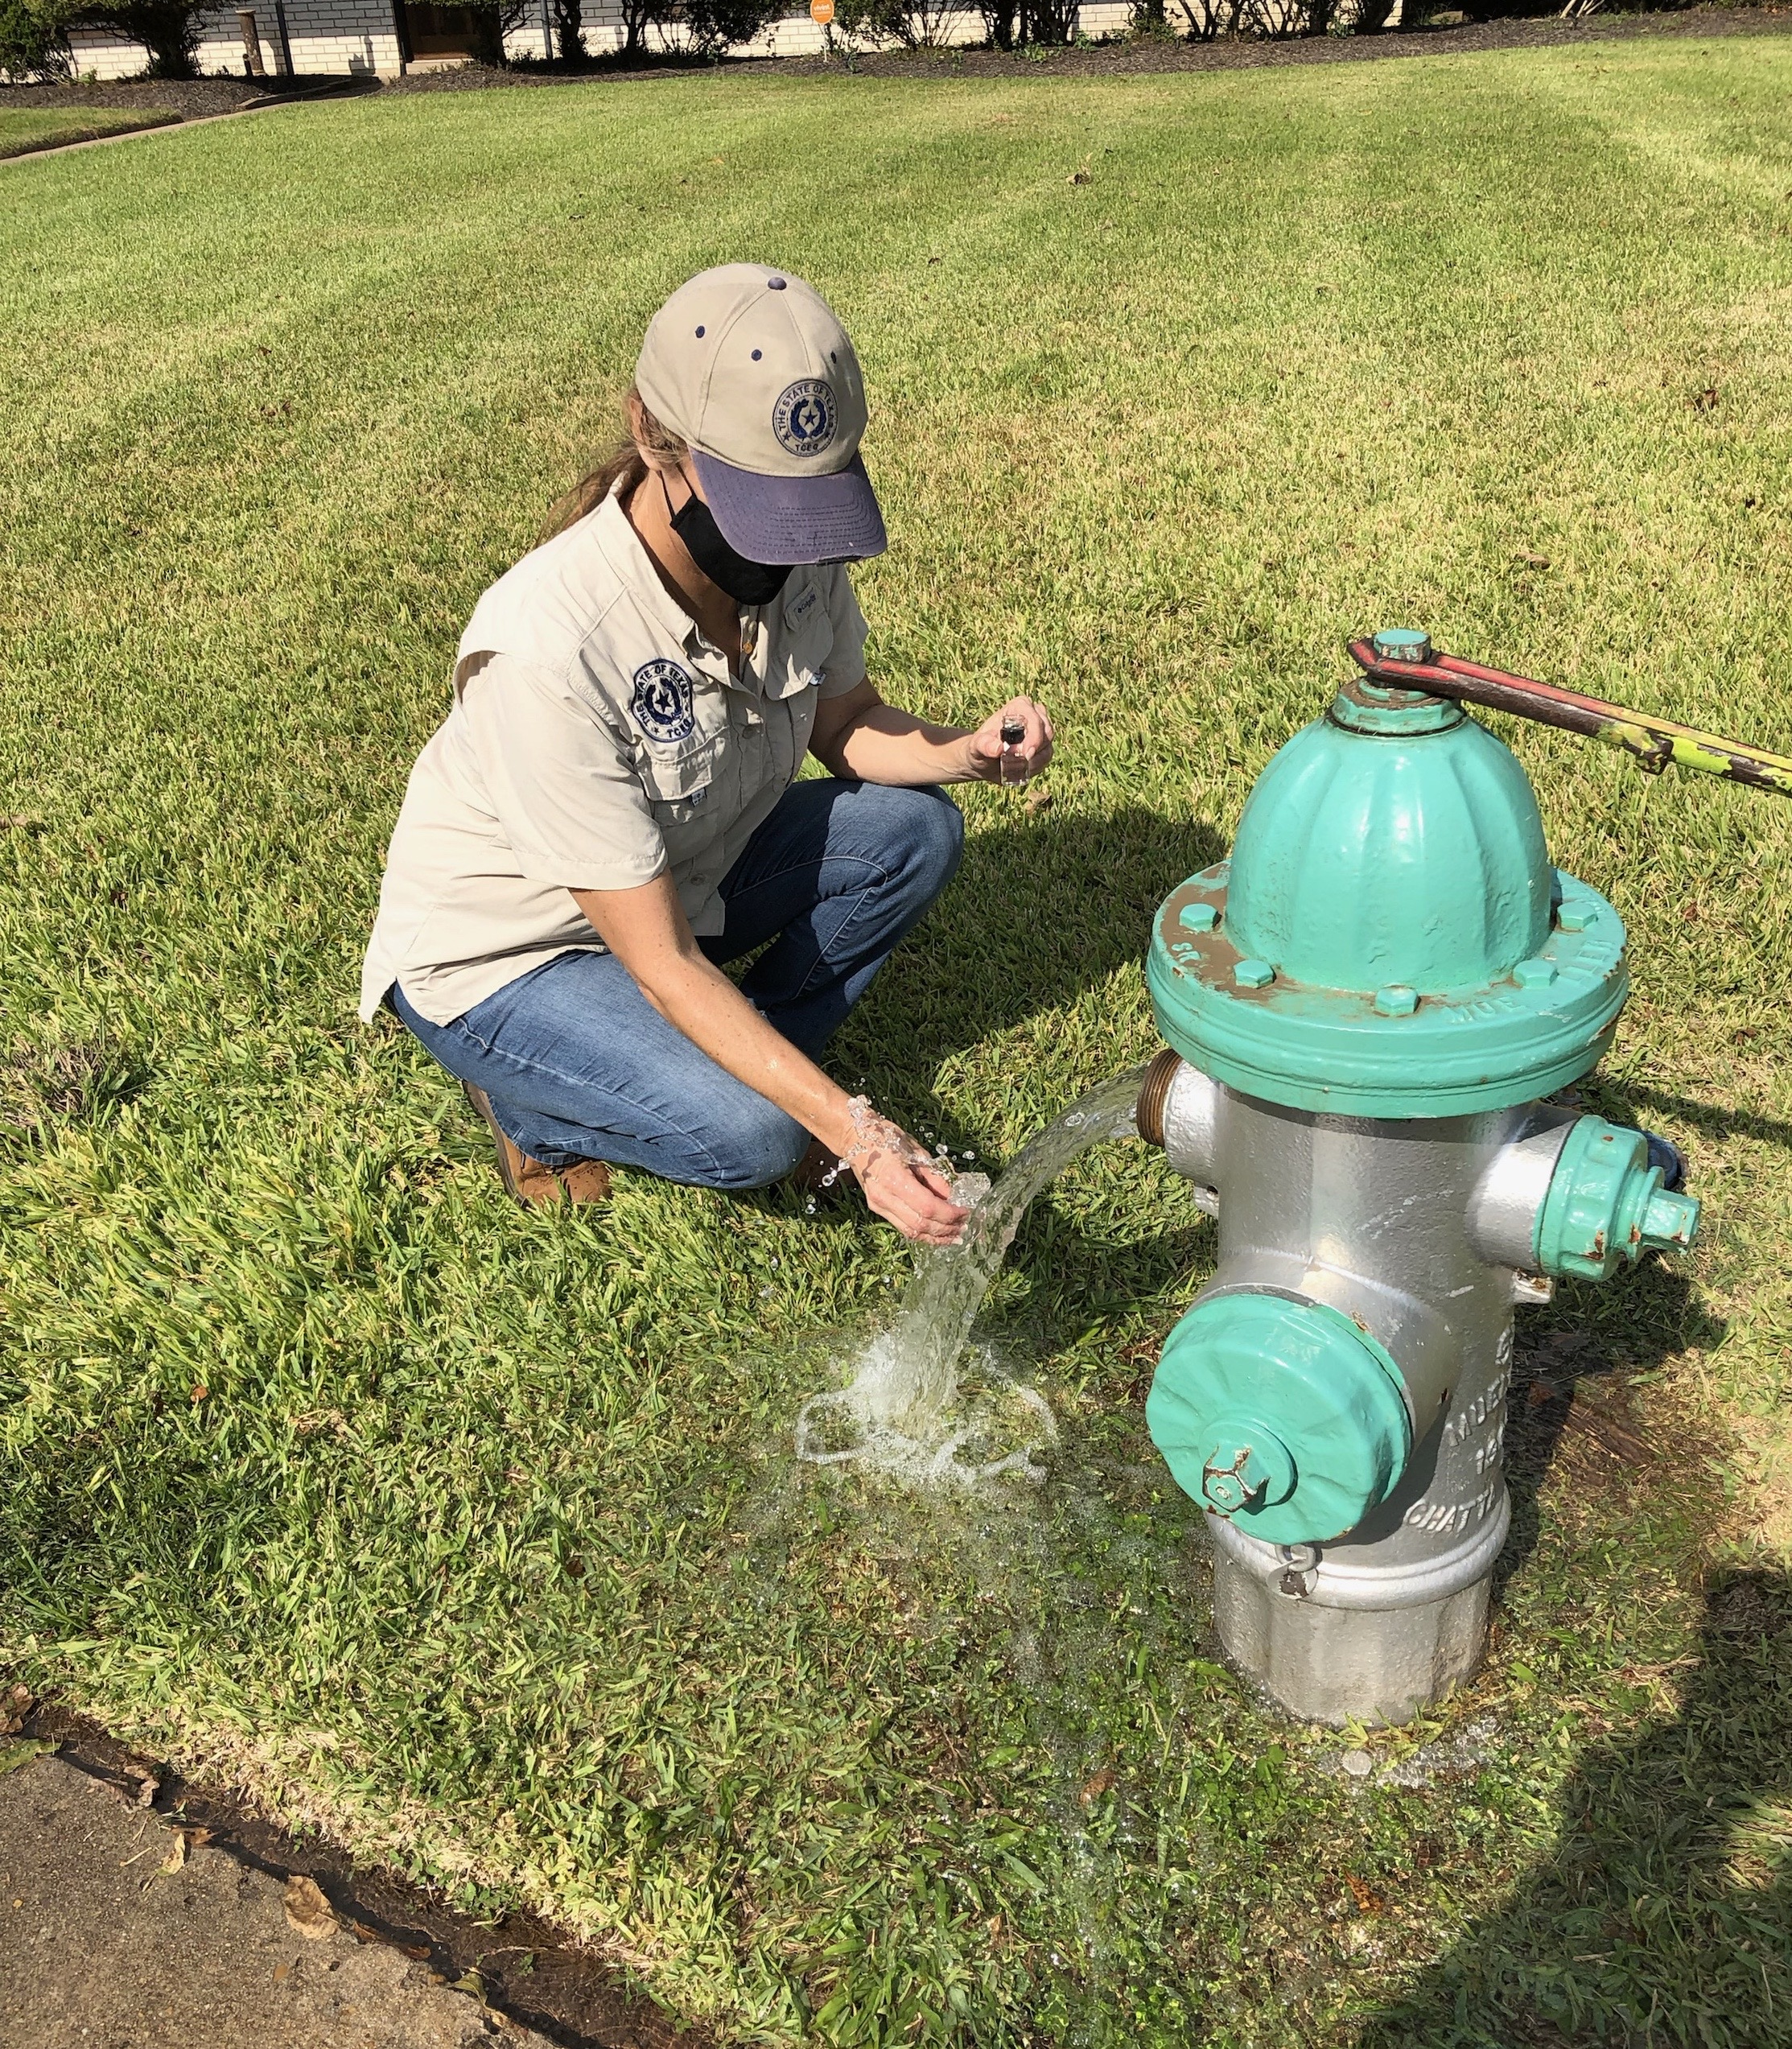
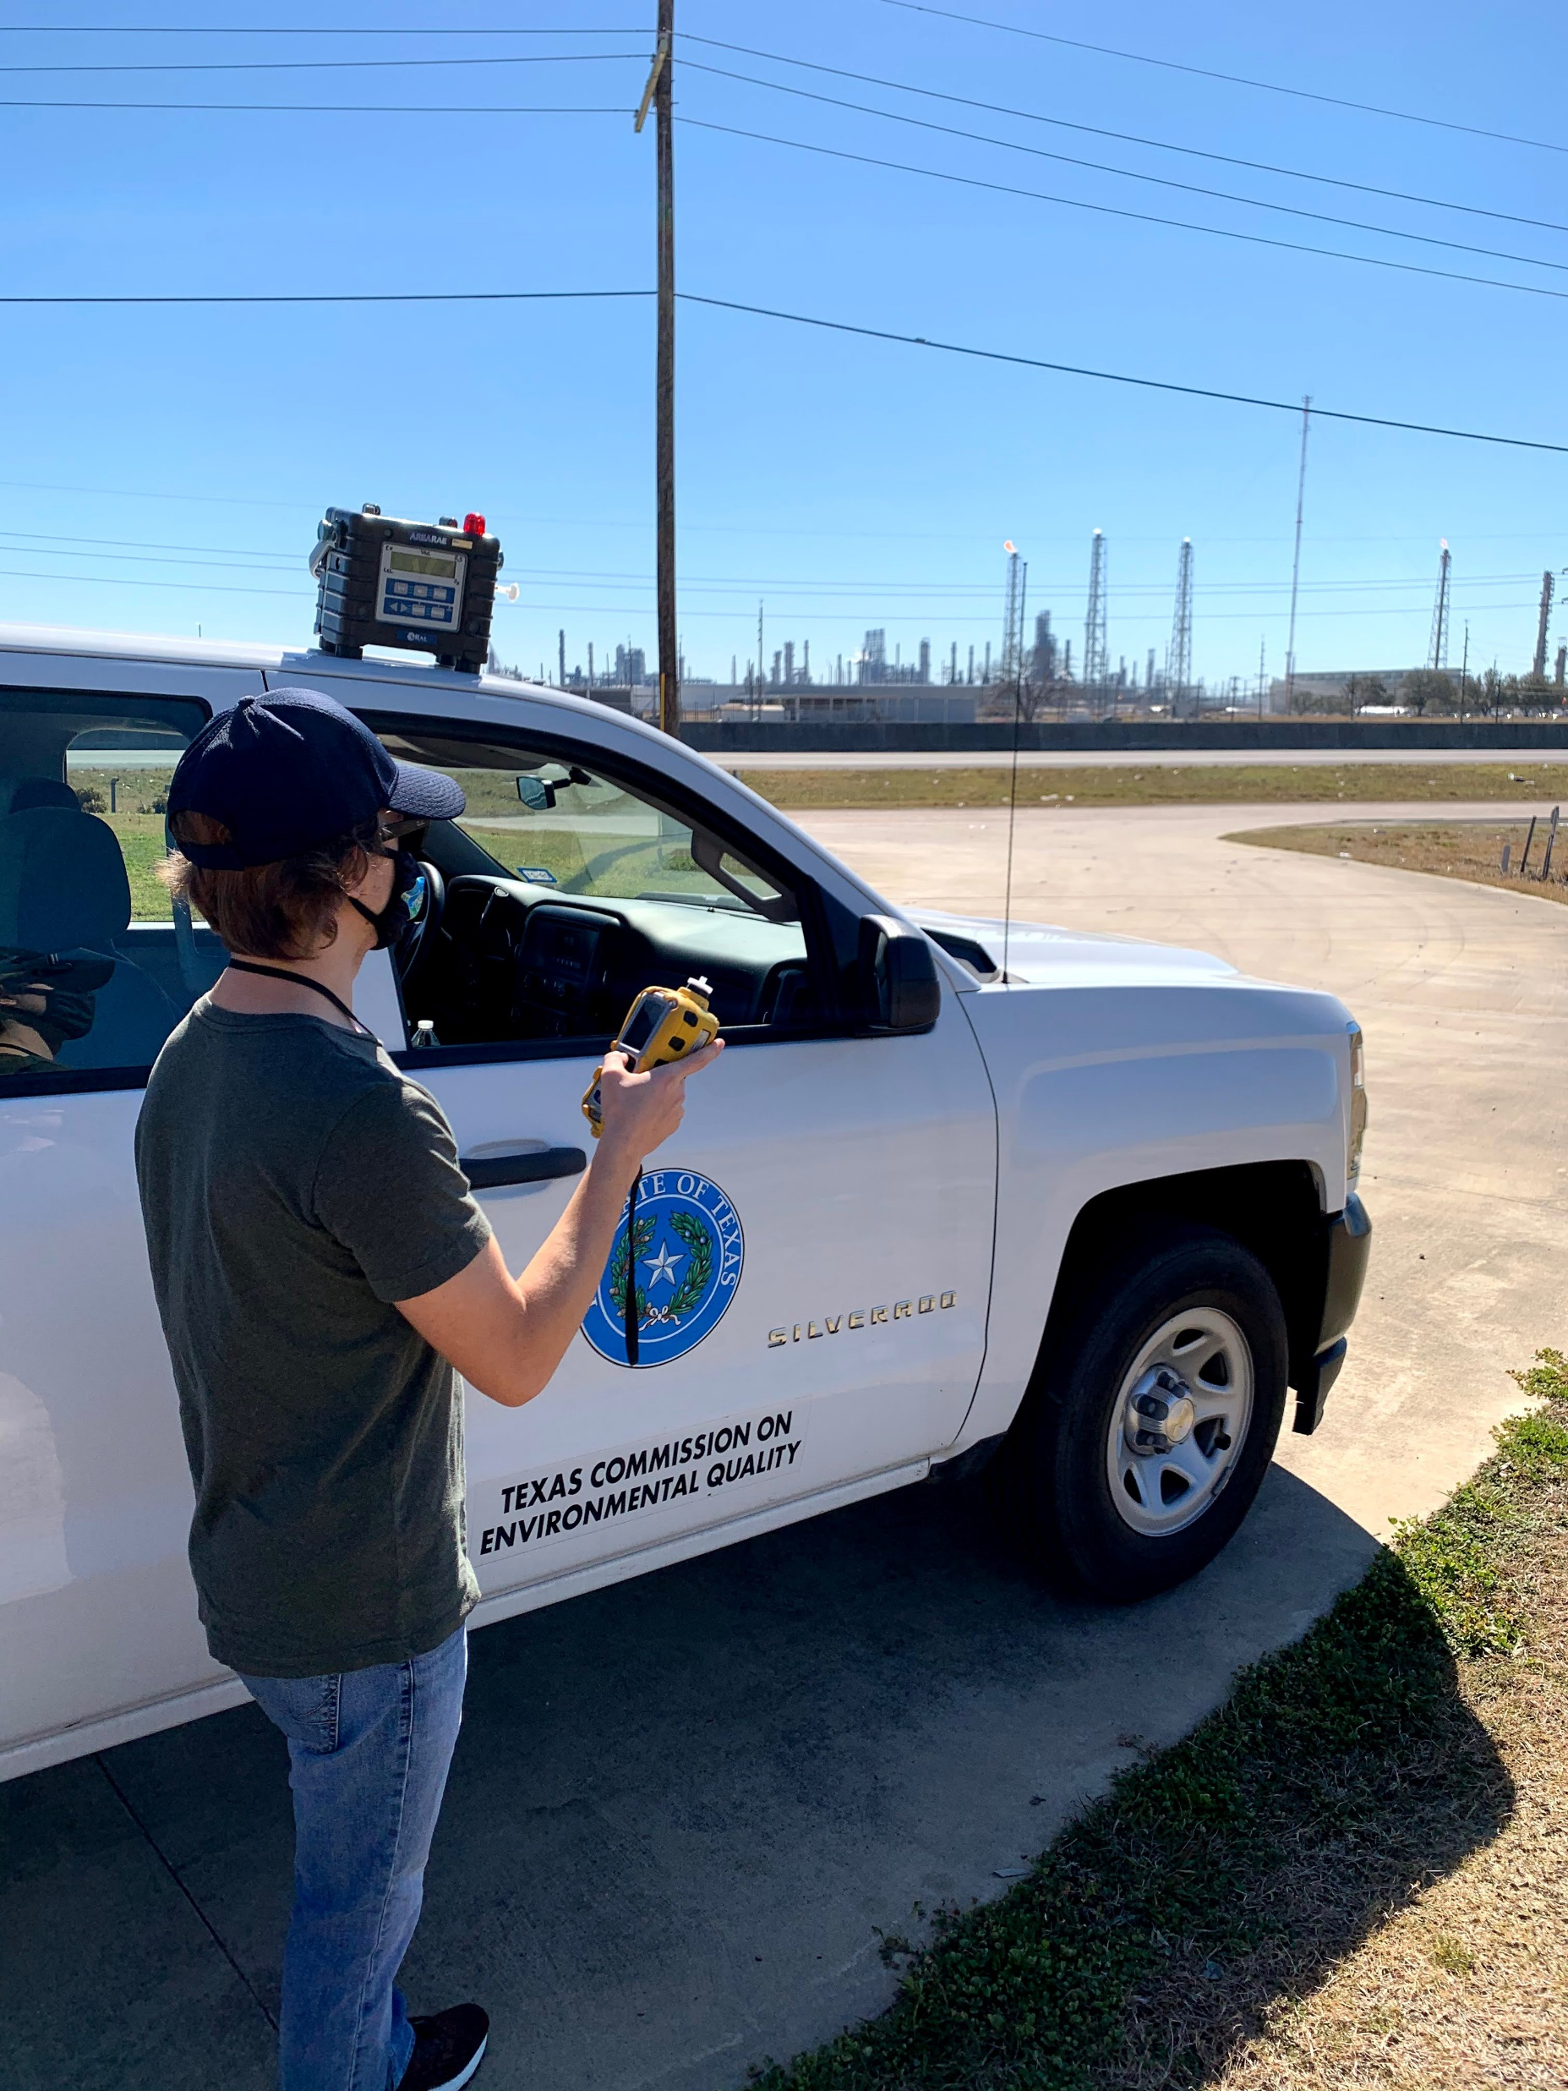
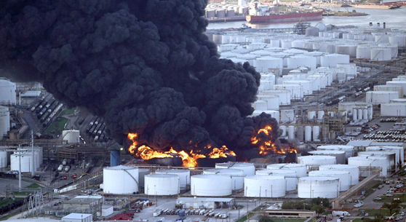
Emergency Response and Readiness
Planning, Preparation, Partnerships, People
  Natural and industrial disasters
Notes:
Emergency response activities are conducted by all regional offices with support from centralized Emergency Management Support and often conducted in cooperation with other state, federal and local authorities. ​
Authority:​
30 Texas Administrative Code Chapter 327​
40 Code of Federal Regulations Part 302​
ESF 10 - State of Texas Emergency Management Plan

Slide 8

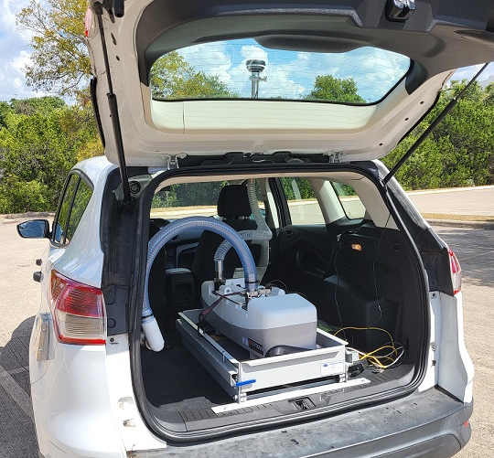
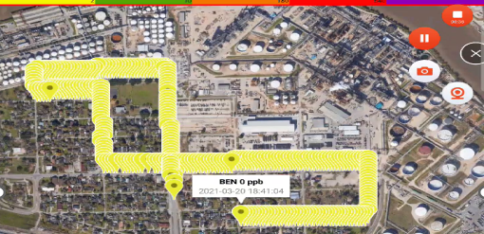
Regional Rapid Assessment Monitoring Vehicles
Existing regional vehicles retrofitted with DUVAS UV spectrometers.
Simplified mobile platform to assess target pollutants near industrial areas with a single instrument.

Slide 9
Complaints Received
Notes:
FY = fiscal year; 9/1 – 8/31
TCEQ typically receives about 10,000 complaints per year
Statewide, all complaints, all media

Slide 10
Emissions Incidents Received
Notes:
FY19 peak triggered changes. We worked with REs and addressed consistency issues across the state. Centralized team. Provide closure and timeline
The total number of events reported has decreased over the last five years, which may be attributed to TCEQ’s focus and outreach to regulated entities on proper reporting, authorization, and enforcement. One outreach example is TCEQ’s “Find It and Fix It” initiative for oil and gas operations in the Permian Basin, initiated in FY 2021. Additionally, TCEQ conducted outreach to industry groups in the oil, gas, and pipeline sectors with an emphasis on properly authorizing and minimizing and controlling predictable emissions. The Emissions Event Review Section also participated in multiple meetings with industry groups and met individually with companies across all sectors to discuss reporting requirements and authorizations. The total number of emissions incidents includes emissions events, scheduled MSS activities, and excess opacity events

Slide 11
Enforcement
Administrative Resolution
  Notice of Violation
  Agreed Order
  State Office of Administrative Hearings
Civil Litigation (Attorney General referral)
  Texas Water Code §§ 7.101, .102, .105

Slide 12
Notices of Violation
Notes:
FY = fiscal year; 9/1 – 8/31

Slide 13
Regional Notices of Enforcement (NOE)

Slide 14
Regional Investigations

Slide 15
Results of Complaint Investigations
Notes:
Of the complaints received, 29% were not investigated either because the complaint was not within TCEQ jurisdiction and referred to another agency, including to a local government in which TCEQ has an agreement to refer such complaints, or there was inadequate information to investigate the complaint.
Complaint investigations can result in violations that may or may not be directly related to the allegation described in the complaint. Between FY 2018 and FY 2023, 34% of complaint investigations cited at least one violation. Approximately 28% of those complaint investigations resulted in an NOV and approximately 6% resulted in an NOE. Approximately 66% of complaint investigations resulted in “no findings,” which means that the complaint allegation or other violations could not be substantiated.
SB471, Tex Water Code 5.176
(c) The commission is not required to investigate a complaint:
(1) that may be addressed during other commission activities; or
(2) that was filed by an individual when there is not a reasonable probability that the commission can substantiate the complaint and:
(A) the complaint is repetitious or redundant of other complaints concerning the same site investigated in the preceding 12 months that were not substantiated by the commission; or
(B) the complainant has filed in the preceding seven years at least five complaints that were not substantiated by the commission.
Complaint investigator manual update
Updated intake form to better guide complainants through TCEQ programs
Updated webpages to include more referral information

Slide 16
Emissions Incident Investigations
Notes:
FY = fiscal year; 9/1 – 8/31
The total number of emissions incident investigations decreased from 1,122 in FY 2022 to 570 in FY 2023. The investigation numbers are lower in FY 2022 and FY 2023 than previous years for various reasons:
Efforts to reorganize the program.
The "Find It and Fix It" initiative.
Efforts in prior FYs to eliminate investigation backlogs.
A decrease in the number of incidents reported.
Incidents received that were non-reportable were excluded from data for FY 2022 and FY 2023

Slide 17
Enforcement Diversion Program
Tex. Water Code 7.0675
Enforcement Diversion Program (EDP) is available if:
  Entity is a small business or a local government; and
  Entity has not enrolled in the program during the last 24-month period; and
  Entity has minor or moderate violations that do not present imminent threat; except that
  Entity may not enroll if enforcement is required by federal law.
TCEQ may not initiate enforcement after successful completion
Notes:
Chapter 7, sub C
Sec. 7.0675. ENFORCEMENT DIVERSION PROGRAM FOR SMALL BUSINESSES AND LOCAL GOVERNMENTS.
(a) In this section, "small business" means a legal entity, including a corporation, partnership, or sole proprietorship, that:
(1) is formed for the purpose of making a profit;
(2) is independently owned and operated; and
(3) has fewer than 100 employees.
(b) The commission shall establish an enforcement diversion program for small businesses and local governments. The program must include:
(1) resources developed for the small business compliance assistance program under Section 5.135;
(2) compliance assistance training; and
(3) on-site technical assistance and training performed by commission staff.
(c) Before the commission initiates an enforcement action for a violation committed by a small business or local government, the commission may enroll the business or government into the enforcement diversion program.
(d) The commission may not enroll a small business or local government into the enforcement diversion program if an enforcement action against the business or government is required by federal law.
(e) The commission may not initiate against a small business or local government an enforcement action for a violation that prompted enrollment in the enforcement diversion program after the business or government has successfully completed the program.
(f) A small business or local government is not eligible to enroll in the enforcement diversion program if the business or government:
(1) committed a violation that:
(A) resulted in an imminent threat to public health; or
(B) was a major violation, as classified under Section 5.754; or
(2) was enrolled in the program in the two years preceding the date of the violation.

Slide 18
Craig J. Pritzlaff
512.239.5160 craig.pritzlaff@tceq.texas.gov
Questions?

