Slide 1
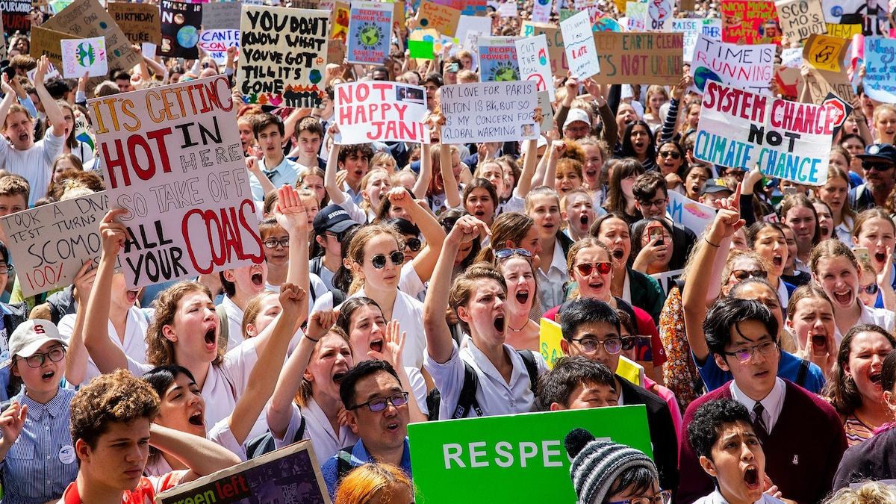
Climate Law:
Giving Legal Advice in The Absence of Statutory Guidance
By Jim Blackburn, Bryan French and Mary Kelley
August 7, 2025

Slide 2
Traditional Environmental Law
No Climate Change Statute
1969
National Environmental Policy Act (NEPA)
1970
Clean Air Act – 1970, 1977, 1990
1972
Clean Water Act – 1972, 1977, 1987m 2014
1973
Endangered Species – 1973, 1977
1976, 1984
Resource Conservation and Recovery Act (RCRA) – 1976, 1984
1980
CERCLA 1980, 1986

Slide 3
Climate Change Law
No Master Climate Change Statute
Most “compliance” actions will be voluntary
Voluntary decision to reduce emissions
Voluntary carbon credit market (except in California)

Slide 4
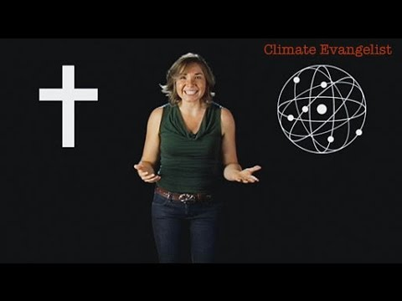
Dr. Kathryn Hayhoe, Climate Evangelist

Slide 5
The Science is Strong
Climate Is Changing and Humans Are Changing It
Human activities, principally through emissions of greenhouse gases, have unequivocally caused global warming, with global surface temperature reaching 1.1°C above 1850-1900 in 2011-2020. Global greenhouse gas emissions have continued to increase, with unequal historical and ongoing contributions arising from unsustainable energy use, land use and land-use change, lifestyles and patterns of consumption and production across regions, between and within countries, and among individuals (high confidence). {2.1, Figure 2.1, Figure 2.2}

Slide 6
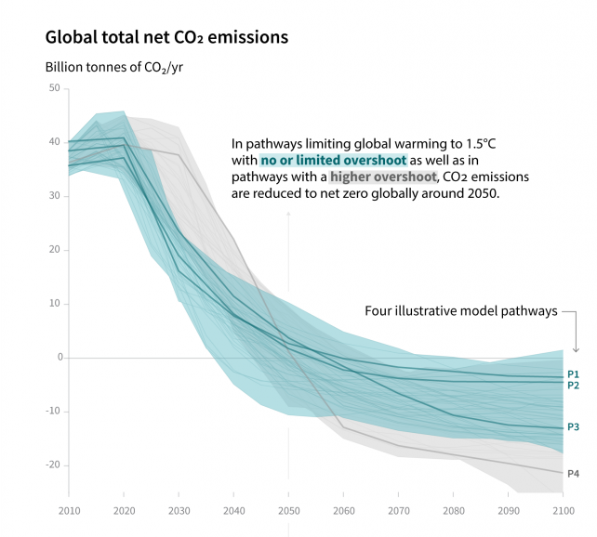

Action Needed to Implement the Paris Accord
Of 2015
Keep Temperature Rise Below 1.5 to 2.0 degrees Centigrade
Net Zero By 2050

Slide 7
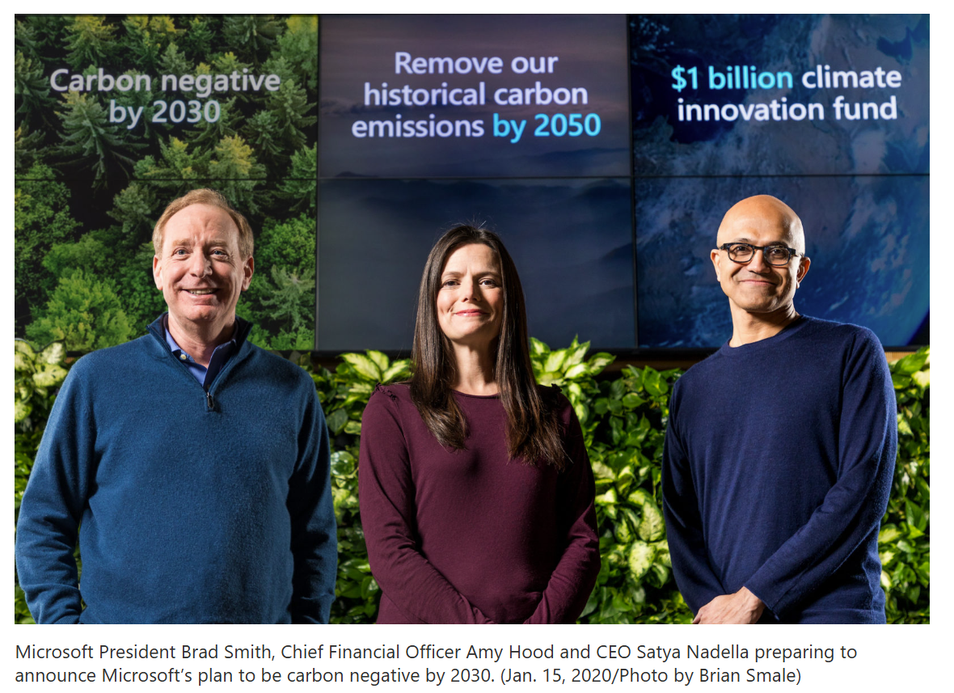


Slide 8
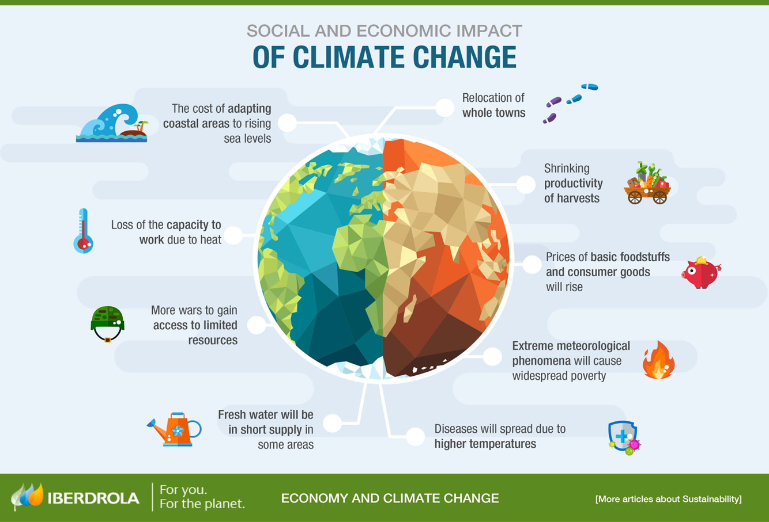

Slide 9
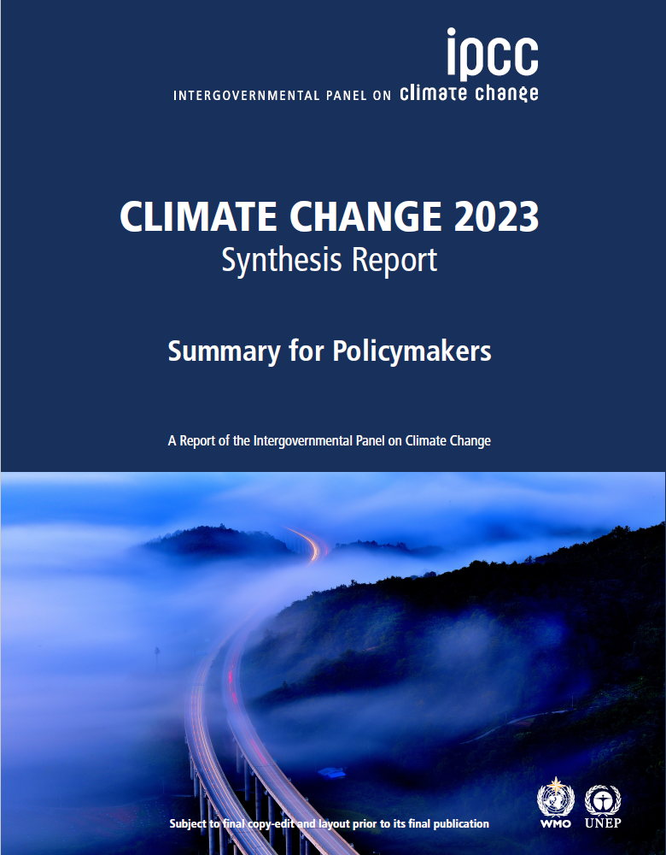
Conclusion 2023
Potential effects of warming more serious than previously thought
Effects happening faster than previously thought
Urging action to abate emissions sooner rather than later

Slide 10
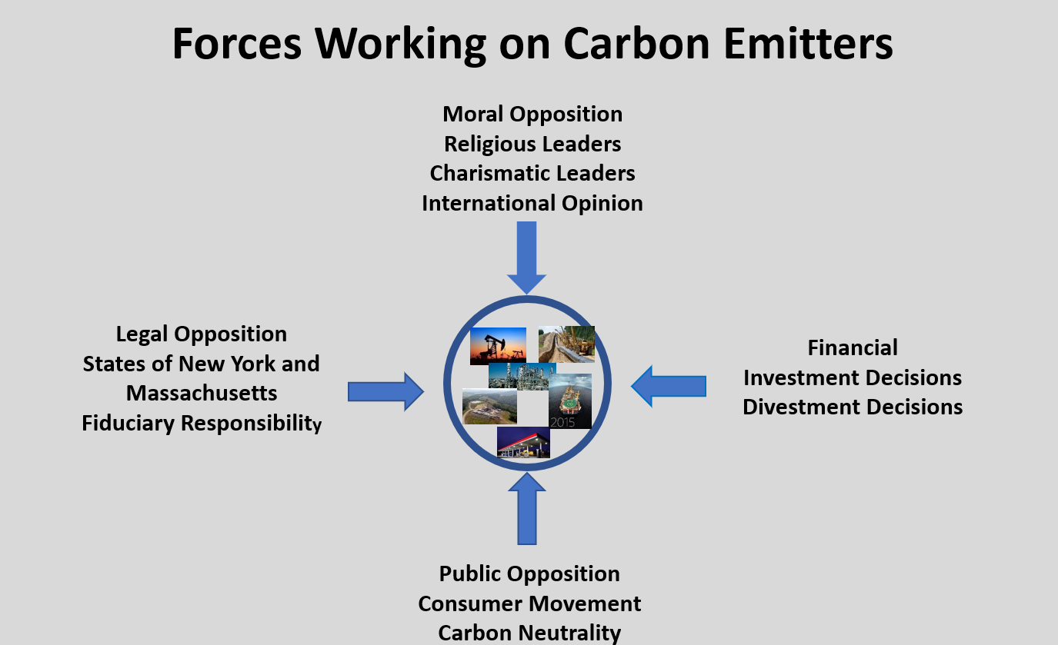

Slide 11
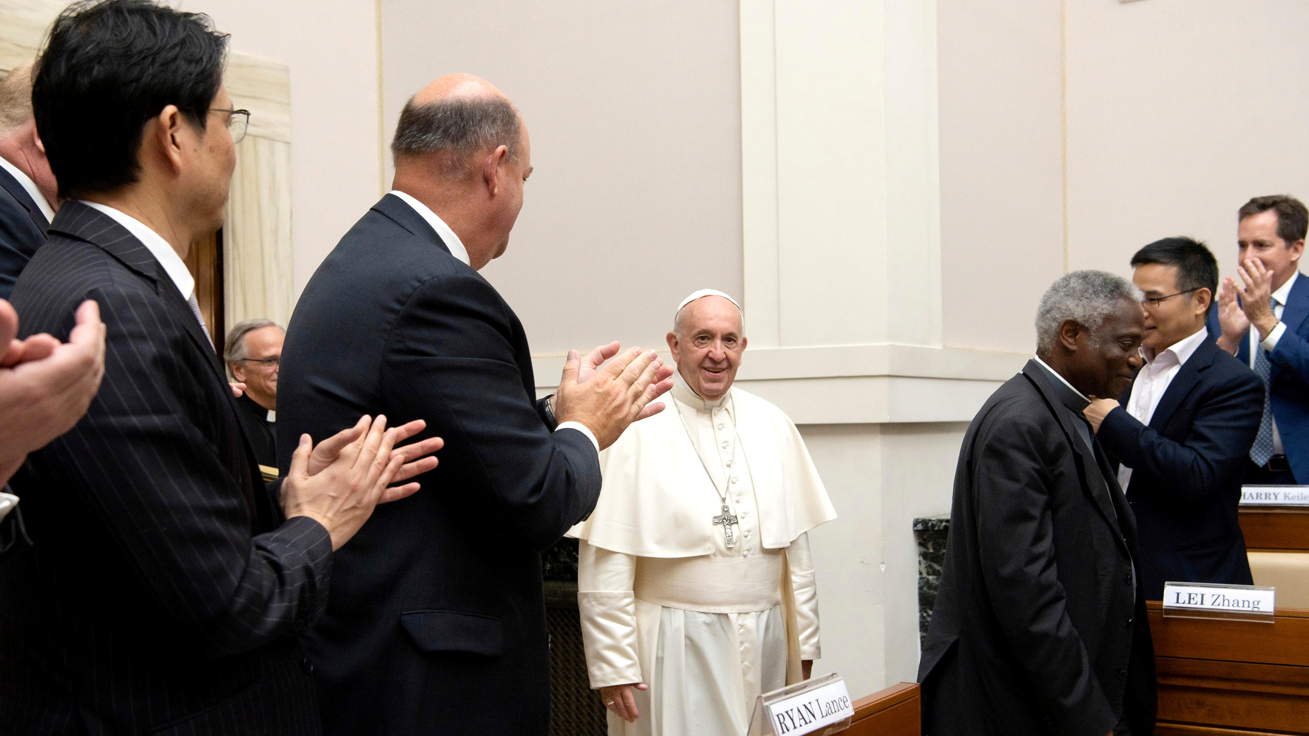

Slide 12
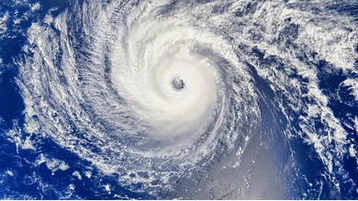
Litigation over tort claims for damages from climate change
Litigation over representations made by companies
Climate
Change
Litigation over shareholder petitions
Potential Commodity Futures Trading Commission (CFTC) regulation
Compliance With Securities and Exchange Commission (SEC) regulations

Slide 13
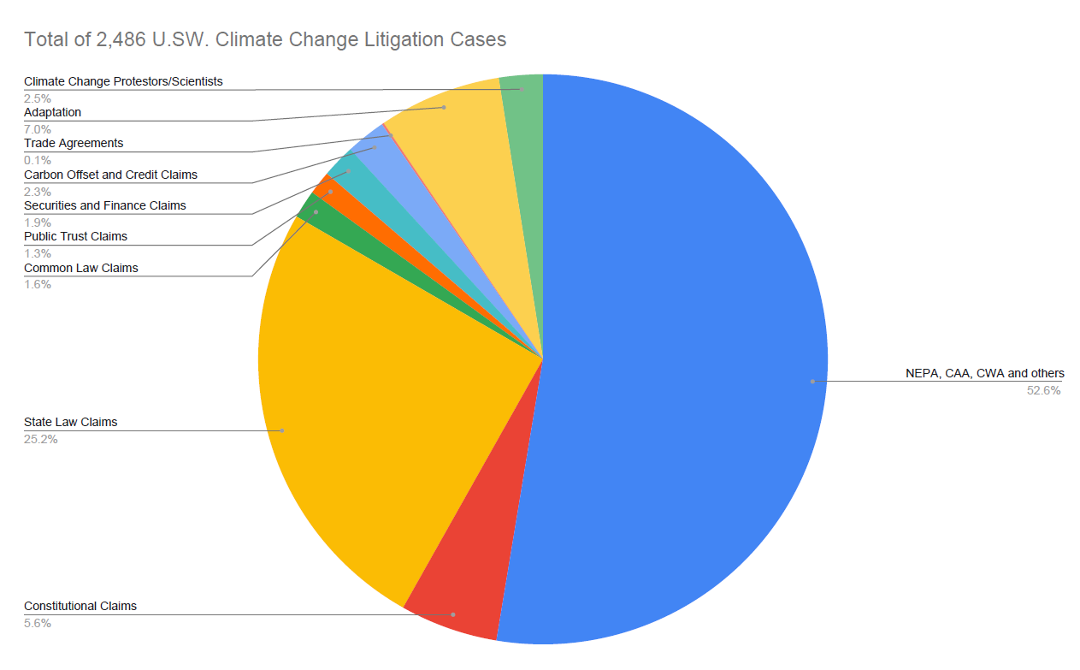
Litigation Re: Climate Change in the United States
2,486 Cases
Chart compiled by Bryan French

Slide 14
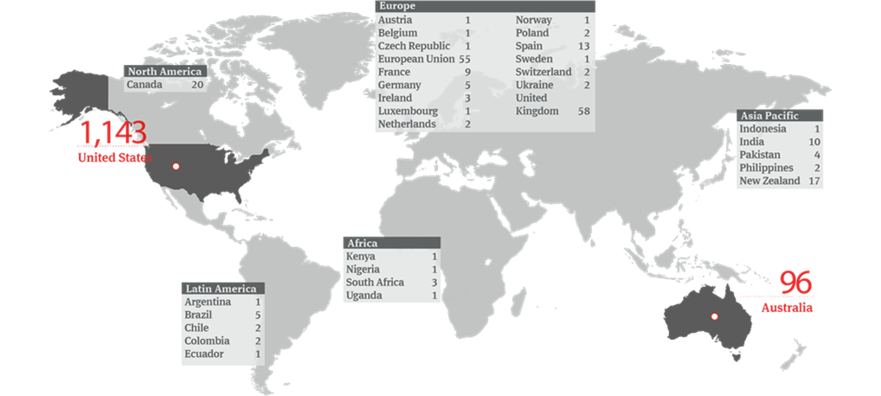
Climate Change Litigation Cases Around the World
https://www.nortonrosefulbright.com/en/knowledge/publications/7d58ae66/climate-change-litigation-update posted January 2020

Slide 15
Voluntary Decision To Reduce Emissions
Paris Accord – Scientific and Ethical Guide if not Legal Guide
Net Zero Emissions by 2050
Requires Calculation of Carbon Footprint
Direct Emissions Scope 1
Electrical Emissions Scope 2
Supply Chain, Product Use, Travel and Investments – Scope 3

Slide 16
The Path To Net Zero
Avoid, Minimize and Mitigate

Slide 17
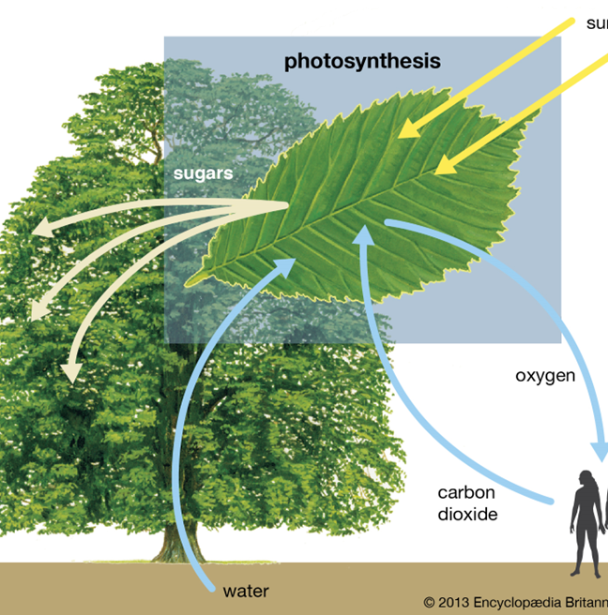
Types of Nature-Based Credits
CO2 Removal and Storage in Natural System
Grasslands
Forests
Coastal “Blue Carbon”
Avoided Conversion of Previously Captured and Stored Carbon
Forests
Coastal “Blue Carbon”
Emissions Reduction by Action in the Field
N20 and methane emission reduction in farming
Methane emission reduction by well plugging

Slide 18
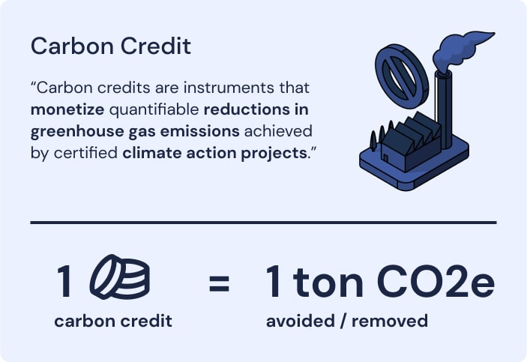
Carbon Credits

Slide 19
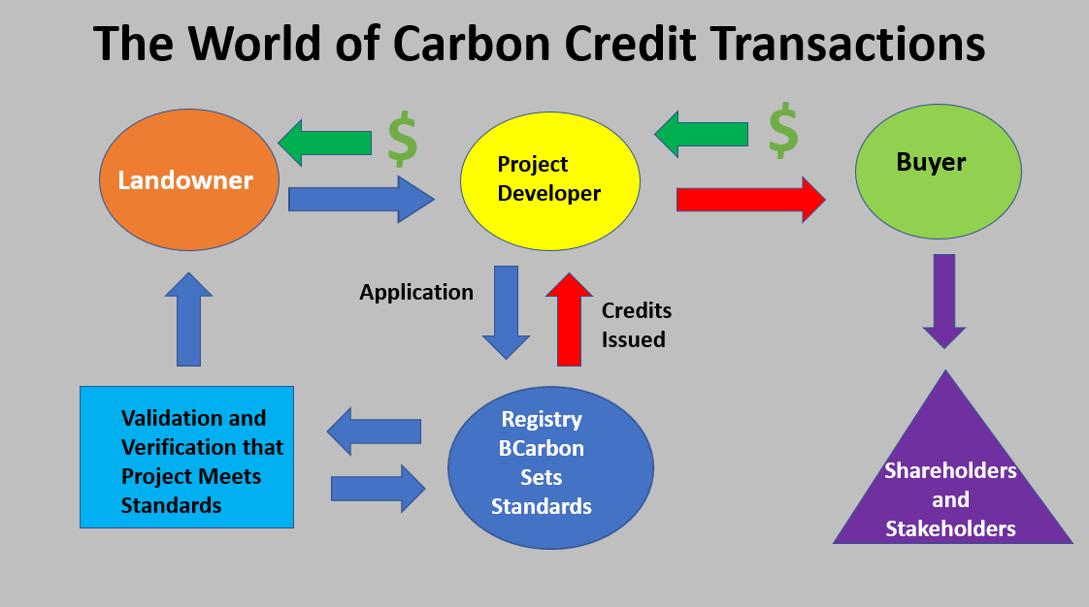
Voluntary Carbon Market
Carbon credits can be created, bought and sold
Market is voluntary – buyers have choice
Not required to meet specific requirements except in CA
Must be prepared to explain and defend decisions
CONTRACTS – CONTRACTS - CONTRACTS

Slide 20
Remember–
This is Voluntary
In many of these areas, there are no precedents
For some, this is a major problem
Tendency to want regulation for security and risk minimization
Flock mindset

Slide 21
End Thoughts
Always stress reasonable care and due diligence
Remember that if you write it or say it, it may be enforceable
You will not be able to remove all risk but your client can minimize risk through transparency
Know the science and use it
Watch Europe for trends

