Slide 1

Enforcement of Environmental Laws
The Criminal Side
Hinton | Bailey, Pc
2025
Joe Bailey
jwbailey@hintonbailey.com

Slide 2
Parallels, Intersections and Concerns
A practical overview to what the environmental lawyer should know
Criminal Enforcement of Environmental Laws
2

Slide 3
Why do we need to know about criminal enforcement?
Where there is civil or administrative cause of action, there may very well be a criminal prosecution.

Slide 4
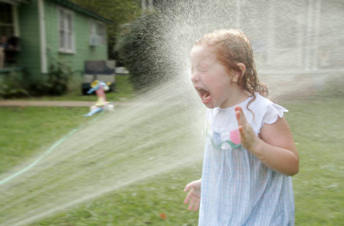
To cover this topic completely in just a few minutes
Like drinking from a fire hose . . .
So . . . just want to acquaint this audience with some of the basic concerns, processes and practical side which might be out there—lying in wait.

Slide 5
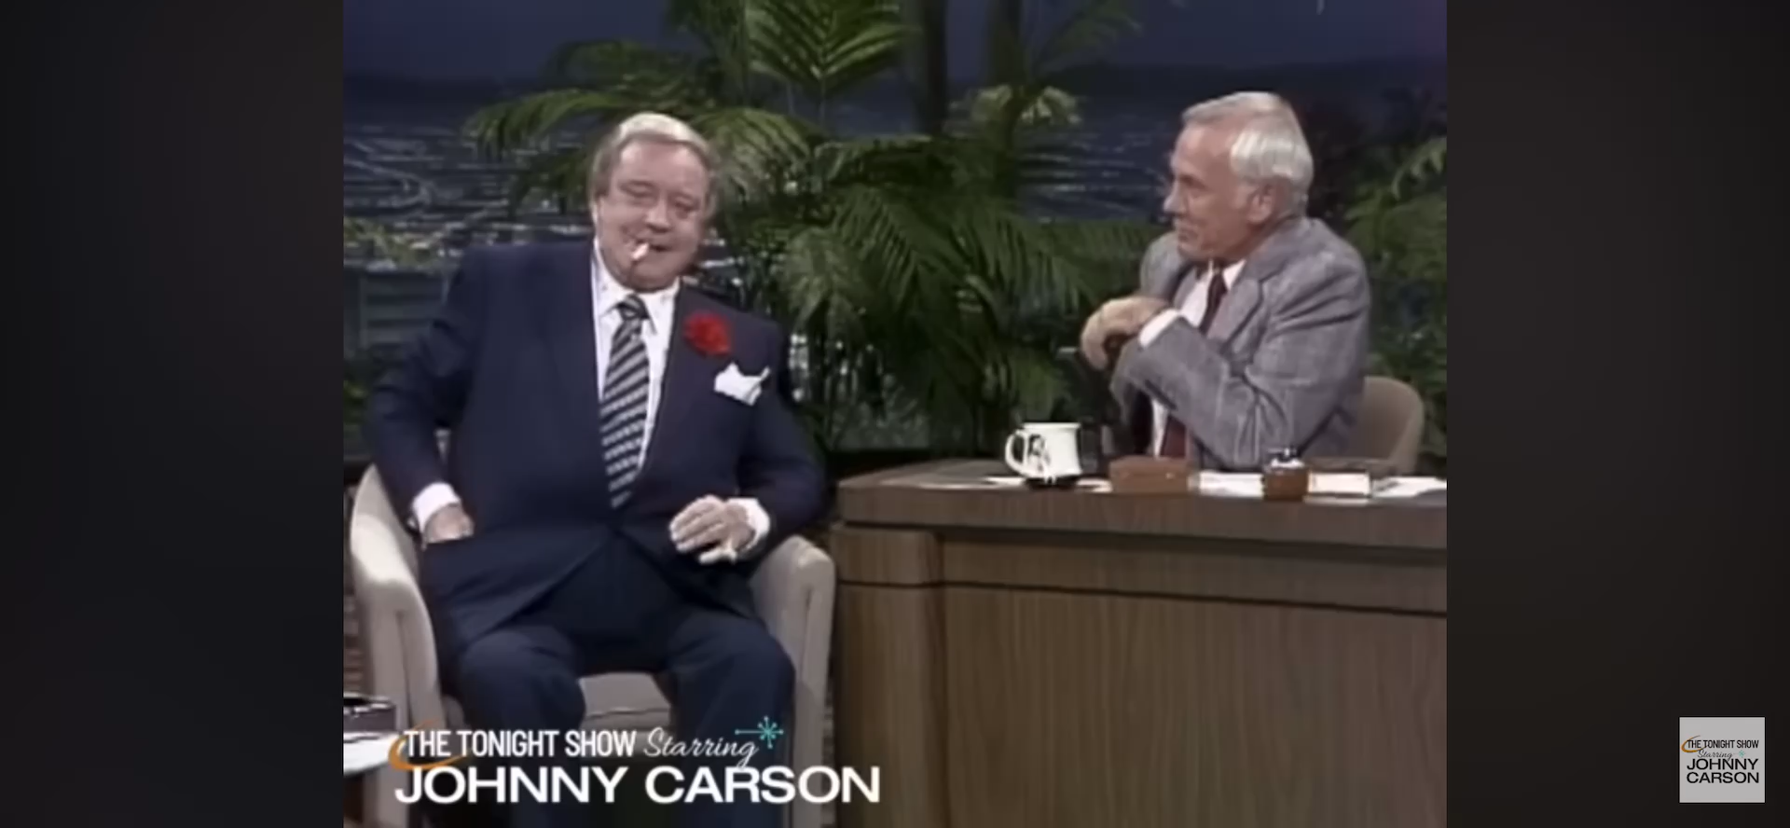
How Sweet It Is!
5

Slide 6

Q: What’s so “sweet” about this topic?
ENVIRONMENTAL BAD GUY
A: It all depends on which side you are on and/or your definition of sweet.

Slide 7
Premise: Many (Most? Virtually all?) environmental civil cases have the potential for criminal liability.
Premise: Even the best, the law-abiding, the honest and the righteous can have problems—sometimes.

Slide 8
Civil cases with criminal consequences
Normally, there must be a significant consequence
UNLESS you are in a jurisdiction where the prosecution of environmental crimes, LARGE or SMALL is active
“LOW HANGING FRUIT”
Death, extreme consequences or publicity are on equal footing where the government is concerned
Of course significant target is also easy
Extraordinary behavior by an actor

Slide 9
30,000 foot view
Texas
federal
Common ground with State
Mens rea: Intent, knowledge, reckless, criminal negligence
Key elements
Active areas of enforcement
Active agencies
“Utility” statutes
General overlap of Feds with Texas
Mens rea: Intentional, with knowledge, willful (deliberate), negligent
Key elements
Agencies
Activity
“Big Hammers”

Slide 10
Actions by Law Enforcement

Slide 11

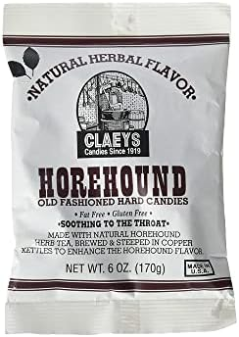

Captain
HOREHOUND,
The Enforcer
An UNHAPPY MAN, named for a NASTY tasting CANDY
1st cousin to LORD LICORICE

Slide 12

“BLUE BELL Ringing” Events
(Have the client prepared!)
Search Warrant
GJ subpoena
Internal investigation (When do you bring in outside counsel? Prepare to self-report)
Indemnification (Representation of target/subject employees)

Slide 13








SEARCH
It will happen without notice/warning
For businesses, the execution often happens early in the morning (when work force is present)
It is going to go forward!
Managers/supervisors/employees are unsure of what to do.
Can be no interference.
Seizure of records, computers, data bases
Police presence is intimidating and scary
Press often is notified
“KEEP YOUR MOUTH CLOSED”

Slide 14
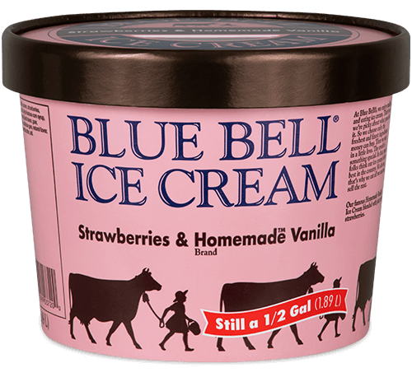
Prepare clients with instructions Supervisors, Managers, Team leaders Can interact with the lead agent at the site Give instructions to employees When (IF) an “event” happens Seizure of Records, documents, proprietary information Privileged communications. Computers, laptops, cell phones, storage banks
Self report INTERNAL INVESTIGATION Contacting the Prosecution – WHEN and HOW; WHAT DO YOU GET? “Flipping” the employee (This will happen.) or Employee(s) will be targeted.
INDEMNIFICATION of employees targeted or charged (practice suggestion) EVERYONE (lawyers) on the SAME PAGE
“Bell Ringing” Events
(continued)

Slide 15

Jury Subpoena
Contact prosecutor as soon as you get notice
There will be a compliance date on the GJ subpoena
Try to have some idea of the length of time it will take to comply. Be realistic in estimation.
BE AWARE THAT THERE MAY BE PRIVILEGED DOCUMENTS REQUESTED.
Advise if there are proprietary documents called for.

Slide 16
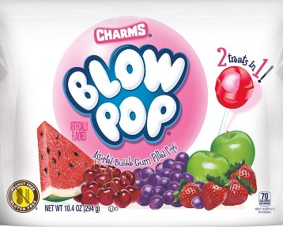

CAUTION!!
Whistle BLOW
ERS
Will always
OVER on you!

Slide 17
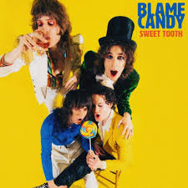
WHO’S REALLY TO BLAME?
INDIVIDUAL and CORPORATE
CRIMINAL LIABILITY

Slide 18
DOJ JUSTICE MANUAL
5-11.114 - Individual and Corporate Defendants
Congress has demonstrated its intent that individuals, as well as corporations, should be criminally prosecuted for violations of federal environmental laws,.
In any case against both a corporation and any of its individual employees the willingness of the offending corporation to enter a guilty plea is not a basis for declining to prosecute an individual.
See also JM 9-16.050. Charges against an individual defendant should not be dismissed on the basis of a plea of guilty by a corporate defendant unless there are special circumstances justifying the dismissal.

Slide 19
TEXAS PENAL CODE
§1.07
(38) "Person" means an individual or a corporation, association, limited liability company, or other entity or organization governed by the Business Organizations Code.
§ 7.21. DEFINITIONS.
"Agent" means a director, officer, employee, or other person authorized to act in behalf of a corporation, an association, a limited liability company, or another business entity.
"High managerial agent" means: (A) a partner in a partnership; (B) an officer of a corporation, an association, a limited liability company, or another business entity; (C) an agent of a corporation, an association, a limited liability company, or another business entity who has duties of such responsibility that the agent ’s conduct reasonably may be assumed to represent the policy of the corporation, association, limited liability company, or other business entity.

Slide 20
§ 7.22. CRIMINAL RESPONSIBILITY OF CORPORATION, ASSOCIATION, LIMITED LIABILITY COMPANY, OR OTHER BUSINESS ENTITY.
(a) If conduct constituting an offense is performed by an agent acting in behalf of a corporation, an association, a limited liability company, or another business entity and within the scope of the agent ’s office or employment, the corporation, association, limited liability company, or other business entity is criminally responsible for an offense defined:
(b) A corporation, an association, a limited liability company, or another business entity is criminally responsible for a felony offense only if its commission was authorized, requested, commanded, performed, or recklessly tolerated by:
(1) A majority of the governing body acting in behalf of the corporation, association, limited liability company, or other business entity; or
(2)A high managerial agent acting in behalf of the corporation, association, limited liability company, or other business entity and within the scope of the agent ’s office or employment.

Slide 21
Mens Rea
Culpable Mental States

Slide 22
TEXAS
CULPABLE MENTAL STATE is required for a violation
(Texas Penal Code § 6.02)
Intent
Knowledge
Reckless
Criminal Negligence
Absent an identified statutory CMS, one is still required—
Unless the statute “plainly dispenses with any mental element.”
It can be any except “criminal negligence”
Generally there is no statutory defense of “accident”

Slide 23
Federal
18 USC 1028
KNOWINGLY/KNOWING (awareness of one’s conduct / awareness of the relevant circumstance)
INTENT (to act purposefully, conscious desire)
WILLFULLY (act was done deliberately)
NEGLIGENT conduct falls below the standard of care expected of a reasonable person
Some statutes, such as the Clean Water Act (CWA) and the Clean Air Act (CAA), impose criminal liability for negligent conduct.
Ex: negligently releasing hazardous air pollutants that endanger others, under the CAA.
Ex: CWA imposes criminal liability for negligent violations of discharge permit conditions and limitations.

Slide 24
Some offenses, particularly those involving regulatory violations, may be considered strict liability offenses, where the mental state of the actor is irrelevant.
These found more on the federal side; but Texas also seeks to impose strict liability on some conduct
See § 7.147 UNAUTHORIZED DISCHARGE (TX Water Code)
. . . Discharges or “allows the discharge” of waste or pollutant into any water of the State that causes or threatens to cause water pollution . . .
24

Slide 25
Violation of State Implementation Plan (SIP)
Knowingly
Violates a requirements of an applicable SIP during a period of federally assumed enforcement, or more than 30 days after having been notified by the Administrator under Section 113(a), 42 U.S.C. 74139(a)(1) that the defendant was in violation of such SIP requirement
Statute: 42 U.S.C. 7413(c)(1)
Penalty: 5 years and/or fines pursuant to 18 U.S.C. 3571.
Penalties doubled if second or subsequent conviction.
Relevant Regulations: 40 C.F.R. 52

Slide 26
DOJ JM 5-12.523 - Coordination with State Programs
Most states have environmental enforcement programs which overlap, in whole or in part, with federal programs. United States Attorneys should familiarize themselves with state environmental enforcement laws and state enforcement officials.
Activity constitutes a violation of both federal and state law.
United States Attorneys should remain advised of pending state environmental enforcement actions.
“Petite policy” If it appears that all federal interests in the case will be vindicated in the state court proceeding, action in federal court may be an unnecessary duplication of effort.
On the other hand, if federal interests will not be protected completely in state court, federal proceedings may be warranted. Where legal action in federal court appears warranted, the United States Attorney should continue to consult and, as appropriate, coordinate with relevant state authorities. Many federal environmental statutes employ cooperative federalism, under which states and tribes share responsibilities with the United States as co-regulators. Some of the statutes identified in JM 5-12.100, e.g., 33 U.S.C. § 1319(b) and 42 U.S.C. § 7413(b), specifically require that notice of any federal civil action be given immediately to appropriate state officials. At least one statute, 33 U.S.C. § 1319(e), requires that a state be made a party to any enforcement action against one of its municipalities.

Slide 27

Subject Matter Federal Statute(s)
Aiding and Abetting 18 U.S.C. § 2
Misprision of Felony 18 U.S.C. § 4
False Claims 18 U.S.C. § 287
Conspiracy 18 U.S.C. § 371
Entry of Goods by Means of False Statements and Smuggling 18 U.S.C. §§ 542, 545, 554
Theft or Conversion of Public Property or Money 18 U.S.C. § 641
Federal Program Theft 18 U.S.C. § 666
False Statement 18 U.S.C. § 1001
Mail Fraud and Wire Fraud (other) fraud offenses 18 U.S.C. § 1341
Money Laundering 18 U.S.C. §§ 1956, 1957
Obstruction of Justice 18 U.S.C. § 1501
Perjury 18 U.S.C. § 1621

Slide 28
DOJ JM 5-11.101 - Categories of Litigation/Prosecution
Divided into four groups:
Pollution Crimes
Wildlife Crimes
Animal Welfare Crimes
Worker Safety Crimes

Slide 29
5-11.107 - Other Environmental Crimes Section Functions: Policy-Making; Support; Training to USAO;
Exchanging Case Information; Information and Guidance Clearinghouse
In addition to its litigation activities, ECS has the following responsibilities:
Setting policy nationally for the prosecution of environmental crimes, including pollution crimes, wildlife crimes, animal welfare crimes, and worker safety crimes;
Providing training to United States Attorneys' Offices, federal investigative agencies, state and local authorities, law enforcement and regulatory personnel of foreign governments, and others;
Analyzing and commenting upon legislation that may affect environmental crimes prosecution;
Liaising with foreign officials and with organizations concerned with international environmental violations; and
Providing expertise, information, and support for environmental prosecutions nationally, including acting as a clearinghouse for prosecution-related information and materials.

Slide 30
DOJ JM 5-11.112 - Parallel Proceedings (Federal)
Because many of the environmental statutes specifically provide for criminal, civil, and administrative sanctions (see, e.g., 33 U.S.C. § 1319(a), (b), (c), and (d)), this is an area of the law in which parallel proceedings occur with frequency. Such proceedings may be appropriate, for example, when in the course of a civil case the government receives evidence of deliberate violations of the law meriting criminal prosecution or when a criminal investigation uncovers evidence of an on-going violation causing environmental contamination that should be stopped quickly through an injunctive action.
Although they may be appropriate in particular circumstances, parallel proceedings must be handled carefully in order to avoid allegations of improper release of grand jury material or abuse of civil process.
Therefore, in any case under any of the statutes identified in JM 5-11.101 in which parallel proceedings arise, the United States Attorney's Office may find it useful to contact the Environmental Crimes Section for assistance in coordinating the parallel proceedings. See also JM Chapter 1-12.000; ENRD Directive No. 2016-12.

Slide 31
US DOJ, Justice Manual
5-11.113 - Coordination with State Programs
Most states have environmental enforcement programs that overlap, in whole or in part, with federal programs. United States Attorneys should familiarize themselves with state environmental enforcement laws and state enforcement officials. Particular attention should be directed toward the following aspects of state-federal relations in the environmental enforcement field:

Slide 32
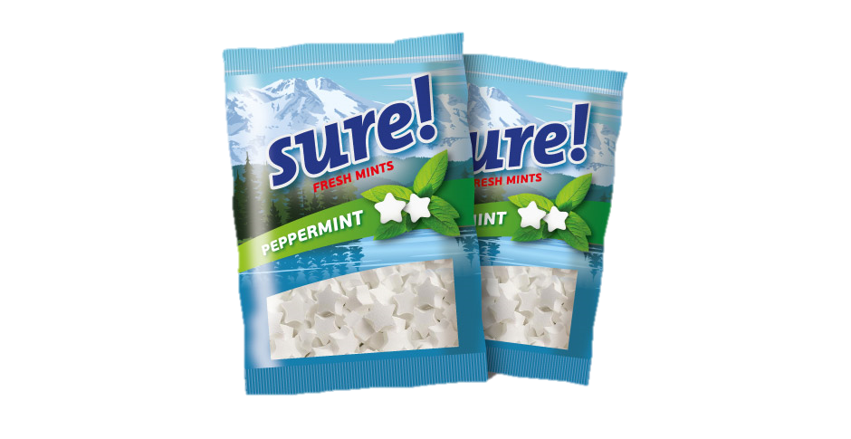
Incentives for Corporate Self-Reporting
Acknowledging that “not all corporate misconduct warrants prosecution”, the DOJ is encouraging companies to self-report violations.
In emphasizing its dedication to equality and fairness, the Department has revised the Corporate Enforcement and Voluntary Self-Disclosure Policy (CEP) to now offer clearer benefits — such as potential declinations and fine reductions .

Slide 33
STATE OF TEXAS
STATUTES & CODES
CRIMINAL PROVISIONS
Solid Waste – Chapters 361 and 365 of the Health and Safety Code
Water Pollution – Chapter 7 of the Texas Water Code
Air Pollution – Texas Clean Air Act § 7.177 - § 7.183 of the Texas Water Code (Includes Endangerment Crimes)
Used oil violations - Chapter 7 of the Water Code, § 7.176, 30 TAC, 40 CFR 279.22
Hazardous Waste Pollution - § 7.163 of the Texas Water Code. See 40CFR for definition of hazardous waste
Illegal Dumping – Health and Safety Code, § 365.012
Traditional Penal Code Offenses –Tampering with a Government Record. § 37.10
Texas Park and Wildlife Cases – Sewage discharges from boats; industrial waste discharges (fish houses/seafood processors); prohibited species cases (non-native fish/plant life); Parks and Wildlife Code
Medical Waste – Health and Safety Code; Water Code
False Statements, Water Code § 7.149; punishment scale § 7.187
Motor Tax Fuel Violations – Tax Code Chapter 162
SEPARATE offenses (Sec. 7.186); REPEAT offenses (Sec. 7.188)

Slide 34
- Applicable to criminal prosecution of environmental violations of Water Code, the Health and Safety Code, (or of any other statute, rule, order, permit, or other decision of the commission that is within the commission's jurisdiction)
Permit related to conduct
- Requires a written request for review to TCEQ before referring a case for criminal prosecution.
- Does NOT apply to violations which constitute an imminent danger of death or bodily injury.
- TCEQ must decide if civil or administrative remedies are adequate.
TEXAS Water Code; Sec. 7.203.
TCEQ CRIMINAL ENFORCEMENT REVIEW.

Slide 35
C. Oily water book (log of transfers required by USCG)
USCG—inspections inside the ship.
Whistleblowers’ rewards ($437,000 each to 12 crew)
“True Crime”
A. Multi-National Corp. Purchases pipeline. Applies to decommission. During the draining process pipeline suffers a 19” crack. Oil everywhere. Experts cannot determine cause of crack. Prosecution on strict liability.
B. Employees CREATE AND VIDEO conduct which they claim replicates a Water Code Violation. Then they blow the whistle. As part of discovery, lawyer receives a voicemail message where one is asking about the “reward.”

Slide 36
When will we see more criminal cases?
Whistleblowers unionize and realize the rewards they can earn . . .
When internal investigations uncover the problem and self report . . .
When county commissioners realize that significant fines are available . . .
When law enforcement tasks forces are created to justify salaries, overtime . . .
When more prosecutor offices, train and dedicate staff . . .

Slide 37

TAKE AWAYS
Questions for the lawyer on Search Warrants
SEARCH WARRANT; affidavit review of PROBABLE CAUSE
ARRESTS MADE?
DOCUMENTS SEIZED? Privileged? Protective order required?
COMPUTERS SEIZED? Payroll, shipping, invoices, inventory, etc.
WHISTLEBLOWERS?
“Snitches”
WORK STOPPAGE?
STAFF under investigation?
Is government going to IMMUNIZE?
CUSTOMERS ON SITE?
INDUSTRY GOSSIP? COMPETITORS GLEEFUL?
PUBLICITY/PR?

Slide 38
TAKE AWAYS
Questions for the lawyer Grand Jury; Internal Investigations
Multiple Targets/Corporate criminal liability
GRAND JURY SUBPOENA
Compliance date
Privileged or protected documents
5TH AMENDMENT (ACT of production)
Identifying target(s) / CONFLICTS
Indemnification
Immunization
INTERNAL INVESTIGATIONS
TIMING and clear segregation of representation
Reports generated (PRIVILEGE?)
Disclosure to government / Proprietary Information PROTECTIVE ORDERS?
Treatment of whistleblowers

Slide 39

Append-TWIX
39

Slide 40
LONE STAR CRIME
The Criminal Enforcement of Environmental Law in the State of Texas
(OZYMY and OZYMY, UT Chatanooga, TN)
St. Mary's Law Journal, Vol. 54 [2023], No. 4, Art. 6

Slide 41
Press Release
Tuesday, May 21, 2024
For Immediate Release
Office of Public Affairs
Texas Petrochemical Company Pleads Guilty to Clean Air Act Violation and Fined More than $30 Million in Criminal Fines and Civil Penalties Related to Explosions at Its Facility in Port Neches
The Justice Department and Environmental Protection Agency (EPA) today announced the filing of a felony criminal charge and related civil complaint and consent decree under the Clean Air Act (CAA)

Slide 42
July-August 2019 The Texas Prosecutor
Prosecuting environmental crimes
Russell Murdock
Office of Regional Counsel, Environmental Protection Agency in Dallas
Criminals come in all shapes and sizes, as do their crimes. One type of crime that does not always receive the attention it deserves is environmental crime. What does an environmental crime look like? Some, like those deriving from the tragedies at Deepwater Horizon or the BP Texas City Refinery explosion, lead to death or immediate serious injury. Others, like those from a recent prosecution in federal court in Marshall, have to do with the criminal exposure of unprotected workers to dangerous asbestos. Still others involve the pollution of our state’s waterways, land, and air. Each represents a danger to the environment of our state and its residents.
The detection, investigation, and prosecution of environmental crimes is a collaborative effort throughout texas. Federal and state agencies work together, as well as with their local counterparts, to enforce environmental laws. Since 2014, 114 defendants have been found guilty or pleaded guilty in environmental criminal cases in Texas. Twenty-two of those were sentenced in federal district court while 92 were sentenced in local district courts. Eighty-three of the defendants were individuals, and 31 were corporations.

Slide 43
Despite these resources and coordination, many environmental crimes are not prosecuted, in part because more prosecutors are needed to accept and prosecute environmental cases. Many line prosecutors may not know that environmental crimes fall under both federal and local jurisdiction; additionally, some may be hesitant to step into a new and complicated area of the law seemingly by themselves. But no Texas prosecutor need ever feel they are alone when prosecuting an environmental crime. Criminal agents, investigators, and attorneys from both the Environmental Protection Agency (EPA) and Texas Commission on Environmental Quality (TCEQ) are available and eager to assist prosecutors each step of the way. One such example of federal and local prosecutions coinciding took place in Harris County. The Harris County District Attorney’s Office successfully prosecuted a truck driver who was dumping hazardous wastes in and around Houston. This prosecution and investigation then directly led to a fraud investigation of EPA’s renewable fuels program, which spanned multiple states and resulted in federal convictions of several individuals.
The EPA has a Criminal Investigation Division comprised of special agents who are fully authorized peace officers empowered to enforce the nation’s environmental laws, as well as any other federal law, in accordance with guidelines established by the United States Attorney General. EPA’s criminal agents are highly trained men and women dedicated to protecting the country’s air, water, and land resources. In addition to the special agents themselves, EPA’s Criminal Investigation Division can call upon the broader technical, legal, and scientific expertise of the EPA to aid investigating and prosecuting its cases. Attorneys from the EPA, called Regional Criminal Enforcement Counsels, specialize in environmental crimes and are available to answer any questions prosecutors may have. The majority of federal prosecutions based on criminal investigations completed by the EPA are brought by local U.S. Attorney Offices or the Environmental Crimes Section of the Department of Justice in Washington, D.C.”

Slide 44
ENRD Environment and Natural Resources Division
EES Environmental Enforcement Section
ECS Environmental Crimes Section
____________
EPA Environmental Protection Agency
BSEE Bureau of Safety and Environmental Enforcement
BOEM Bureau of Ocean Energy Management
USCG United States Coast Guard
FEDERAL ENFORCEMENT

Slide 45
EPA Criminal Investigation Division
www.epa.gov/enforcement/criminal-enforcement-overview
Dallas office 214.665.6600.
TCEQ Environmental Crimes Unit
www.tceq.texas.gov/compliance/investigation/crime
Southern Environmental Enforcement Network
www.seentrain-ing.org.
Hinton | Bailey, PC
Joe Bailey 2025

Slide 46
FEDERAL ENVIRONMENTAL CRIMES
ENRD
Title 5:
5-11.000; 5-12.000 et seq
Department of Justice Manual

Slide 47
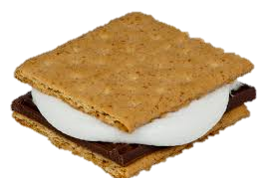
June 2025
This month’s Bulletin includes cases involving emissions tampering, animal fighting, wastewater discharges, refrigerant smuggling, wildlife trafficking, and more.
July 14, 2025
May 2025
This month’s Bulletin includes cases involving exotic bird smuggling, dog fighting, oily wastewater discharges, tampering with a monitoring method, illegal crab harvesting, and more.
June 6, 2025
April 2025
This month’s Bulletin includes cases involving monkey smuggling, tampering with a monitoring device, pesticide sales, false lead paint certificates, dog fighting, biofuel credits fraud, hazardous waste storage, electroplating waste discharges, scallop overharvesting, and more.
May 12, 2025
March 2025
This month’s Bulletin includes cases involving refrigerant smuggling, falsified emissions testing, dog fighting, illegal transportation of hazardous waste, wetlands destruction, tampering with drinking water system, big game hunting, and more.
April 2, 2025
February 2025
This month's Bulletin includes cases involving smuggling, tampering with a monitoring device, dog fighting, worker death, wastewater discharges, dolphin killings, illegal asbestos removal, and more.
March 4, 2025
January 2025
This Bulletin’s cases include violations of the Clean Air Act; Conspiracy; Tampering with a Monitoring Device; Refrigerant Smuggling; wildlife Smuggling; Vessel Pollution; Clam Overharvesting; Big Game Hunting; and more.
February 14, 2025
Environmental Crimes Bulletins ; “and S’mores”
DOJ. Environment and Natural Resources Division update

Slide 48
Federal Insecticide, Fungicide and Rodenticide Act (FIFRA), 7 U.S.C. §§ 136y
Energy Supply and Environmental Coordination Act, 15 U.S.C. §§ 791-798
Toxic Substances Control Act (TSCA), 15 U.S.C. §§ 2601-2697
Surface Mining Control and Reclamation Act, 30 U.S.C. §§ 1201-1211
Rivers and Harbors Appropriations Act, 33 U.S.C. § 403, and Refuse Act, 33 U.S.C. § 407
Federal Water Pollution Control Act (Clean Water Act), 33 U.S.C. §§ 1251-1388
Marine Protection Research and Sanctuaries Act (Ocean Dumping Act), 33 U.S.C. §§ 1401-1445
Deepwater Port Act, 33 U.S.C. §§ 1501-1524
Act to Prevent Pollution From Ships, 33 U.S.C. §§ 1901-1915
Safe Drinking Water Act, 42 U.S.C. §§ 300f-300j-27
Atomic Energy Act, 42 U.S.C. §§ 2011-2296b-7 (violations under 42 U.S.C. §§ 2272 and 2273)
Noise Control Act, 42 U.S.C. §§ 4901-4918
Solid Waste Disposal Act (including, in Subchapter III, the Resource Conservation and Recovery Act (RCRA)), 42 U.S.C. §§ 6901-6992k
Clean Air Act, 42 U.S.C. §§ 7401-7671q
Comprehensive Environmental Response, Compensation and Liability Act (CERCLA), 42 U.S.C. §§ 9601-9675
Emergency Planning and Community Right to Know Act (EPCRA) (SARA Title III), 42 U.S.C. §§ 11001-11050
Outer Continental Shelf Lands Act, 43 U.S.C. §§ 1331-1356b
Federal Hazardous Material Transportation Law, 49 U.S.C. §§ 5101-5128
Federal statutes

Slide 49
Pollution Crimes, Federal
Federal Insecticide, Fungicide and Rodenticide Act (FIFRA), 7 U.S.C. §§ 136y
Energy Supply and Environmental Coordination Act, 15 U.S.C. §§ 791-798
Toxic Substances Control Act (TSCA), 15 U.S.C. §§ 2601-2697
Surface Mining Control and Reclamation Act, 30 U.S.C. §§ 1201-1211
Rivers and Harbors Appropriations Act, 33 U.S.C. § 403, and Refuse Act, 33 U.S.C. § 407
Federal Water Pollution Control Act (Clean Water Act), 33 U.S.C. §§ 1251-1388
Marine Protection Research and Sanctuaries Act (Ocean Dumping Act), 33 U.S.C. §§ 1401-1445
Deepwater Port Act, 33 U.S.C. §§ 1501-1524
Act to Prevent Pollution From Ships, 33 U.S.C. §§ 1901-1915
Safe Drinking Water Act, 42 U.S.C. §§ 300f-300j-27
Atomic Energy Act, 42 U.S.C. §§ 2011-2296b-7 (violations under 42 U.S.C. §§ 2272 and 2273)
Noise Control Act, 42 U.S.C. §§ 4901-4918
Solid Waste Disposal Act (including, in Subchapter III, the Resource Conservation and Recovery Act (RCRA)), 42 U.S.C. §§ 6901-6992k
Clean Air Act, 42 U.S.C. §§ 7401-7671q
Comprehensive Environmental Response, Compensation and Liability Act (CERCLA), 42 U.S.C. §§ 9601-9675
Emergency Planning and Community Right to Know Act (EPCRA) (SARA Title III), 42 U.S.C. §§ 11001-11050
Outer Continental Shelf Lands Act, 43 U.S.C. §§ 1331-1356b
Federal Hazardous Material Transportation Law, 49 U.S.C. §§ 5101-5128

Slide 50
Animal Welfare Crimes
Humane Methods of Livestock Slaughter Act, 7 U.S.C. §§ 1901-1907 (including violations cross-referenced under 21 U.S.C. §§ 601-626)
Animal Welfare Act, 7 U.S.C. §§ 2131-2159
Animal Fighting Prohibition Enforcement Act, 7 U.S.C. § 2156, 18 U.S.C. § 49
Horse Protection Act, 15 U.S.C. §§ 1821-1831
Animal Crush Video Prohibition Act, 18 U.S.C. § 48

Slide 51
Fish and Wildlife Coordination Act, 16 U.S.C. §§ 661-667e
Bald and Golden Eagle Protection Act, 16 U.S.C. §§ 668-668
National Wildlife Refuge System Administration Act, 16 U.S.C. §§ 668dd-668ee
Sikes Act, 16 U.S.C. §§ 670a-670o
Migratory Bird Treaty Act, 16 U.S.C. §§ 703-712
Migratory Bird Conservation Act, 16 U.S.C. §§ 715-715r
Airborne Hunting Act, 16 U.S.C. §§ 742j-1
Northern Pacific Halibut Act of 1982, 16 U.S.C. §§ 773-773k
Whaling Convention Act, 16 U.S.C. §§ 916-916
Fur Seal Act of 1966, 16 U.S.C. §§ 1151-1175
Marine Mammal Protection Act, 16 U.S.C. §§ 1361-1423h
Endangered Species Act of 1973, 16 U.S.C. §§ 1531-1544
Magnuson-Stevens Fishery Conservation and Management Act, 16 U.S.C. §§ 1801-1891d
Antarctic Conservation Act, 16 U.S.C. §§ 2401-2413
Antarctic Marine Living Resources Convention, 16 U.S.C. §§ 2431-2444
Lacey Act Amendments of 1981 (Lacey Act), 16 U.S.C. §§ 3371-3378, 18 U.S.C. § 42
Atlantic Salmon Convention Act, 16 U.S.C. §§ 3601-3608
Pacific Salmon Fishing Act, 16 U.S.C. §§ 3631-3645
African Elephant Conservation Act, 16 U.S.C. §§ 4201-4246
Wild Exotic Bird Conservation Act, 16 U.S.C. §§ 4901-4916
North Pacific Anadromous Stocks Convention Act, 16 U.S.C. §§ 5001-5012
Atlantic Coastal Fisheries Cooperative Management Act, 16 U.S.C. §§ 5101-5108
Rhinoceros and Tiger Conservation Act, 16 U.S.C. §§ 5301-5306
High Seas Fishing Compliance Act, 16 U.S. C. §§ 5501-5509
Northwest Atlantic Fisheries Convention Act, 16 U.S.C. §§ 5601-5612
Hunting, fishing, trapping; disturbance or injury on wildlife refuge, 18 U.S.C. § 41
Wildlife Crimes, Federal

Slide 52
Worker Safety Crimes
Occupational Safety and Health Act (OSHA), 29 U.S.C. §§ 651
Migrant and Seasonal Agricultural Worker Protection Act, 29 U.S.C. §§ 1801-1872
Mine Safety and Health Act (MSHA) of 1977, 30 U.S.C. §§ 801-966
Atomic Energy Act, 42 U.S.C. §§ 2272-2297h–13

Slide 53
5-11.106 - Foreign Vessel Matters; MOTR Protocols
Environmental crimes, including both pollution and wildlife crimes, may involve the interdiction at sea of foreign-flagged vessels. Because such actions may involve international treaties and laws and may adversely affect the foreign relations of the United States, they are covered by the Maritime Operational Threat Response (MOTR) Protocols which subsumes Presidential Directive 27 of January 19, 1978, establishing a mandatory consultation process among interested federal agencies for non-military incidents that could have such an adverse effect
In an environmental context, a potential maritime interdiction generally will be initiated by the Coast Guard, which notifies the Department of State, thereby setting in motion the coordination activities among the MOTR agencies involved. A conference call among the interested MOTR agencies is convened to discuss options and obtain interagency concurrence for an approved course of action. ECS participates in the MOTR coordination activities for situations involving potential pollution or wildlife crimes. When a particular district will be affected by a foreign-flagged vessel interdiction, that United States Attorney's Office is consulted. When MOTR coordination activities are unable to achieve interagency consensus on the course of action, the matter will be resolved by the White House. A proposed MOTR action cannot proceed without either consensus among the agencies or a resolution by the White House.
Presidential Directive 27 (PD-27), also known as "NSC-27," was issued on January 19, 1978, and outlined procedures for dealing with non-military incidents that could impact US foreign relations. Specifically, it focused on developing a uniform and clearly understood process for responding to such incidents.

Slide 54
Mine Safety and Health Act (MSHA) of 1977, 30 U.S.C. §§ 801-966
Atomic Energy Act, 42 U.S.C. §§ 2272-2297h–13
*Due to the unique history of Mine Safety and Health Act (MSHA) enforcement, at the election of the United States Attorney, the responsibility for the investigation and prosecution of MSHA cases will rest with the United States Attorney’s Office. When the United States Attorney makes such an election for a particular case, the United States Attorney’s Office will notify the Environmental Crimes Section of the election to prosecute the case (as required in JM 5-11.103), and of its disposition (as required in JM 5-11.108).
If a United States Attorney’s Office makes such an election to solely handle a MSHA case or matter within its district, it may also solely handle any appeal in the case or matter. In such an appeal, the United States Attorney’s Office will provide reasonable notice to ENRD and a copy of the draft brief for comment prior to filing

Slide 55
DOJ, justice Manual 5-12.523 - Coordination with State Programs
On the other hand, if federal interests will not be protected completely in state court, federal proceedings may be warranted. Where legal action in federal court appears warranted, the United States Attorney should continue to consult and, as appropriate, coordinate with relevant state authorities. Many federal environmental statutes employ cooperative federalism, under which states and tribes share responsibilities with the United States as co-regulators.
Some of the statutes identified in JM 5-12.100, e.g., 33 U.S.C. § 1319(b) and 42 U.S.C. § 7413(b), specifically require that notice of any federal civil action be given immediately to appropriate state officials. At least one statute, 33 U.S.C. § 1319(e), requires that a state be made a party to any enforcement action against one of its municipalities.

Slide 56
TEXAS PENAL CODE
Sec. 6.02. REQUIREMENT OF CULPABILITY. (a) Except as provided in Subsection (b), a person does not commit an offense unless he intentionally, knowingly, recklessly, or with criminal negligence engages in conduct as the definition of the offense requires.
(b) If the definition of an offense does not prescribe a culpable mental state, a culpable mental state is nevertheless required unless the definition plainly dispenses with any mental element.
(c) If the definition of an offense does not prescribe a culpable mental state, but one is nevertheless required under Subsection (b), intent, knowledge, or recklessness suffices to establish criminal responsibility.
(d) Culpable mental states are classified according to relative degrees, from highest to lowest, as follows:
(1) intentional;
(2) knowing;
(3) reckless;
(4) criminal negligence.

Slide 57
TEXAS PENAL CODE
Sec. 6.03. DEFINITIONS OF CULPABLE MENTAL STATES. (a) A person acts intentionally, or with intent, with respect to the nature of his conduct or to a result of his conduct when it is his conscious objective or desire to engage in the conduct or cause the result.
(b) A person acts knowingly, or with knowledge, with respect to the nature of his conduct or to circumstances surrounding his conduct when he is aware of the nature of his conduct or that the circumstances exist. A person acts knowingly, or with knowledge, with respect to a result of his conduct when he is aware that his conduct is reasonably certain to cause the result.
(c) A person acts recklessly, or is reckless, with respect to circumstances surrounding his conduct or the result of his conduct when he is aware of but consciously disregards a substantial and unjustifiable risk that the circumstances exist or the result will occur. The risk must be of such a nature and degree that its disregard constitutes a gross deviation from the standard of care that an ordinary person would exercise under all the circumstances as viewed from the actor's standpoint.
(d) A person acts with criminal negligence, or is criminally negligent, with respect to circumstances surrounding his conduct or the result of his conduct when he ought to be aware of a substantial and unjustifiable risk that the circumstances exist or the result will occur. The risk must be of such a nature and degree that the failure to perceive it constitutes a gross deviation from the standard of care that an ordinary person would exercise under all the circumstances as viewed from the actor's standpoint.

Slide 58
Texas Commission on Environmental Quality’s (TCEQ) Environmental Crimes Unit
provides technical support and criminal investigative expertise in multi-agency investigations. TCEQ’s Environmental Crimes Unit is comprised of several criminal investigators positioned throughout the state. In addition to investigating crimes, this unit also serves as a resource for and provides training to local, state, and federal law enforcement officers on criminal environmental violations.
Recognition of environmental crime as a threat to public safety and to encourage and support enforcement of environmental statutes at the state level. Several members of TCEQ’s Environmental Crimes Unit volunteer with the Southern Environmental Enforcement Network (SEEN) to provide training not only to law enforcement, but also to local prosecutors.

Slide 59
Where are we focused?
Where are we headed?
Noticeably ABSENT: certainly not in the top 10

Slide 60
Matthew R. Galeotti, Head of the Criminal Division at the US Department of Justice, issued a memorandum outlining the Department’s renewed enforcement priorities and updating policies regarding the prosecution of corporate and white-collar crime. MAY 12, 2025
“the most urgent criminal threats to the country,”
Material Support by Corporations to Cartels, Transnational Criminal Organizations (TCOs) and Foreign Terrorist Organizations (FTOs)
Waste, Fraud and Abuse (Health Care Fraud and Federal Program and Procurement Fraud)
Trade and Customs Fraud, Including Tariff and Sanctions Evasion
Fraud Perpetuated Through Variable Interest Entities (VIEs)
Fraud that Victimizes US Investors, Individuals and Markets
Conduct that Threatens US National Security
Complex Money Laundering
Violations of the Controlled Substances Act and the Federal Food, Drug, and Cosmetic Act (FDCA)
Bribery and Associated Money Laundering Impacting U.S. National Interests
Crimes Involving Digital Assets

Slide 61
“Prioritization and Associated Policy Changes To combat these harms, the Criminal Division will prioritize investigating and prosecuting white-collar crimes in the following high-impact areas:
Waste, fraud, and abuse, including health care fraud and federal program and procurement fraud that harm the public fiscally;
Trade and customs fraud, including tariff evasion;
Fraud perpetrated through VIEs, including, but not limited to, offering fraud, “ramp and dumps,” elder fraud, securities fraud, and other market manipulation schemes;
Fraud that victimizes U.S. investors, individuals, and markets including, but not limited to, Ponzi schemes, investment fraud, elder fraud, servicemember fraud, and fraud that threatens the health and safety of consumers;
Conduct that threatens the country’s national security, including threats to the U.S. financial system by gatekeepers, such as financial institutions and their insiders that commit sanctions violations or enable transactions by Cartels, Transnational Criminal Organizations, hostile nation-states, and/or foreign terrorist organizations;
Material support by corporations to foreign terrorist organizations, including recently designated Cartels and TCOs;
Complex money laundering, including Chinese Money Laundering Organizations, and other organizations involved in laundering funds used in the manufacturing of illegal drugs;
Violations of the Controlled Substances Act and the Federal Food, Drug, and Cosmetic Act (FDCA), including the unlawful manufacture and distribution of chemicals and equipment used to create counterfeit pills laced with fentanyl and unlawful distribution of opioids by medical professionals and companies;
Bribery and associated money laundering that impact U.S. national interests, undermine U.S. national security, harm the competitiveness of U.S. businesses, and enrich foreign corrupt officials;
As provided by the Digital Assets DAG Memorandum: crimes (1) involving digital assets that victimize investors and consumers; (2) that use digital assets in furtherance of other criminal conduct; and (3) willful violations that facilitate significant criminal activity. Cases impacting victims, involving cartels, TCOs, 6 See Executive Order 14209, Pausing Foreign Corrupt Practices Act Enforcement to Further American Economic and National Security (Feb. 10, 2025); Cartels and TCOs AG Memorandum. 5 or terrorist groups, or facilitating drug money laundering or sanctions evasion shall receive highest priority.

Slide 62
A. State enforcement agencies may be valuable sources of information on suspected violations of federal environmental statutes. United States Attorneys may be in a position to assist in apprising state officials of the nature of the federal enforcement program within the district or state and in developing methods for exchanging information on suspected violations;
B. State authorities often possess evidentiary materials that are relevant to pending federal investigations and court proceedings. United States Attorneys should be aware of the nature and extent of the states' investigatory resources and should make provision in appropriate circumstances for the exchange of information on pending cases with state authorities;
C. Frequently a particular activity constitutes a violation of both federal and state laws. When state officials are proceeding with an environmental enforcement case that may include violations of federal law, the United States Attorney in the affected district should monitor that state activity. If it appears that all federal interests in the case will be vindicated in the state court action, action in federal court may be an unnecessary duplication of effort. On the other hand, if federal interests will not be protected completely in state court, federal proceedings may be warranted.
D. A number of United States Attorneys' Offices have found that task forces, which include personnel from state and local agencies and from other federal agencies, are very effective means of coordinating efforts with state and local governments and making optimal use of available resources. Task force formats vary among offices, and ECS can advise United States Attorneys' Offices of other offices that are willing to share the lessons of their experiences.

Slide 63
Why do we do what we do?
Love of the environment?
Cutting the cost of business at nature’s expense?
We’re in position to help the world?
Too many bad guys doing bad things? Somebody has to step up?

Slide 64
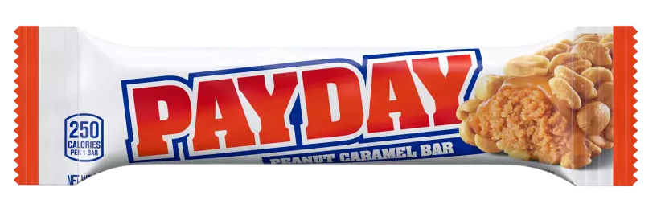
It’s
Hinton | Bailey, PC
Joe Bailey 2025

Slide 65



HUGE THANK YOU !
To my children for their inspiration, innate artistic abilities, shameless jocularity, original artwork and technical skills in helping me with putting this PPt together. The journey was quite fun.
jb

