Slide 1
ETHICS BETWEEN The Devil and the Deep Blue Sea
Ethics Issues Old and New
Michael S. Truesdale F. Witcher McCullough Patricia Peterson

Slide 2
(insert slide with Witcher/Mike picture)

Slide 3
Or the other way around?

Slide 4
Current references (July 2023)
-- “CAN’T BE TRUSTED. . .”
-- “LOW INTEGRITY . . .”
-- “YOU MUST BE ILLITERATE . . .”
-- “UNPROFESSIONAL. . .”
-- “JUST PLAIN EVIL . . .”

Slide 5
Freebie Ethics POINTERS
“Communications-with-opposing-counsel” tips for the day:
“When the debate is lost, slander becomes the tool of the loser.”
--Socrates
“Don’t trust everything you read on the internet”
--Abraham Lincoln

Slide 6
I. The Disciplinary Process
Summary of the Texas Disciplinary Rules of Conduct

Slide 7
A. Preliminary steps in process: Classification
A writing is filed with CDC
Filing is classified as “complaint” or “inquiry”
“Complaint” is a filing that, on its face, screening, or a preliminary investigation, alleges “Professional Misconduct” (i.e., conduct that violates at least one of the Texas Rules of Disciplinary Procedure (TRDP 1.06(G))
“Inquiry” is a filing that does not appear to set forth conduct that violates a rule (TRDP 1.06(T))
“Discretionary Referrals” involve grievances alleging minor misconduct that may be referred to the Client Attorney Assistance Program (TRDP 1.06(M)).
If classified as “inquiry,” matter is dismissed subject to appeal
If classified as “complaint,” then the matter proceeds
Vast majority of filings are dismissed at this stage

Slide 8
A. Classification (cont.)
Once classified as a “complaint, CDC gives respondent a copy of complaint and requests a response within 30 days.
CDC then conducts a “just cause” investigation (TRDP 2.12)
“Just Cause”: induces a reasonably intelligent and prudent person to believe respondent engaged in Professional Misconduct requiring sanctions or suffers a disability requiring suspension/probation (TRDP 1.06(Z))
If CDC does not find “just cause,” case is referred to summary disposition panel
SDP will decide whether case should proceed or be dismissed
No appeal from SDP ruling
To find just cause, CDC may set investigative hearing before local panel
Result will be dismissal, agreed sanction, or litigation

Slide 9
B. Practical Pointers upon “complaint” designation
Consider getting counsel (often covered by legal malpractice insurance)
RESPOND TO CORRESPONDENCE FROM CDC!!!
Failure to do so constitutes an independent grievable offense (TRDP 8.04(8))
In other jurisdictions, failure to respond = automatic suspension
Work/communicate with CDC staff
CDC staff seeks to work with counsel to resolve complaints short of full-blown litigated proceedings

Slide 10
C. Resolution of “Complaints”
Upon “complaint” designation, respondent is given written notice of complained-of conduct and rules allegedly violated
Respondent then has 20 days to elect between proceeding to jury trial in district court or by administrative hearing before a local grievance committee
If respondent fails to make election, matter will default to a panel
Elections have consequences
Election to proceed in district court means no option for “private reprimand”
Appellate rights from election
District Court—Appeal proceeds as any civil case to court of appeals/Supreme Court
Panel—Appeal proceeds to Board of Disciplinary appeals then Supreme Court

Slide 11
D. End results of complaint prosecutions
Guidelines governing appropriate resolution of complaints
Dismissal
Referral to GRP
Settlement for agreed sanction
Ordered sanctions
Private reprimand
Public reprimand
Suspension (probated in full, partially probated, or active)
Disbarment

Slide 12
E. Common complaints that make it to CFLD
Failure to respond to grievance (TRCP 8.01(b); 8.04(a)(8)
Misuse of funds (TRCP 1.14(a)
Failure to communicate/inadequate communication (TRCP 1.03(a-b)
Complaints about scope of engagement – who is client?

Slide 13
The Grievance Process Wrap-up
You can take steps to proactively avoid grievances outright
You can take steps to minimize the consequences of grievances

Slide 14
II. Ethical & Practice tips
Documentation
Calendaring
Advice
Screening Clients
Conflicts
Fees

Slide 15
Importance of documentation
Intake
Engagement
Conflicts
Client-Required Actions/Expections
Advice
Oral communications
Settlement offers/negotiations
Withdrawal, Termination or Conclusion of Representation

Slide 16
Calendaring
Immediate Entry
Dual Entry
Backup
Scheduling Reminders in Advance
Time Management
Rushed Work
Inadequacy

Slide 17
Advice Given
Document
Who’s the Client?
Avoid giving advice to non-clients
Piggy-backers
Qualify Advice
Uncertainty in Law
New Rulings
Jurisdictional Splits

Slide 18
Advice given cont.
Juries and judges
Probabilities and Predictions
New Evidence
Over- Promising
Differing Recollections

Slide 19
Screen Clients
Hard to reject $$$
Scope of Practice (bandwith, competence)
Mentors/Co-counsel
Client’s Resources (financial & evidentiary)
Client’s Expectations (“slam dunk” v. principle)
Illegal Business
Red Flags
Terminate

Slide 20
Conflicts
Potential conflicts prior to representation
May arise later
Consents and Waivers
Types of conflicts
Multi-party
Entity/constituent
Family
Prior work
Business Interests

Slide 21
Fee Issues
New contract for each new matter
Descriptive billings
Bill achievable amounts
Avoid making expenses as profit centers
Altering fee agreements mid-representation
Consider partial refunds
Compulsory counterclaim
Disgorgement of fees excluded

Slide 22
III. Emerging issues
Remote work
Concerns about protecting client confidentiality in a digital world
Concerns with increased use of video conferencing
Concerns with security and use of shared networks
Location of physical files in two or more sites
Rules governing attorney practice out-of-state (unauthorized practice of law?)

Slide 23
III. Emerging issues (cont.)
Technology issues
Ethical use of AI
Protection against hacks and phishing
Document storage obligations in paperless world
Icloud storage and confidentiality
Metadata
Computer security

Slide 24
III. Emerging issues (cont.)
Social media and public communications
Reconciling social media postings with disciplinary rules on advertising
Responding to reviews

Slide 25
IV. Resources to help maintain an ethical practice
State Bar of Texas Ethics Hotline
Contact info 800-532-3974
5,000+ calls handled annually, most returned within 24 hours
Texas Lawyers Assistance Program
1/3 of attys under 30 face alcohol/substance issues
1/4 of attys have depression
1/5 have anxiety
1/10 have considered suicide
TLAP offers confidential help to attorneys, judges, and law students
www.TLAPhelps.org

Slide 26
V. Wrapping it up
William S. Preston, Esq. and Theodore Logan, 1989

Slide 27
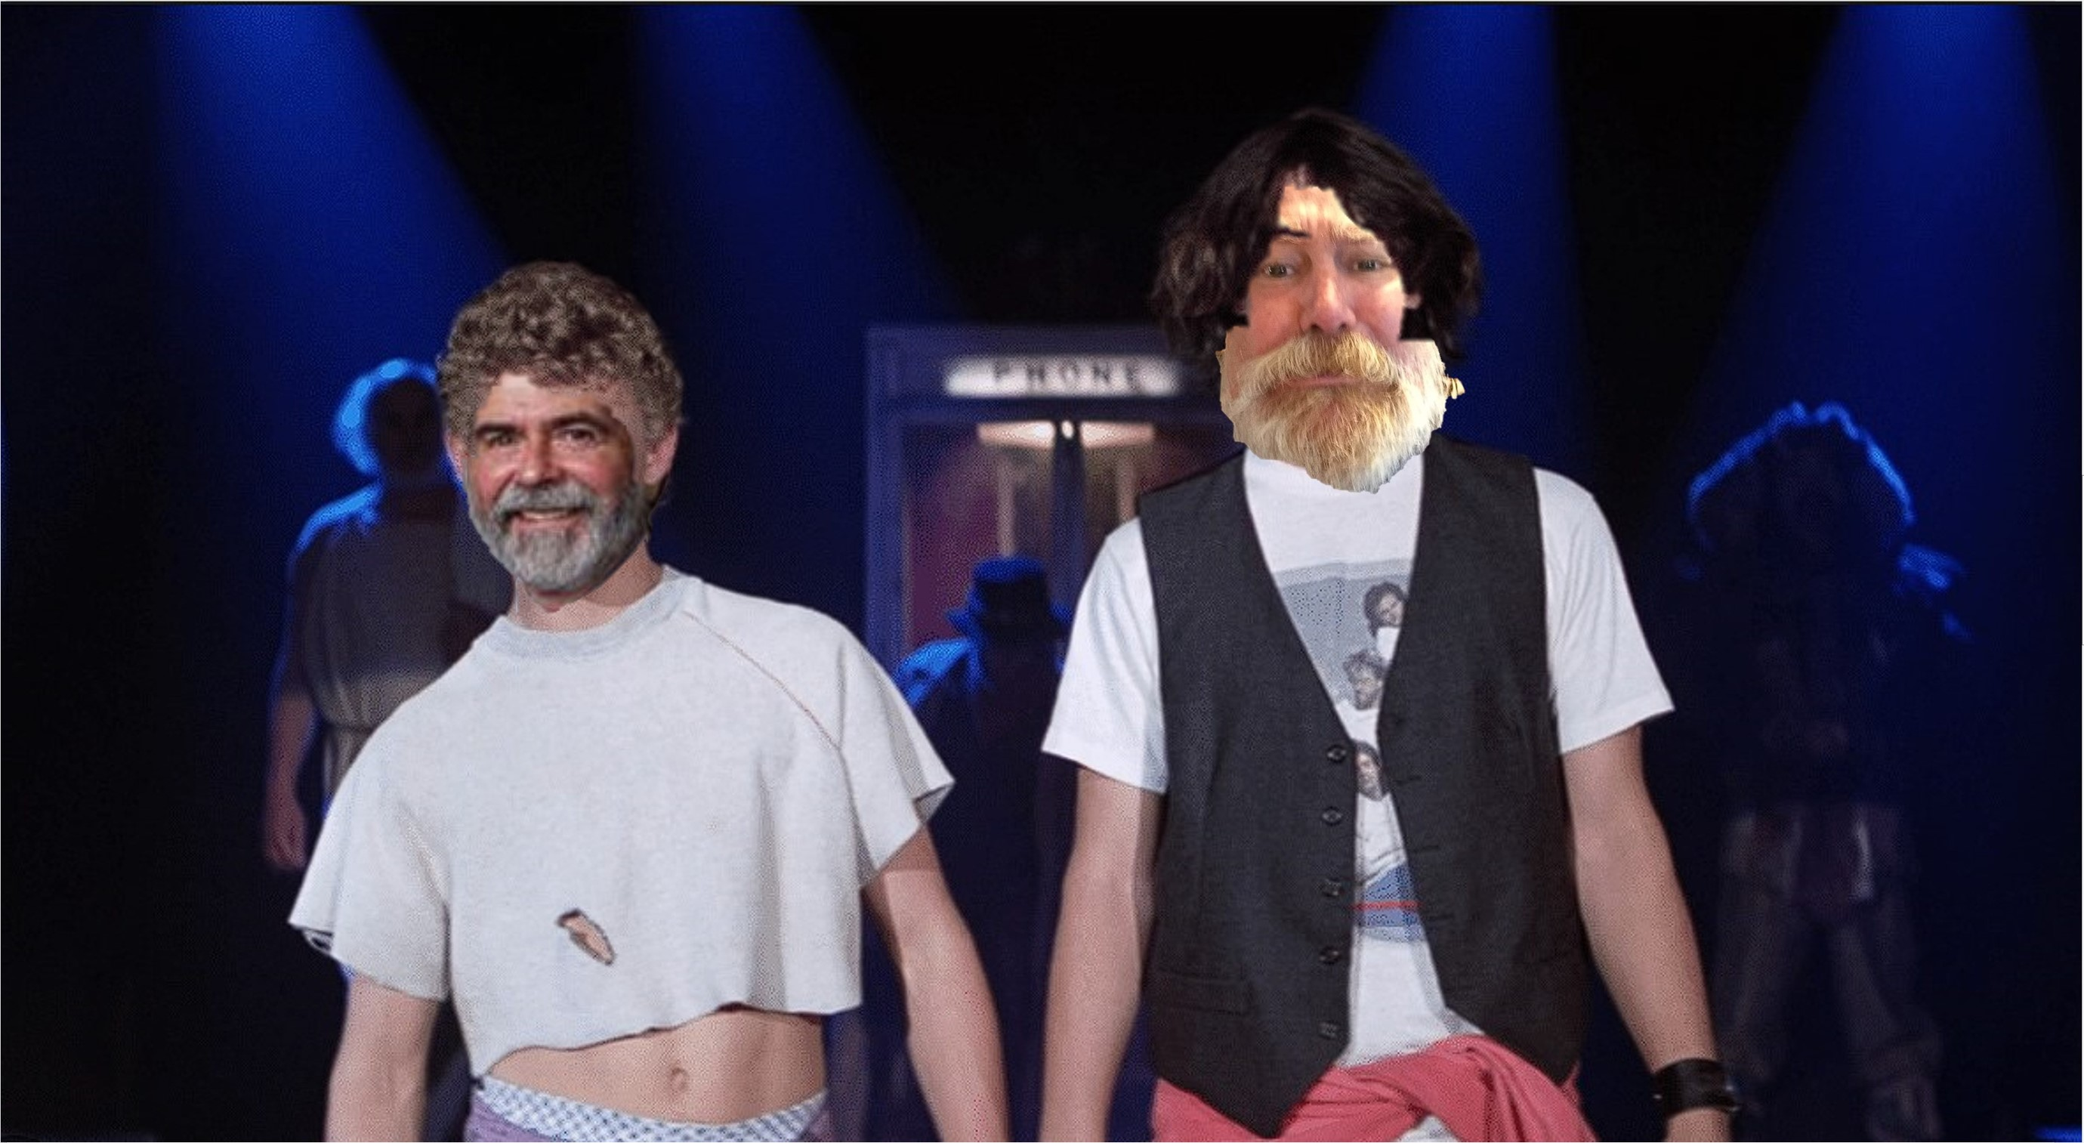
“Be excellent to each other”

