Slide 1
TCEQ Toxicology Updates
Sabine Lange, PhD, DABT
Chief Toxicologist
Toxicology, Risk Assessment, and Research Division
Texas Commission on Environmental Quality
August 3, 2023

Slide 2
Outline
PFAS remediation cleanup values and EPA drinking water values
PM and crystalline silica monitoring around aggregate production operations (APOs)
Short update on ethylene oxide cancer dose-response assessment

Slide 3
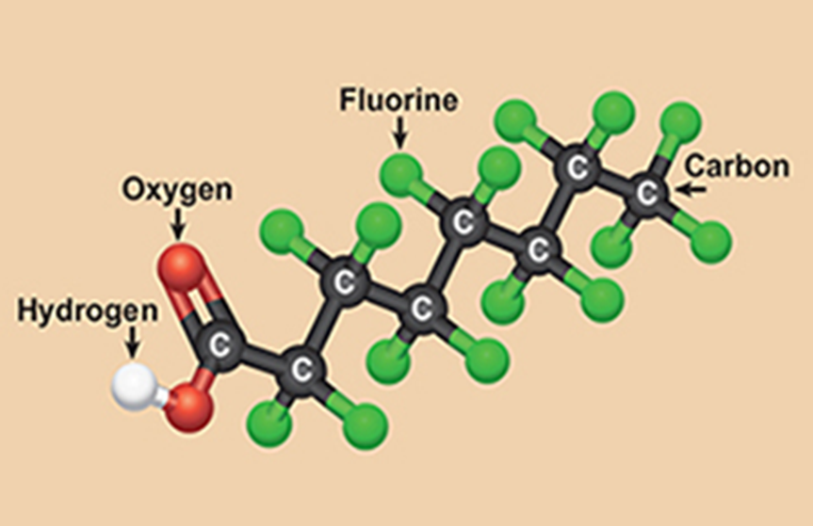
Per- and Polyfluoroalkyl Substances (PFAS)

Slide 4
PFAS Introduction
Per- and poly-fluoroalkyl substances (PFAS) are synthetic chemicals and do not occur naturally in the environment
Over 12,000 PFAS on EPA’s CompTox PFAS list
“Forever chemicals” – chemically stable, persistent
Used in industry, food contact materials, consumer products, medical products, and aqueous film-forming foam (AFFF)
Move through soils and can contaminate drinking water sources
The CDC found that 98% of Americans have PFAS in their blood in a study conducted from 1999 to 2018
Exposure to PFAS can cause adverse health effects
Perfluorooctanoic acid (PFOA)
R

Slide 5
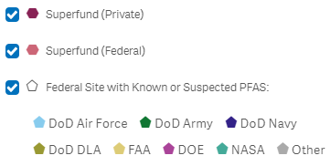
(Some) PFAS Sites in Texas
Source: EPA PFAS Analytic Tools, https://echo.epa.gov/trends/pfas-tools

Slide 6
Environmental Regulations for PFAS
A lot of different regulations are being proposed, finalized, or implemented addressing different aspects of PFAS use, contamination, safety, etc.
Focus today is on toxicity factors:
A numerical value that describes the potency of a chemical to cause adverse effects, used to establish safe levels of contaminants in air, soil, and water.
Used to derive values for screening and cleanup of remediation sites, for advisory levels and standards for drinking water, etc.
Focus on PFAS toxicity factors for two programs:
Remediation – values set by TCEQ, EPA, other agencies
Drinking water – values set by EPA for drinking water standards

Slide 7
Remediation Screening and Cleanup Levels
Multiple agencies set values for use in screening or cleanup of contaminated sites
Values are derived for air, water, and soil exposure pathways
TCEQ: protective concentration levels (PCLs) – site cleanup levels
https://www.tceq.texas.gov/remediation/trrp/trrppcls.html
EPA: regional screening levels (RSLs) – screening levels for site evaluation
https://www.epa.gov/risk/regional-screening-levels-rsls-generic-tables
Agency for Toxic Substances and Disease Registry (ATSDR): minimal risk levels (MRLs) – guidance values (non-cancer health effects only)
https://wwwn.cdc.gov/TSP/MRLS/mrlsListing.aspx

Slide 8
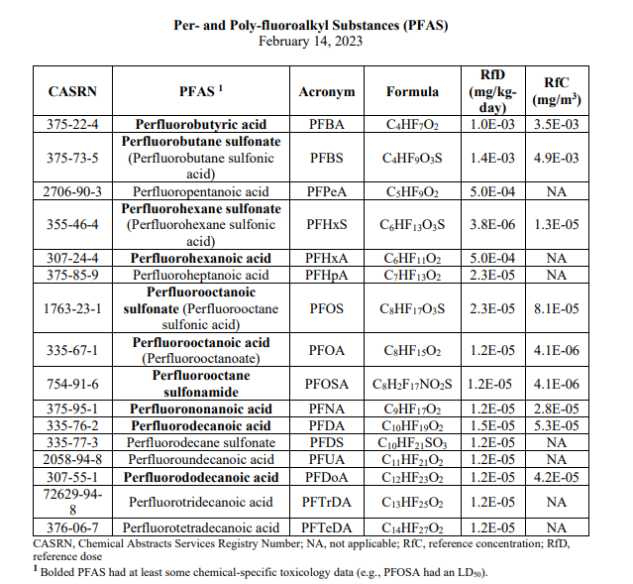
TCEQ Toxicity Factors for PFAS
First derived in 2011 based on need for values for state remediation sites
PFBA, PFHxA, PFPeA updated in 2023 based on recent EPA IRIS assessments
Remaining 13 PFAS currently undergoing updates based on new data
Updated 2023
https://www.tceq.texas.gov/downloads/toxicology/pfc/pfcs.pdf
Notes:
This table shows the toxicity factors derived by the TCEQ for 16 PFAS. This table shows both oral reference doses (RfDs) and inhalation reference concentrations (RfCs). It also includes the Chemistry Abstract Service Registry Number (CASRN), acronyms, and chemical formulas.

Slide 9
PFAS with Agency Remediation Levels & Basis of Value
Per- and Polyfluoroalkyl Substance (PFAS) | EPA RSL | TCEQ PCL | ATSDR
Perfluorooctanoic acid (PFOA) | ATSDR (2021) | TCEQ (2011) | Int. MRL (2021)
Perfluorooctanesulfonic acid (PFOS) | ATSDR (2021) | TCEQ (2011) | Int. MRL (2021)
Perfluorobutanesulfonic acid (PFBS) | PPRTV (2021)/OW (2022) | TCEQ (2011) | Evaluated, No MRL (2021)
Perfluorobutanoic acid (PFBA) | IRIS (2022) | IRIS (2022) | Evaluated, No MRL (2021)
Perfluorohexanesulfonic acid (PFHxS) | ATSDR (2021) | TCEQ (2011) | Int. MRL (2021)
Perfluorohexanoic acid (PFHxA) | IRIS (2023) | IRIS (2023) | Evaluated, No MRL (2021)
Perfluorononanoic acid (PFNA) | ATSDR (2021) | TCEQ (2011) | Int. MRL (2021)
Hexafluoropropylene oxide dimer acid (HFPO-DA) - GenX | EPA OW (2022) | -- | --
Perfluoroundecanoic acid (PFUnDa/PFUnA) | -- | TCEQ (2011) | Evaluated, No MRL (2021)
Perfluoropentanoic acid (PFPeA) | -- | IRIS (2023) | --
Perfluorododecanoic acid (PFDoA/PFDoDA) | -- | TCEQ (2011) | Evaluated, No MRL (2021)
Perfluorodecanoic acid (PFDA) | -- | TCEQ (2011) | Evaluated, No MRL (2021)
Perfluorodecane sulfonic acid (PFDS) | -- | TCEQ (2011) | --
Perfluoroheptanoic acid (PFHpA) | -- | TCEQ (2011) | Evaluated, No MRL (2021)
Perfluorotetradecanoic acid (PFTeDA) | -- | TCEQ (2011) | --
Perfluorotridecanoic acid (PFTrDA) | -- | TCEQ (2011) | --
Perfluorooctane sulfonamide (PFOSA/FOSA) | -- | TCEQ (2011) | Evaluated, No MRL (2021)
Int MRL – Intermediate-duration minimal risk level; IRIS – EPA Integrated Risk Information System; OW – EPA Office of Water; PPRTV – EPA Provisional Peer-Reviewed Toxicity Values
Notes:
Shown are 17 PFAS chemicals with remediation values derived for them by EPA, TCEQ, and/or ATSDR. 7 PFAS are in common between EPA and TCEQ.
Shown also are the source of the values.
TCEQ has values for 16 PFAS, all but three are from the TCEQ 2011 derivation. TCEQ updated PFBA and PFHxA based on recent finalized IRIS evaluations, and surrogated PFPeA to PFHxA because there is no usable toxicity information for that chemical.
EPA has values for 8 unique PFAS. Two of EPA’s values are based on final IRIS assessments (PFBA & PFHxA), 4 on ATSDR intermediate MRLs derived in 2021 (including the two big ones: PFOS & PFOA), one is based on a PPRTV, and two are from the office of water (2022). The PFBS RSL is based on the PPRTV, but is the same value as the EPA Office of Water provided for the final HAL in 2022
In 2021 ATSDR completed their review of 12 PFAS chemicals, but decided that the data was insufficient to derive values for all but four of the PFAS (PFOS/A, PFHxS, and PFNA), and for those they derived values only for intermediate exposure duration (14 days-1 year); remediation values are typically derived assuming a chronic exposure duration of years.

Slide 10
EPA Screening Levels and TCEQ Cleanup Levels
PFAS | EPA Resident Soil RSL (mg/kg)* | TCEQ Total-Soil-Combined PCL (mg/kg) | EPA Tap Water RSL (µg/L)* | TCEQ GW-GW-Ingestion PCL (µg/L)
Perfluorobutanesulfonic acid (PFBS) | 19.0 | 86.0 | 6.0 | 34.0
Perfluorobutanoic acid (PFBA) | 78.0 | 61.0 | 18.0 | 24.0
Perfluorohexanesulfonic acid (PFHxS) | 1.3 | 0.25 | 0.39 | 0.093
Perfluorohexanoic acid (PFHxA) | 32.0 | 33.0 | 9.9 | 12.0
Perfluorononanoic acid (PFNA) | 0.19 | 0.76 | 0.06 | 0.29
Perfluorooctanesulfonic acid (PFOS) | 0.13 | 1.5 | 0.04 | 0.56
Perfluorooctanoic acid (PFOA) | 0.19 | 0.6 | 0.06 | 0.29
*RSLs based on target hazard quotient of 1
GW – Ground water
Differences in exposure factors used by different agencies produce variations in the screening/cleanup levels, even with identical toxicity factors (reference doses) – e.g., PFBA, PFHxA

Slide 11
EPA Drinking Water Standards
Drinking water standards are regulatory values with specific requirements for compliance and potential for enforcement
EPA sets two levels:
Maximum contaminant levels (MCLs) - enforceable standards
MCL goals (MCLG) – non-enforceable public health goal set at the max level of a contaminant that confers no adverse health risks (MCLG = 0 for known or likely carcinogens)
With authority from the Safe Drinking Water Act, the EPA is directed to set MCLs that are as close as is feasible to the MCLG
Analytical feasibility
Treatment feasibility
The MCL can be higher than the feasible level if the benefits at the feasible level don’t justify the costs – if this is the case, then the MCL level is set to “maximize health risk reduction benefits at a cost that is justified by the benefits”

Slide 12
EPA’s 2023 Proposed PFAS Drinking Water Stds
The proposed rule was published on March 29 and the public comment period ended on May 30. The EPA received more than 100,000 comments on the proposed rule.
Proposed PFOA and PFOS standards:
MCLG = 0 (likely carcinogens)
MCL = 4 ppt for each (based on practical quantitation level (PQL) for measurement of PFOA & PFOS)
For comparison, 2022 interim lifetime health advisory levels: PFOA = 0.004 ppt; PFOS = 0.02 ppt (non-regulatory)
Proposed standard for PFHxS, PFNA, GenX, PFBS: Hazard Index (HI) MCL for All 4 Compounds = 1.0
PFAS | Health-Based Water Concentration (ng/L) | Basis for Health-Based Water Concentration
Perfluorohexane sulfonic acid (PFHxS) | 9.0 | ATSDR (2021) intermediate MRL
GenX chemicals (HFPO-DA) | 10 | EPA (2022) health advisory level
Perfluorononanoic acid (PFNA) | 10 | ATSDR (2021) intermediate MRL
Perfluorobutane sulfonic acid (PFBS) | 2000 | EPA (2022) health advisory level
$$HI= \frac{PFHxS H2O Conc }{9 ppt}+\frac{GenX H2O Conc}{10 ppt}+\frac{PFNA H2O Conc }{10 ppt}+\frac{PFBS H2O Conc }{2000 ppt}$$

Slide 13
Challenges for PFAS Drinking Water Standards
New drinking water standards are rare, and setting them is a complex balance to achieve health protection for the population, while also setting standards that are:
Based in sound science
Attainable
Won’t bankrupt water systems
Amenable for risk communication to the public
This rule is considered to have substantial associated costs (in some scenarios they outweigh the benefits), and there is concern about how attainable they may be given the number of potential PFAS sources

Slide 14
Air monitoring near aggregate production operations (APOs)

Slide 15
Air Emissions from APOs
Aggregate production operations occur at sites where aggregates are being or have been extracted from the earth (~1,000 APOs registered in Texas)
Operations include rock crushers, quarries, mining, cement mixing, asphalt mixing, etc.
APOs may be close to developed areas, causing public concern from potential health impact of particulate matter (PM) and crystalline silica emissions
Both PM and crystalline silica have many potential sources
TCEQ Monitoring and Toxicology Divisions conducted a year-long ambient air monitoring survey of PM and crystalline silica concentrations near APOs and at a background site (no nearby APOs)

Slide 16
Crystalline Silica
Silica is the most abundant mineral in the earth’s crust and is present in soil, sand, and rock formations
Aggregates may contain silica
There are two forms of silica: amorphous and crystalline. Crystalline silica is significantly more hazardous than amorphous silica
Crystalline silica is an occupational inhalation hazard (≈2.3 million workers in the US are potentially exposed to crystalline silica, mainly in the construction industry)
Occupational exposure to crystalline silica can cause silicosis
A rare, irreversible, progressive, and fatal lung disease
Development may result after daily exposure to high occupational levels of fine (< 4 µm in diameter) crystalline silica particulates over several years
The general public is not at risk of developing silicosis, unless they have hobbies that expose them to high levels of respirable crystalline silica

Slide 17
TCEQ PM₄ Crystalline Silica & Total PM_{2.5} Monitoring
TCEQ conducted an air monitoring project to assess crystalline silica and PM concentrations near APOs
The aim is to measure concentrations of PM₄ crystalline silica and total PM_{2.5}
Goal: to determine what contribution, if any, APOs may have to ambient air concentrations of PM₄ crystalline silica and total PM_{2.5} relative to background in the Central Texas area
Sites are predominantly downwind of APOs
A background site is not near APOs
24-hour samples were collected every 3 days (near-APOs) or every 6 days (background site) for 1 year

Slide 18
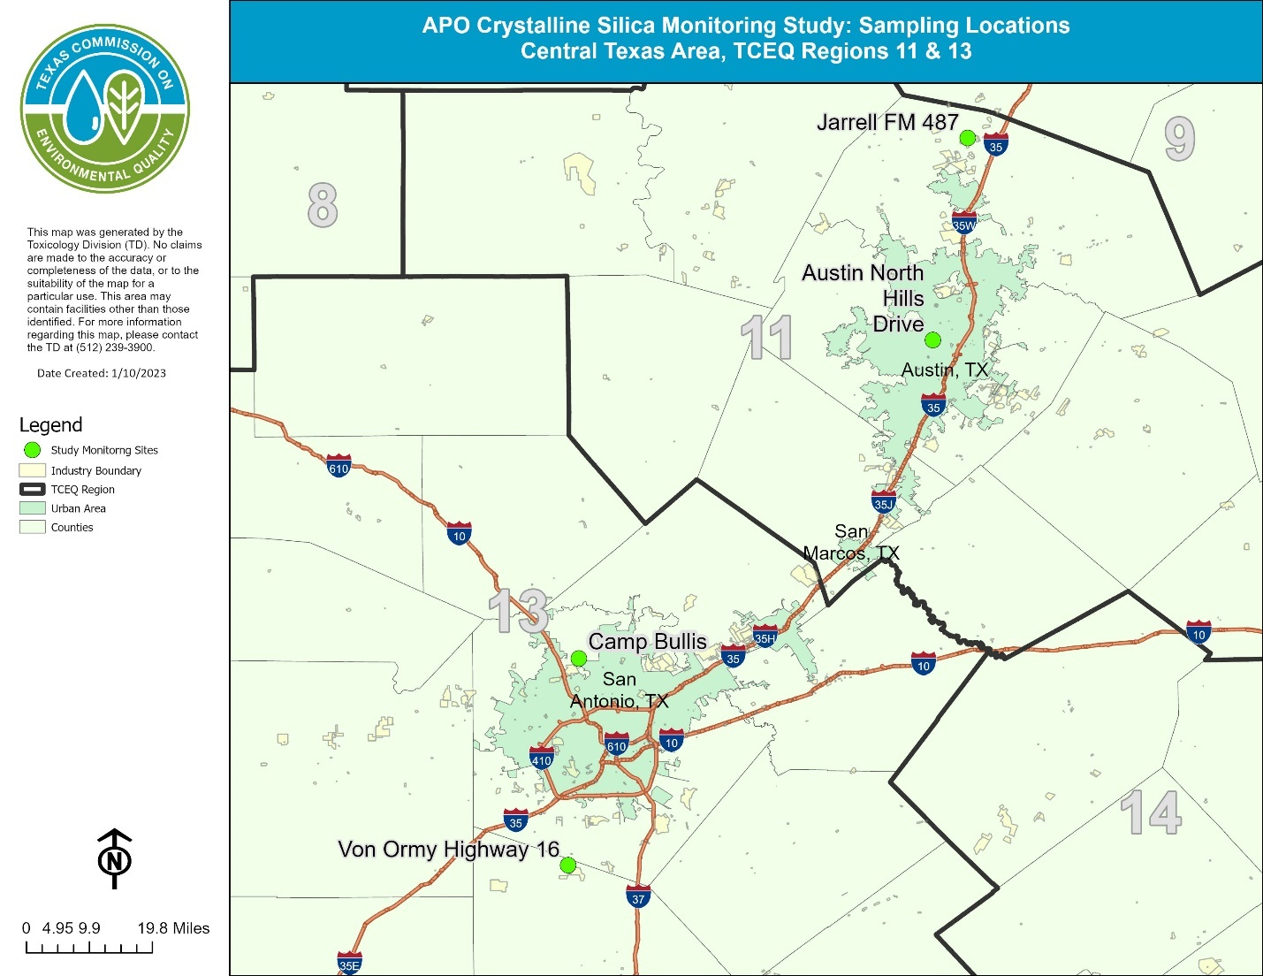
Close to quarry with rock crushers & stone cutters
APO Monitoring Study Locations
Background site in Austin (no nearby APO activities)
Close to a large APO site with a limestone quarry, rock crushing, cement & asphalt mixing
Close to several sand mining pits

Slide 19
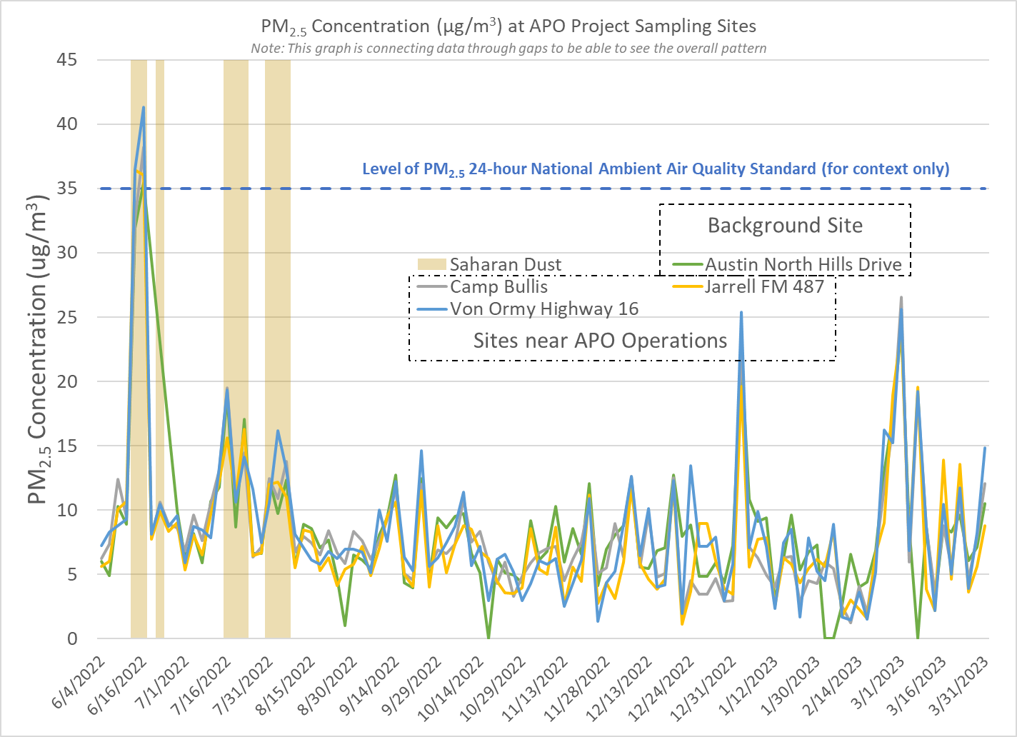
PM_{2.5} follows similar patterns at all sites
Levels of PM_{2.5} comparable between background site and sites near APO operations
Measured concentrations were compared to the level of the 24-hr PM_{2.5} NAAQS (comparison provided for context only)
Only days higher than the NAAQS corresponded to Saharan dust events and occurred at all monitoring sites

Slide 20
Crystalline silica is present at measurable levels at all sites
This is expected, silica is the most abundant mineral in the earth’s crust
All measurements thus far are well below the health-based 24-hr AMCV (24 µg/m³)
Highest concentrations measured on days impacted by Saharan dust

Slide 21
Next Steps
One year of monitoring was finished in mid-July
Final data should be available approximately end of August
Upon final data evaluation and assessment of long-term trends, a final report will be completed
Interim report (data through end of October 2022): Ambient Monitoring of Particulates, Including Crystalline Silica, Near APO Facilities, Interim Report
https://www.tceq.texas.gov/downloads/toxicology/research-projects/interimapo.pdf

Slide 22
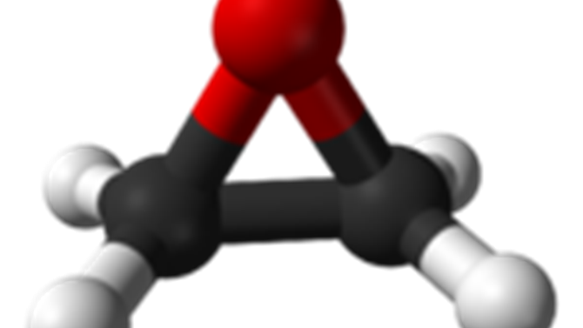
Short Update: Ethylene Oxide

Slide 23
Ethylene Oxide (EtO) Regulations
EtO is a chemical that is used as an intermediate in industrial processes, and is used to sterilize ½ of all sterile medical devices in the US (> 20 billion devices per year)
EtO has been the subject of various rule-makings in the last several years:
National Emission Standards for Hazardous Air Pollutants (NESHAPs): Miscellaneous Organic Chemical Manufacturing (MON) – finalized Dec. 2022
Hazardous Organic Chemicals NESHAPs (HON) for the Synthetic Organic Chemical Manufacturing Industry (SOCMI) Source Category – proposed Mar. 2023
NESHAPs: EtO Emissions Standards for Sterilization Facilities – proposed Mar. 2023
Pesticide Registration Review; Proposed Interim Decision and Draft Risk Assessment Addendum for EtO – Mar. 2023

Slide 24
Ethylene Oxide Cancer Dose-Response Assessment
Cancer risk attributed to EtO in these rulemakings is based on EPA’s 2016 Integrated Risk Information System (IRIS) cancer dose-response assessment
Estimated 1 in 100,000 excess cancer risk associated with lifetime exposure to 1 ppt EtO
TCEQ completed an EtO cancer dose-response assessment in 2020 for use in Texas air permitting and air monitoring programs, came to very different risk conclusions than EPA’s assessment
Estimated 1 in 100,000 excess cancer risk associated with lifetime exposure to 2.4 ppb EtO
To ensure that the best available science is being used by TCEQ and Texas, TCEQ is contracting with the National Academies of Sciences, Engineering, and Medicine (NASEM) to conduct a peer review of the TCEQ’s EtO assessment
Anticipate completion of the review in approximately 18 months

Slide 25
Questions?
Contact Information:
Sabine Lange
Email: sabine.lange@tceq.Texas.gov
Phone: (512) 239-3108
https://www.tceq.texas.gov/toxicology

