Slide 1
2023 Texas ENVIRONMENTAL SUPERCONFERNCE
Fallout from Ohio Train Derailment Legal – Political – Radioactive?
Steven Cook
Of Counsel
Bracewell LLP
August 3, 2023

Slide 2
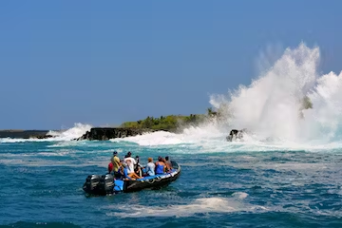
Legally Compliant or Effective Communications A story from Hawai’i
Safety Briefing on a Zodiac boat tour
Short but effective - still remember it 30+ years later
When faced with a “train wreck,” what will be the driver in your messaging?
Legal correctness
Accuracy
Usefulness

Slide 3
Warning: Shark-infested waters
Caveats to Presentation
Based on publicly available information and reports
NTSB hearing docket excellent resource
Not a judgment as to liability or whether any particular action met any applicable duty of care
Plenty of other arenas for that to be determined
Accuracy of details is only as good as the sources used
No warranty express or implied
Qualifications
Have not been to East Palestine, Ohio
Have not worked extensively with vinyl chloride
Have ridden Amtrak
Have worked at a chemical company
Expert? Perhaps in some venues
Future predictions are likely of similar quality as those obtained from certain standard air quality models

Slide 4
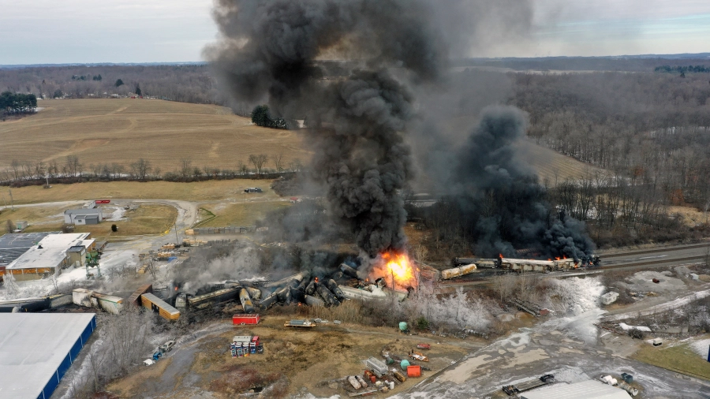
And so it begins
Train 32N derailment occurs at milepost 49.5 in East Palestine, Ohio at about 8:54 pm local time on Feb. 3, 2003
9,309 feet in length (1.76 miles/2.84 km)
Nearly 18,000 tons
140 loaded rail cars, 9 empties
17 loaded hazardous materials cars
5 cars loaded with stabilized vinyl chloride monomer
Other materials included isobutylene, certain acylates, benzene residue
38 railcars derailed including 11 with hazardous materials
Not classified as high-hazard flammable train
Initial evacuations of residential homes initiated at 9:45 pm

Slide 5
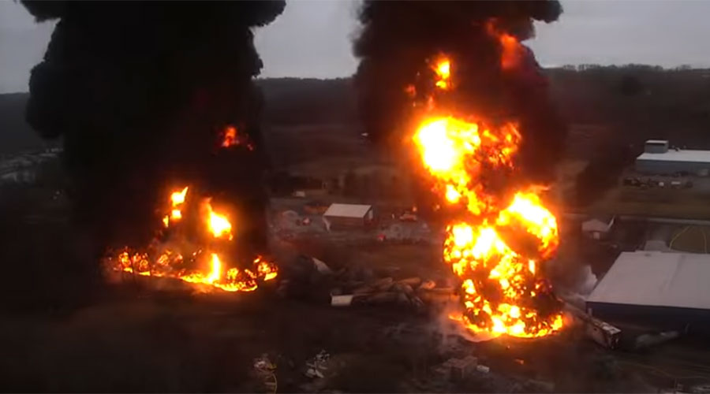
And so it begins cont.
Afternoon of Feb. 6th incident command makes decision to vent and burn five rail cars containing vinyl chloride

Slide 6
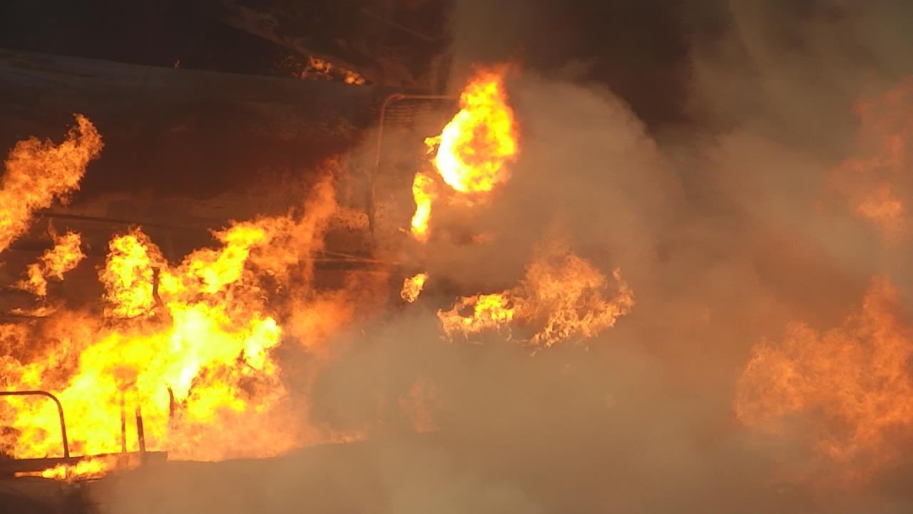
Environmental Enforcement Fallout
Legal Description
Clean Water Act Point Source
Clean Water Act Onshore Facility
CERCLA Facility
Clean Air Act Stationary Source?

Slide 7
Theme of Questions – Early On
What do you know?
If you don’t know, when will you know it?
How do you want to tell it?

Slide 8
The Questions – a sampling So many from so many
When can I return to my home?
Will you drink this glass of water?
What was released?
Why weren’t we notified sooner?
How long will you stay?
Will you cover all their medical bills for the rest of their life?
Why is the waste coming here?

Slide 9
The Value of a Map
Is it safe to drink the water?
Will you drink this glass of water?

Slide 10
The Value of This Map
Is it safe to drink the water?
Will you drink this glass of water?

Slide 11
Questions morph over time
What do you know?
Becomes
What do you know and when did you know it?
Becomes
What should you have known and when should you have known it?

Slide 12
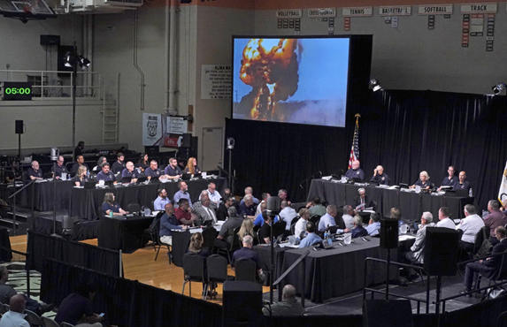
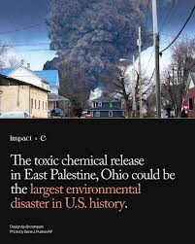
Legal & Political Fallout – a sampling
USEPA Unilateral Order
Ohio AG lawsuit
DOJ Enforcement
Investigations aplenty
Class actions
NGO calls for bans
But they have a permit

Slide 13
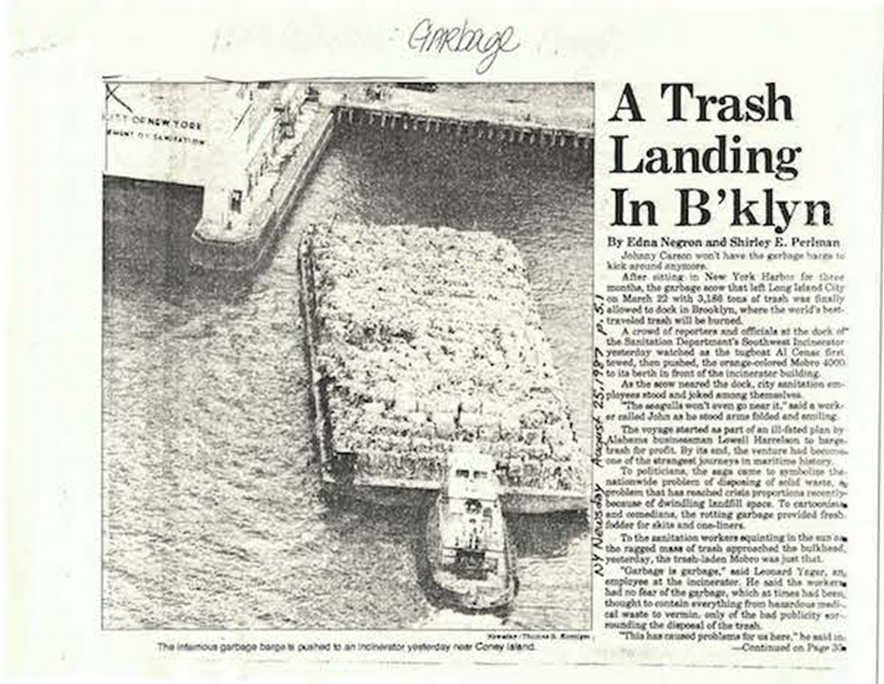
What Happens when the Waste Becomes Politically Toxic?
Mobro 4000 and its “Wretched Refuse”
3,000+ tons of New York City and Long Island trash including at least one bedpan
Mob involvement?
Left New York in March 1987
Arrived in North Carolina or was it Louisiana or maybe Alabama or perhaps Belize, the Bahamas or maybe even Mexico (only if it could get around the naval blockade)
45 days later and 6,000 miles it ended up in ….

Slide 14
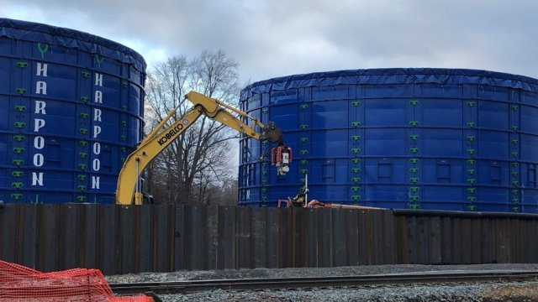
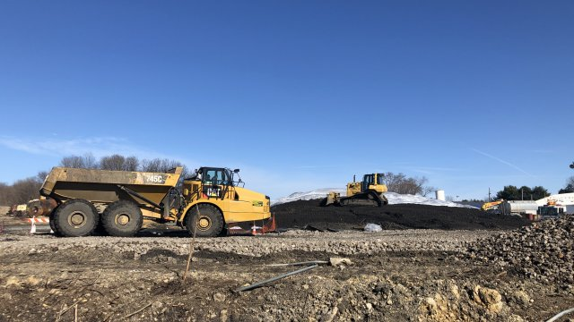
Where goeth the Soil and Wastewater from East Palestine?
To Michigan – not so fast
To Texas – yeah, but
To Oklahoma – not happening
How about Indiana?
Roundtrip to Baltimore and back to Ohio?

Slide 15
The CEO
Site visits
Town halls
Media
Legislative hearings
US Senate & House committees
Pennsylvania Senate & House committees
Ohio Senate & House committees
Preparation and “Make it Right”

Slide 16
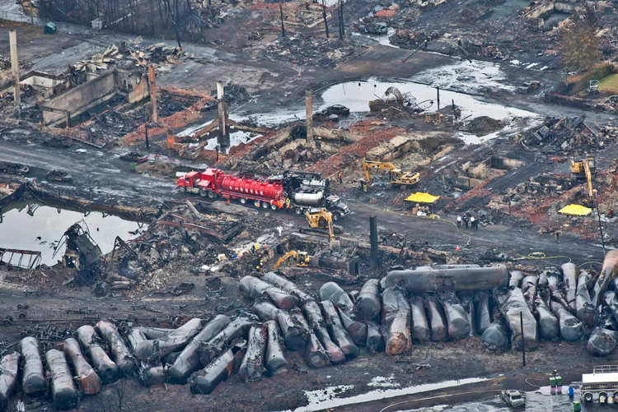
The Others – a sampling
Relief scams
Wage claims
School districts
Property stigma
More money for all

Slide 17
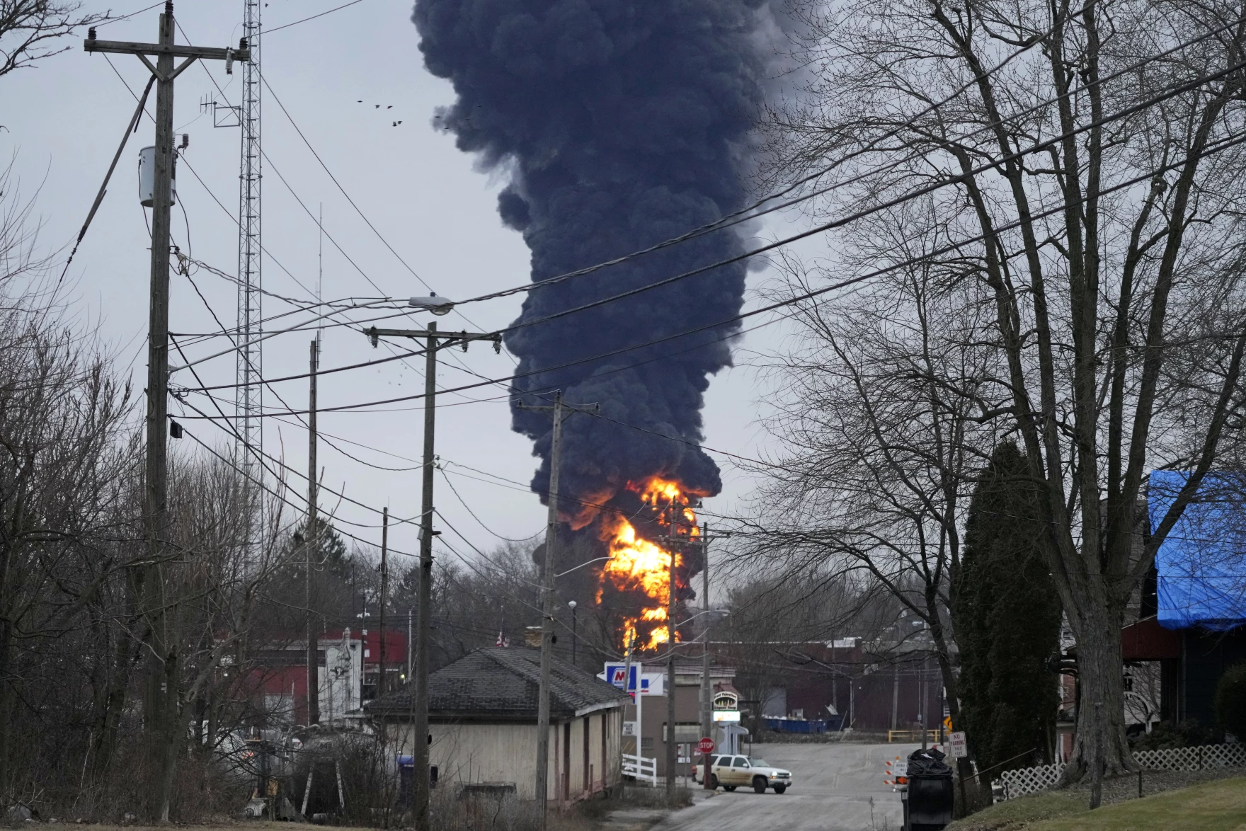
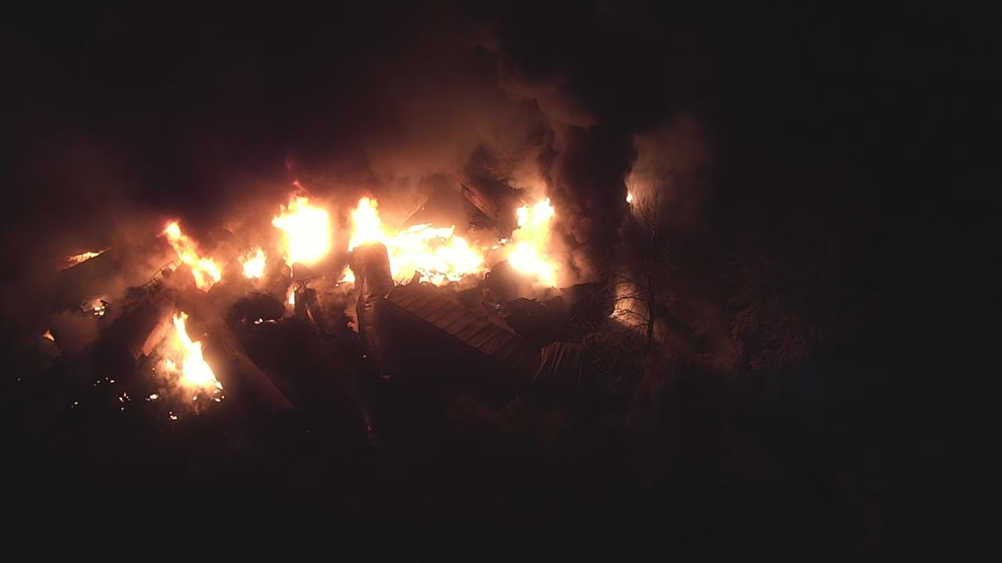
The Communication Challenge Messaging in a 140/280/4000-character world
No impacts
“Controlled burn” or is it a “vent & burn”
Make it right
Welcome Center

Slide 18
How Can I Be Better Prepared For the Fallout?
Avoid the “I hope we fixed that” moment
Does your system actually work?
We have an app for that
Practice, practice, practice
Establish guiding principles during the calm before the storm
Validate while weathering the storm
Listen, listen, listen
Understand incident command structure and how to work within it
Identify resources outside of your operations center that can assist with non-core response issues

Slide 19
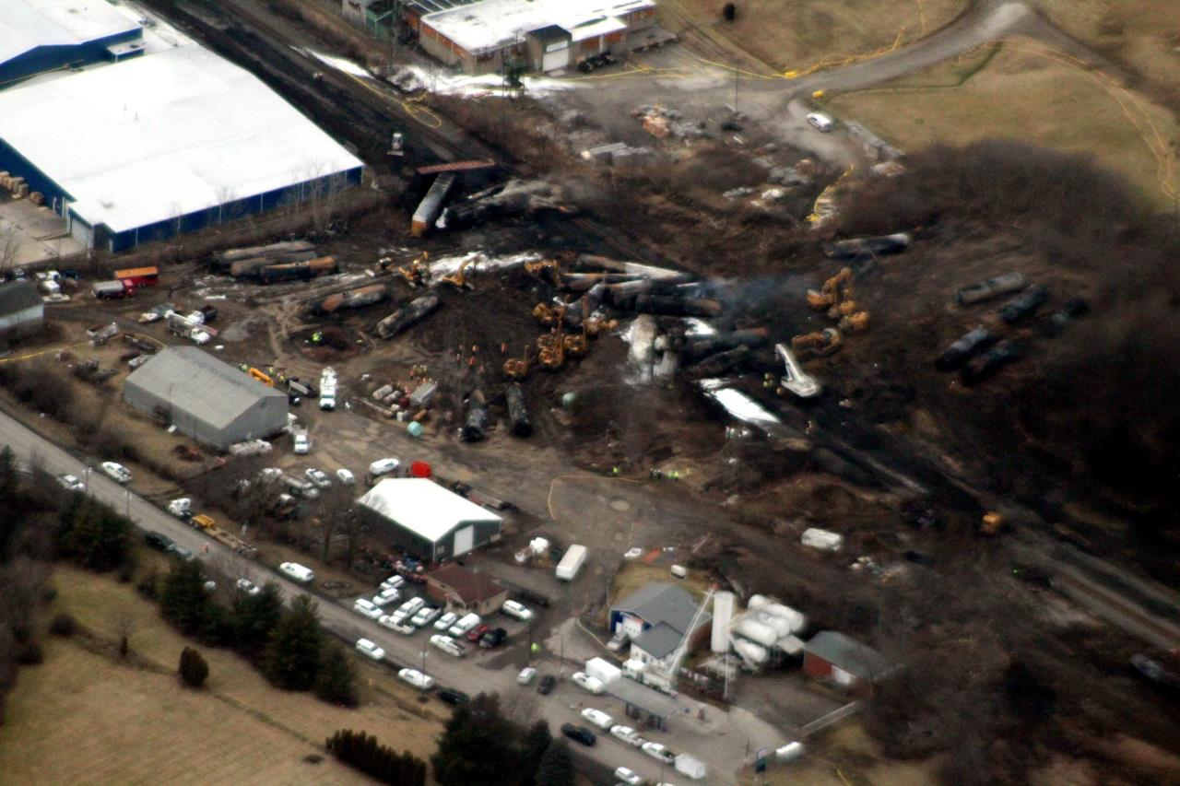
So what shall I do while weathering the storm?
Listen & Act
Detail actions/take actions/report on actions
Wash rinse repeat
Listen some more

Slide 20
Future Fallout?
Where should the waste go?
EPA letters likely enough to quell but could see notification to states & local communities prior to shipment become the standard
Who’s coming to dinner?
On-site presence by political and agency leadership could become standard practice
Will proposed bans be implemented?
Will communications during “the storm” be clearer?
Will there be fewer accidents?
Will there be new legislation/rules that “fix” things that were not at issue?
Will there be long-term health and environmental studies and follow-up?
New York Times June 23, 2023
After the Ohio Train Derailment: Evacuations, Toxic Chemicals and Water Worries
When a train derailed in the village of East Palestine on Feb. 3, it set off evacuation orders, a chemical scare and a federal investigation.
…
Concerns mounted about the effect the derailment and the fire could have on residents’ health and the environment.
The episode “changed East Palestine forever,” Keith A. Drabick, the village’s fire chief, said in a National Transportation Safety Board investigative hearing on June 22.

Slide 21
Thank You!
Steven Cook, Of Counsel
Environment, Lands and Resources
Houston, TX
steven.cook@bracewell.com
713.221.1366

