Slide 1

A Seal of Approval
“IF you are very quiet you can hear the
secrets being whispered by the sea”
-Author Unknown
Natural Resources Damages Act
characterdesignreferences.com/reviews-1/the-song-of-the-sea
Texas General Land Office
Commissioner Dawn Buckingham, M.D.
Notes:
Hello, my name is Scottie Aplin and I am a staff attorney with the Office of General Counsel at the General Land Office. the GLO manages 13 million acres of state-owned assets such as minerals, submerged lands, estuaries and beaches and dunes. As a steward of the State’s 367-mile coastline, the GLO is responsible for responding to oil spills in the coastal environment and is a member of the state’s Natural Resource Trustee Council, which is responsible for evaluating injuries caused to the Texas natural resources from spills of oil and hazardous substances, recovering damages from the responsible party, and using the recovered funds to restore those lost resources.
These materials expresses the views and opinions of its author and is not an official statement of position by the General Land Office or the Land Commissioner.

Slide 2
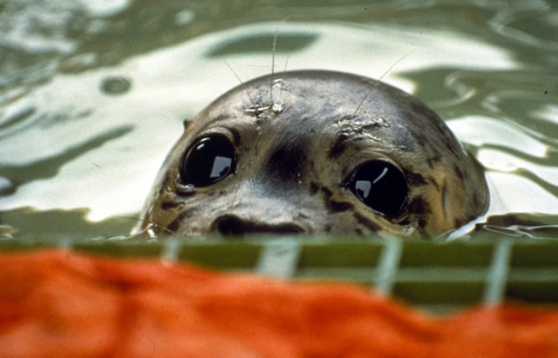
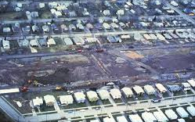
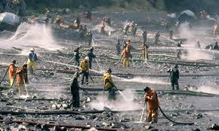
In the Beginning…
In the beginning the US, a newly developing nation, encouraged the exploitation of natural resources and did not have strict liability.
  Then, there was Love Canal
  And Exxon-Valdez
  Then, there is CERCLA, OPA, and OSPRA
evostc.state.ak.us/status-of-restoration/harbor-seals/
Texas General Land Office
Commissioner Dawn Buckingham, M.D.
Niagraatlarge.com
Bob Hallinen
Notes:
1. Negligence/Trespass, etc was not sufficient to get relief for injury to the public because the law required proving a duty/obligation to the public, injury/harm, and causation. Historically, each of these was a problem of proof for a plaintiff. And then, there are waivers of liability and determining who is responsible, which created a problem. Of course, we still exploit our natural resources, however, we are doing so under the protection of a variety of environmental laws.
2. In the 1970’s protests by the Love Canal community because of tremendous levels of unusual health problems within the community brought attention to the problems associated with waste disposal practices. The community, specifically its school, was built on a site where several companies had disposed of a variety of hazardous wastes. Resolution was done though declarations of emergencies by New York State and the US Government. In the end around 900 residences were relocated. Recovery of costs was difficult. As a result, CERCLA (42 USC 9601, et seq.) was adopted in 1980 to provide for response and strict liability for releases of hazardous wastes.
3. In 1989, the oil tanker Exxon Valdez ran aground in Alaska, spilling 11 million gallons of oil in Prince William Sound, affecting more than 1,300 miles of shoreline and hundreds of thousands of animals to include shorebirds, otters and seals. Because of the magnitude of the spill and the difficulty associated with clean up and providing for compensation, arguably, the area still hasn’t fully recovered. As a result, the Oil Pollution Act (OPA) (33 USC 2701, et seq) was passed in 1990 which established strict liability, including NRDA provisions, for releases of oil.
4. Around the same time, the State of Texas Passed the Oil Spill Prevention and Response Act (OSPRA) Texas Natural Resources Code §40.101, et al to address response to, clean up of and compensation for releases of oil.

Slide 3
Strict Liability
Comprehensive Environmental Response, Compensation and Liability Act (CERCLA)
  Addresses Releases of Hazardous Substances, “SuperFund”
Oil Pollution Act (OPA)
  Part of the Clean Water Act
  Addresses releases of Oil
Oil Spill Response and Prevention Act (OSPRA)
  Texas Version of OPA
Texas General Land Office
Commissioner Dawn Buckingham, M.D.
Notes:
1. CERCLA is focused on responding to and remediating releases of hazardous materials. It also has provisions that address recovery of resources that are impacted by a release through Natural Resource and Damage Assessment (NRDA). The focus is upon ensuring that trustees of public resources can recover the costs of repairing, replacing or acquiring the equivalent to the resources that were damaged by a release.
2. OPA was an amendment to the Clean Water Act in 1990 to prevent and respond to releases from vessels and facilities into waters of the United States. OPA is focused on preventing, responding to, cleaning up, and compensating the public and making it whole after an oil spill. The act established the National Contingency Plan, which documents how to properly coordinate and respond to a spill, and provided for the recovery of the costs of repairing, replacing or acquiring the equivalent to the resources that were damaged by the release of oil. This presentation focuses upon OPA because that is a primary function of the GLO. NRDA, however, addresses CERLCA and OPA releases and provides for the authority of all the trustees to address compensation.
3. OSPRA was adopted in 1991 and is the mechanism for responding the release of oil in the State of Texas. It designates the state trustees under the NRDA program and provides for seeking compensation for releases of oil in state waters
4. These Acts are strict liability statutes, which means that negligence is not a consideration, the statutes are only concerned with reparations. Compensation for damage caused by a spill includes any injury from the spill and any damage that is caused to natural resources by the response actions themselves, such as removal of sand from a beach front. It is very important to note that the NRDA provisions do not penalize someone who causes a release. Penalties and response costs are wholly separate from any recovery made in a NRDA action.

Slide 4
First, there were Responsible Parties (RP)
Generally, A Responsible Party is the owner or operator of a facility or Vessel that releases oil into the water of the united States.
responsible person(s) SHALL be invited to participate. The RP Shall provide and may obtain photographs, split samples, and final data utilized and discovered during the natural resource damage assessment.
The Trustees are responsible for determining the level of an RP’s participation.
Secret: Cooperation and Sharing information Gets you to YES!
Texas General Land Office
Commissioner Dawn Buckingham, M.D.
Notes:
1. A person responsible for an actual or threatened unauthorized discharge of oil is responsible for containing the oil and cleaning it up. RP’s are strictly and jointly liable for removal of the oil and any injuries that were caused. They will also be held responsible for the injuries to natural resources, such as animals and their habitat. They are also liable for response costs, damages to natural resources, and reasonable costs of assessing the damage. 33 USC § 2702(a), TNRC §§ 40.202 & 203. Responsibility can be to individuals and businesses.
2. Damages are defined in 33 USC § 2702((b)(2). A number of damages are identified here, to include property, revenues, and public services, to name a few. The most important for our purposes, however, is the natural resources damages. Natural resource damages addresses injury to, destruction of, loss of, or loss of use of, natural resources, including the reasonable costs of assessing the damage.
3. Trustees shall extend an invitation to a party responsible for the release of oil. 15 CFR § 990.14, 31 Texas Administrative Code § 20.23. Sometimes during the spill informal collaboration starts. A formal invitation to participate in full assessment usually happens after the trustees have made a determination that that an injury has occurred.
4. The trustees are responsible for defining the level of participation of the RP based upon: the identification of the RP’s, their willingness to participate and fund an assessment and the degree of cooperation of the RP The trustees can also take into account the actions of an RP in prior assessments. 15 CFR § 990.14, 31 TAC § 20.23.

Slide 5
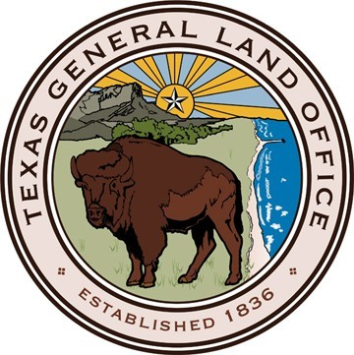





Then, there were Trustees
Trustees
  Federal Agencies
  State Agencies
  Other Trustees
Duties
Advise & Assist with Spill response
Assess injuries & Damages
Develop a restoration plan
Implement Restoration
Secret: The Goal is to make the PUBLIC whole
Notes:
1. Under OPA, the federal government trustees are designated by the president, states by their governors. 33 USC § 2706(b) and 40 CFR §300.605. In 1995 the Texas Governor appointed several agencies to act as NRDA trustees by letter. OSPRA also designates the trustees through TNRC 40 §107. The State of Texas has one of the largest trustee Councils and is one of the most active councils in the country.
2. The trustees play a role in spill response by advising on approaches to spill response and clean up and assisting with the overall response. Trustees have a role in determining when a response action is complete. TNRC 40 § 107 (c)(5)&(6) and 31 TAC 19.37.
3. Another primary task is to assess injuries, determine the level of injury and ability to restore the injury. 33 USC §§ 2702 & 2706 and 40 CFR 107. Trustee actions include sampling, review of data, and studies; work with RP to assess the injury; entering into participation and funding agreements, and consent decrees.
4.Trustees are also responsible for restoration planning & implementation, including restoration planning, and facilitating public involvement
The ultimate GOAL is to ensure that the public is made whole!

Slide 6
Secrets of the Trustees
Federal and State Trustees shall assess damages to natural resources and Develop and implement a plan for restoration.
Assessment procedures must be reasonable and reliable.
During the Pre-Assessment Stage, the Trustees consider:
  Time and cost
  Relevance
  Adequacy of information
Secret:
  NRDA Is not about Penalties, it is solely concerned with REPARATIONS
  Trustees want to get to restoration!
Texas General Land Office
Commissioner Dawn Buckingham, M.D.
Notes:
1. This is mandatory language…we are doing our job here not trying to penalize anyone. The obligation is to rebuild/replace what was damaged. 33 USC §§ 2702 & 2706.
2. Law requires that assessments must be reasonable and reliable. TNRC § 40.107(c)(7)(E) and 15 CFR § 990.27. The basis for assessment must be built on data and analyzed in accordance with scientific principles and best practices. The Texas trustees’ preferences are proven methods and techniques and the trustees will use independent sources to support their conclusions. The trustees tend to stay away from novel, non-standard, or untested approaches and methodologies. Occasionally trustees must rely upon their own or hired subject matter experts to provide technical and scientific information. Considerations of time and cost are of importance in assessing a case.
3. During the pre-assessment, the trustees generally evaluate existing information to decide whether to proceed with a full assessment. 15 CFR § 990.42(a) It includes undertaking a limited range of pre-assessment activities like data review, collection and sharing of data and evidence, and evaluating emergency restoration. The Notice Of Intent to Perform will be issued if the trustees determine that 1) injuries have resulted, 2) response actions don’t adequately address those injuries and 3) feasible restoration actions exist to address the injury. 15 CFR §§ 990.42 & 44.

Slide 7
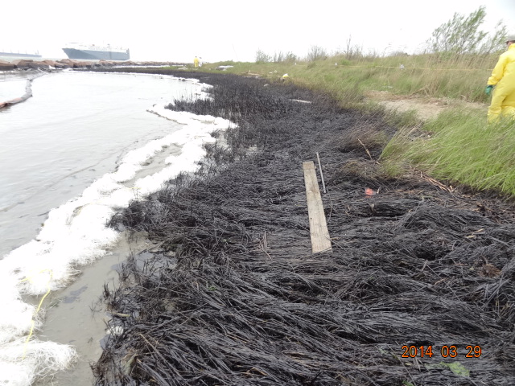
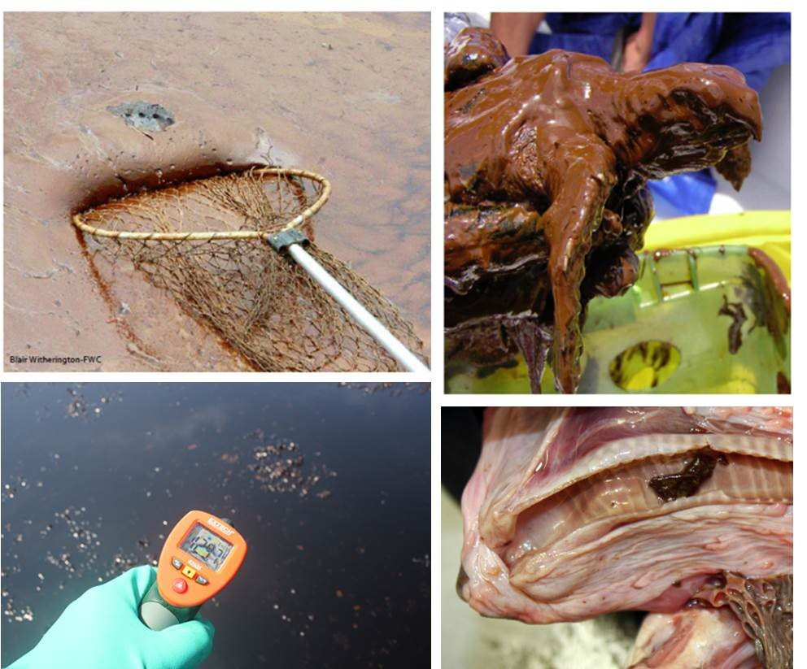
Cooperative Assessment
Notice Of Intent to Perform an Assessment
Collecting & Sharing information
Cooperation
Patience is Key!
Secret: Remember, this is a multi-party Assessment and settlement
Texas General Land Office
Commissioner Dawn Buckingham, M.D.
Notes:
1. The notice of intent to perform an assessment includes an invitation to engage in a cooperative assessment. It is the point at which attorneys get involved in moving to a formal cooperative stance, which may entail cooperation agreements, tolling agreements, discussion of sampling plans, and small working groups.
2. Collecting and sharing information means that the parties can and should do split samples, investigate the site together, cooperate on identifying proper areas for establishing baseline. Technical activities should be done together where possible. Discussion about technical approaches may be feasible, as well. This will entail ensuring the assessment costs are covered through “cost packages.”
3. Cooperation means getting to yes. It is important to include trustees in data collection and to discuss approaches with the trustees. Discussions with trustees does not mean that the trustees will be committing to a position or approach. This part of the discussions will generally be limited to the injury. Generally, the information that relates to actual damages or specific settlement options will not be discussed at this stage.
4. Don’t expect the trustees to discuss in detail many of their positions. This kind of detail needs to be worked out among the trustees before they can discuss any of it with the RP. And, the State of Texas has one of the most active Trustee Council in the nation and we are working on other cases. Settlement takes time. Remember, this is a multi-party engagement!

Slide 8
Assessment
Identification: determining exposure and actual injury.
Quantification: the degree and special and temporal extent of such injuries relative to a baseline.
  Baseline is important in comparing the injured resources to what resources would have been but for the injury.
Scaling: This is evaluating potential compensation for the injured resources and scaling that compensation to a level necessary to make the public whole.
Texas General Land Office
Commissioner Dawn Buckingham, M.D.
Notes:
1. Assessment is the process of collecting, compiling, and analyzing information to make a determination of whether and what resources were injured and what would be required to compensate for it. The trustees are responsible for determining that an actual injury occurred. 15 CFR § 990.51. Potential categories of injury include, but are not limited to, changes in: survival, growth, and reproduction; behavior; community composition; ecological processes and functions; physical and chemical habitat quality or structure; and public services. An injury could be caused by the spill or the response actions.
2. The trustees must determine whether an injury has occurred by comparing the degree and spatial and temporal extent of the injury relative to the baseline environmental conditions. At a minimum, the trustees must consider the location of the spill, how big the spill was and how long it took to clean up the spill. 15 CFR § 990.52. I will leave it to the scientists to explain the details but for legal purposes, the assessment of the injury evaluates the condition of the area of the spill prior to the spill. That often requires searching for similarly situated sites to use as a baseline of comparison. Statute does require consideration of natural recovery as part of the analysis. Information that is used to address these questions Includes samples, local information, historic data, studies, etc. If you think lawyers are bad, you should listen to scientists argue the merits and use of habitat equivalency analysis and the appropriate inputs for that analysis!
3. Finally, the trustees work on Scaling: 15 CFR §990.53. This is the process of determining what will be required to compensate for the injury including: primary restoration actions to return the injured natural resources and services to baseline conditions and compensatory restoration actions to compensate for losses from the time of the incident to the return of injured resources and services to baseline.

Slide 9
Settlement
Trustees may settle claims provided that the settlement satisfies OPA and is fair, reasonable, and in the public interest, considering the adequacy of the settlement to restore, replace, rehabilitate or acquire the equivalent of the injured resources and services.
Secret: Settlement is attractive because It IS Cost effective and Gets to Restoration Sooner.
Settlement is memorialized in a Consent Decree.
The final agreement between the state trustees and the RP shall be subject to public review and comment.
Secret:
  This affects how the Trustee Negotiate for Settlement!
Texas General Land Office
Commissioner Dawn Buckingham, M.D.
Notes:
1. NRDA provides litigation and specific standards that can be used in trustees proof of injury. It also, however, explicitly provides for settling a case. 15.CFR § 990.25. Settlement is not just about horse trading, thought, t is about ensuring that the public gets actual compensation for the injured resources. That is why so much time is spent collecting data, researching issues, and debating the information. The job of the trustees is to ensure that the public interest is protected by ensuring that natural resources are adequately replaced.
2. Why is settlement attractive to the trustees?
The longer everyone spends time on assessment, argument, and litigation the more expensive the process gets.
The longer the injury stays in place, the injury is ongoing, thus increasing the restoration that will be required. This relates back to the issue of compensatory restoration. Litigation will increase the injury because of the extended time taken to get to restoration.
3. The discussion of final damages will entail bringing the attorneys back into the process. Usually, this will include the Department of Justice and Attorney General. Generally, a final settlement will entail preparation of a pleading and be memorialized in a Consent Decree. An important part of settlement is providing notice to the public of how the agreement will compensate the public for the injuries. 31 TAC § 20.42. This will affect what the trustees can settle for because they must be able to tell the public what they did, why and how it makes the public whole.
4.Secret: Keep in mind that settlement not only entails working with an RP or RPs but the trustees are not a single cohesive unit. Each agency brings to the table its own interests, resources, and expertise. So, it sometimes takes time for the trustees to agree amongst themselves as to what an injury maybe, what would be appropriate restoration and what the damages need to be.

Slide 10


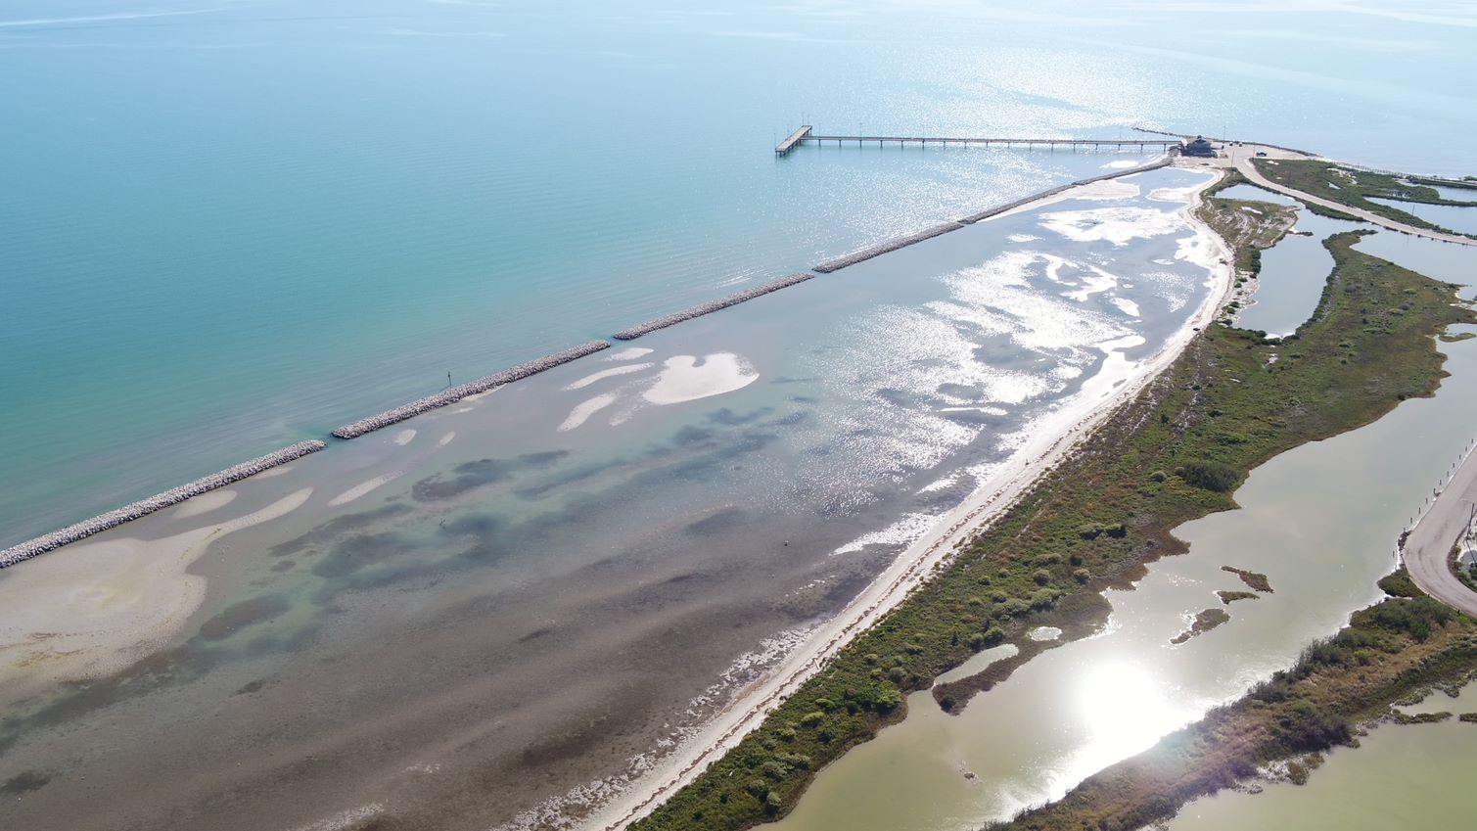
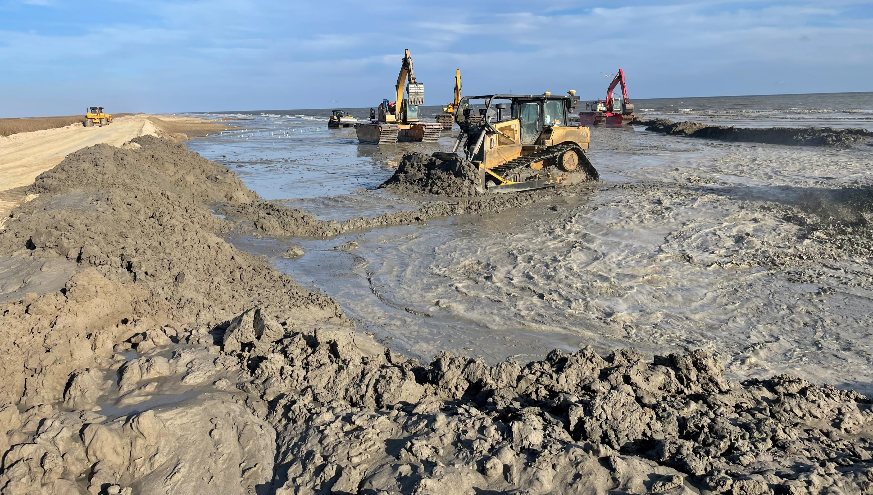
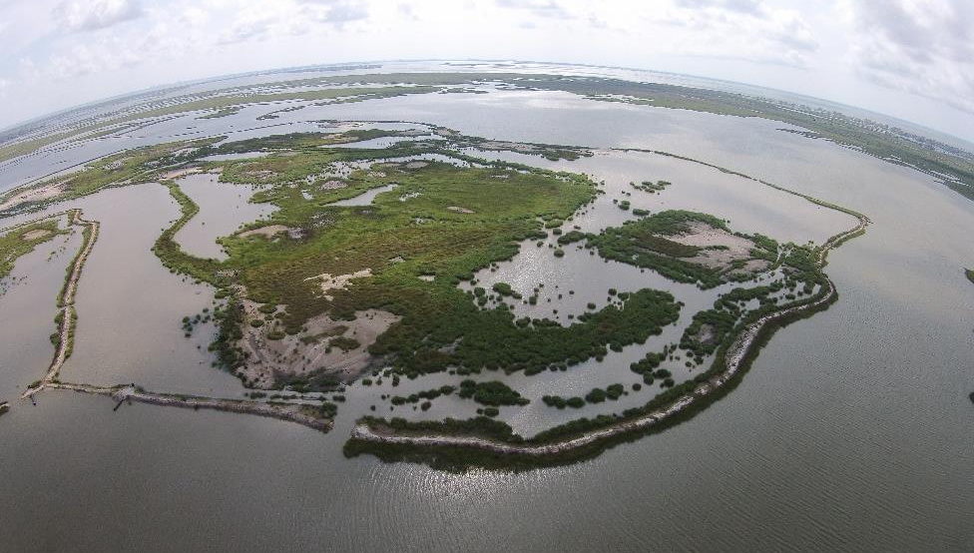
Restoration
Restoration Projects must:
  make the environment and public whole
  Be Based upon a reasonable range of alternatives
Projects must be cost effective and efficient.
Restoration Plans must be published, with opportunity for public review and comment.
And, the Best Part, is Implementation of Restoration
Secret: Public Accountability is how the Parties get to a final SEAL of approval!
Texas General Land Office
Commissioner Dawn Buckingham, M.D.
Notes:
1. After settlement, the trustees will start restoration planning and implementation. Restoration planning is defined by law. Trustees must develop a plan and provide a reasonable range of restoration alternatives under 15 CFR § 990.53, The alternatives will be evaluated based on, at a minimum on :
(a) The cost to carry out the alternative;
(b) The extent to which each alternative is expected to meet the trustees' goals;
(c) The likelihood of success of each alternative;
(d) The extent to which each alternative will prevent future injury as a result of the incident, and avoid collateral injury as a result of implementing the alternative;
(e) The extent to which each alternative benefits more than one natural resource and/or service; and
(f) The effect of each alternative on public health and safety.
2. OSPRA goes even further. Under TNRC § 40.107, the trustees must make sure that the plan is cost effective. Cost matters when determining what the trustees will consider adopting in a restoration plan.
3. Its important to know that the trustees are responsible for include and inform the public on restoration planning. Restoration plans will describe the injury and how a project will compensate for that injury. In Texas, the trustees will often solicit project suggestions from fellow trustees and the public. Restoration plans must be published and the public given an opportunity to review and comment on a plan. 15 CFR § 990.55.
4. Implementation of restoration will entail entering into funding and implementation agreements amongst the trustees, with project partners, and vendors that have been selected through a solicitation process. After a project has been completed, there will also be monitoring of the projects to ensure that the results adequately compensate for the injury.

Slide 11
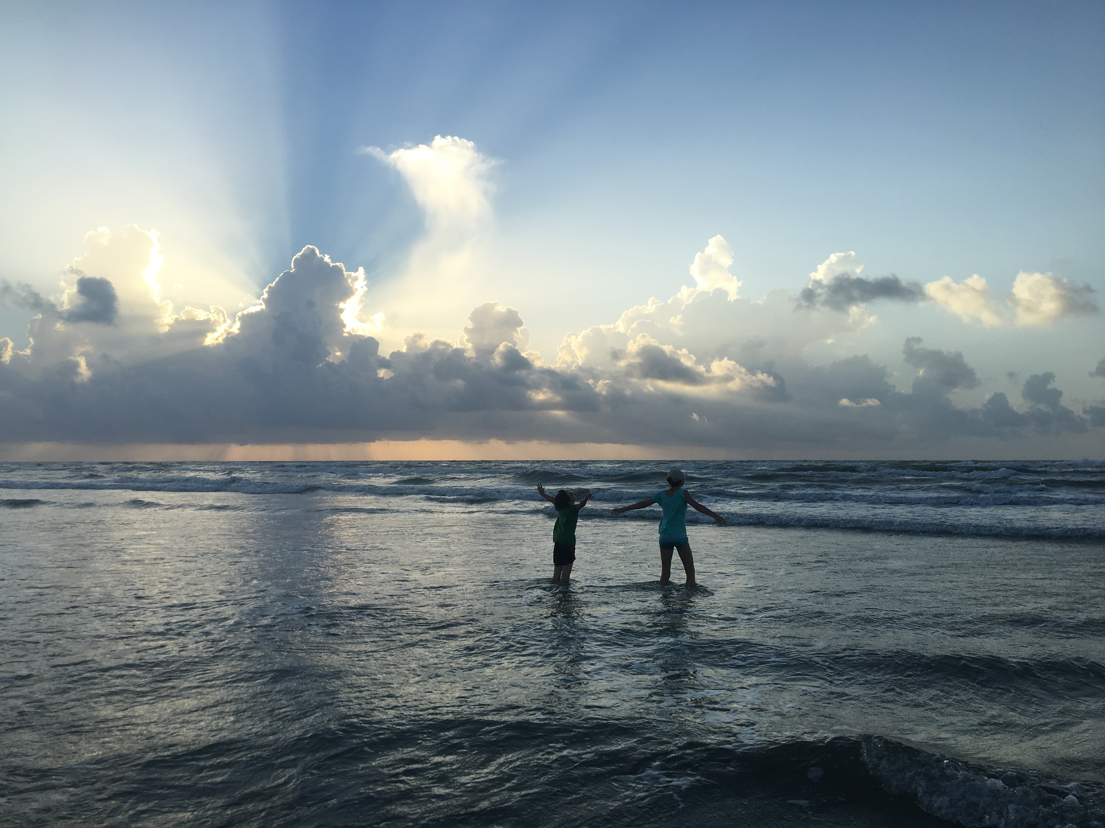
“In every outthrust headland, in every curving beach, in every grain of sand there is the story of the earth.”
― Rachel Carson
Texas General Land Office
Commissioner Dawn Buckingham, M.D.
Notes:
Today, the story is that there is better prevention of and responses to releases when they do happen. While there are established processes and standards for addressing compensation for releases when they do happen, settlement helps the story come to a swift and satisfactory end. To this day, the science is continuing to inform us on injuries caused by releases and how to best compensate for those injures. As for now, the story of NRDA provides the public, and their natural resources, with a happy ending!

