Slide 1
Advanced Nuclear: Bridging the Clean Energy Gap
Martin J. O’Neill
Associate General Counsel
35th Annual Texas Environmental Superconference, Austin, TX
August 4, 2023

Slide 2

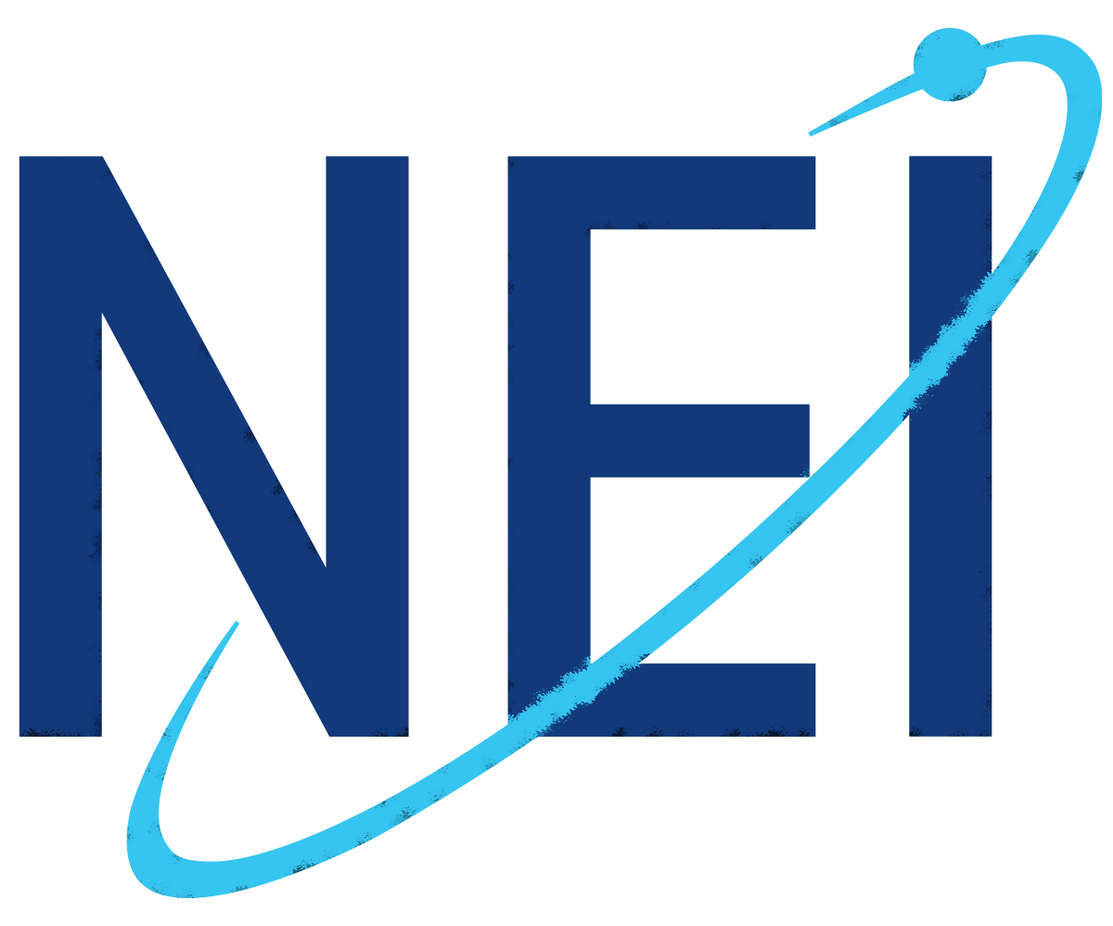

THE NUCLEAR ENERGY INSTITUTE
is the principal policy organization of the nuclear technologies industry, based in Washington, D.C.
On behalf of its members, NEI provides a unified industry voice on key policy, technical, legal, and regulatory issues before Congress, the executive branch, state and local legislatures, federal regulators, and international organizations.
Our mission is to promote the use and growth of nuclear energy through efficient operations and effective policy.
https://www.nei.org/home

Slide 3
Current U.S. Fleet: 93 Reactors at 53 Plant Sites in 28 States
U.S. Clean Generation (2022)
45.5%
NUCLEAR
25.6%
WIND
15.1%
HYDRO
12.0%
SOLAR
1.0%
GEOTHERMAL
Updated: April 2023

Slide 4
Nuclear’s Unique Value Proposition for a Net-Zero Grid
(See Also Appendix to these Slides)
Source: DOE, Pathways to Commercial Liftoff: Advanced Nuclear (Mar. 2023), available at https://liftoff.energy.gov/

Slide 5
A Large Demand
for New Nuclear
DOE estimates the U.S. will need ~550-770 GWe of additional clean, firm capacity to reach net-zero by 2050.
Recent studies conducted or reviewed by DOE all project a major need for new nuclear capacity in the U.S.
(~2-4 times the current fleet capacity of ~95 GW).
In its Mar. 2023 Pathways report, DOE chose 200 GW as an “ambitious yet achievable” benchmark.
Source: DOE, Pathways to Commercial Liftoff: Advanced Nuclear (Mar. 2023), available at https://liftoff.energy.gov/

Slide 6
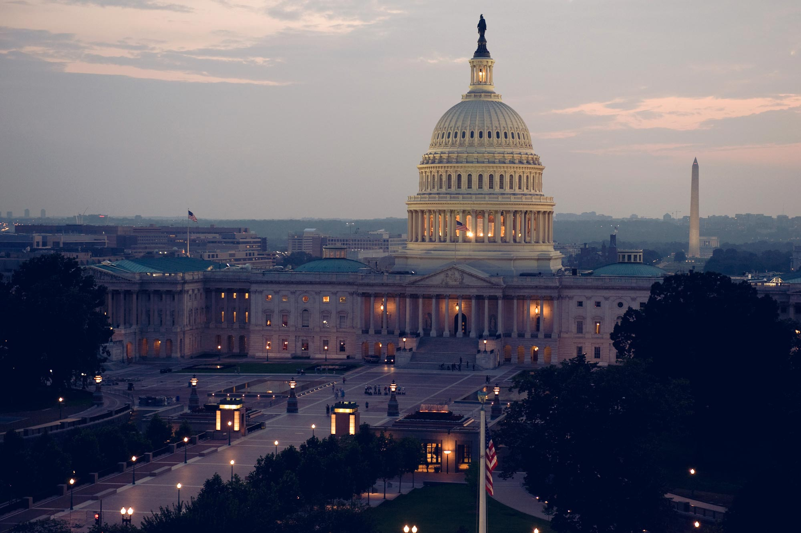
Federal Recognition of Nuclear’s Value
Nuclear Energy Innovation Capabilities Act of 2017
Nuclear Energy Innovation and Modernization Act of 2019
The Energy Act of 2020
DOE’s Carbon Free Power Project (CFPP) and Advanced Reactor Demonstration Program (ARDP)
2021 Infrastructure Investment
and Jobs Act (IIJA or BIL)
2022 Inflation Reduction Act
2022 CHIPS and Science Act

Slide 7
DOE Financial Support Programs for Advanced Reactor Demonstrations – the ARDP and CFPP
Source: DOE, Pathways to Commercial Liftoff: Advanced Nuclear (Mar. 2023), available at https://liftoff.energy.gov/

Slide 8
Key BIL and IRA Provisions
Bipartisan Infrastructure Law
Inflation Reduction Act
Production Tax Credit (PTC) for Operating Plants
Up to $15 per MWh
Technology-Inclusive PTC for Clean Electricity
$30 per MWh
Technology-Inclusive Investment Tax Credit (ITC) for Clean Electricity
30% + 10% in energy communities + 10% using
U.S. components
Clean Hydrogen Credit
$3 per kilogram
HALEU Availability Program
$700 Million
Civil Nuclear Credit Program
$6B to support financially challenged plants
Advanced Reactor Demonstration Program (ARDP) Funding
$2.5B funding for two projects
Nuclear Hydrogen Hub
$8B total in the bill

Slide 9
2023 State Policies Under Consideration
100+ bills introduced that impact nuclear
Nuclear Moratorium Repeals – IL, CA, OR, MN
Clean Energy Standards and Definitions – VA, MN, NH, CT, MA, CO, TN, AZ, NM, ID
SMR Studies – SD, OK, MN, NY, ME, TX
Task Force – NE, CT
Hydrogen – NE, MN, WV
Workforce – WA, NE, VA, WV
Regulatory Reform – WY, IN, VA, WV, IL
Advanced Nuclear – WA, WV, VA, IN, MN, NY, OK, CT, SD, IL, OR, ME, NE, MO, CA, TX, ND, FL

Slide 10

Industry is Planning for Second Renewals + New Nuclear
A recent NEI survey confirmed nuclear power’s expected role in
meeting decarbonization goals
Long-term operations
>2X nuclear capacity
Small modular reactors
>90% of fleet expects to operate to at least 80 years
100 GW of new nuclear opportunity by 2050s
Translates to roughly 300 SMR-scale plants
NEI member companies produce nearly half of all U.S. electricity
DOE forecasts ~200 GW of new nuclear to meet carbon reduction goals
Sources: NEI, The Future of Nuclear Power: 2023 Baseline Survey (March 2023)
DOE, Pathways to Commercial Liftoff: Advanced Nuclear (March 2023)

Slide 11



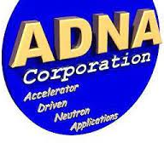

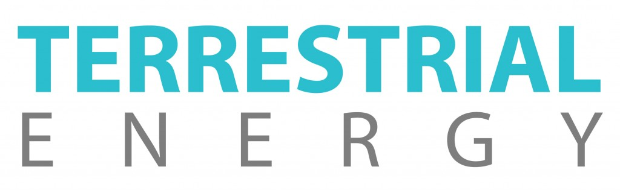

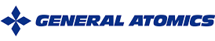



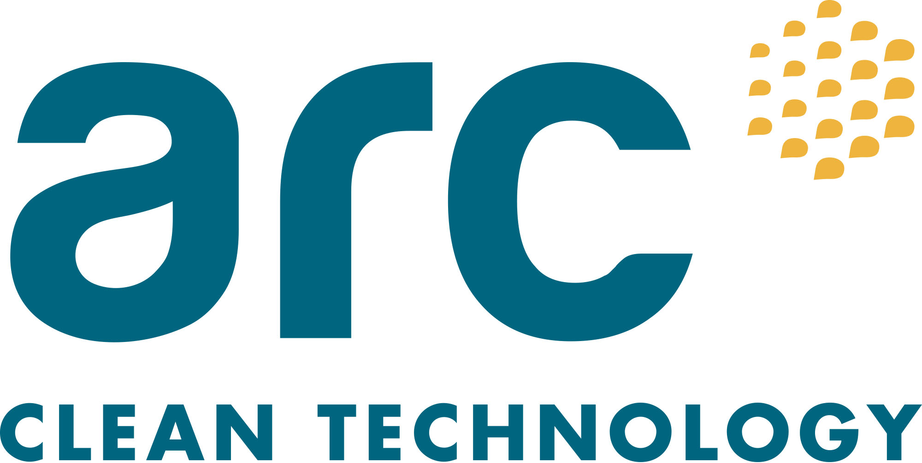
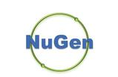
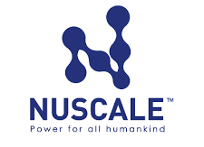
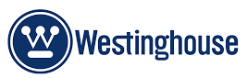
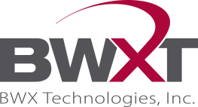



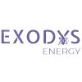

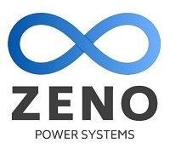



Advanced Reactor Developer Members

Slide 12
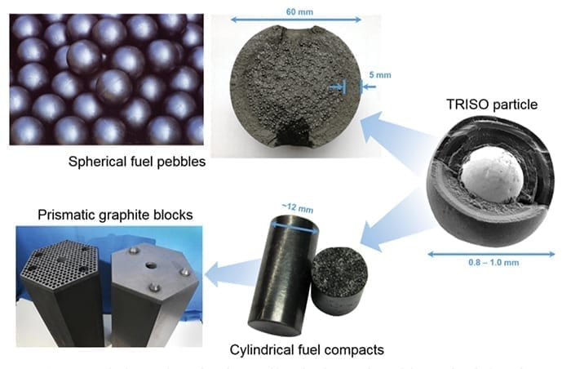
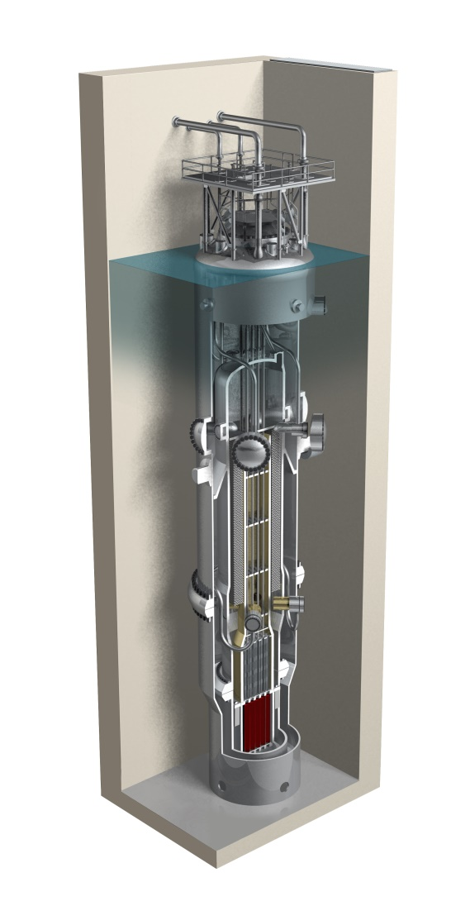
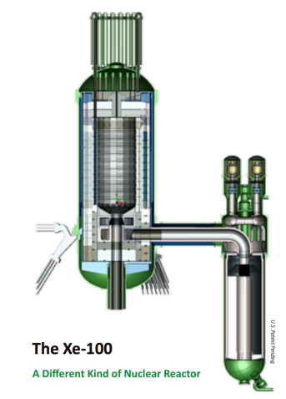
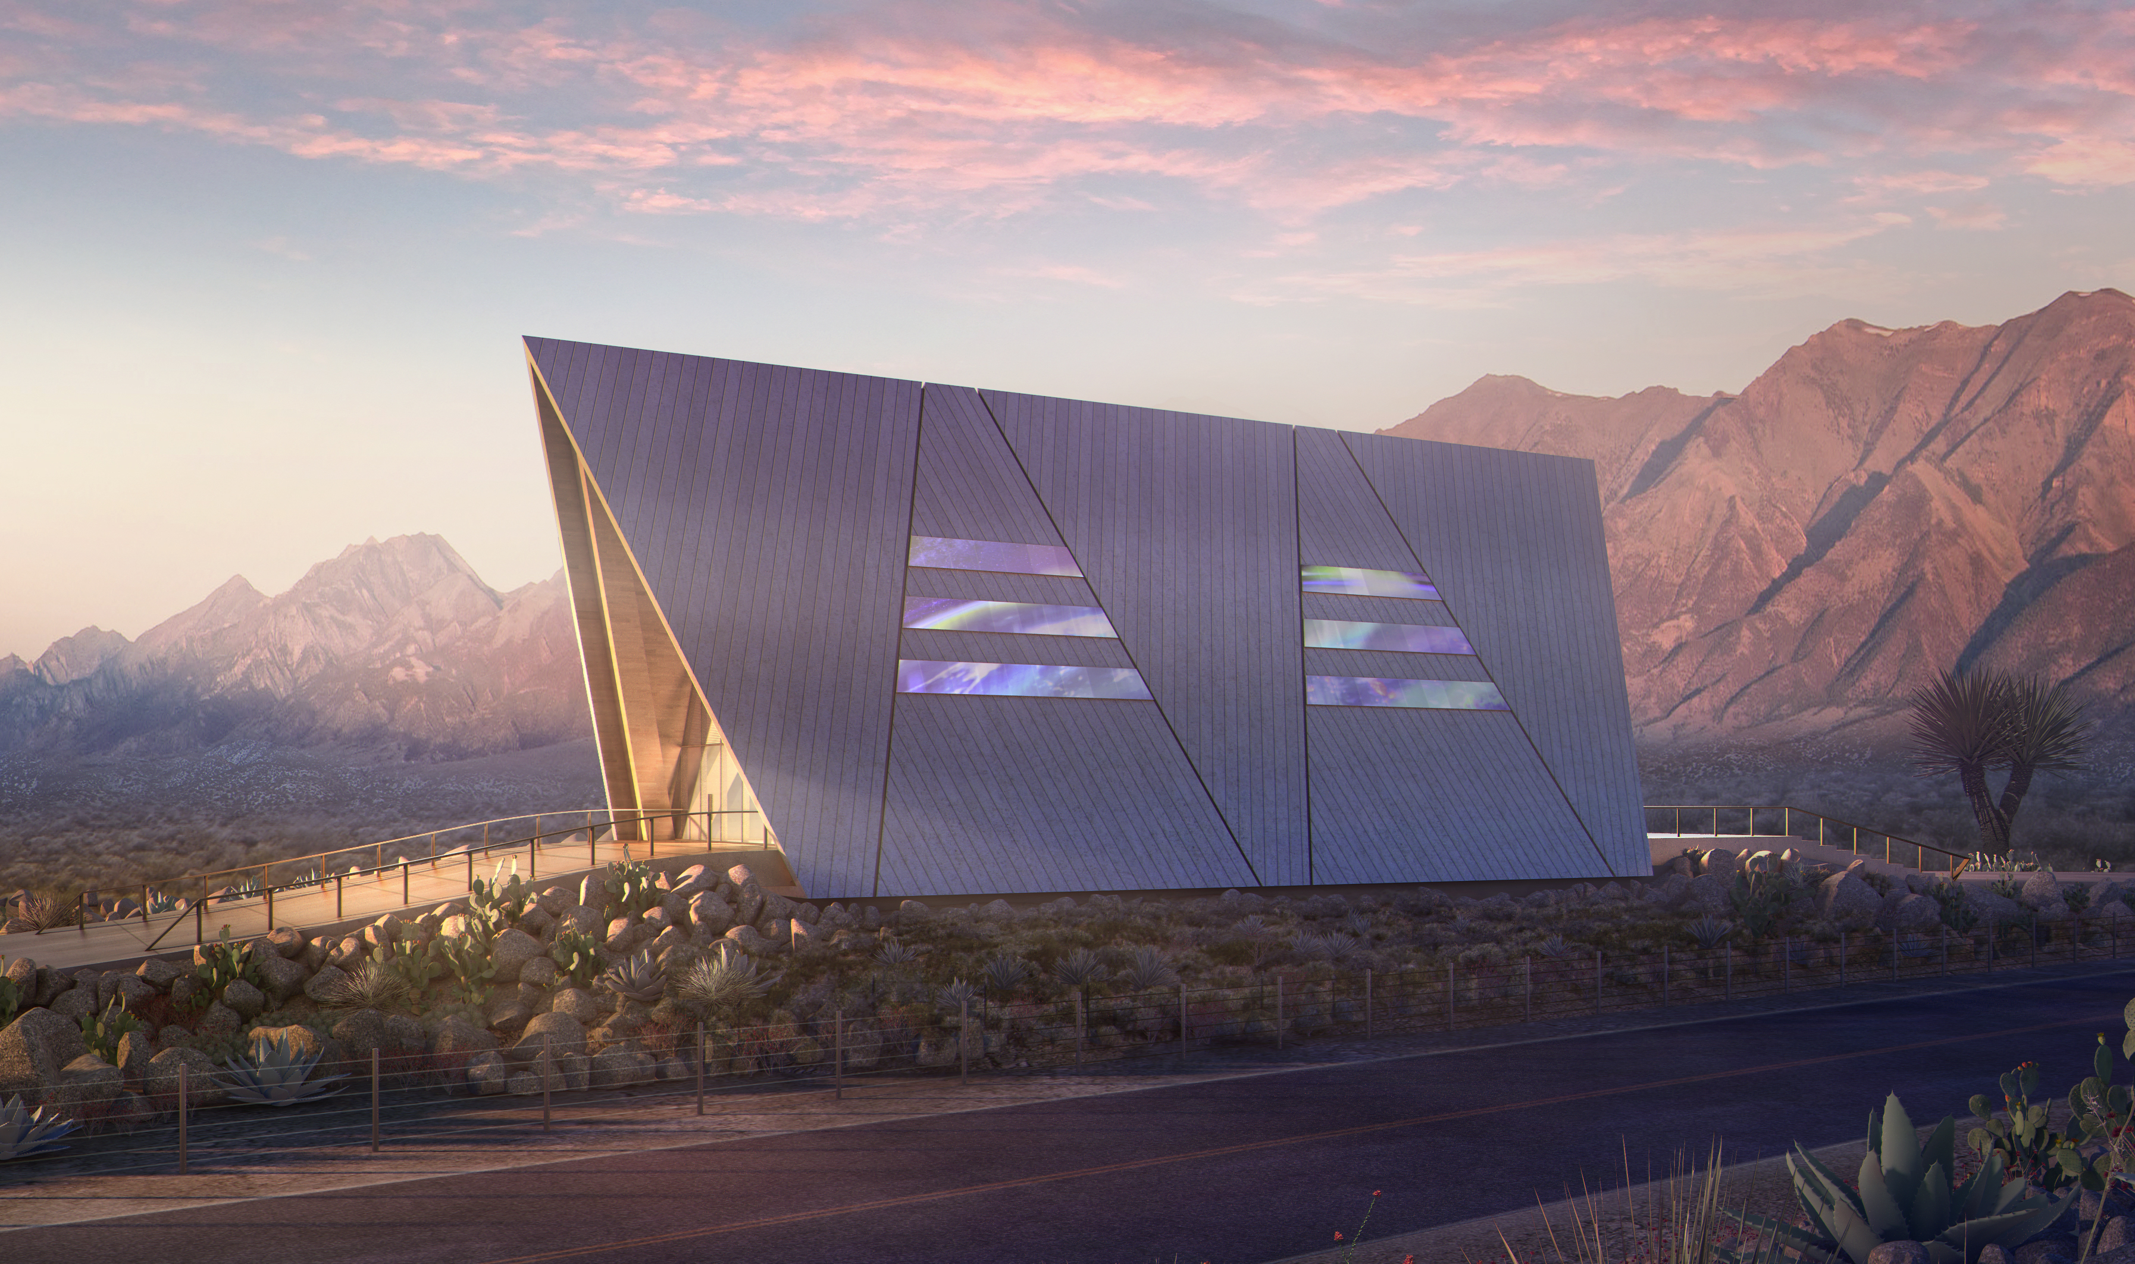
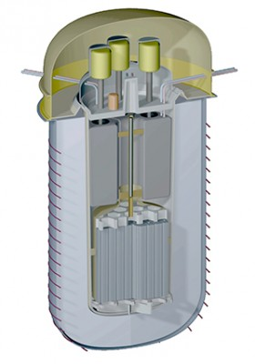
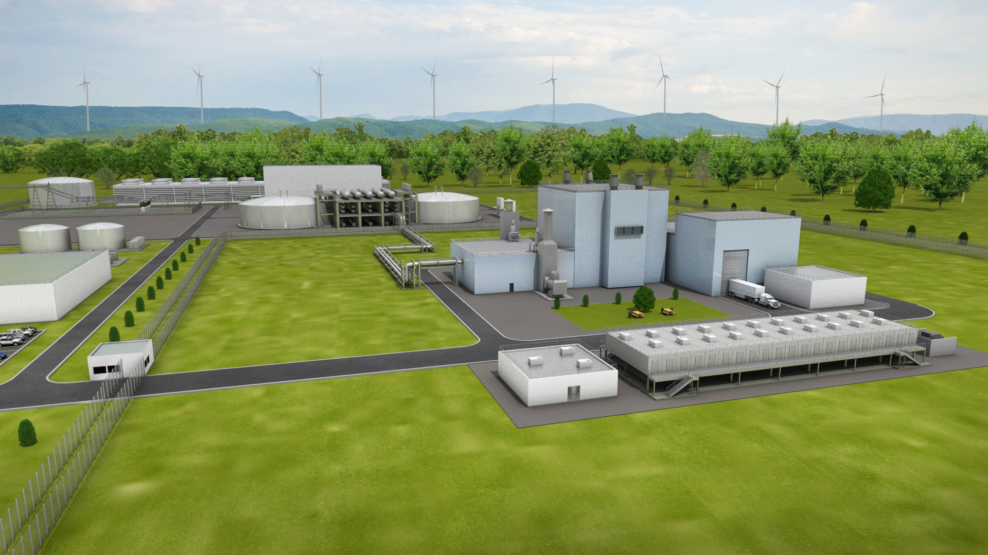
Representative Advanced Reactor Technologies
TRISO Fuel
High Temp
Gas Reactors
Micro Reactors
(< 10MW)
LWR SMRs
<300MW
Molten Salt Reactors
Liquid Metal Reactors
TerraPower Natrium (shown)
Several in development
Oklo (shown)
Approximately a dozen in development
NuScale (shown)
GEH BWR X-300
Holtec SMR-160
Terrestrial (shown)
Several in development
X-energy (shown)
Several in development
Non-Water Cooled
Most <300MW, some as large as 1,000 MW
NEI, Advancing Nuclear Technologies
Nuclear Innovation Alliance Technology Primer (July 2022)
NEA Small Modular Reactor Dashboard (Mar. 2023)

Slide 13
Advanced Reactor Safety Advantages
Building upon a strong safety record
Operating fleet: one of the safest industrial working environments
  Strong-Independent Regulator, Built tough, Operational Performance
Enhancing safety for advanced reactors*
  Safety profiles fundamentally differ from other power reactors
Inherent Safety Features
Rely on physics
Reduce Risks
Much smaller radionuclide inventory
Emergency Response
No credible event resulting in unacceptable off-site doses
Power
Additional coolant
Human actions
Minimize potential for accidents
Mitigate consequences
Fail-safe, shuts itself off
Natural circulation
Gravity
Emergency planning
Proliferation resistant fuel and enrichments below 20% U-235
Maintain safety without the need for:
Operational simplicity: very few instruments and controls
Robust hardened structures
Advanced fuel tech (TRISO)
*Features vary by design
Notes:
Operational safety is essential to everything that nuclear plants do. The U.S. nuclear industry continues to be recognized as one of the safest industrial working environments in the nation. The steps we take to guarantee safety at nuclear plants don’t just meet the standards created by the federal government—they exceed them.
Nuclear Plants Are Well-Run
Nuclear plants have a track record of safe operation. In the history of U.S. commercial nuclear energy, there have been no radiation-related health effects linked to their operation.
Our plants pursue excellence. An industry organization, the Institute of Nuclear Power Operations (INPO), sets best practices determined from years observing plant operations. INPO also conducts regular evaluations of nuclear plants, investigating all aspects of nuclear safety. The World Association of Nuclear Operators (WANO) does similar work on an international level. U.S. nuclear plants boast consistently high marks from WANO and INPO when it comes to safety system performance, operational excellence and industrial safety.
Plant Workers Are Well-Qualified
Nuclear plant operators must hold valid federal licenses to operate or supervise reactor controls. Obtaining a license requires extensive training, taking up to 24 months to complete before the U.S. Nuclear Regulatory Commission tests and certifies the operator.
Reactor operators continue training throughout the life of their license, spending one week sharpening their skills in the classroom and the reactor simulator for every five or six weeks of work.
Nuclear plant operators must be certified physically fit and mentally sound to operate a plant. All plant employees are subject to background and criminal history checks before they set foot in the plant.
How Employees Uphold A Safety Conscious Work Environment
Nuclear Plants Are Built Tough
Our nuclear plants are designed and licensed under an approach to safety called “defense-in-depth.” The key is multiple independent layers of protection. No single safety layer is exclusively relied upon, no matter how strong it may be.
Multiple physical barriers protect against an accidental radiation release, such as the rods that encase the uranium fuel used to power nuclear plants, the reactor that contains the fuel rods and the steel-reinforced concrete building that houses the reactor.
Several redundant and diverse safety systems ensure that the fuel rods in the reactor remain sufficiently cooled. Nuclear plants test these systems routinely to ensure they do their job.
FIND OUT ABOUT EMERGENCY PREPAREDNESS AT PLANTS
Nuclear Energy Is Heavily Regulated
The NRC licenses and regulates commercial nuclear energy. The NRC enforces its regulations with inspections, can levy fines—and can even order a plant to shut down.
Every nuclear plant is assigned at least two full-time on-site NRC inspectors, who are free to observe anything at the plant at any time.
The NRC and the industry routinely analyze events at nuclear plants throughout the world to identify possible improvements for U.S. plants. This approach has led to enhanced safety at our plants, including many modifications like the FLEX strategy that followed the accident at Fukushima. FLEX equipment is an important part of our overall safety strategy.
Safety is in the DNA of every U.S. nuclear energy plant. That’s one of the benefits of nuclear energy: U.S. plants are among the safest and most secure industrial facilities in the country. The safety of our employees and the communities in which we live and work is our top priority.
Nuclear power plants maintain the highest standard for operational safety, security, cybersecurity and emergency preparedness. The industry’s comprehensive safety procedures and stringent federal regulations keep our plants and neighboring communities safe

Slide 14
System Benefits of Advanced Reactors
Long term price stability
Low fuel and operating costs
Reliable dispatchable generation
24/7, 365 days per year, years between refueling
(Average capacity factors >92%)
Integration with renewables and storage
Paired with heat storage and able to quickly change power
Efficient land use
Other Environmental
Black-start and operate independent from the grid
Resilience for mission-critical activities
Protect against natural phenomena, cyber threats and EMP
Clean energy (carbon-free generation)
Many SMRs are being designed with ability for dry air cooling
Land utilization <0.1 acre/TWh (Wind =1,125 acre/TWh; Solar 144 acre/TWh) (due to nuclear’s high energy density)
Sources: SMR Start, SMRs in Integrated Resource Planning (Feb. 2020)
DOE, Pathways to Commercial Liftoff: Advanced Nuclear (Mar. 2023), available at https://liftoff.energy.gov/

Slide 15








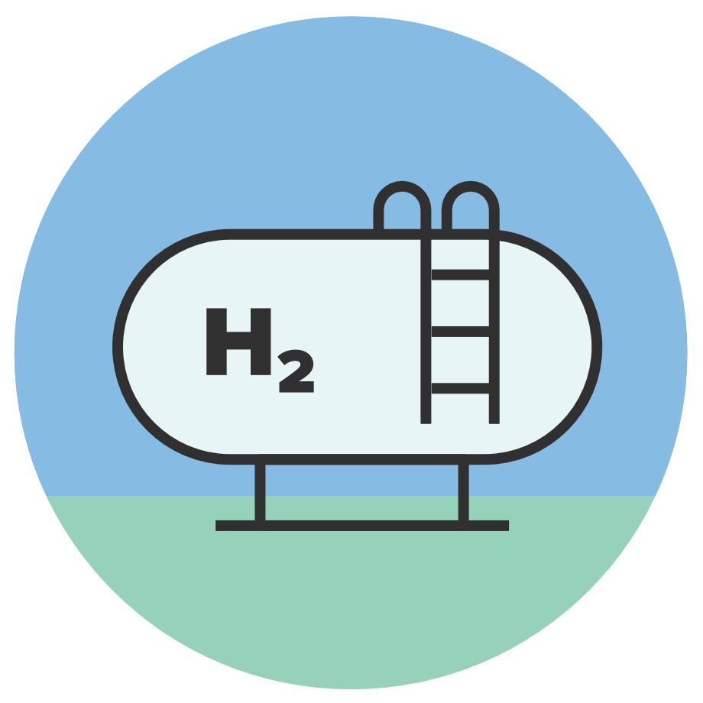






Advanced Nuclear’s Versatile Applications
Spectrum of Sizes and Options
Variety of Outputs
Multitude of Uses
Homes
Vehicles
Businesses
Micro
(Few MW)
Mini
(10s of MW)
Small
(100s of MW)
Electricity
Aviation
Rail
Shipping
H₂ Hydrogen
Concrete
Steel
Factories
Large (1,000+ MW)
Process Heat
Water
Space
Watch the video: https://www.youtube.com/watch?v=7zN_YLg-roo

Slide 16
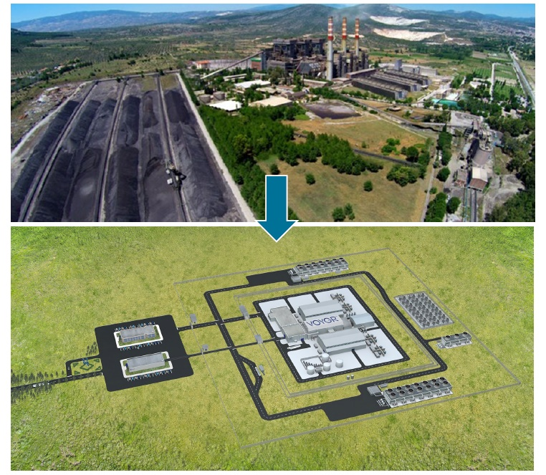
Possible Coal-to-Nuclear Plant Conversions
Coal power plant shutdowns can be devastating to local communities
SMRs can provide carbon-free
replacement power while:
  Retaining and retraining fossil plant
  workforce
  Reusing coal/gas plant infrastructure
  Preserving the local tax base/economy
  Benefiting the electric grid system
  Generating emissions-free power
Scott Madden, Gone with the Steam, Oct. 2021
INL, Transitioning Coal Power Plants to Nuclear Power, Dec. 2021
Good Energy Collective, Opportunities for Coal Communities through Nuclear, Dec. 2021
ORNL, TVA Coal-Fired Plant Potential for Advanced Reactor Siting, Sept. 2021
INL, Investigating Challenges Benefits and of Converting Retiring Coal Plants into Nuclear Plants, Sept. 2022

Slide 17
Advanced Reactor Cost-Related Advantages

Slide 18
Source: DOE, Pathways to Commercial Liftoff: Advanced Nuclear (March 2023)

Slide 19
Advanced Nuclear Deployment Plans
Projects in planning or under consideration in U.S. and Canada >20; Globally >30
State action or stakeholder interest in advanced reactors
Planned or considered project
Under construction
See Appendix to these slides for listing of specific projects.
Updated June 2023

Slide 20
North American Customer Interest
Utility/Customer | Recent Public Expressions of Interest in SMRs
Dominion | 2023 Integrated Resource Plan identifies need for up to 4.8 GWe by 2050, first plant online in 2034
Dow | Investment in X-energy and deployment of Xe-100 by 2030 for electricity and process heat
Duke | Pursuing Early Site Permit in North Carolina, plans for 7.7 GWe between 2032 and 2048
Entergy | Plans for SMR-160 by early 2030’s
Energy Northwest | Considering deployment of advanced reactors; July 2023 Joint Development Agreement with X-energy
NB Power | Plans for ARC-100 and Moltex MSR by early 2030’s
Nucor Steel | Investment in NuScale and interest in deployment for electricity
NPPD | SMR feasibility and potential site study
OPG | Submitted Construction Permit application for BWRX-300 at Darlington for operation by 2029
PacifiCorp | Deployment of Natrium by 2029, and IRP includes 2 more plants
SaskPower | Selected BWRX-300 for future deployment
TVA | Construction Permit application for BWRX-300 at Clinch River in late 2023
UAMPS | Combined Operating License application for NuScale VOYAGR-6 in Idaho in early 2024
Universities | Univ. of Illinois, Penn State, Purdue, Abilene Christian University
US Government | Air Force pursuing micro-reactor in Alaska
Others | Dairyland Power, Grant County PUD, Copper Valley, Compass Mining, Sask Research Council,

Slide 21
Challenges to New Nuclear Deployment
Success with FOAK plants
  Establish new nuclear builds as predictable – on time and on budget
NRC Licensing Efficiency
  Unprecedented scale of licensing effort
Siting Issues
  Public acceptance/engagement, environmental reviews, transmission
Reliable Fuel Supply
  Need to establish domestic HALEU infrastructure (can’t rely on Russia)
Supply Chain Ramp-up
  Global demand race – new reactor construction worldwide
Workforce Expansion
  Licensing, construction, supply chain, plant operation
Facilitation of Exports
  Market competition from China, Russia, South Korea
Used Fuel Management
  Still lack permanent disposal site; opposition to CISF in TX, NM
DOE, Pathways to Commercial Liftoff: Advanced Nuclear (Mar. 2023), available at https://liftoff.energy.gov/
McKinsey & Company, What will it take for nuclear power to meet the climate challenge? (Mar. 2023)

Slide 22
Priority Actions to Address Challenges
Optimize industry-wide design simplification, standardization and modularization; repeat siting; individual-project best practices
Promote efficient NRC safety and environmental licensing reviews
Early engagement with state regulators and local communities
Support aggressive government and industry efforts to build a skilled workforce, supply chains, and HALEU fuel supply
Ensure electricity markets value nuclear’s capabilities and benefits
Promote ways to incentivize domestic and foreign private financing of U.S. advanced nuclear technologies and projects
See DOE Advanced Nuclear Commercial Liftoff Report and EPRI/NEI Advanced Reactor Roadmap – Phase 1: North America

Slide 23

Questions Related to NEI and Advanced Nuclear?
Marty O’Neill
Associate General Counsel
Nuclear Energy Institute
mjo@nei.org
NEI just launched its Advanced Reactor Hub at:
https://www.nei.org/news/2023/welcome-to-the-advanced-nuclear-hub

Slide 24
Appendix – Supplemental Slides

Slide 25
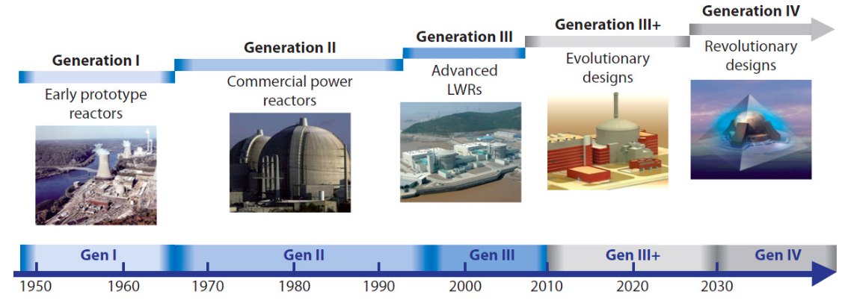
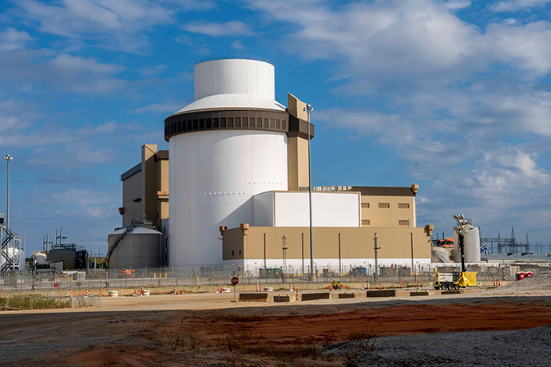
Generations of Nuclear Power Reactors
Vogtle Units 3 & 4
(Westinghouse AP1000)
Reference: World Nuclear Association, “Advanced Nuclear Power Reactors”, available at https://world-nuclear.org/

Slide 26
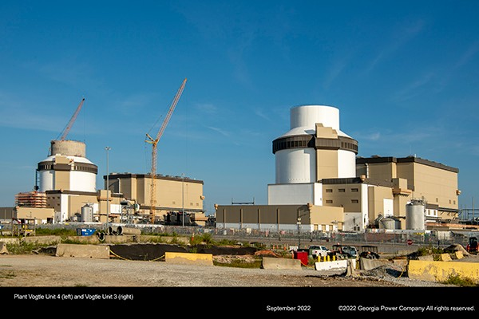
New Vogtle Units 3 & 4 to Begin Operation in 2023
Two Westinghouse
AP-1000 Reactors
1100 MW(e) each
Both units entering operations in 2023
First new power reactors built in U.S. in decades
Four AP-1000 units already operating in China
Containment Progress as of Sept. 2022 (Waynesboro, GA)
Courtesy: Georgia Power

Slide 27
Source: DOE, Pathways to Commercial Liftoff: Advanced Nuclear (March 2023)

Slide 28
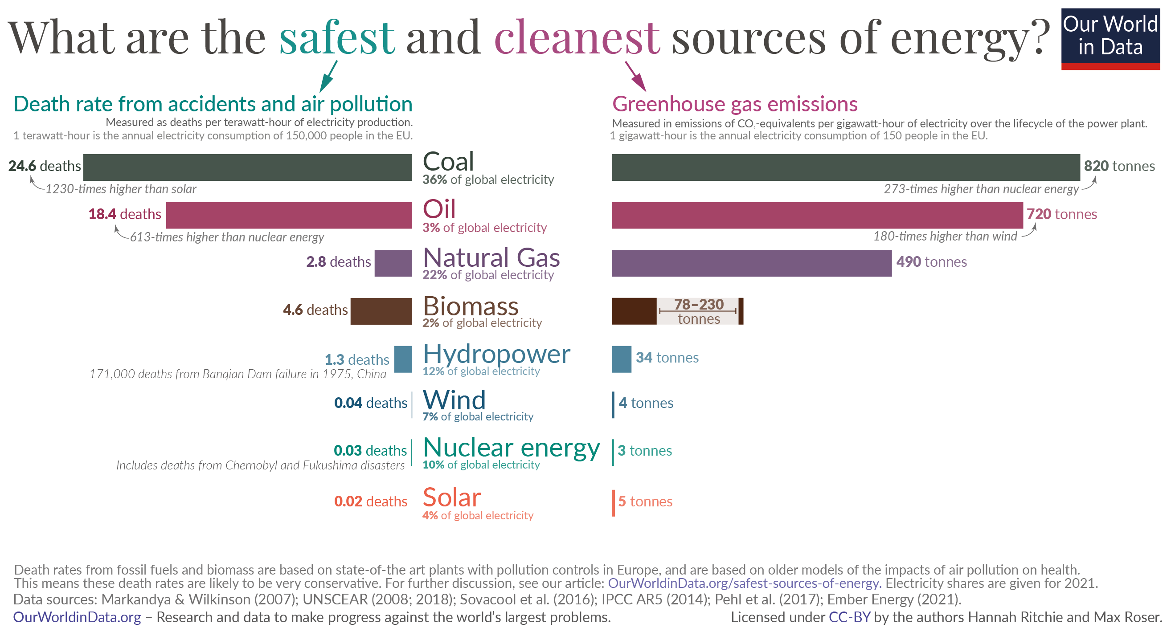

Slide 29
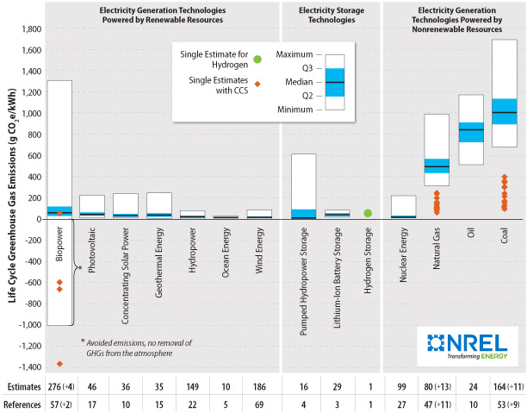
Nuclear Energy Has Among the Lowest Lifecycle GHG Emissions of All Generation and Storage Technologies
NREL, Life Cycle Assessment Harmonization, https://www.nrel.gov/analysis/life-cycle-assessment.html

Slide 30
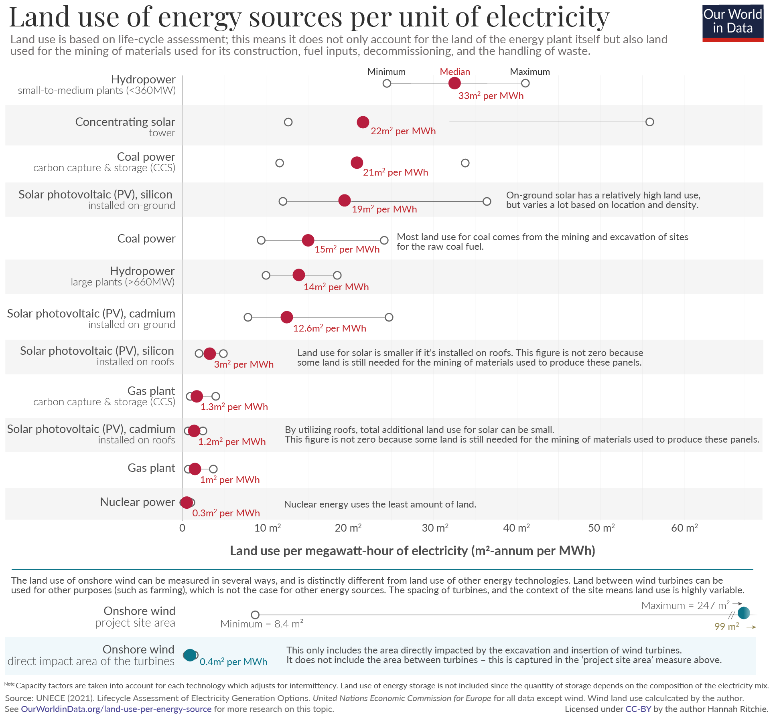
Nuclear’s High Energy Density Means Lower Land Use Requirements Relative to Other Generation Sources

Slide 31
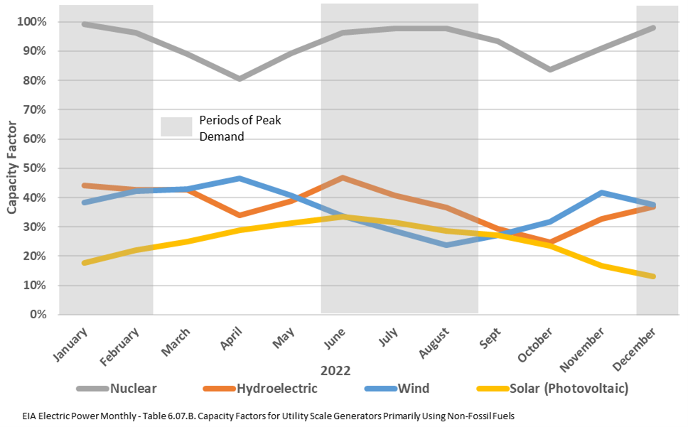
Nuclear’s High Capacity Factor Make it Highly Reliable

Slide 32
Growing Recognition of Nuclear as an ESG Asset
Center for ESG and Sustainability (CESG), Columbia University, Solving the Energy Trilemma: The Case for Nuclear as a Sustainable Investment (Oct. 2022)
Brookfield Asset Management, A New Dawn for Nuclear Power (Sep. 2022)
OECD-NEA, Meeting Climate Change Targets: The Role of Nuclear Energy (May 2022)
LucidCatalyst, Beautiful Nuclear (June 2022)
International Energy Agency, Nuclear Power and Secure Energy Transitions: From Today’s Challenges to Tomorrow’s Clean Energy Systems (June 2022)
Morgan Stanley, The Nuclear Revival: Embracing a Clean, Reliable and Safe Source of Energy (Apr. 2022)

Slide 33
Utility Carbon Emission Projections Based on Pledges
Source: ABB Velocity Suite, U.S. Environmental Protection Agency, utility press releases.

Slide 34
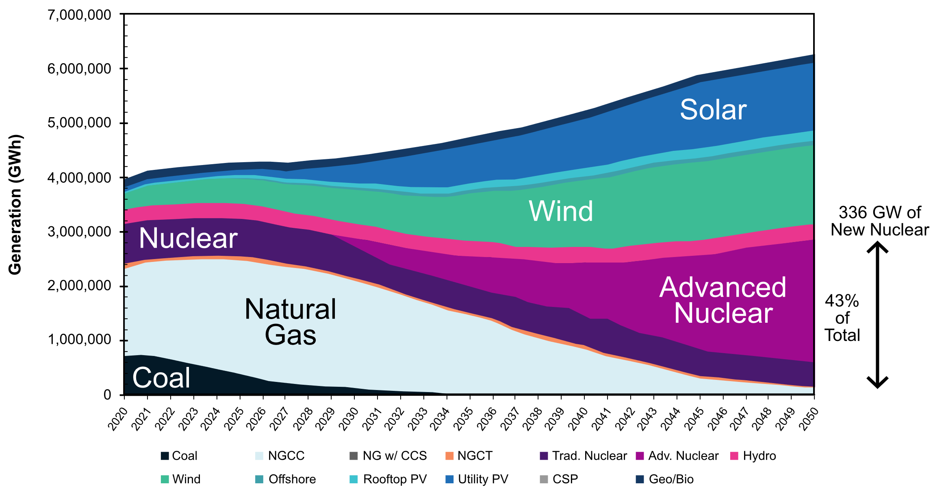
U.S. Market Opportunity for Advanced Nuclear
VCE Modeling Forecast (Nominal Case)
Source: Vibrant Clean Energy, Role of Electricity Produced by Advanced Nuclear Technologies in Decarbonizing the U.S. Energy System (June 2022), available at https://www.vibrantcleanenergy.com/media/reports/

Slide 35

Advanced Nuclear Can Help Meet a Wide Range of Process Heat Temperature Needs
H2 Production - Low Temperature Electrolysis
Seawater Desalination
District Heating
Pulp and Paper Production
Tar Sands Oil Production
Petrochemical (Ethylene, Styrene) Production
Oil Refining & Ammonia/
Fertilizer Production
H2 Production – High Temperature Steam Electrolysis
H2 Production - Methane Reforming
H2 Production - Thermochemical
Cement & Glass Manufacturing
200ºF
2000ºF
Source: Nuclear Cogeneration, civil nuclear energy in a low-carbon future policy briefing, The Royal Society,
Oct. 2020, https://royalsociety.org/topics-policy/projects/low-carbon-energy-programme/nuclear-cogeneration/

Slide 36
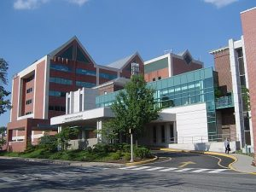
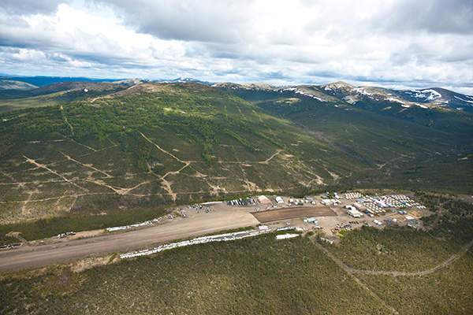
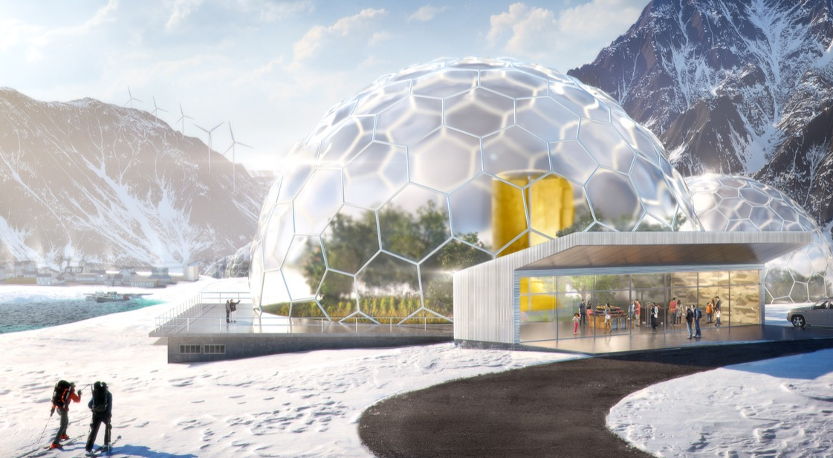
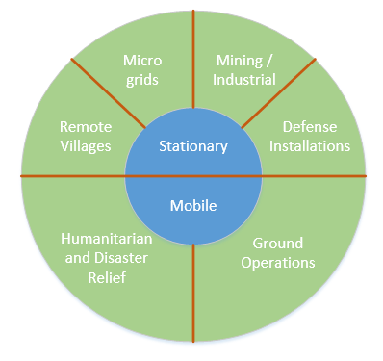
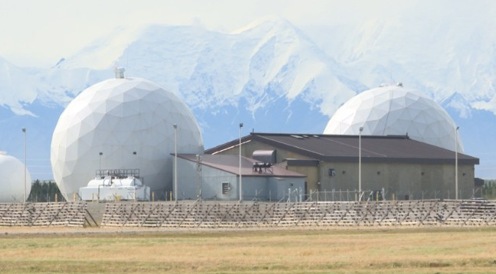

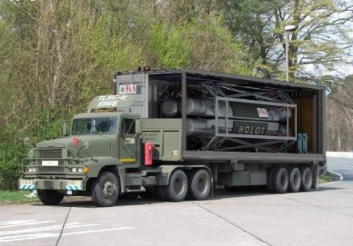
Micro-Reactor Market Opportunities

Slide 37
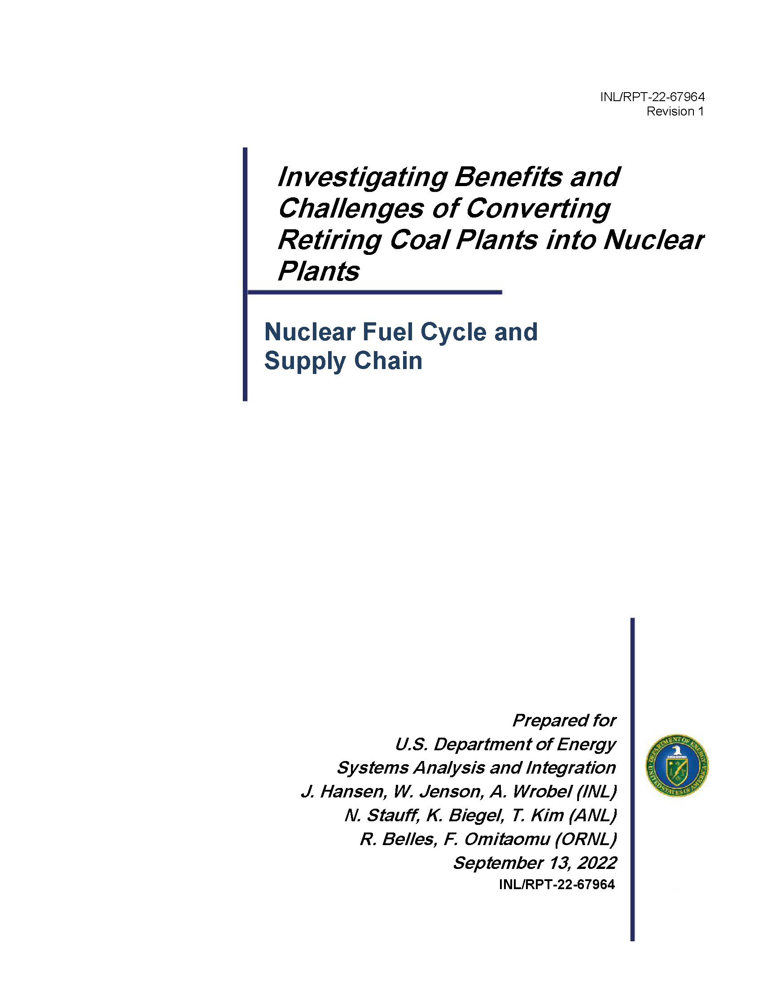
DOE: Benefits of Coal-to-Nuclear Transition
Potential candidates
  157 retired coal plant sites
  237 operating coal plant sites
GHG emissions could fall by 86%
650 permanent positions
$275 million in annual economic activity

Slide 38
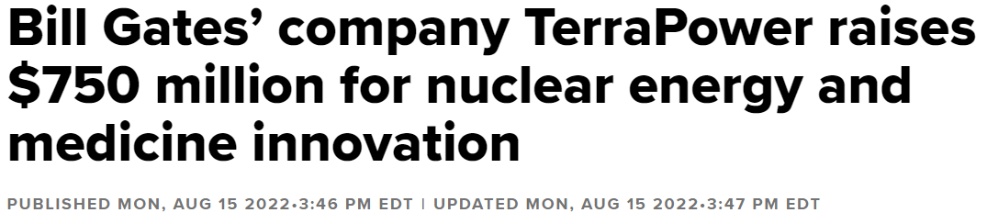

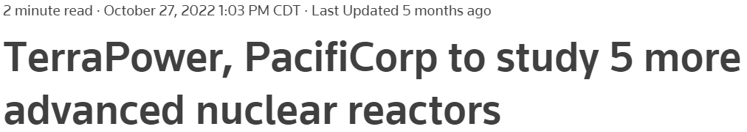

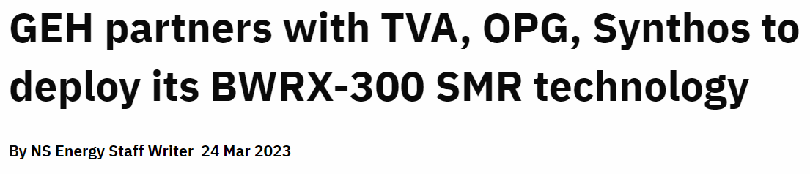
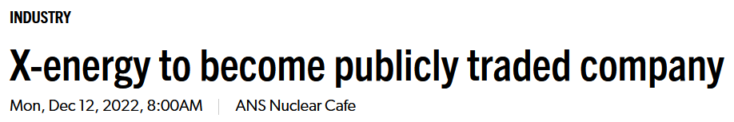
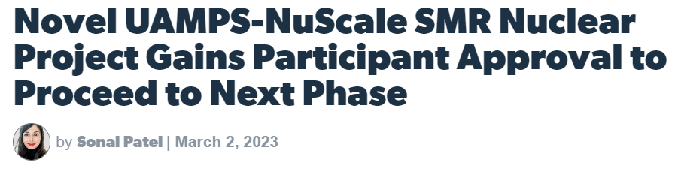
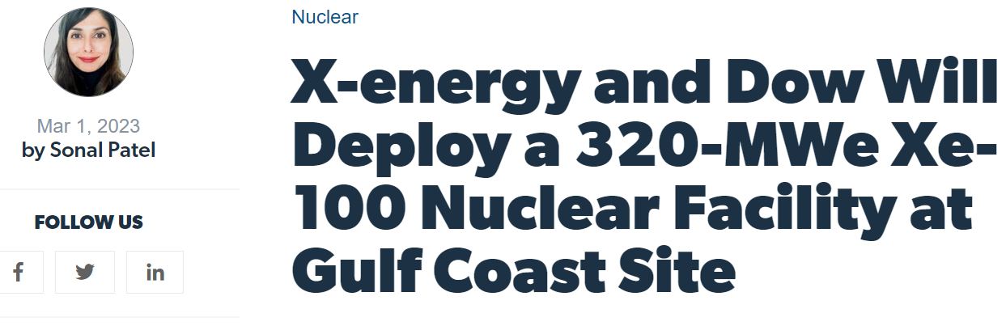

Advanced Nuclear in the News

Slide 39
Advanced Reactor Deployment Plans (1/2)
Grid-scale reactors
Updated 5/11/2023
Developer | Utility / User | Location | Size | Target Online
NuScale | UAMPS | Idaho, USA | 6 @ 77 MWe | 2029
 | KGHM Polska Miedz | Poland | 6 @ 77 MWe | 2029
 | Nuclearelectrica | Romania | 6 @ 77 MWe | 2028
GEH BWR X-300 | OPG | ON, Canada | 300 MWe | 2028
 | TVA | TN, USA | 300 MWe | 2032
 | Synthos & Orlen | Poland | 300 MWe (>10 plants) | Early 2030s
 | SaskPower | Sask., Canada | ~300 MWe (4 plants) | 2032 to 2042
Holtec SMR-160 | TBD | NJ, USA | 160 MWe | 2030
 | Entergy | Gulf Coast, USA | 160 MWe | Early 2030s
X-energy | Dow | Texas, USA | 4 @ 80MWe | 2030
TerraPower | Pacific Corp. | Wyoming, USA | 345 – 500 MWe | 2030
ARC | NB Power | NB, Canada | 100 MWe | 2030
Moltex | NB Power | NB, Canada | 300 MWe | 2032
TBD | Purdue/Duke Energy | Indiana, USA | TBD | TBD

Slide 40
Advanced Reactor Deployment Plans (2/2)
Micro-reactors and low scale test reactors
Updated 5/25/2023
Developer | Utility / User | Location | Size | Target Online
Oklo | Oklo | Idaho, USA | 15 MWe | 2026
 | Oklo | Ohio, USA | 2 @ 15 MWe | 2028
 | Compass Mining | TBD | TBD (150 MWe total) | TBD
Ultra Safe Nuclear | Global First / OPG | CRL, Canada | 5 MWe | 2025
 | University of Illinois | Illinois, USA | 5 MWe | 2027
 | Copper Valley (CVEA) | Alaska, USA | 5 MWe | TBD
Westinghouse | Sask Research Council | West Canada | 5 MWe | 2027
 | Bruce Power | ON, Canada | 5 MWe | 2027
 | Penn State University | USA | 5 MWe | 2027
Radiant | TBA | Idaho, USA | 1.2 MWe | 2026
TBD | Eielson AFB | Alaska, USA | 1 – 10 MWe | 2027
BWXT | DoD SCO | Idaho, USA | 1.5 MWe | 2024
Kairos Power | Kairos | TN, USA | 35 MWth | 2026
Natura | Abilene Christian University | TX, USA | 1 MWth | 2025
TBD | Univ. of Missouri | MO, USA | TBD | TBD

Slide 41
Regulatory Priorities for Advanced Reactors
Regulatory objectives
  Streamline regulatory processes for timelier & more efficient review and oversight
  Resolve key generic technical or policy topics well before applications are submitted (optimize pre-application engagement process)
  Revise or establish new regulations quickly to achieve regulatory framework modernization
NRC Review Efficiency
Environmental Reviews
Physical Security
Emergency Preparedness (EPZ & Planning Standards)
Near Term Risk-informed Technology Inclusive Regulatory Guidance
Parts 50/52 LL Rulemaking
Part 53
Annual Fees for Non-LWRs
Siting
Advanced Manufacturing Technologies
Fuel Qualification
Operations
Source: NEI Input on Regulatory Priorities for New and Advanced Reactors, June 7, 2022

Slide 42




NRC Efforts to Modernize the Regulatory Framework
Functional Containment (SECY-18-0096)
Part 53
Emergency Preparedness (SECY-22-0001)
Advanced Nuclear Reactor GEIS
Physical Security for Advanced Reactors
Technology-Inclusive, Risk-Informed Regulatory Framework
Licensing Modernization Project
TICAP/ARCAP
Fuel Qualification (NUREG-2246)
Application Level of Detail
RG 1.233
Adv Rx Siting
(SECY-20-0045)
See U.S. NRC, SECY-23-0022, “Advanced Reactor Program Status”
4

