Slide 1
Hydrogen – A Versatile Clean Energy Carrier
Texas Environmental Superconference
Friday August 4, 2023

Slide 2
Sunlight and Wind in a Jar
How can we capture sunlight and wind at large scale and ship it around the world?

Slide 3
Hydrogen 1.01
Most abundant element in the universe
Present in common substances (water, sugar, methane)
Very high energy by weight (3X more than gasoline)
A versatile clean energy carrier with a wide rage of applications
Challenges
Rarely found naturally, must make from water or hydrocarbon sources
Production, storage, and transport are all energy intensive
Today costs are relatively high and infrastructure is limited
Hydrogen emissions can prolong GHG in the atmosphere
How we will use and produce hydrogen is not without controversy

Slide 4
Hydrogen in the U.S. Today

Slide 5
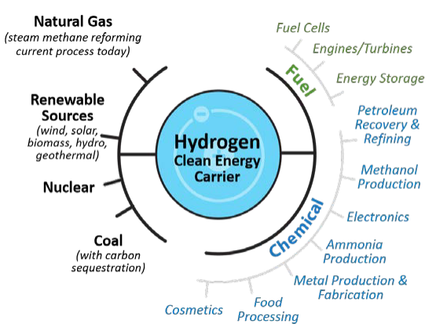
Hydrogen’s Role in Decarbonization
Hydrogen can enable U.S. energy security, resiliency, and economic prosperity, and is part of an “all of the above” energy strategy for these reasons:
Hydrogen can be produced from diverse domestic resources for use in multiple sectors, or for export.
Hydrogen has the highest energy content by weight of all known fuels―3X higher than gasoline―and is a critical feedstock for the entire chemicals industry, including liquid fuels.
Hydrogen and fuel cells can enable zero or near zero emissions in transportation, stationary or remote power, and portable power applications.
Hydrogen can be used as a “responsive load” on the grid to enable grid stability and gigawatt-hour energy storage, and increase utilization of power generators, including nuclear, coal, natural gas, and renewables.
Hydrogen can enable innovations in domestic industries, such as transportation (e.g., in vehicles, aviation, and marine applications) and iron making.
Source: https://www.energy.gov/sites/default/files/ 2020/07/f76/hfto-h2-at-scale-handout-2020.pdf
Notes:
https://www.iea.org/data-and-statistics/charts/global-hydrogen-demand-by-sector-in-the-net-zero-scenario-2020-2030

Slide 6
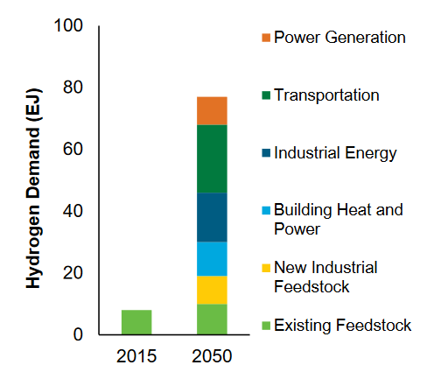
Why Now is an Exciting Time for Hydrogen
New hydrogen markets are emerging
International momentum is building to develop a hydrogen energy economy
Department of Energy programs and goals
U.S. Policy supporting hydrogen infrastructure and production
Source: “Hydrogen Scaling Up.” Hydrogen Council. November 2017. http://hydrogencouncil.com/wp-content/uploads/2017/11/Hydrogen-scaling-up-Hydrogen-Council.pdf

Slide 7
National Hydrogen Strategies
Netherlands
Norway
Germany
Spain
EU
Portugal
France
Chile
Finland
Canada
Italy
Hungary
Morocco
Uzbekistan
Belgium
Poland
Russia
Slovakia
United Kingdom
Colombia
Uruguay
United States*
Egypt
China
Singapore
Austria*
Sweden*
Brazil*
Oman
Saudi Arabia*
South Korea
Australia
Japan
2017
2018
2019
2020
2021
2022
* Drafts of strategies in preparation

Slide 8
DOE low-carbon hydrogen cost targets
Launched in June 2021, the Hydrogen Earthshot sets a target to reduce the cost of clean hydrogen to $1/kg by 2032
80% cost reduction compared to current average cost of producing hydrogen from renewable energy ($5/kg)
Modeled after the successful SunShot Initiative that drove cost declines in solar energy
Other Energy Earthshot initiatives include: Long Duration Storage Shot, Carbon Negative Shot, Enhanced Geothermal Shot, Floating Offshore Wind Shot, and Industrial Heat Shot

Slide 9
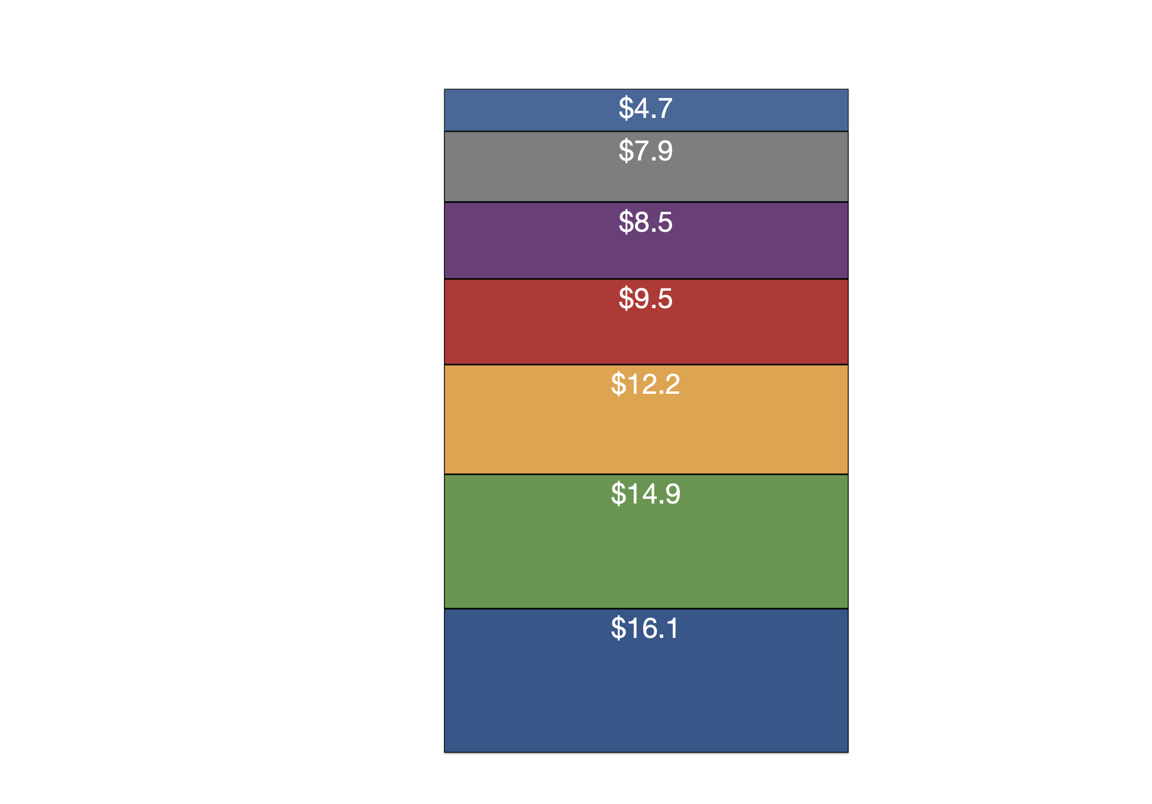
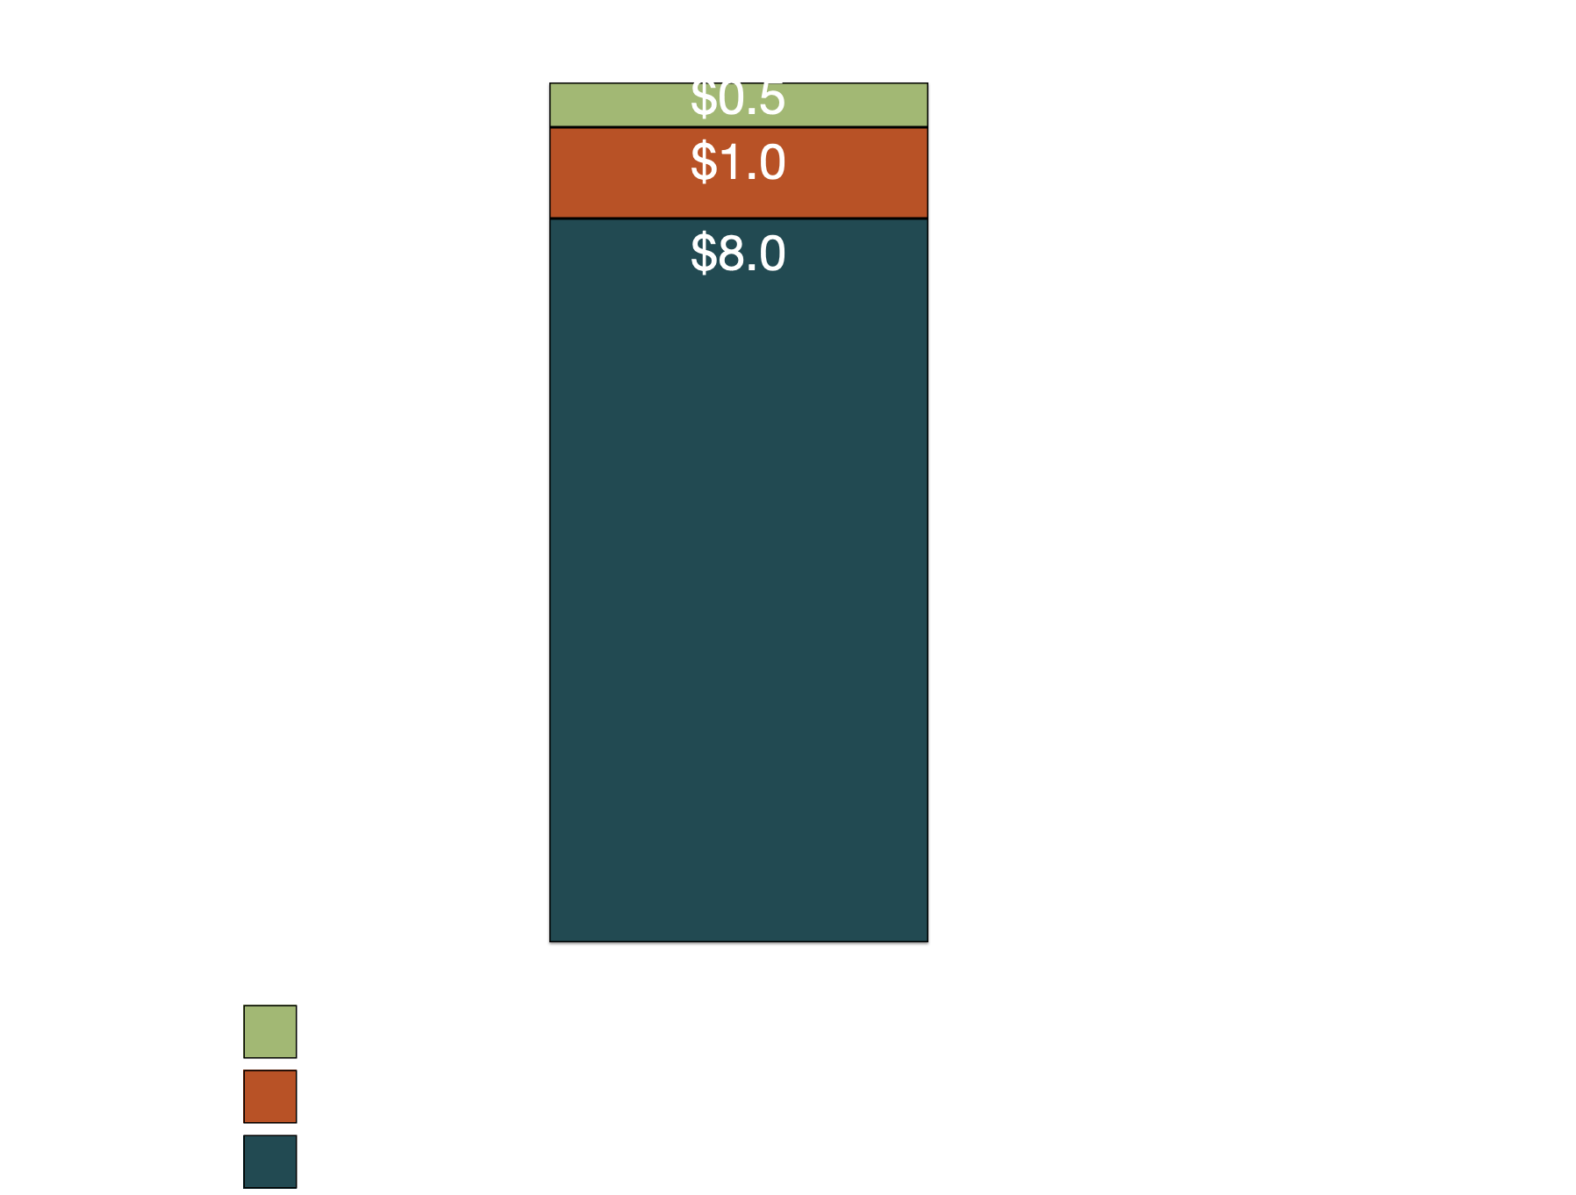
Infrastructure Investment and Jobs Act included $9.5 billion for hydrogen programs
Hydrogen Programs

Slide 10
Regional Clean Hydrogen Hub Program
Production
End Use
Geography
At least one from…
At least one in…
Each in different regions of the US
Residential and commercial heating
Renewable energy
Electric power generation
Nuclear energy
At least two in…
Transportation
Natural gas producing regions
Fossil fuels
Industrial sector

Slide 11
The new clean hydrogen production tax credit included in the IRA could make clean hydrogen competitive
Clean hydrogen PTC has a tiered credit value structure based on production emissions
Emissions Threshold | Credit Value (assumes 5x bonus)
>= 2.5 kg CO_{2e}/kgH₂ & < 4 kg CO_{2e}/kg H₂ | $0.60/kg H₂
>= 1.5 kg CO_{2e}/kgH₂ & < 2.5 kg CO_{2e}/kg H₂ | $0.75/kg H₂
>= 0.45 kg CO_{2e}/kgH₂ & < 1.5 kg CO_{2e}/kg H₂ | $1.00/kg H₂
< 0.45 kg CO_{2e}/kg H₂ | $3.00/kg H₂
*Approximate prices of current production methods to demonstrate impact of tax credit

Slide 12
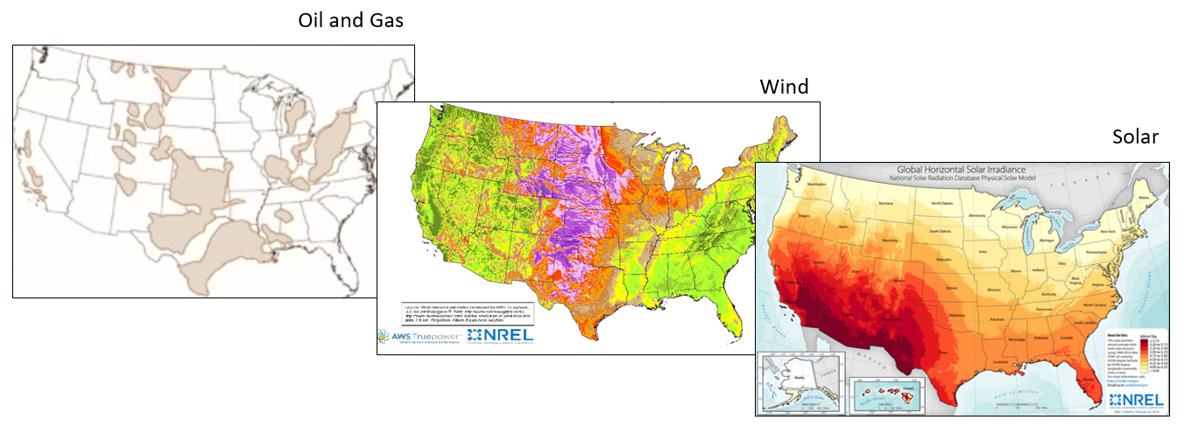
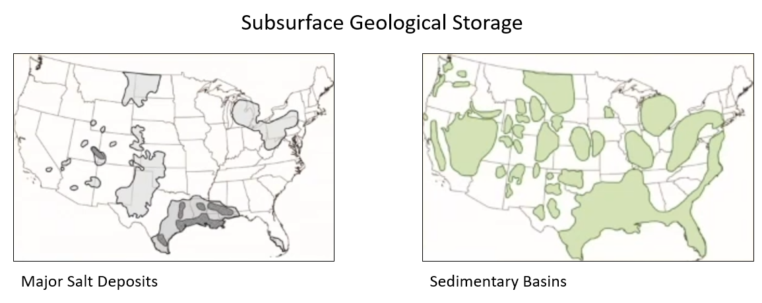
Why Hydrogen in Texas?
Currently produce about 1/3 of total US hydrogen production in Texas
3 MMT of 10 MMT consumed annually in US
Hundreds of miles of existing hydrogen pipelines
Ample resources for hydrogen production
Both natural gas and renewable energy
Geology well suited for storage of H2 and CO2 required for hydrogen production applications with CCS
Industry leaders located in Texas

Slide 13
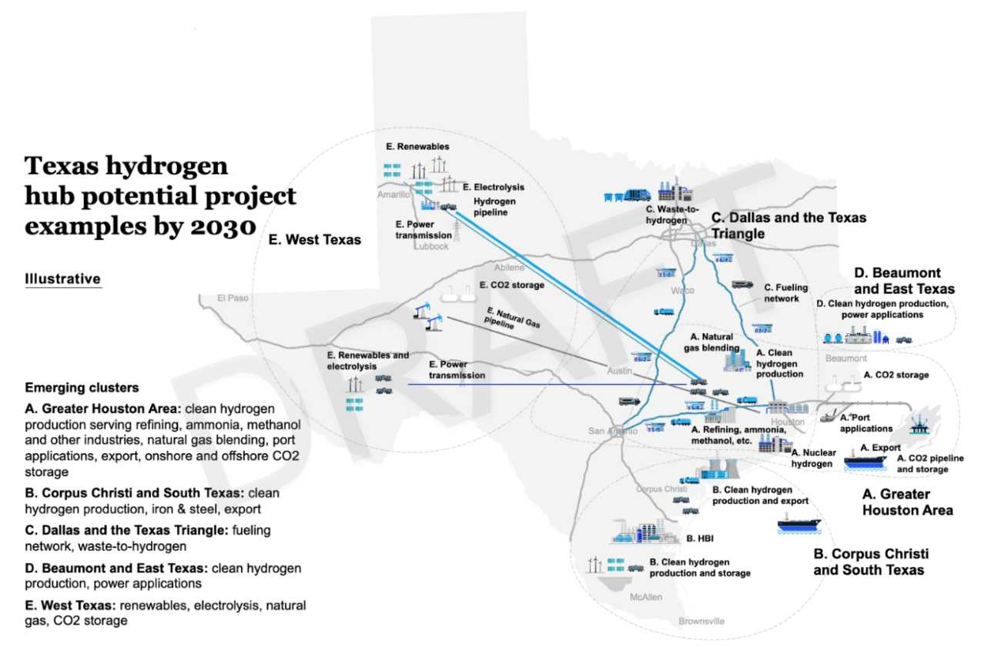
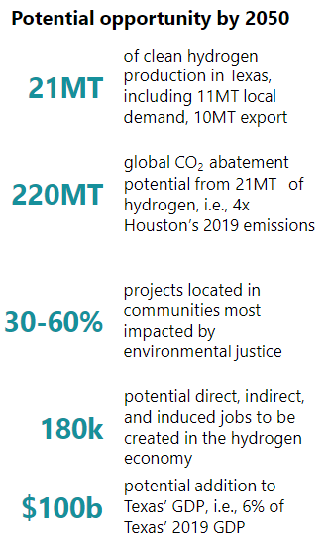
A Potential Hydrogen Economy in Texas
Study led by Center for Houston Future

Slide 14
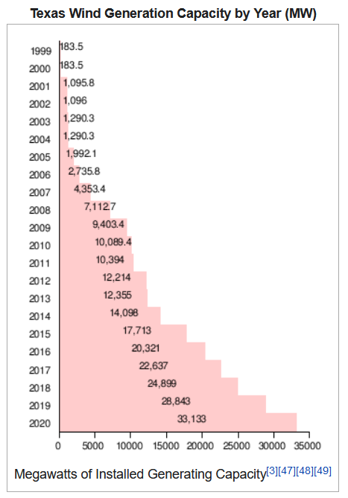
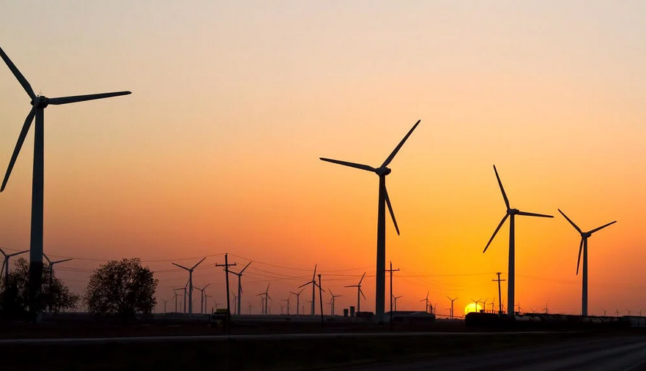
There is a model for Hydrogen…
Wind Power development in Texas
PTC enabled the business opportunity
Renewable Portfolio Standard spurred growth
CREZ later expanded electric transmission corridors
Provided value for land owners and jobs for local communities
Infrastructure Incentives and Hydrogen Production Tax Credit policies could enable similar growth for hydrogen
PTC & Renewable Portfolio Standard
CREZ

Slide 15
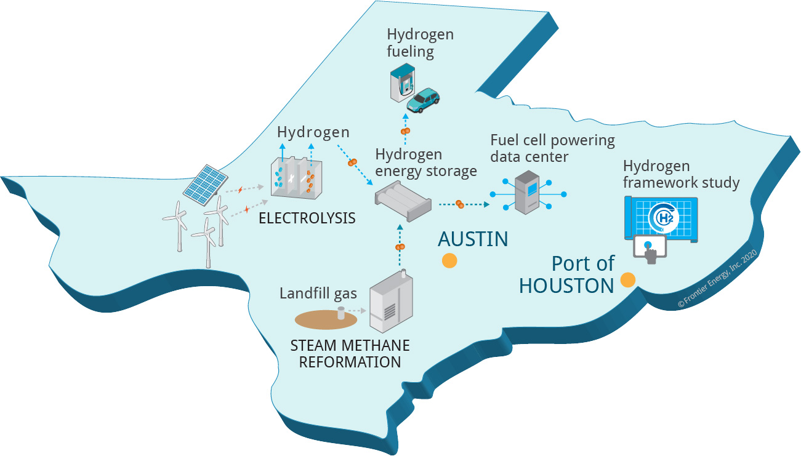
Demonstration and Framework for H2@Scale in Texas
Two Research Tracks
Demonstrate multiple RH2 generation options, co-located with vehicle fueling and a large base load consumer to enable cost-effective H2 energy solutions
Develop framework for actionable H2@Scale pilot plans in Texas, Port of Houston and Gulf Coast region, including energy storage
Sponsored by the Department of Energy – EERE with cost share from project partners

Slide 16
MICHAEL
LEWIS
Research Scientist
Center for Electromechanics
mclewis@cem.utexas.edu
(512) 232-5715

Slide 17
H2@UT - https://sites.utexas.edu/h2/
UT has about 80 researchers working across the entire field of hydrogen production, storage, transmission, and use
Providing information to industry and government supporting prudent decisions to guide the growth of the hydrogen economy
Educating students who will lead future hydrogen growth

