Slide 1
Harris County district attorney’s Environmental Crimes division
Assistant District Attorney
Kristena Glenn

Slide 2
Historical Perspective
Began in the mid to late 1970s under DA Carol Vance as the “Pollution Division”
He assigned 1 prosecutor and a small support staff until the 1990s when an additional DA Assistant was assigned to the division
In the mid-1990s, DA Johnny Holmes changed the name of the ”Pollution Division” to the Environmental Crimes Division

Slide 3
Current Perspective

Slide 4
Environmental Crimes Division Today
3 Prosecutors
2 Paralegals
Team handles a large caseload (Approx. 500 cases annually)
Cases involve both corporate polluters and unsophisticated law violators
Often the suspect/defendant is not an average criminal offender

Slide 5
Harris County Environmental Civil and Criminal Investigatory Agencies
Harris County Pollution Control Services (HCPCS)
Houston Police Department (Major Offenders)
Harris County Constables Office – Precincts 1, 3, and 4
Texas Parks & Wildlife Department
Texas Commission on Environmental Quality (TCEQ)
Harris County Attorney’s Office
Texas General Land Office (GLO)
Federal Agencies too:
EPA
USGC

Slide 6
Crimes Prosecuted
Solid Waste – Chapters 361 and 365 of the Health and Safety Code
Air Pollution – Texas Clean Air Act § 7.177 - § 7.183 of the Texas Water Code (Includes Endangerment Crimes)
Water Pollution – Chapter 7 of the Texas Water Code
Hazardous Waste Pollution - § 7.163 of the Texas Water Code. Consult 40CFR for definition of hazardous waste
Used oil violations - Chapter 7 of the Water Code, § 7.176, 30 TAC, 40 CFR 279.22
Motor Tax Fuel Violations – Tax Code Chapter 162
Texas Park and Wildlife Cases – Sewage discharges from boats; industrial waste discharges (fish houses/seafood processors); prohibited species cases (non-native fish/plant life)
Traditional Penal Code Offenses – Assault and Negligent Homicide, Tampering with a Government Document

Slide 7
2023 Case Load
Cases Pending
22 Water pollution
342 Illegal dumping
9 Texas Parks & Wildlife
Investigations
67 Illegal dumping
26 Water Pollution
16 Used Oil Violations
5 Texas Parks & Wildlife
5 Traditional Penal Code
54 Traditional Penal Code
12 Used Oil Violations

Slide 8
Evidence Based Prosecution
Documentary Evidence: Corporate business records may be obtained by a Grand Jury subpoena without infringing on 4th and 5th Amendment rights. Emails may reveal thought processes, knowledge, and intent
Testimonial Evidence: Employees, neighbors, other professionals without privilege, and experts could be witnesses in an environmental crimes case
Physical Evidence: Parts, machinery, soil samples, labs, air monitoring data
Clean up as Cover-up?: Use extreme caution when remediating immediately

Slide 9
Prosecuting Illegal Dumping

Slide 10
What is mostly being dumped?
Household litter
Tires
Couches
Construction materials
Dirt
LITTER

Slide 11
The majority of our filings are for illegal dumping crimes
We currently have over 340 illegal dumping cases filed, and will likely have 50-100 additional illegal dumping cases filed by year’s end
These are crimes committed by people often unemployed and with nonviolent criminal histories.
However we also prosecute the person driving the crimes (i.e. employers) who are often more sophisticated, i.e. commercial dumpers

Slide 12
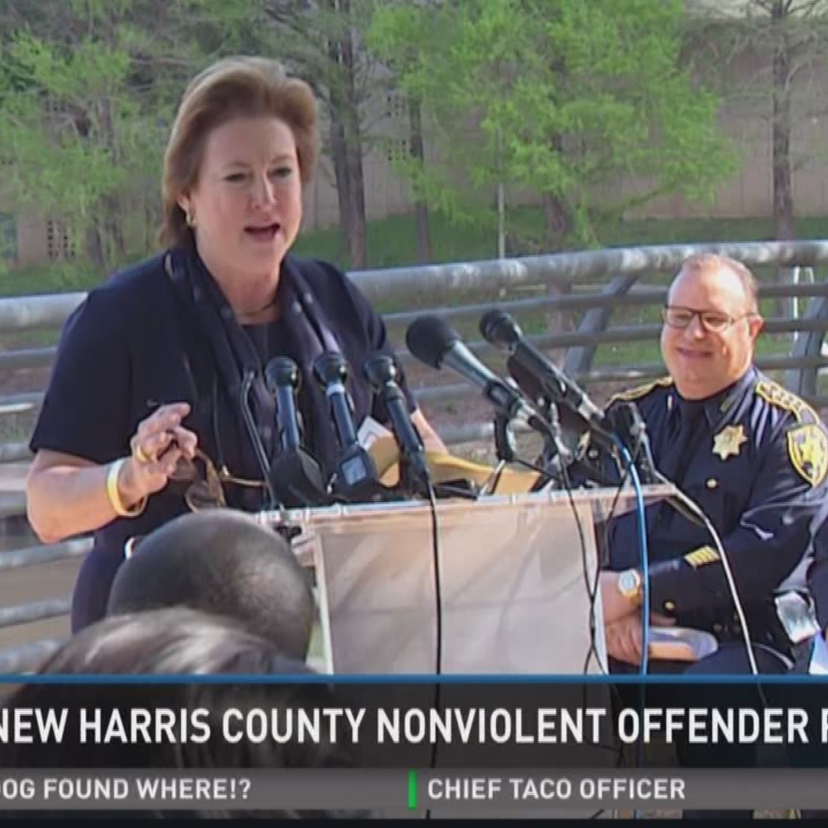
Kim Ogg’s Clean Green Pretrial Diversion Program
The Harris County District Attorney’s Office (HCDAO) is committed to public safety, responsible use of taxpayer money, and equal justice for all. Accordingly, this office is instituting a new policy affecting the prosecution of persons who are first-time environmental offenders for misdemeanor illegal dumping of nonhazardous solid waste as defined by Section 361 and 365 of the Texas Health and Safety Code

Slide 13
Clean & Green Diversion Program
Currently serving ≈ 16 participants/week
More than 619 participants successfully completed the program last year
Yielded ≈ 3,700 hours of community service
Last year C & G participants and supervisors picked up:
1,106 illegally disposed tires
1,333 litter filled trash bags
68 mattresses and 168 furniture items

Slide 14
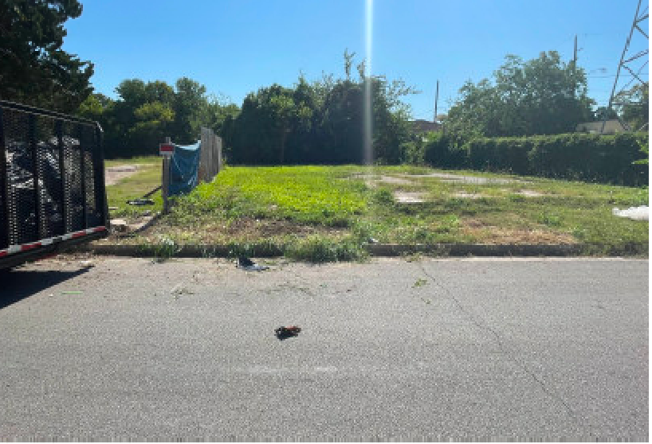
Before
After

Slide 15
Used Oil Violations

Slide 16
The Law……….
Sec 7.176 VIOLATIONS RELATED TO THE HANDLING OF USED OIL. (a) A person commits an offense if the person:
(1) intentionally discharges used oil into
(A) a sewer or septic tank; or
(B) a drainage system, surface water or groundwater, a watercourse, or marine water unless the concentration of used oil in the waste stream resulting from the discharge as it enters water in the state is less than 15 parts per million following the discharge and the person is authorized to discharge storm water under a general permit under Sec. 26.040
(2) knowingly mixes or comingles used oil with solid waste that is to be disposed of in landfills or directly disposes of used oil on land or in landfills, unless the mixing or comingling of used oil with solid waste that is to be disposed of in landfills is incident to and the unavoidable result of the dismantling or mechanical shredding of motor vehicles, appliance, or other items of scrap, used, or obsolete metals;
(3) knowingly transports, treats, stores, disposes of, recycles, causes to be transported, or otherwise handles any used oil within the state:
(A) in violation of standards for the management of used oil; or
(B) without first complying with the registration requirements of Chapter 371, Health and Safety Code, and rules adopted under that chapter;
(4) intentionally applies used oil to roads or land for dust suppression, weed abatement, or other similar uses that introduce used oil into the environment;
(5) violates an order of the commission to cease and desist an activity prohibited by this section or a rule applicable to the prohibited activity; or
(6) intentionally makes a false statement or representation in an application, label, manifest, record, report, permit, or other document filed, maintain, or used for purposes of program compliance
(b) It is an exception to the application of this section that a person unknowingly disposes into the environment any used oil that has not been properly segregated or separated by the generator from other solid wastes…

Slide 17
“in violation of standards or rules for the management of used oil”
30 TAC § 324.6 – 40 CFR § 279.22(d)
The commission incorporates by reference rules for used oil generators in 40 Code of Federal Regulations Part 279, particularly Subpart C
A person or entity that services equipment involving removal of used oil from the site in quantities less than or equal to 55 gallons may choose to be the generator. If the service company removing the used oil from equipment does not assume generator responsibility, the site owner or operator will remain the generator
40 C.F.R. § 279.20 Applicability
(a) … A used oil generator is any person, by site, whose act or process produces used oil or whose act first causes used oil to become subject to regulation.
EXCEPTIONS:
(1) Household “do-it-yourselfer” used oil generators are not subject to regulation under this part
(2) Vessels at sea or at port are not subject to this subpart. For purposes of this subpart, used oil produced on vessels from normal shipboard operations is considered to be generated at the time it is transported ashore. The owner or operator of the vessel and the person(s) removing or accepting used from vessel are co-generators of the used oil …
(3) Diesel fuel. Mixtures of used oil and diesel fuel mixed by the generator of used oil for use in the generator’s own vehicles are not subject to this part once the used oil and the diesel fuel have been mixed up. Prior to mixing, the used oil fuel is subject to the requirements of this subpart.
(4) Farmers. Farmers who generate an average of 25 gallons per month or less of used oil from vehicles or machinery used on the farm in a calendar year are not subject to the requirements of this part.

Slide 18
40 CFR § 279.22 Used oil storage.
Used oil generators are subject to all applicable Spill Prevention, Control and Countermeasures (40 CFR part 112) in addition to the requirements of this Subpart. Used oil generators are also subject to the Underground Storage Tank (40 CFR part 280) standards for used oil stored in underground tanks whether or not the used oil exhibits any characteristics of hazardous waste, in addition to the requirements of this subpart.
(a) Storage units. Used oil generators shall not store used oil in units other than tanks, containers, or units subject to regulation under part 264 or 265 of this chapter
(b) Condition of units. Containers and above ground takes used to store used oil at generator facilities must be:
(1) In good condition (no severe rusting, apparent structural defects or deterioration); and
(2) Not leaking (no visible leaks).
(c) Labels
(1) Containers and aboveground tanks used to store used oil at generator facilities must be labeled or marked clearly with the words “Used Oil.”
(2) Fill pipes used to transfer used oil into underground storage tanks at generator facilities must be labelled or marked clearly with the words “Used Oil.”
(d) Response to releases. Upon detection of a release of used oil to the environment that is not subject to the requirements of part 280, subpart F of this chapter and which has occurred after the effective date of the recycled used oil management program in effect in the State in which the release is located, a generator must perform the following cleanup steps:
(1) Stop the release
(2) Contain the released oil;
(3) Clean up and manage properly the released used oil and other materials; and
(4) If necessary , repair or replace any leaking used oil storage containers or tanks prior to returning them to service

Slide 19
Outdoor Burning

Slide 20
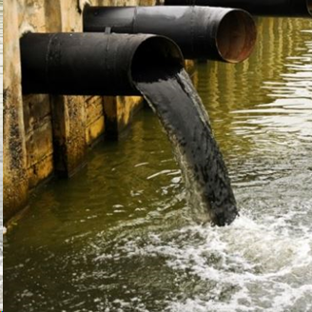
Water Pollution

Slide 21
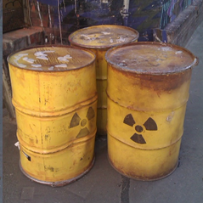
Hazardous Waste

Slide 22
Charging ENTITIES - CorporationS & AssociationS (PartnershipS)

Slide 23
What type of entities can be charged for an Environmental offense?
Corporations & Partnerships?
YES
Sole Proprietorships?
NO. Charge individuals responsible.
D/B/A (doing business as) with one “owner”
No. Charge individuals responsible.

Slide 24
What makes a corporation guilty of a crime?
If conduct constituting an offense is performed
by an agent acting on behalf of an entity AND
within the scope of their office or employment
(Penal Code 7.22 )
Then the entity is guilty!

Slide 25
WHAT “within the scope of employment” means?
Conduct that is incidental to job duties or originated in activities closely associated with employment.
Range of activities, duties, or responsibilities, that an employee is reasonably expected to carry out or fulfill within the ambit of his or her job or position
Substantial deviations from work tasks are typically outside the scope of employment.

Slide 26
Examples of Strict Liability Statutes
Illegal Dumping (Misdemeanor):
A person (or entity) disposes or allows or permits the disposal of litter or other solid waste at a place that is not an approved solid waste disposal site.
Water Pollution (Misdemeanor):
A person (or entity) discharges or allows the discharge of waste/pollutant into water in the state.

Slide 27
Felony Offenses Penal Code 7.22
An entity is criminally responsible for a felony offense only if its commission was authorized, requested, commanded, performed, or recklessly tolerated by:
The majority of the governing board acting on behalf of the entity OR
A high managerial agent acting on behalf of the entity and within the scope of their office or employment
This is almost always the way corporations become guilty of felonies.

Slide 28
Felony Offenses
An entity is criminally responsible for a felony offense only if its commission was authorized, requested, commanded, performed, or recklessly tolerated by:
The majority of the governing board acting on behalf of the entity OR
A high managerial agent acting on behalf of the entity and within the scope of their office or employment
This is almost always the way corporations become guilty of felonies.
We use previous citations, incidents, ee statements, everyday practices to prove recklessly tolerating

Slide 29
What is a high Managerial Agent?
Defined by the Texas Penal Code as:
an officer of a corporation or association;
a partner in a partnership; or
an agent of a corporation or association who has duties of such responsibility that his conduct may reasonably be assumed to represent the policy of the corporation or association.

Slide 30
Examples of High Managerial Agent
Can be as high as the president
Or can be the janitor, depending on the duties of the position.
Ex. - Janitor is made responsible for disposing of all cleaning-related wastes (Pine Sol, Lysol, Pledge, Clorox, ect.) and decides to pour the chemical wastes into a storm drain. The company is culpable for felony water pollution.

Slide 31
What is an Agent?
Defined by the Texas Penal Code as:
a director, officer, employee, or other person authorized to act in behalf of a corporation or association.

Slide 32
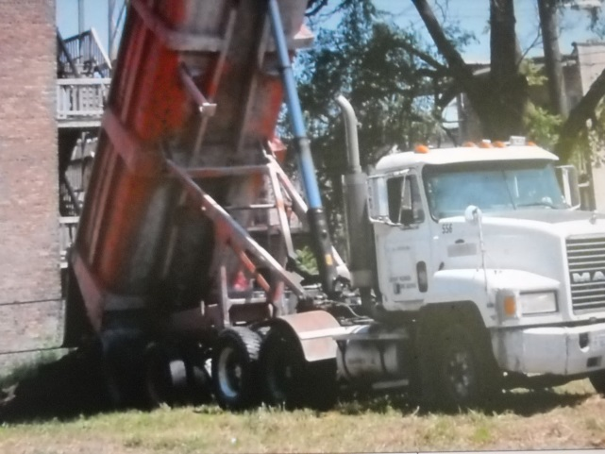
What about the person who commits the environmental offense in behalf of the company/for the benefit of the company?
That person is an agent.
Can that person be charged individually if he does not benefit financially or personally?

Slide 33
Texas Penal Code § 7.23
CRIMINAL RESPONSIBILITY OF PERSON FOR CONDUCT IN BEHALF OF CORPORATION OR ASSOCIATION.
(a) An individual is criminally responsible for conduct that he performs in the name of or in behalf of a corporation or association to the same extent as if the conduct were performed in his own name or behalf.
(b) An agent having primary responsibility for the discharge of a duty to act imposed by law on a corporation or association is criminally responsible for omission to discharge the duty to the same extent as if the duty were imposed by law directly on him.

Slide 34
Texas Penal Code § 7.23 (continued)
(c) If an individual is convicted of conduct constituting an offense performed in the name of or on behalf of a corporation or association, he is subject to the sentence authorized by law for an individual convicted of the offense.

Slide 35
Texas Penal Code § 7.24
DEFENSE TO CRIMINAL RESPONSIBILITY OF CORPORATION OR ASSOCIATION.
It is an affirmative defense to prosecution of a corporation or association under Section 7.22(a)(1) or (a)(2) that the high managerial agent having supervisory responsibility over the subject matter of the offense employed due diligence to prevent its commission.

Slide 36
Punishment For Entities
Texas Penal Code:
No probation available to corporations under Texas State Law.
Fines only.

Slide 37
Texas Penal Code § 12.51.
Authorized Punishment for Corporations and Associations
Class C Misdemeanor $2,000
Class B or A Misdemeanor $10,000
Felony $20,000
Felony or Class A & SBI or death: $50,000
OR 2 times the amount the company gained by committing the Felony, Class A, or Class B Misdemeanor.

Slide 38
Upon conviction of an entity the Court must notify the Attorney General.
Corporations cannot have their records expunged.

Slide 39
Intake
The prosecutors are on call 24/7

Slide 40
Search Warrants

Slide 41
What do we use them for?
Camera surveillance into private property
Documents
Samples
Pictures
Drone use
Running dye tests
Cell phones
Any unreasonable search is unconstitutional
Secondary warrants

Slide 42
Parallel Investigations

Slide 43
Roundtables
Not sure if you took pictures at the last roundtable?
If not here is something we could use

Slide 44
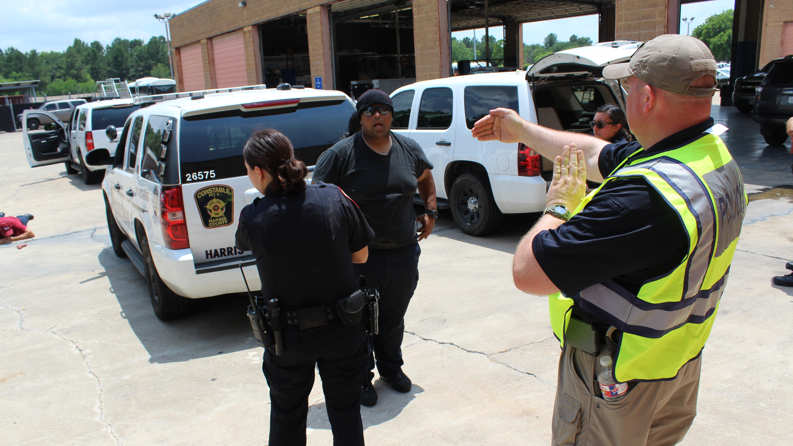
Trainings

Slide 45
Contact
Kristena Glenn
Glenn_kristena@dao.hctx.net
713- 274-5580

