Slide 1
35th Annual Texas Environmental Superconference
“It’s a Beach”
John C. Cruden, Principal, Beveridge & Diamond PC
Wednesday, August 2, 2023
Privileged & Confidential | Attorney-Client Communication

Slide 2

EPA Criminal Enforcement: Protecting People and the Environment

Slide 3
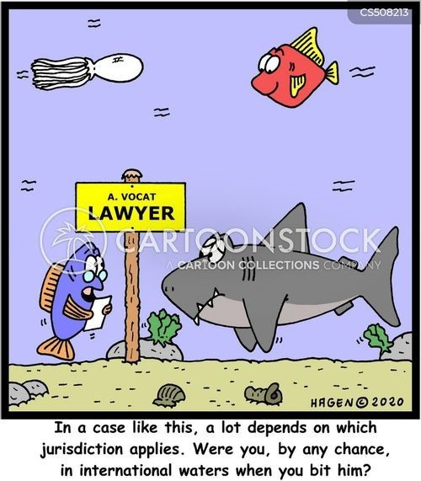

Slide 4
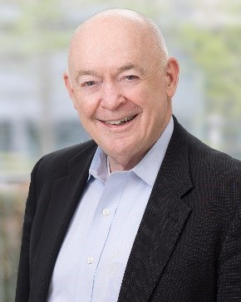
Questions
Thank you!
John C. Cruden
Principal
Washington, DC
Environmental Law
jcruden@bdlaw.com
(202) 789-6018

