Slide 1
ASKRAIL® FOR FIRST RESPONDERS

Slide 2
ASKRAIL
“With the push of a button, AskRail equips first responders with accurate, real-time information to plan a swift, safe response to a rail incident. Combined with specialized on-the-ground training, the AskRail app ensures communities have the tools they need to keep people safe.”
— AAR President and CEO Ian Jefferies

Slide 3
ASKRAIL
AskRail provides immediate access to accurate, real-time information about railcars carrying hazardous materials on a train. AskRail was created as part of an initiative to improve communication of emergency response information to responders during incidents. Railinc developed the application in collaboration with the Class I railroads.
The AskRail application is free and available for Windows desktop at askrail.us. Mobile versions are available on the App Store and Google Play Store.
Through AskRail’s easy-to-use interface, emergency responders can:
Query the contents of a railcar with a simple railcar ID search
View the make up of the train if the car is on an active train
View emergency contact information for all Class I railroads
Access reference resources that can support their incident response
Access a list of emergency contact phone numbers for all seven Class I freight railroads

Slide 4
HOW AND WHEN TO USE
Upon arriving at a rail accident, an emergency responder should first attempt to locate the train's conductor and get the train consist, a document that describes the make-up of the train. If the conductor and/or train consist is unavailable, the emergency responder can use the AskRail application to query the Equipment ID for a specific railcar to determine its contents.
The application serves emergency responders who arrive first at the scene of a rail emergency and need critical information about the contents of a railcar.
It is recommended that emergency responders use AskRail temporarily for safety isolation, evacuation, and/or assessment from a distance while securing the proper shipping paper. The train consist or waybill should be secured before offensively approaching the railcar. The AskRail application should only be utilized by industry-qualified hazmat emergency responders.

Slide 5
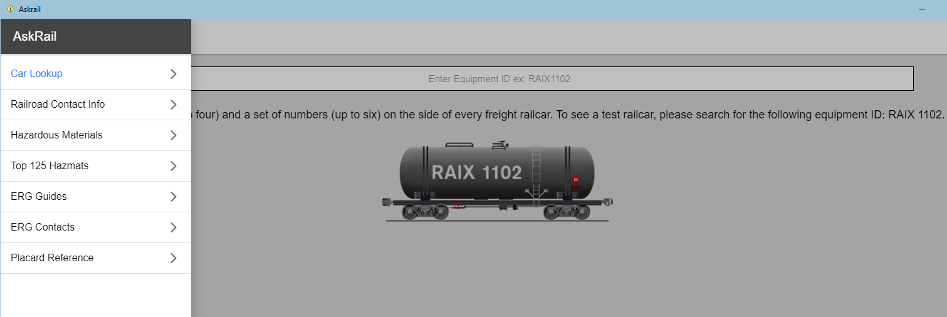
HOW IT WORKS
Enter Rail Car Initials and Numbers in
the Car Query field.
Use RAIX1102 as pictured as a test car.
To check the contents of a container, enter the Container Number in the search field (do not enter the conveying railcar Equipment ID).
*The letters in a Container Number always end in “U” or “Z”.
AskRail has two security levels:
Single Car Lookup
Train Consist Lookup

Slide 6
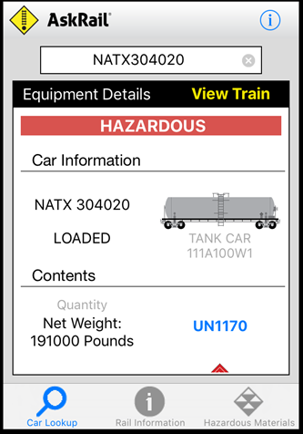
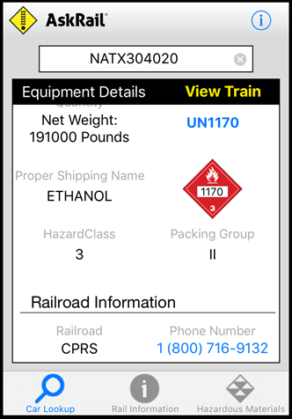
QUERY RESULTS (SINGLE CAR)
The query returns the following information:
Loaded or empty status
If the car is Hazardous–a RED Hazardous Banner appears
Green appears for non-hazardous
United Nations/North America (UN/NA) ID for any
located hazardous materials
Proper shipping name (PSN) for the railcar’s contents
Hazard class for the railcar's contents
Railroad name
Railroad’s emergency contact information
Scroll up and down

Slide 7
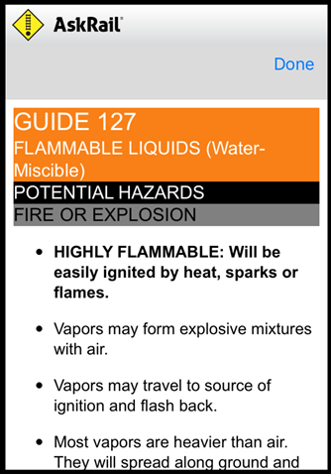
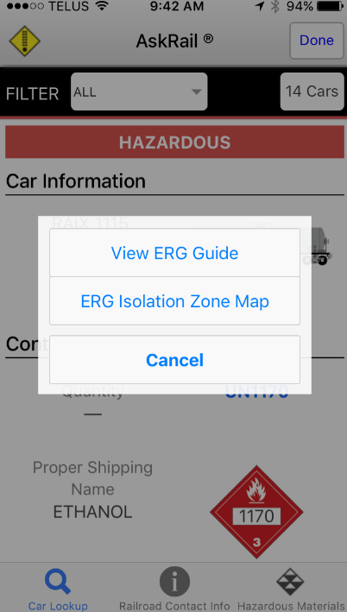
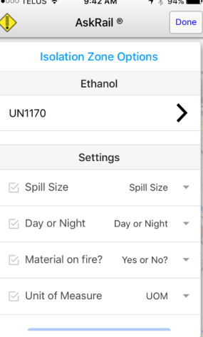
QUERY RESULTS (SINGLE CAR)
When you click the UN # or the Placard on the device, the Emergency Response Guide (ERG) appears for that UN Number. You can also choose the Isolation Zone, which will appear if listed in the ERG.

Slide 8
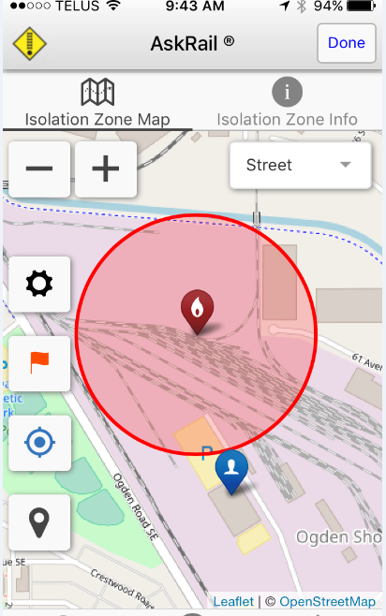
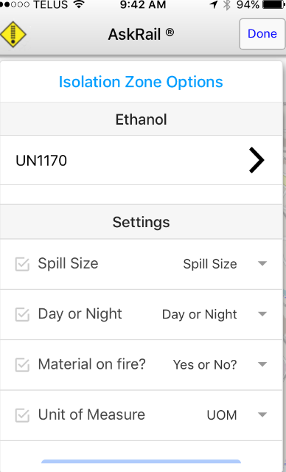
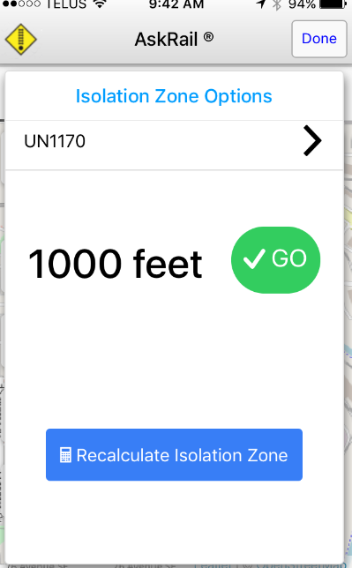
ISOLATION ZONE
3. Map is displayed.
2. Isolation in feet is given.
1. Choose each of the settings.

Slide 9
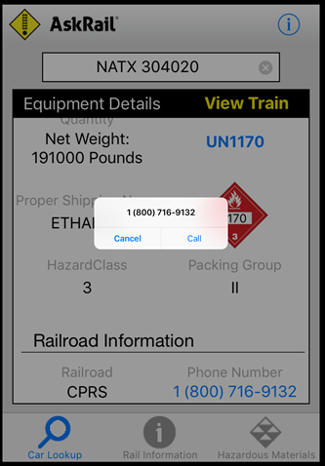
CLASS I EMERGENCY NUMBERS
To call the emergency number, touch the number (if using a mobile device) or dial the number (if using a desktop).

Slide 10
View train query
The Train Details screen displays the contents of the railcar associated with the entered equipment ID and allows you to scroll through a list showing the equipment IDs of each railcar in the consist.
If the equipment ID is red, the railcar contains hazardous material or hazardous residue.
Consist lookup is generally restricted to Department Chiefs, Directors, Chief Officers, Company Officers, and designees of the Chief such as firefighters in charge of a hazmat team (exceptions may apply due to regional differences).
If you have permissions for the consist lookup functionality, a blue View Train link appears when you look up railcar contents.
Note that it may take 15 seconds or more for the View Train link to appear.

Slide 11
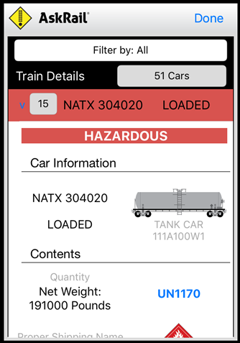
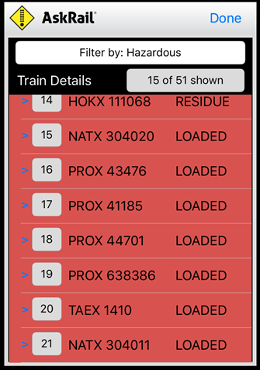
VIEW TRAIN QUERY
The Train Details screen also allows you to see whether the railcar is loaded, empty, or contains residue. You can filter by All Cars, Hazardous Cars or Non-Hazardous Cars only.
Important: The sequencing of the cars in the application may not match the sequencing of the cars on the paper consist, which is the compliance document and takes precedence in any discrepancy.

Slide 12
HOW TO APPLY
Go to: http://www.askrail.us/
​1. Download the app from the Google Play store or the App Store, or download the Windows Desktop Application from the website.
2. Complete the registration process in the app on your device.
3. You will receive an email notification once your registration has been approved.
4. Once you have been approved to use the app, the app will become fully functional and ready for use.

Slide 13
Questions ?
Devin Sprinkle
Association of American Railroads
AVP Environment, Hazardous Materials and Climate Change
dsprinkle@aar.org
312.765.3180

