Slide 1
EPA Enforcement and Environmental Justice
Cheryl Seager
Director
Enforcement and Compliance Assurance Division
Notes:
Conducted in April 2022

Slide 2
Community engagement
April 30, 2021
Starfield Memo on Strengthening Enforcement in Communities with Environmental Justice Concerns
Increase engagement with communities about enforcement cases that most directly impact them.
Provide more information to communities about facilities, pollution, and enforcement activities, through appropriate and available means such as press releases and public meetings.
Empower communities by increasing awareness of enforcement program resources and make it easier for the public to search for EJSCREEN information and Enforcement and Compliance History Online (ECHO) compliance history data.
Increase opportunities for community engagement in the development of cleanup and reuse agreements to ensure community concerns are addressed in a meaningful manner.

Slide 3
Community Engagement
Administrator visited Louisiana in November 2022.
Pollution Accountability Team Developed.
Community meetings in St. John the Baptist, Calcasieu Parishes, and St. James Parish, prior to deploying the PAT in Louisiana.
Requested input from the community members about facility targets and routes.
Focused on facilities with large quantities of volatile organics and air toxics and those with specific emissions of BTEX compounds, sulfur dioxide and ethylene oxide.
Notes:
As you are probably aware this Administration is really focused on engaging with overburdened communities, as can be seen with the Administrator’s Journey to Justice Tour that went through the Gulf Coast states, including Louisiana and Texas in November 2021. As a way to address the concerns brought to the Administrator’s attention during the Journey to Justice Tour, Region 6 worked with other Regions and HQ to create a special project, the Pollution Accountability Team. This Team used 3 main tools: 1) the Geospatial Measurement of Air Pollution mobile air monitoring unit (GMAP) from the National Enforcement Investigations Center (NEIC),
2) the Airborne Spectral Photometric Environmental Collection Technology (ASPECT) aircraft from the Office of Emergency Management and
3) Facility inspection teams – 6 total CAA inspectors (3 teams of 2 inspectors)
Community meetings in St. John the Baptist, Calcasieu Parishes, and St. James Parish, prior to deploying the PAT in Louisiana.
Requested input from the community members about facility targets and routes.
Focused on facilities with large quantities of volatile organics and air toxics and those with specific emissions of BTEX compounds, sulfur dioxide and ethylene oxide.

Slide 4
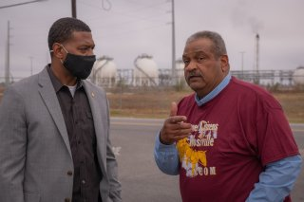
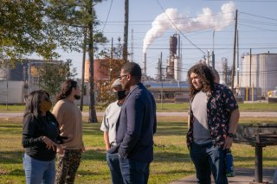
Community Concerns
Communities of Color in the industrial corridors in Louisiana are being exposed to excess pollution from industrial facilities
Studies have indicated that cancer risk is elevated in these communities due to pollution exposure*
EPA needs to conduct more inspections at facilities in these areas
Notes:
Administrator Regan met with residents in New Orleans, St. John the Baptist Parish, St. James Parish, and Mossville, where he saw the impacts of pollution, climate change and crumbling water infrastructure.
* Tulane Study: Toxic Air Pollution is Linked to Higher Cancer Rates among Impoverished Communities in Louisiana

Slide 5
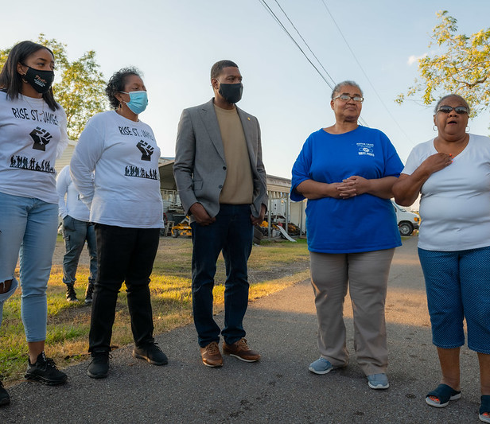
Successful Community Meetings
What is the most effective way to obtain community input?
Clearly communicated the objective of the project
Asked for specific input and concerns – what time of day they thought emissions were highest, what facilities would benefit from monitoring, etc.
Committed to sharing the data publicly
Notes:
1: How should we conduct the meetings? Who were the communities that needed to be invited? We used maps and Google Earth Pro to zoom into these communities and facilities.
2: This was not a community monitoring assessment. The goal of this project was to evaluate facility compliance and specifically to determine if excess emissions from facilities were potentially causing community impacts. We had to keep coming back to this point since the communities all wanted more air monitoring.
2: Ask for input and specific concerns

Slide 6
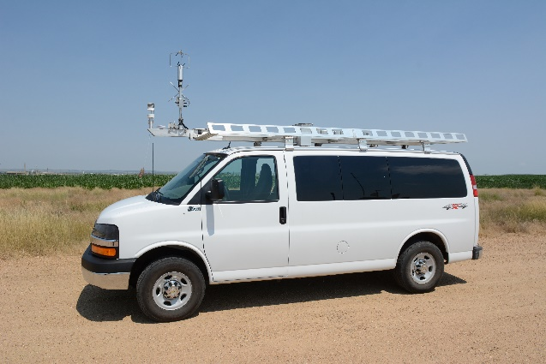
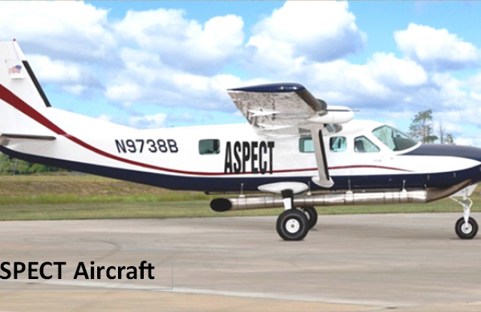
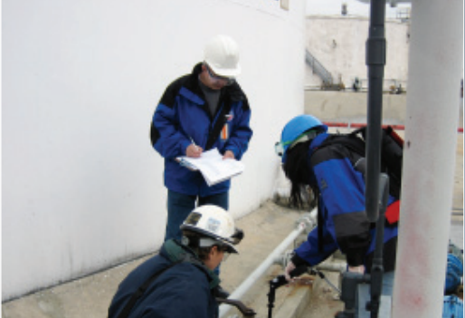
The Pollution Accountability Team
The Pollution Accountability Team (PAT) was a special project conducted in April 2022 to evaluate facility compliance and excess emissions from specific facilities in four Louisiana parishes.
Main tools of the project:
Geospatial Measurement of Air Pollution mobile air monitoring unit (GMAP) from the National Enforcement Investigations Center (NEIC)
Airborne Spectral Photometric Environmental Collection Technology (ASPECT) aircraft from the Office of Emergency Management
Credentialed CAA Inspection Teams from LDEQ, Region 5, Region 6, and headquarters

Slide 7
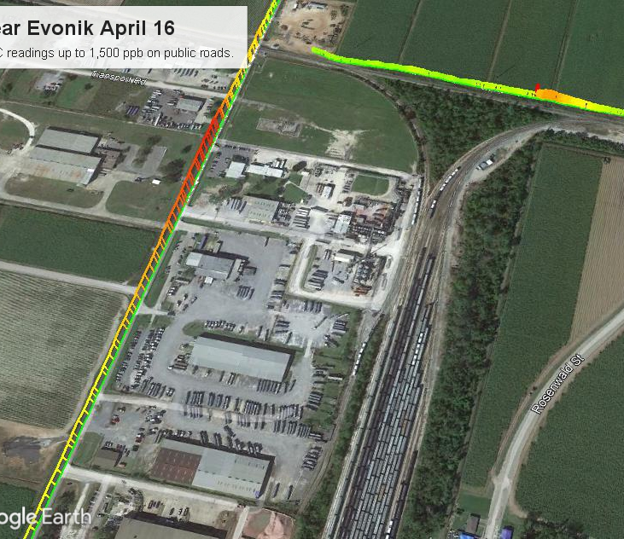
PAT Project Outcomes to Date
Conducted 24 Inspections in 13 days
Conducted approximately 120 hours of GMAP monitoring in the targeted parishes and hundreds of miles of monitoring
16 of the inspections identified potential noncompliance and are moving forward with investigations and formal enforcement
Enforcement resolution – Evonik Settlement
Issued 4 CAA Section 114 Information requests
Issued 3 Notices of Violations
Notes:
SEP was focused on getting additional emissions reductions for a community already overburdened by cancer risk from Denka chloroprene.

Slide 8
PAT Enforcement Outcomes
Evonik settlement
Facility in Reserve, LA with emissions of ethylene oxide that were contributing to the cancer risk to communities in St. John the Baptist Parish
PAT GMAP and inspection revealed excess emissions from the facility scrubber of ethylene oxide and propylene oxide
Facility committed to replacement of scrubber with thermal oxidizer to improved DRE from 95% to 99.9% resulting in a reduction of 5.6 tons of hazardous air pollutants (“HAPs”), including 2.16 tons of ethylene oxide, each year.
Supplemental Environmental Project valued at $335,000 to design, install, and operate a Vapor Recovery System, to capture VOCs which are currently permitted to release to the atmosphere during the truck loading/unloading process.
Civil penalty of $75,000

Slide 9
DOJ Comprehensive Environmental Justice Strategy (2022)
Background
Announced by DOJ and EPA on May 5, 2022
https://www.justice.gov/opa/pr/justice-department-launches-comprehensive-environmental-justice-strategy
Important aspects
Formation of DOJ’s Office of Environmental Justice
Interim Final Rule Regarding Use of Supplemental Environmental Projects -May 10, 2022
Notes:
And this next slide addresses very recent news – less than a month ago – from DOJ announced by DOJ and EPA on the new comprehensive environmental justice strategy. There was quite a bit of media coverage so this may not be news to some of you, but hopefully I have some additional insights to share.
The strategy an announcement regarding creation of a new Office of Environmental Justice at DOJ. That office will serve as a central hub for the strategy and to help prioritize cases that will have the greatest impact on the communities most overburdened by environmental harm.
It announced the return of SEPs, or supplemental environmental projects, through an interim rule.
SEPs are tools used in EPA settlements that can support projects that bring significant benefits to communities, including (i) projects to abate lead paint hazards in housing or provide blood lead level analyzers to community health clinics; (ii) installation of enhanced air filtration systems at schools in heavily industrialized areas; (iii) projects to enhance the emergency response capabilities of local fire departments or hazardous emergency response teams, and (iv) installation and operation of a fence line monitoring system.
SEPs allow the agency to work towards collaborative solutions with the regulated community, and also to seek early relief for communities that may have suffered harm.
I also want to make sure you are aware of the opportunity to comment on the strategy and interim rule, and I believe that comment period is open until July 11, 2022, and DOJ encourages electronic submission of all comments through the regulations.gov website

Slide 10
Supplemental Environmental Projects (SEPs)
EPA's 2015 SEP Policy Highlights
Voluntary
Environmentally beneficial
Nexus
Not otherwise legally required to perform]
Developed and Implemented by the Company
Augmentation Issues

Slide 11
Region 6 SEP Examples
Design, procure, install and implement operation of new gas detectors for both Hydrogen Chloride area and Liquefied Petroleum Gass areas to provide early detection of leaks and/or vapors.
Install VOC emissions perimeter monitors for the RMP covered areas.
Purchase a thermal imaging camera with VOC quantification capabilities.
Purchase drones which include camera, thermal imaging, a loudspeaker, and a spotlight, for non-profit community organizations to enhance their ability to response to emergency situations and protect the public.
Donate laptops and computer monitors to the Office of Emergency management and Local Emergency Planning Committee.
Donate rescue equipment, automated CPR Device, thermal imaging cameras, water rescue dummy, PPE, underwater drone sonar for river operations, and SCBA equipment to the local fire department.

Slide 12
Takeaways
Opportunities for engagement with communities with EJ concerns.
Take advantage of win-win, collaborative approaches to resolving noncompliance like SEPs.
Willingness to engage with communities and industry to identify common goals and discuss concerns
Notes:
As you can probably tell, I’m interested in ensuring y’all have updated information and the primary documents related to the agency’s strategies. I’ve also put a few takeaways and I’m sure you will walk away with a few more as well.
I think you will find that our mission to protect human health and the environment is one that is best tackled in a collaborative and transparent manner.
You will find that the agency is very willing to engage with communities and help you positively engage with communities as well, and in Region 6 you will be working with problem solvers that will be looking for best outcomes.
Again, I regret not having the opportunity to visit with you in person and talk during lunch and after, but I do have a few minutes to answer questions more generally, and I’d also ask that this presentation with my contact be circulated to the membership as well. And of course if there are specific questions, I’d be happy to address them offline as well or direct you to the expert at the agency that can help. Thank you so much for your time.

