Slide 1
Renewable Energy –
Wind and Solar
Texas Environmental Superconference
August 4, 2023
Christine Fernandez Owen, Partner
Chicago, Illinois

Slide 2
Wind energy in the United States
The first large utility scale wind farm was installed in the 1980s in California.
By 2012, U.S. wind energy production was capable of powering 15 million homes (60 GW).
By 2019, the U.S. had installed onshore capacity of more than 100 GW to power over 28 million homes.
Source: EERE Wind History

Slide 3
Technological developments – wind energy
Since the early 2000s, wind turbines have increased in size (both height and blade length) while generating more energy.
Increasing the size of rotor diameters allows wind turbines to sweep more area, capture more wind, and produce more electricity. The longer the blade, the greater the ability to capture wind even in areas with relatively less wind.

Slide 4
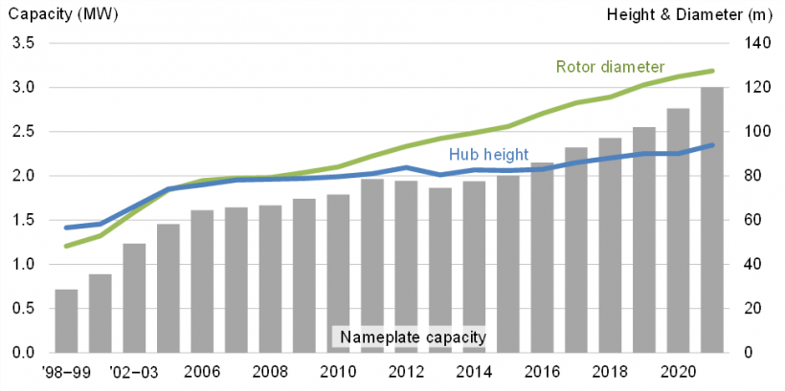
Wind turbine growth
Source: Wind Turbines: the Bigger, the Better | Department of Energy

Slide 5
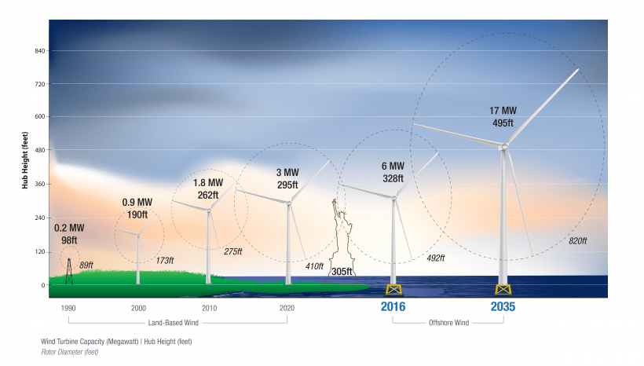
Wind energy progress in the United States
In 2021, the average capacity of utility-scale wind turbines installed was 3 MW.
At the end of 2021, wind power capacity was about 136,000 MW, making it the largest renewable energy source in the country.
Wind energy costs have been reduced from over 55 cents (current dollars) per kWh in 1980 to an average of under 3 cents per kWh today.
Source: EERE Wind Power and EERE Technology

Slide 6
Solar energy in the United States
1982, ARCO Solar’s 1 MW project commences operations in California.
1993, PG&E installs a 500 KW PV system to increase reliability at substation near Kerman, California.
2002 - 38.7 KW PV facility commences operations in Richland, Washington.
2010 Capacity:
862.54 MW of utility-installed
1.89 MW of community-installed
1022.11 MW of commercial-installed
629.29 MW of residential-installed
Source: Timeline of Solar Industry and Solar Installed Capacity Statistics

Slide 7
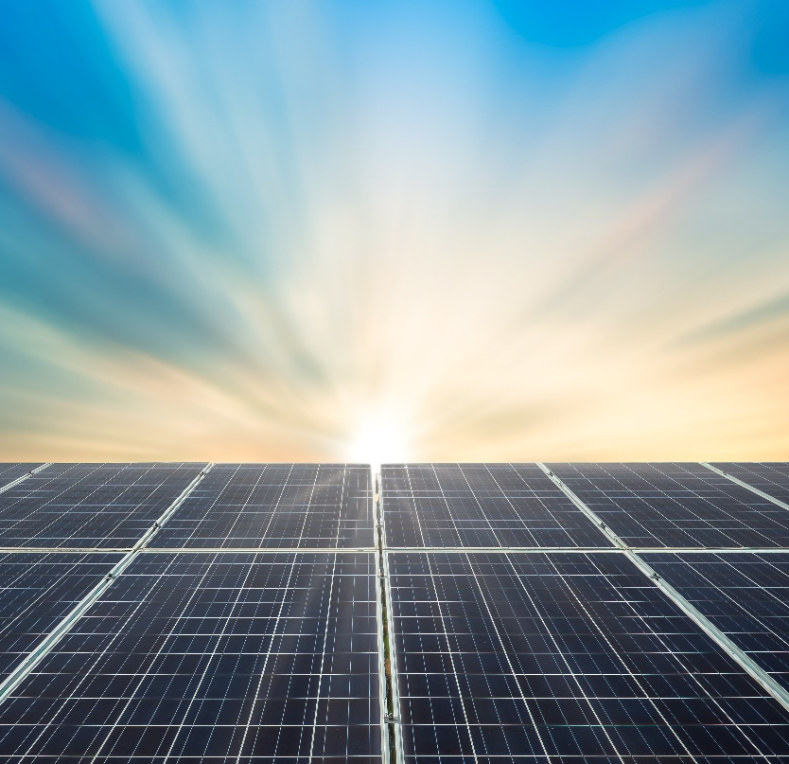
Current stats of solar energy in the United States
2010 ->2022 (12 Years)
Utility scale increased 105X
Residential increased 46X
2022 Capacity:
91,776.54 MW of utility-installed
5,374.85 MW of community-installed
16,691.1 MW of commercial-installed
29,311.89 MW of residential-installed
At of end of Q1 in 2023, more than 149 GW of installed solar capacity, capable of powering 26 million homes.
Source: Solar Installed Capacity Statistics

Slide 8
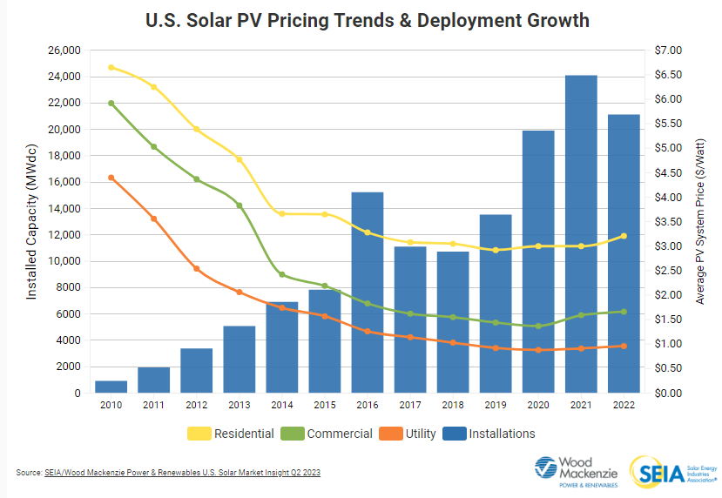
Solar energy progress

Slide 9
Technological developments - solar panels
6%
Efficiency panel created by Bell Laboratories in 1955.
10%
Efficiency cell created by Hoffman Electronics in 1959.
20%
Efficiency cell constructed by researchers at University of New South Wales in 1985.
22-24%
Efficiency for commercially-available conventional silicon-only cells in 2023.
30%
Efficiency for perovskite film onto conventional silicon solar cells in May 2023. Not yet commercially available.
Source: Timeline of Solar Industry and Pervoskite-Silicon Cell

Slide 10
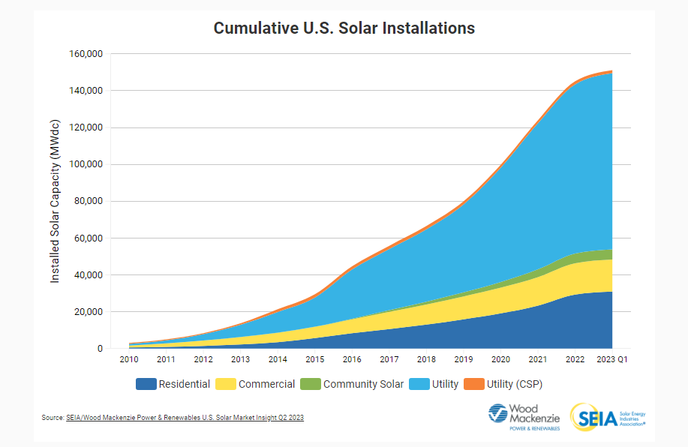
Solar energy progress

Slide 11
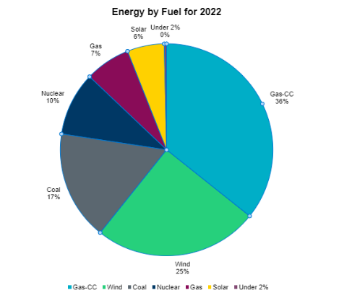
Texas energy production by resource
Source: ERCOT Energy Fuel

Slide 12
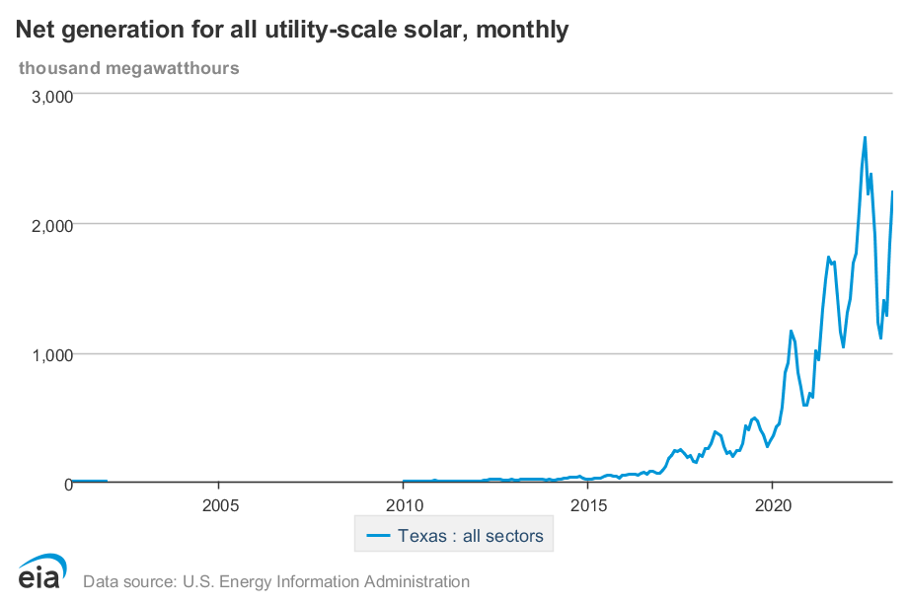
Solar energy generation in Texas
Source: EIA Interactive Fuel Resource Chart

Slide 13
2022 – 2023 Texas Legislative Session

Slide 14
Inflation Reduction Act
Tax credits available for up to 70% of the project cost
30% base tax credit
10% for domestic content
10% for energy communities
10% to 20% for low-to-moderate income
Manufacturers of equipment for renewable energy projects also will see benefits.
Extends tax credits into a number of other energy technologies, including hydrogen and carbon capture.

Slide 15
Section 48 ITC and Section 45 PTC
Production Tax Credit
Eligible Renewable/Other Technologies: Geothermal Electric, Solar Thermal Electric, Solar Photovoltaics, Wind (All), Biomass, Hydroelectric, Municipal Solid Waste, Landfill Gas, Tidal, Wave, Ocean Thermal, Wind (Small), Hydroelectric (Small), and Offshore Wind.
Investment Tax Credit
Eligible Renewable/Other Technologies: Solar Water Heat, Solar Space Heat, Geothermal Electric, Solar Thermal Electric, Solar Thermal Process Heat, Solar Photovoltaics, Wind (All), Stand-alone storage, Geothermal Heat Pumps, Municipal Solid Waste, Combined Heat & Power, Fuel Cells using Non-Renewable Fuels, Tidal, Wind (Small), Geothermal Direct-Use, Fuel Cells using Renewable Fuels, Microturbines, Offshore Wind Biogas, Microgrid Controllers, and Interconnection Property.

Slide 16
Inflation Reduction Act
Direct Pay Option
Transferability of Tax Credits
Energy Communities
Brownfield site
Closed coal mine
Other communities where tax collections are tied to oil, gas, or coal, and there is a high rate of unemployment
Long term stability helps innovation, progress

Slide 17
Questions?

