Slide 1


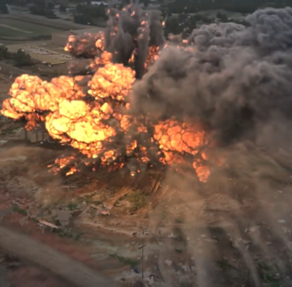
Use of Experts in Crisis Litigation
Lauren Brogdon, Haynes Boone
Randy Sorrels, Sorrels Law
Shawn Paquette, GSI Environmental
Texas Environmental Superconference
August 5, 2022

Slide 2
Role of Experts
1
Expert Disclosures and Reports
2
Depositions and Trial Testimony
3
Non-Retained Experts
4
2

Slide 3
When to Hire an Expert
Advantages of early retention
What information is needed?
Which fields/experts to consider
Information to provide in initial interviews

Slide 4

Daubert v. Merrell Dow Pharma. Inc.
509 U.S. 579 (1993)
E.I. du Pont de Nemours & Co. v. Robinson
923 S.W.2d 549 (Tex. 1995)

Slide 5
Merrell Dow Pharma., Inc. v. Havner
953 S.W.2d 706
(Tex. 1997)

Slide 6
Role of Expert
We do the truth, you do the justice
Don’t be an advocate (It is what it is)
Tell the story simply

Slide 7
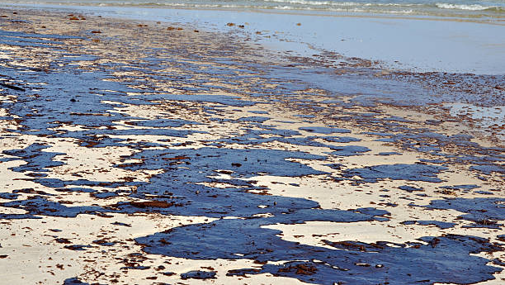
Context Matters
Requested scope of evaluation
  May shift during engagement
Using multiple experts – stay in your lane (but know where you fit overall)
  Overlap and duplication
  Order of presentation in deposition and at trial
Legal issues
  Law of the case
  Precedent
  Contracts and agreements

Slide 8
Sampling and Testing
Adequacy and reliability of sampling conducted to date
Regulatory agency oversight
  Prior sampling
  Ongoing remediation/investigation/reporting
Additional sampling to address:
  Liability
  Damages

Slide 9
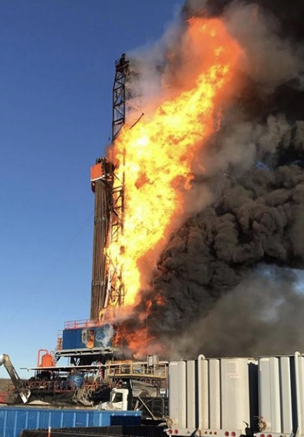
GET IT IN WRITING:
DISCLOSURES AND REPORTS
Whether to prepare a report
Draft reports
Correspondence
Sampling results, data, and methodology
  If conducted by expert
  If conducted by others
How to draft disclosures

Slide 10
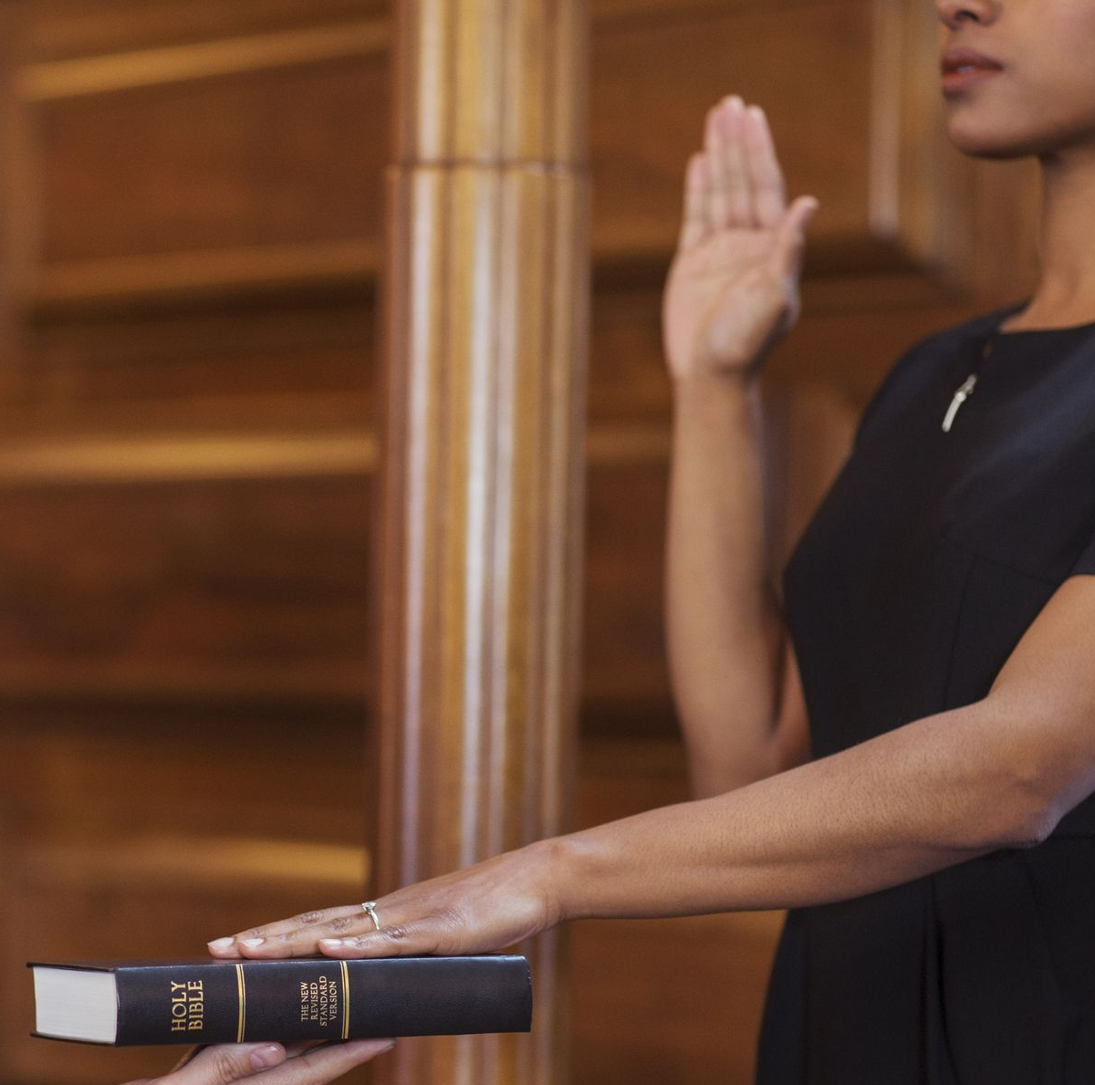
PREPARING TO TESTIFY
Whether to depose opposing experts
Prepared v. scripted
Educating expert about context
Strongest and weakest points of the case

Slide 11
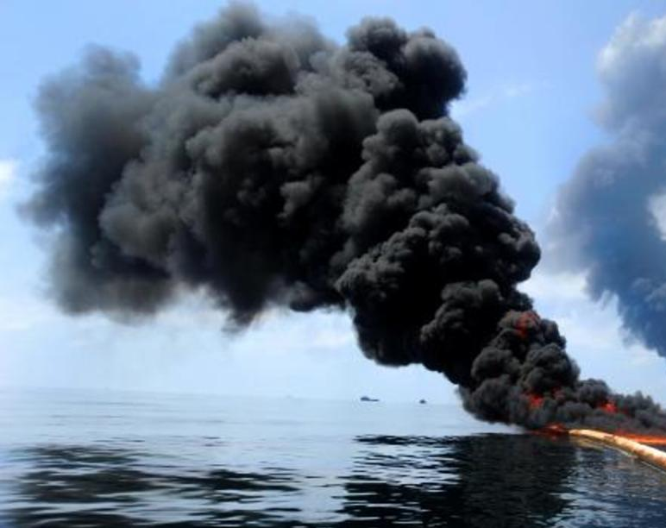
Shawn on the Stand: Q&A
Confidence v. Arrogance
Questions outside of your area of expertise
Questions within your area of expertise but outside of your scope
Uncertainty

Slide 12
The Hardest Questions to Answer

Slide 13
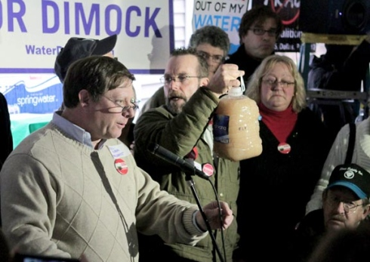
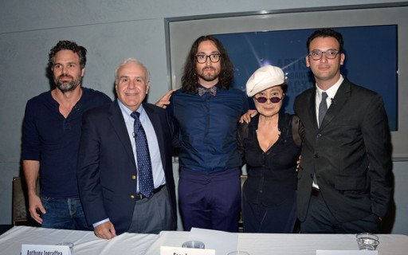

When Your Expert Is (or Wants to be) in the Public Eye

Slide 14
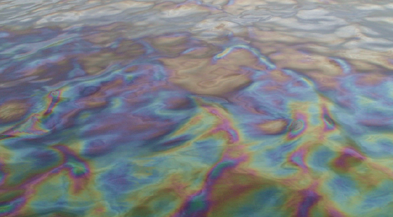
Non-Retained Experts
Company witnesses
Third-party regulators or investigators
Treating physicians

Slide 15
Conclusion

Slide 16
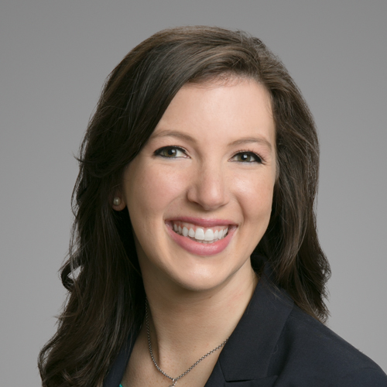
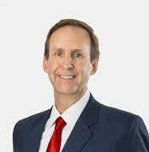
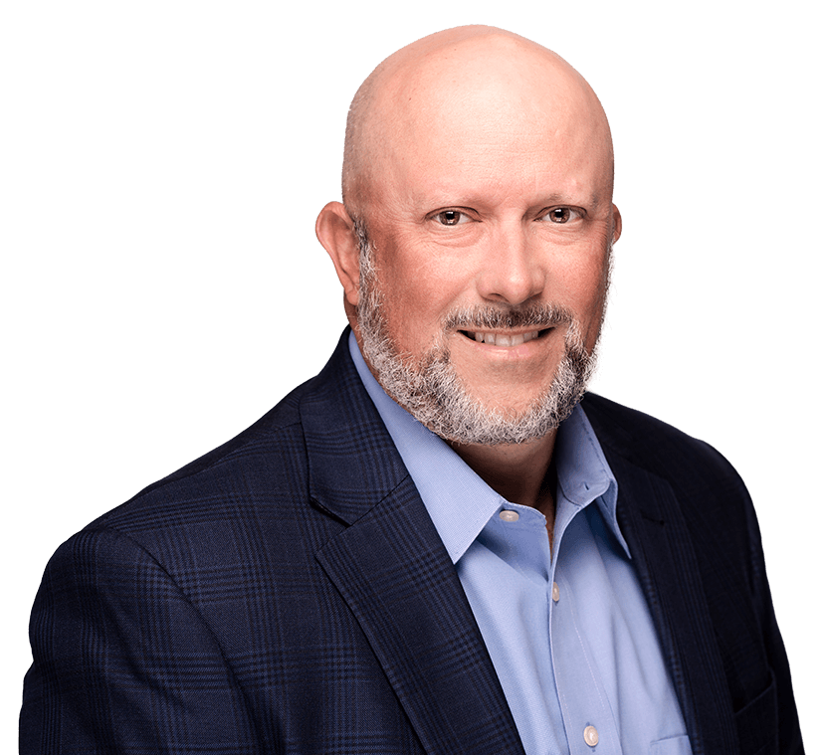
Lauren Brogdon
Haynes and Boone
Partner & Chair, Crisis Management Practice Group
lauren.brogdon@haynesboone.com
(713) 547-2006
1
Randy Sorrels
Sorrels Law
Partner
randy@sorrelslaw.com
(713) 496-1100
2
Shawn Paquette, P.E., BCEE
GSI Environmental
Vice President & Principal Engineer
smpaquette@gsi-net.com
(832) 604-5560
3

