Slide 1
The U.S. Supreme Court and
Environmental Law: An Update
John Cruden & Robert V. Percival
August 5, 2022
August 5, 2022

Slide 3
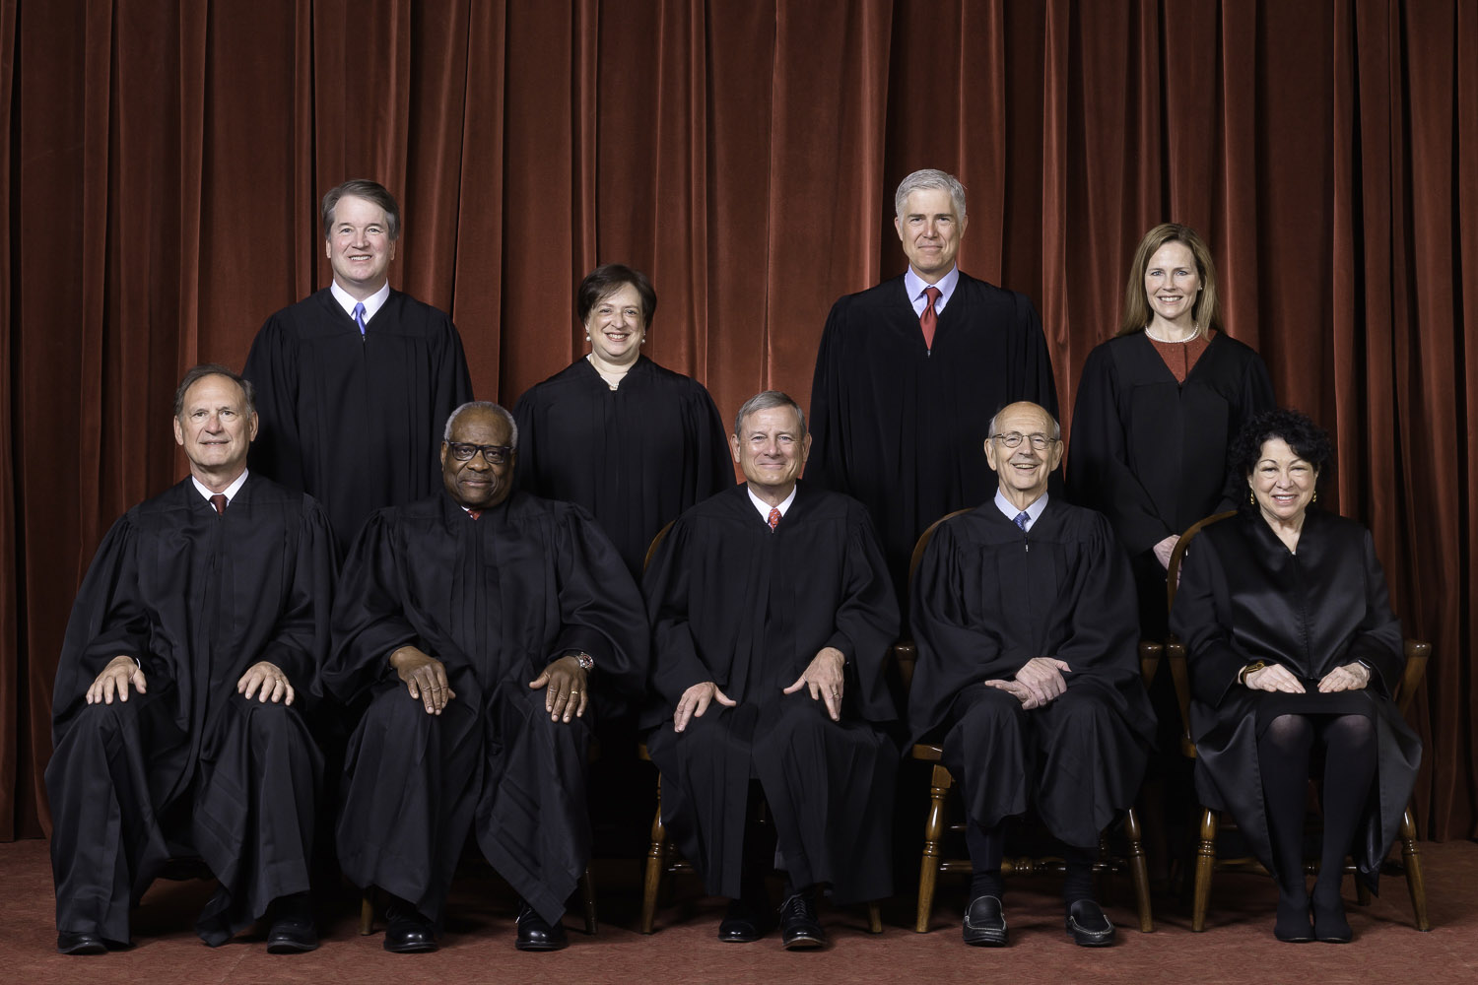

Slide 4
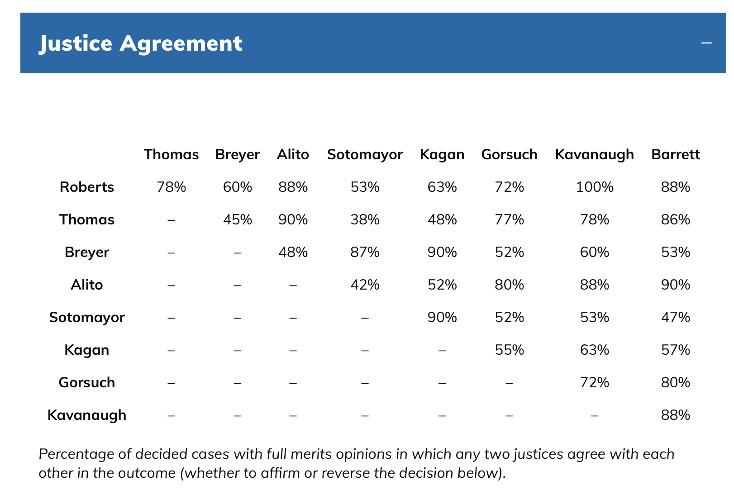

Slide 5
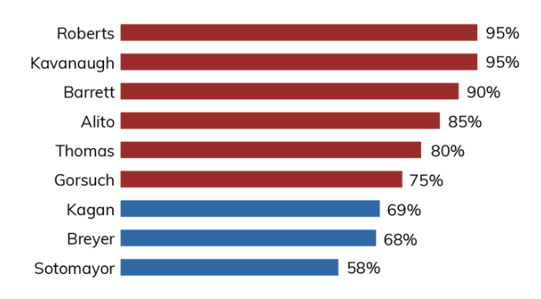
FREQUENCY IN THE MAJORITY
DURING OT 2021

Slide 6
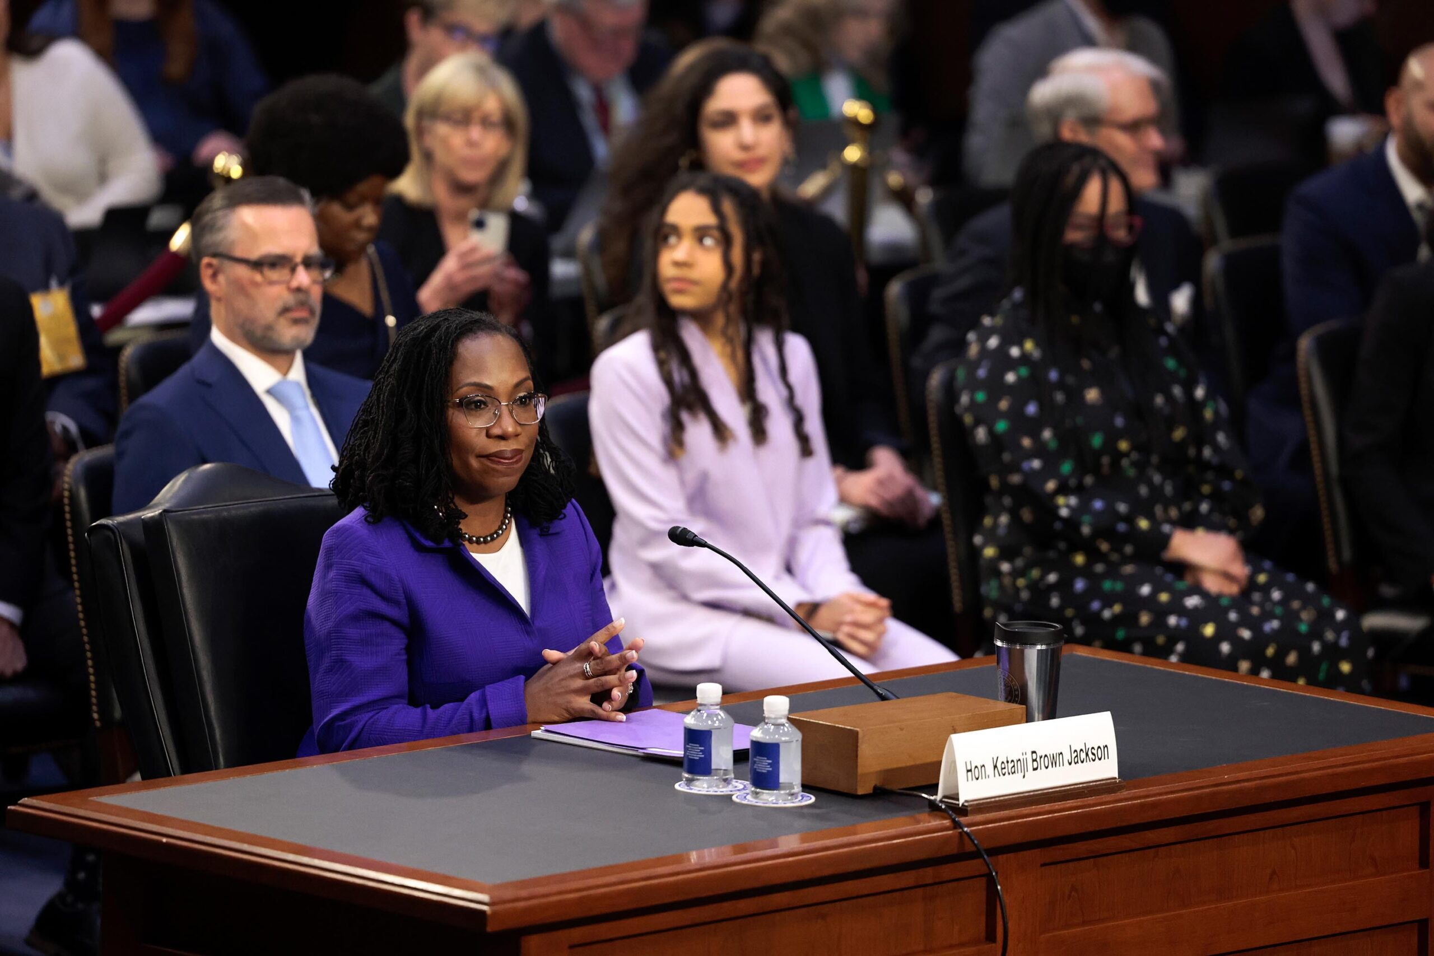
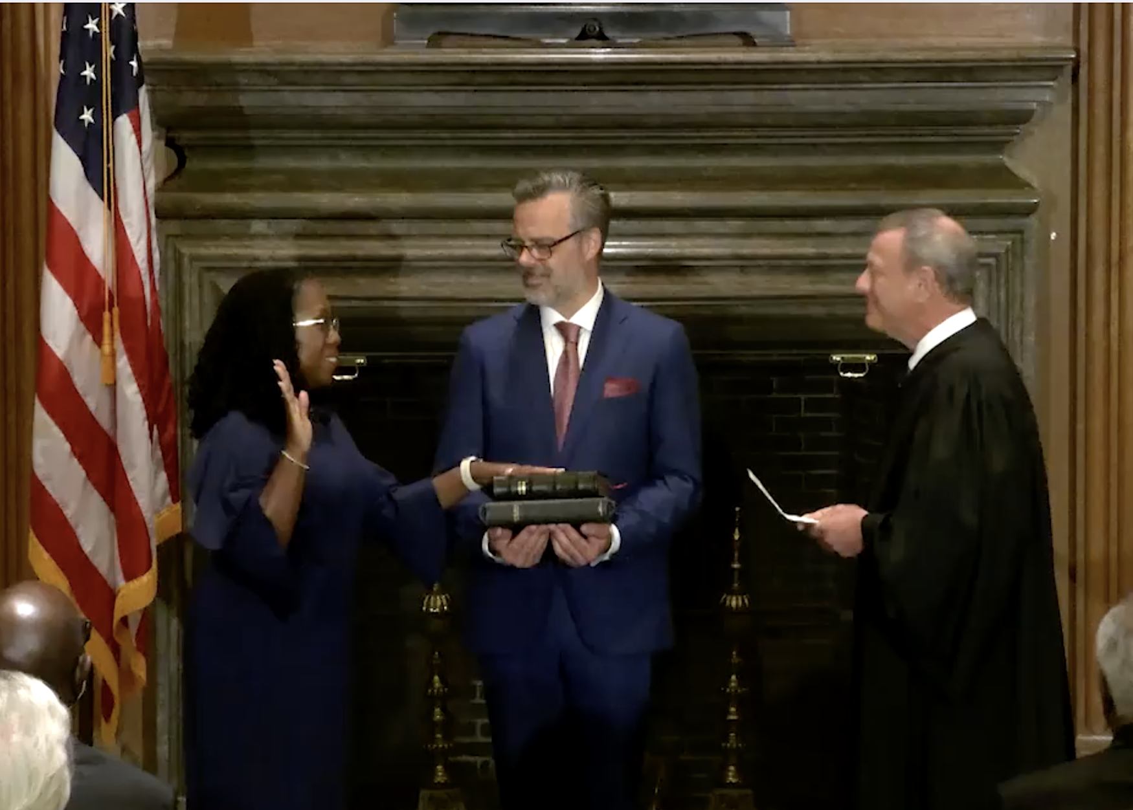

Slide 7
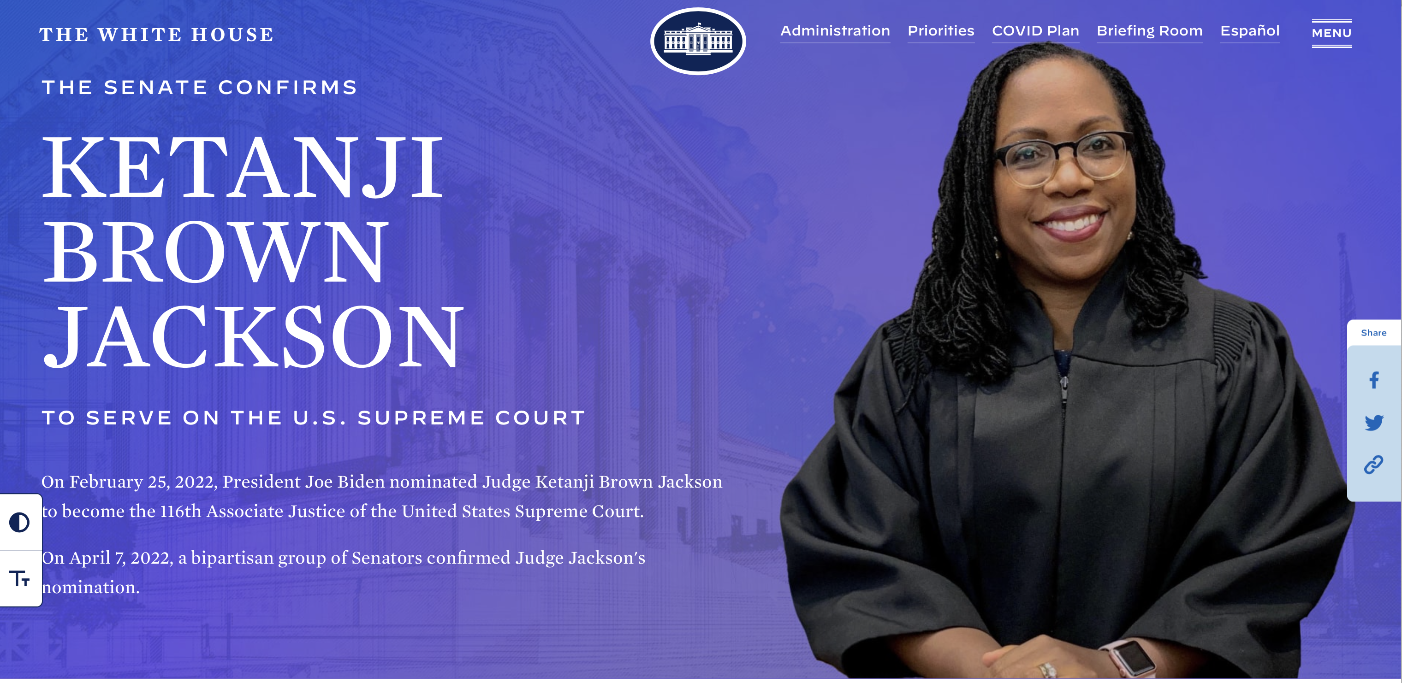

Slide 8
JUSTICES ON U.S. SUPREME COURT BY YEAR OF CONFIRMATION
JUSTICE | Age | Year Confirmed | Years on Court | Appointed by | Days to Confirmation | Vote
THOMAS | 74 | 1991 | 30 | H.W. Bush | 99 | 52-48
CJ ROBERTS | 67 | 2005 | 16 | W. Bush | 62 | 78-22
ALITO | 72 | 2006 | 16 | W. Bush | 82 | 58-42
SOTOMAYOR | 68 | 2009 | 12 | Obama | 66 | 68-31
KAGAN | 62 | 2010 | 11 | Obama | 87 | 63-37
GORSUCH | 54 | 2017 | 5 | Trump | 66 | 54-45
KAVANAUGH | 57 | 2018 | 3 | Trump | 89 | 50-48
BARRETT | 50 | 2020 | 1 | Trump | 30 | 52-48
JACKSON | 51 | 2022 | 1 month | Biden | 41 | 53-47

Slide 9
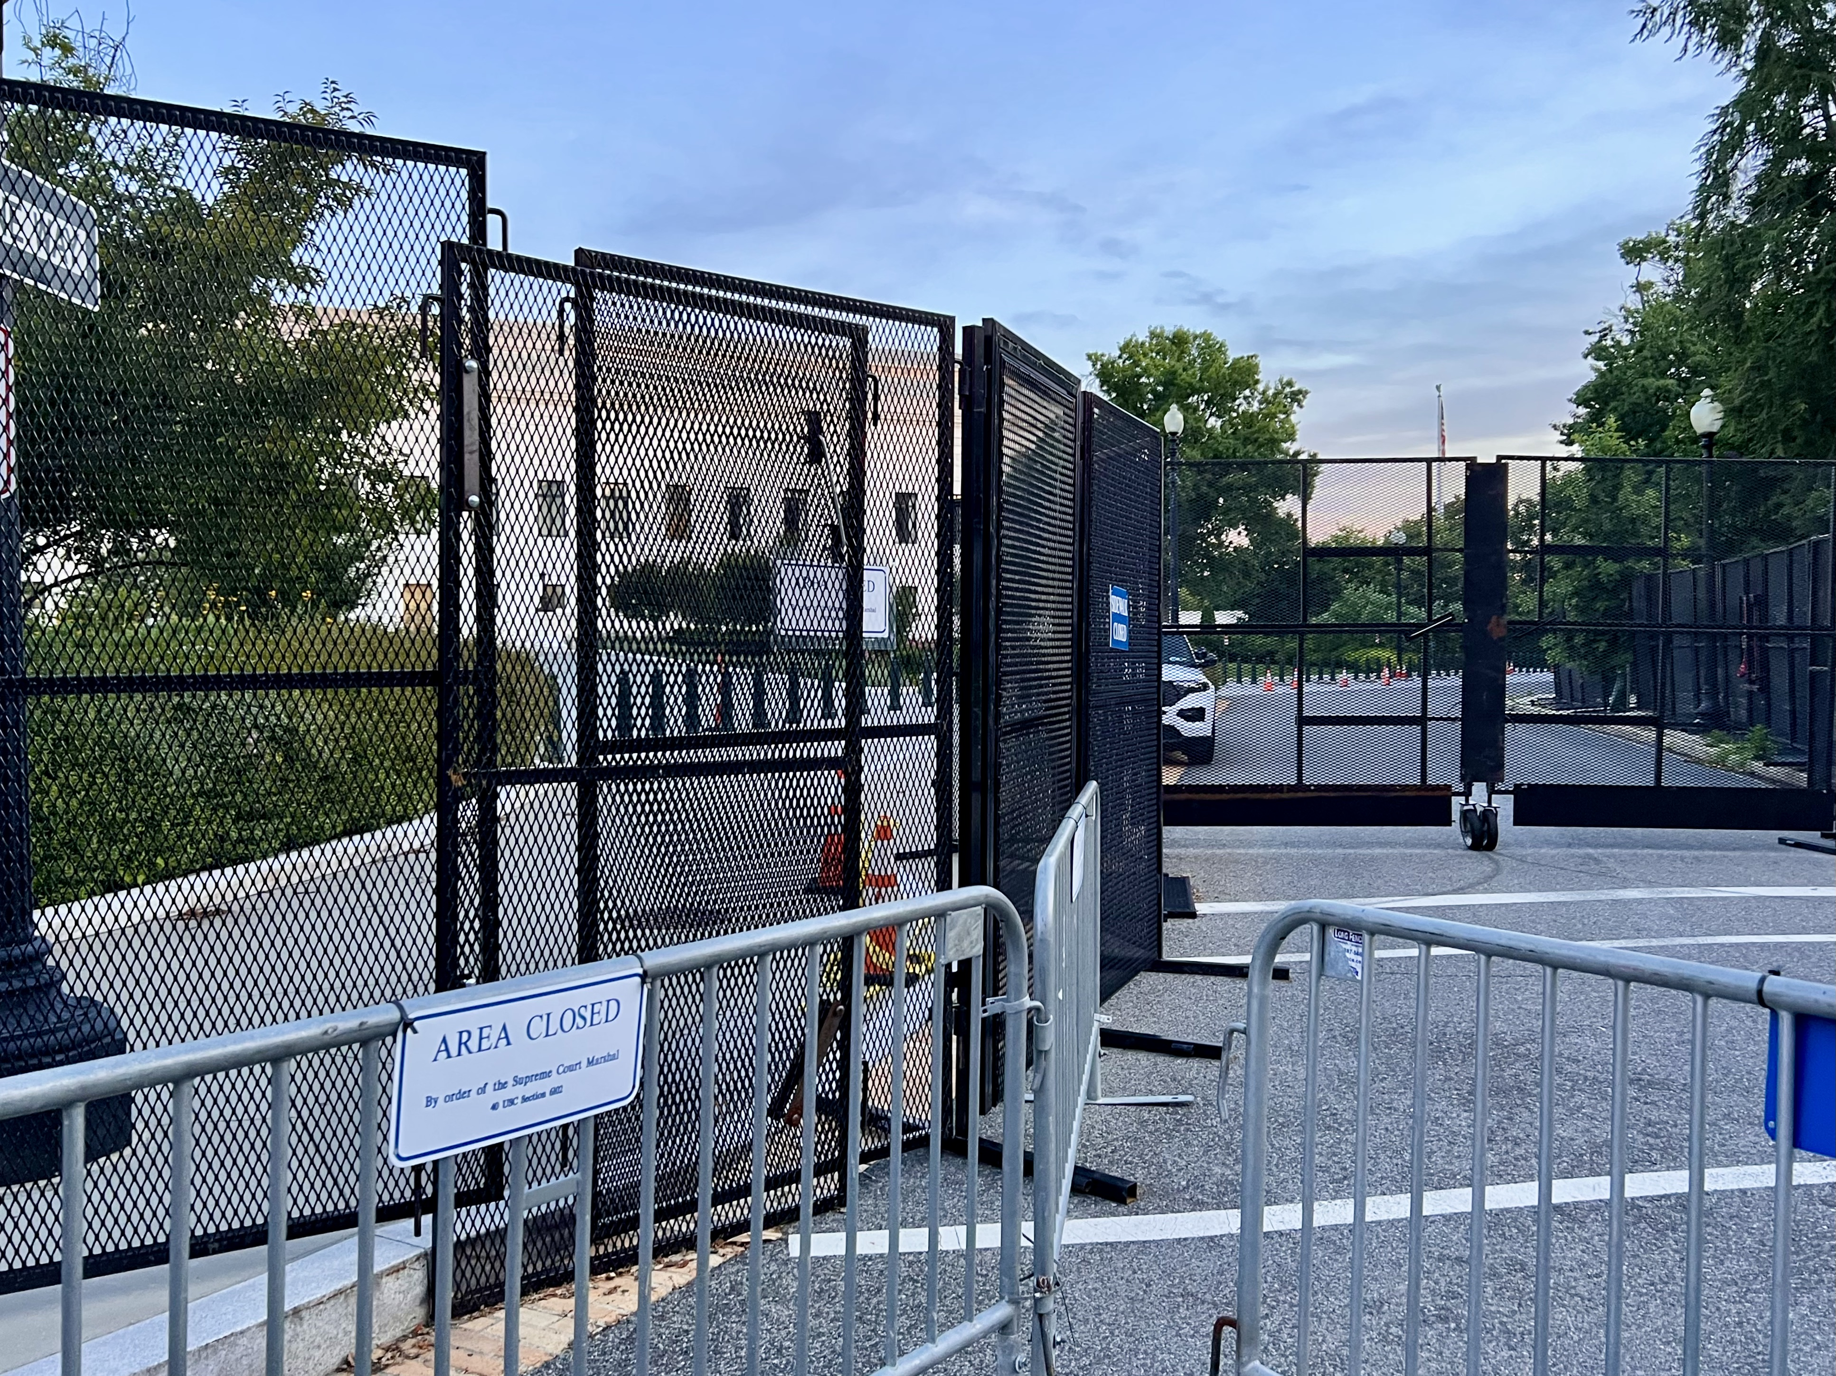
JULY 4, 2022

Slide 10
Case Decided in
2021-2022 Term

Slide 11
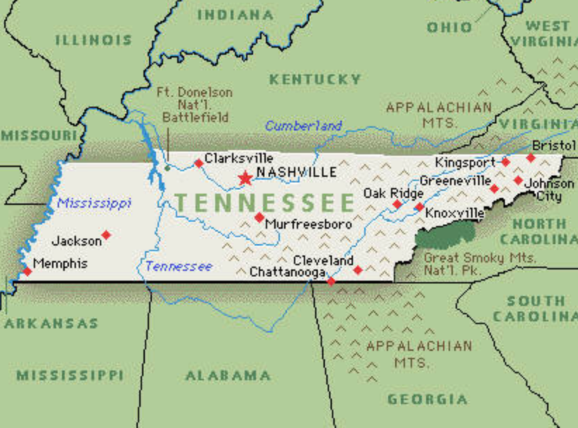
MISSISSIPPI v.
TENNESSEE
Original No. 143
Case will be the first to be argued on October 4, 2021 when the Court opens its 2021 Term.
This is the latest chapter in a decade-long legal battle in which Mississippi claims that the city of Memphis, Tennessee is stealing its groundwater. Mississippi filed a 300-page motion in 2014 asking the Court’s permission to file a new complaint seeking $615 million in damages. Mississippi claims that the city of Memphis, by pumping 140 million gallons of water a day from wells has created a “cone of depression” in the water table that sucks water across state lines into Tennessee. Mississippi estimates that 252 billion gallons of water belonging to it has been sucked into Tennessee. Special master ruled that an equitable apportionment of water rights, which Mississippi does not seek, is a precondition for any possible recovery.

Slide 12
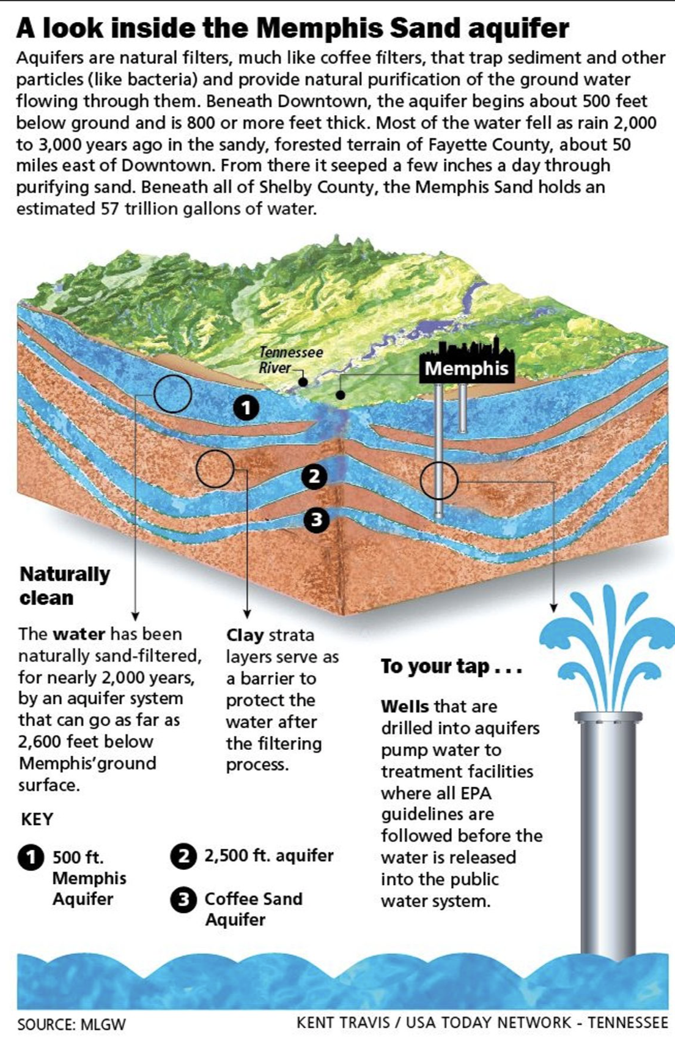
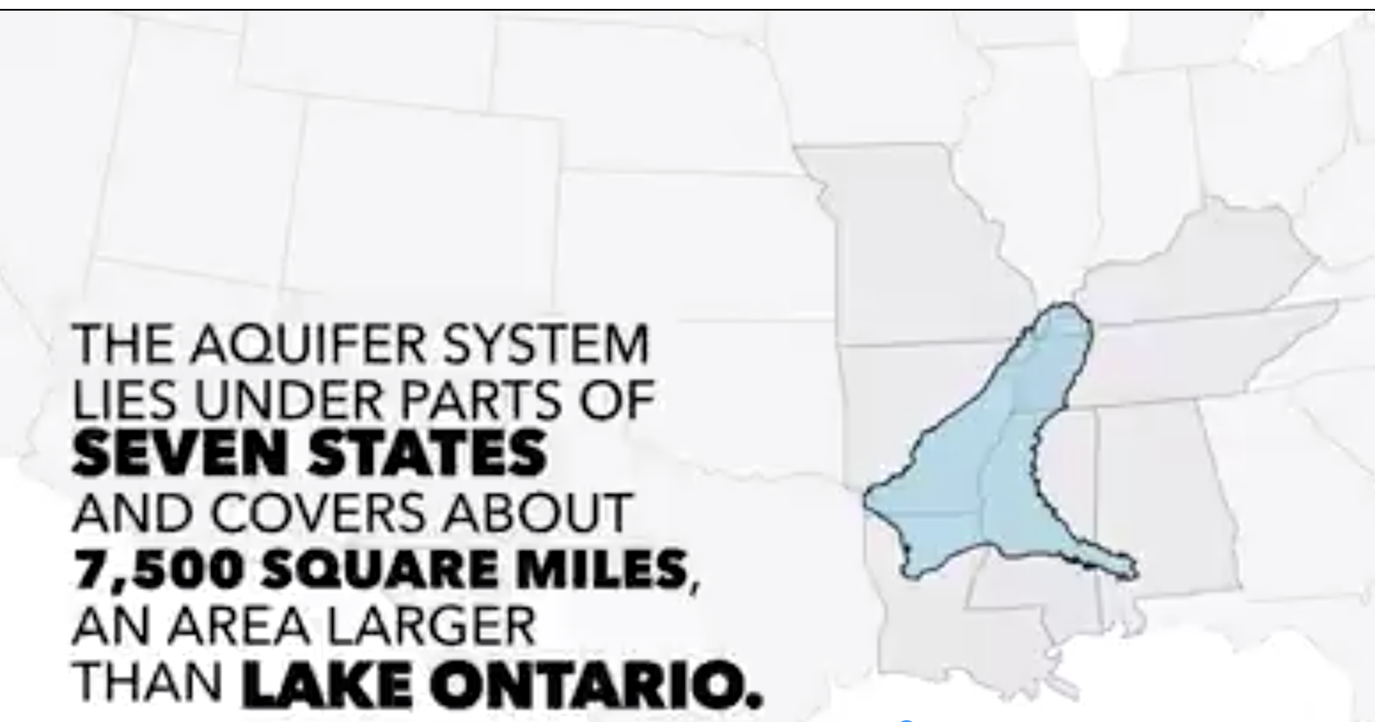
Mississippi v. Tennessee,
Orig. No. 143
(dispute over use of interstate aquifer) Decided Nov. 22, 2021

Slide 13
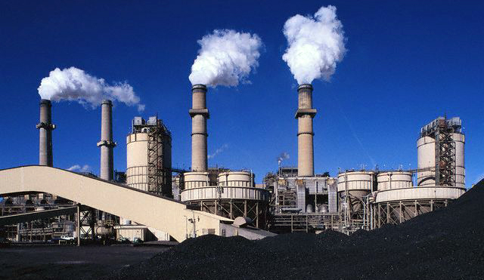
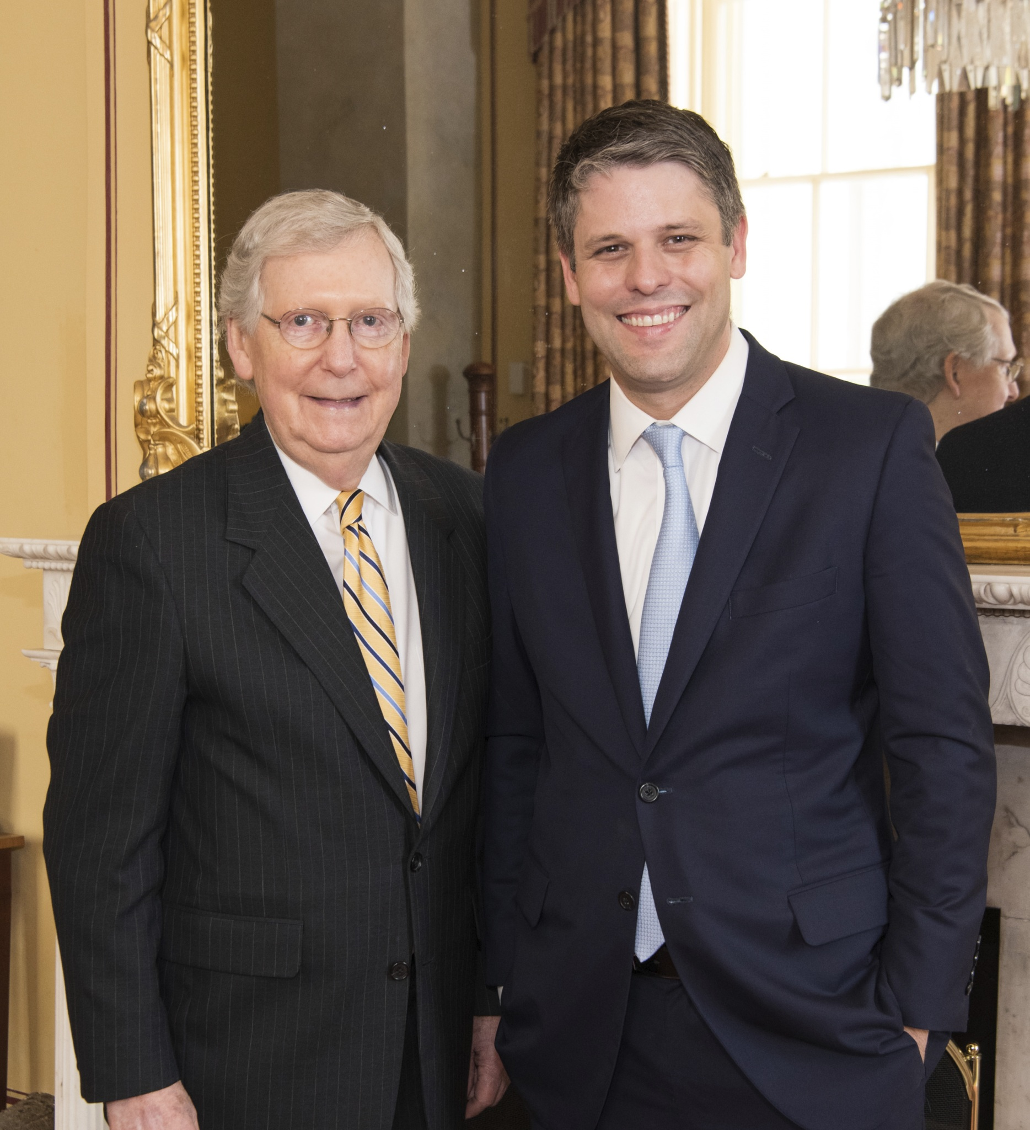
West Virginia v. EPA
Decided June 30, 2022
DC Circuit Judge
Justin Walker,
Dissenter below in
American Lung
The Court Embraces the
“Major Questions Doctrine”

Slide 14
Granted Cases to Be Argued in 2022

Slide 15
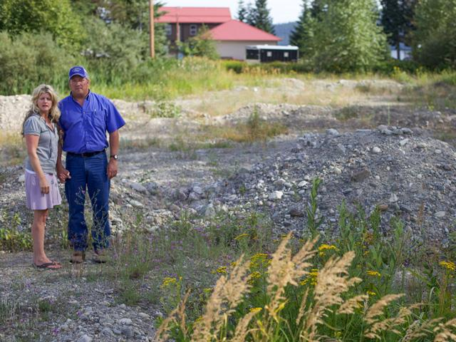
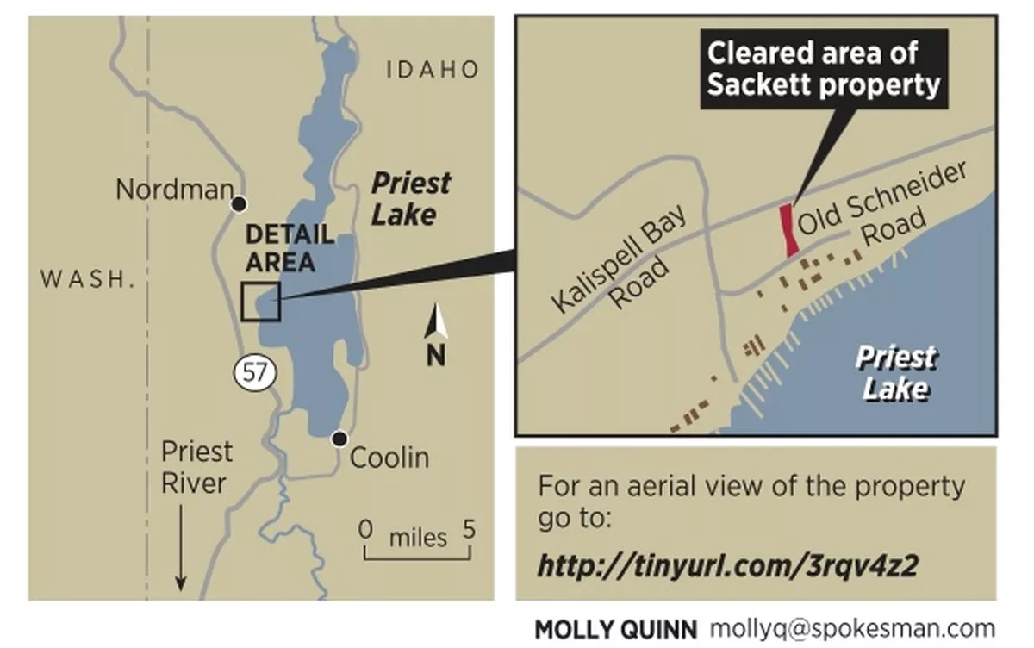
No. 21-454, SACKETT v. EPA
Set for argument October 3, 2022

Slide 16
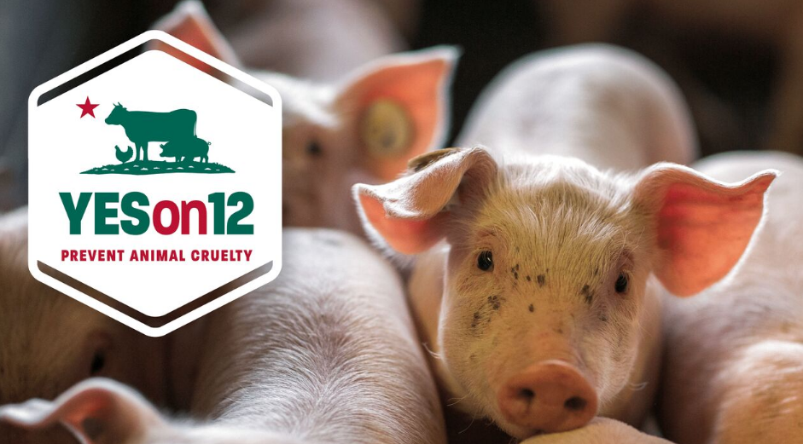
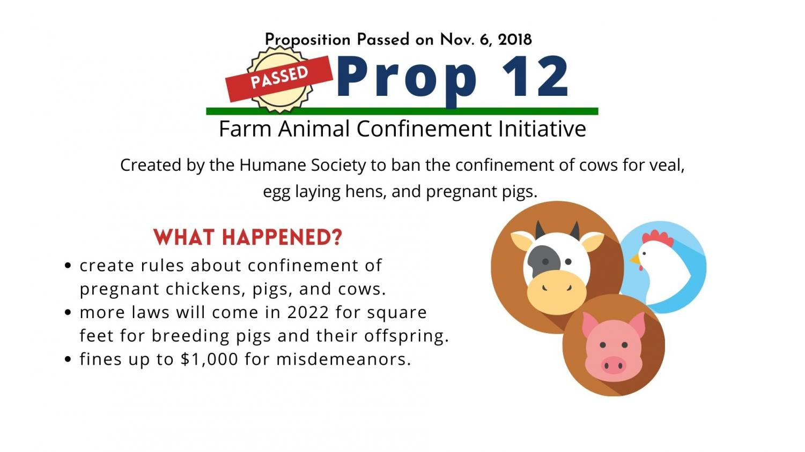
NATIONAL PORK
PRODUCERS COUNCIL v.
ROSS, No. 21-468
Set for argument on
October 11, 2022
Table 1
National Pork Producers Council v. Ross | No. 21-468
Cert granted January 24 | 2022
Set for Argument on October 11 | 2022

Slide 17
Pending Cert Petitions

Slide 18
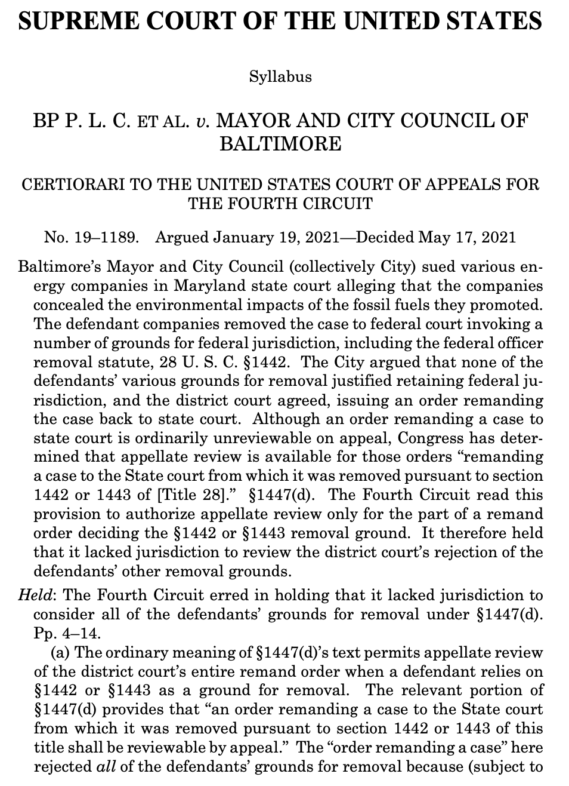
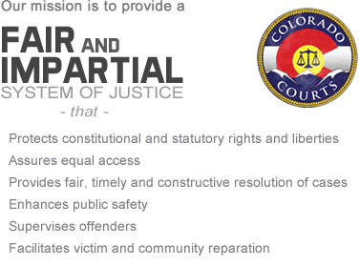
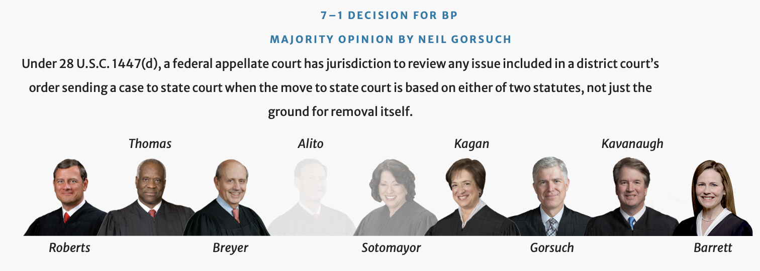
Suncor Energy v. Board of
County Commissioners of
Boulder County, No. 21-1550

Slide 19
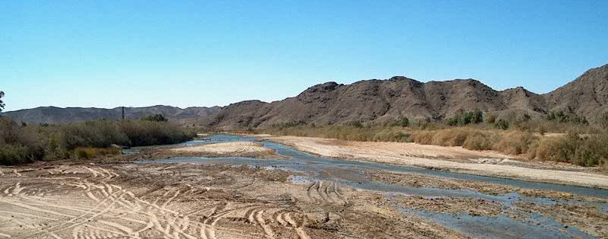
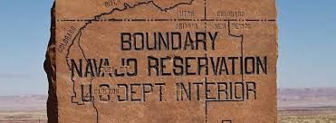
DEPARTMENT OF INTERIOR v.
NAVAJO NATION, No. 22-51
ARIZONA v. NAVAJO NATION, No. 21-1484

Slide 20
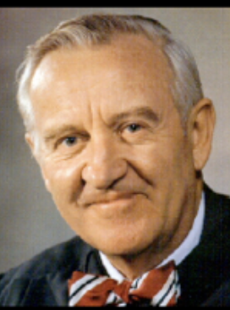
BUFFINGTON v.
McDONOUGH, No. 21-972
Reconsider
Chevron
Deference?
Blackmun notes on what Stevens said at initial conference on Chevron v. NRDC (1984):
“House Committee reports confusing. When I am so confused I go with the agency.”

Slide 21
Cases on the Horizon

Slide 22
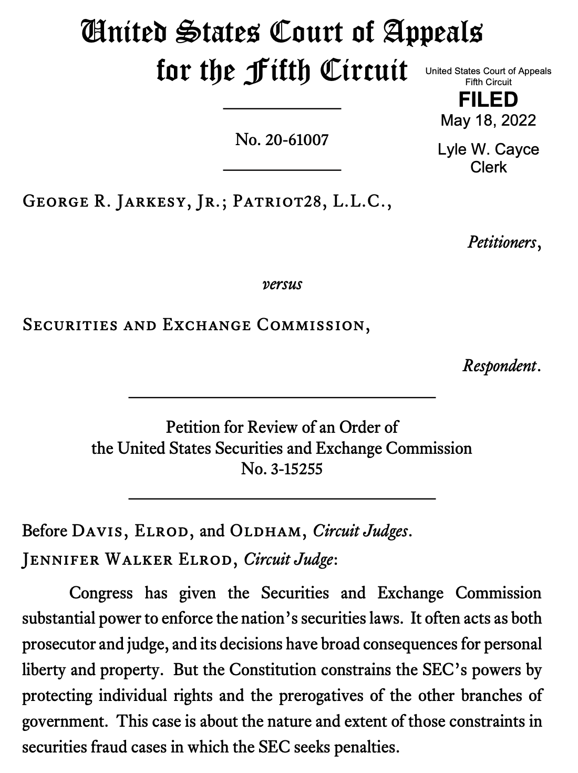
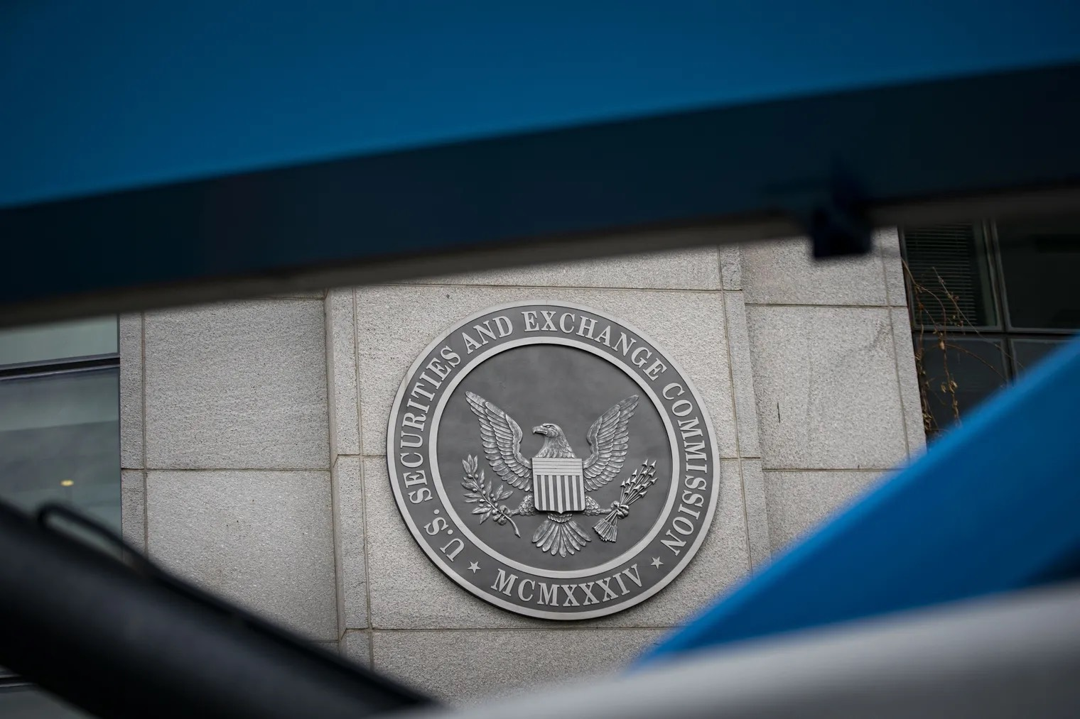
JARKESY v.
SECURITIES & EXCHANGE
COMMISSION
(5th Cir. May 18, 2022)

Slide 23
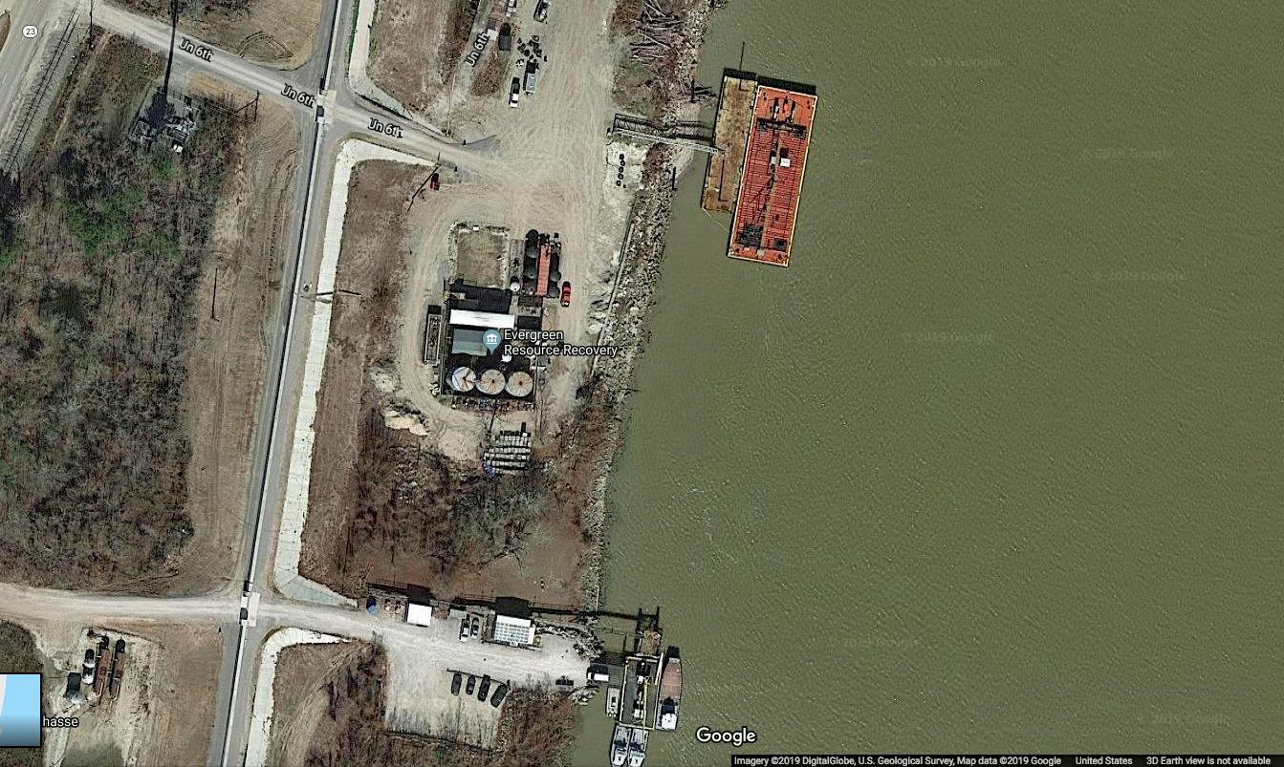
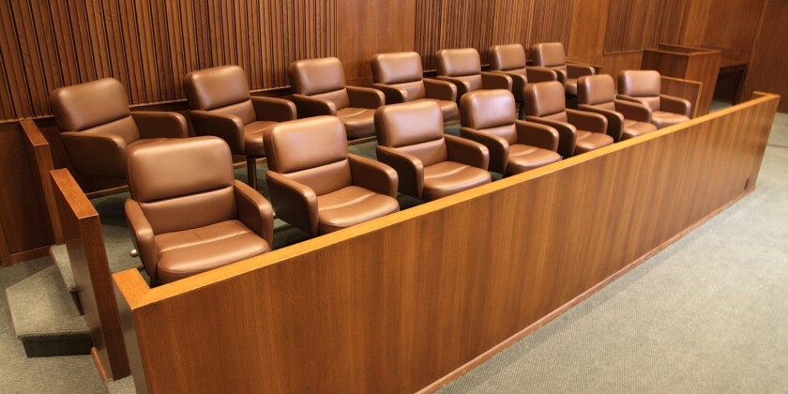
U.S. v. ERR, LLC (5th Cir. 2022)
Does the 7th Amendment Provide a Right to a Jury Trial in Civil Enforcement Action under the Oil Pollution Act?

Slide 24
Environmental Cases in
Which Court Declined Review in 2022

Slide 25
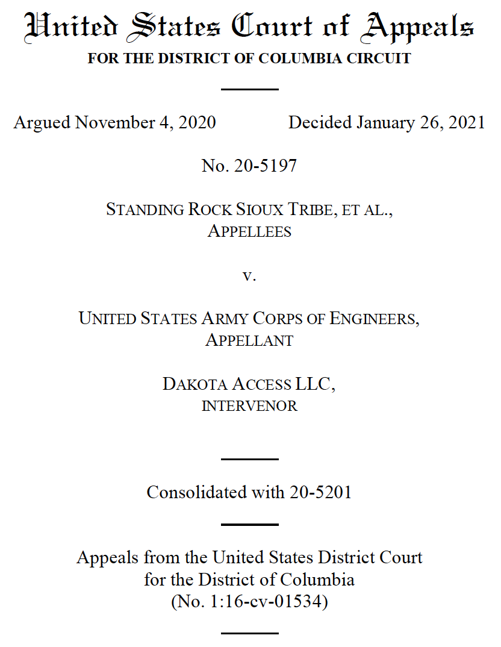
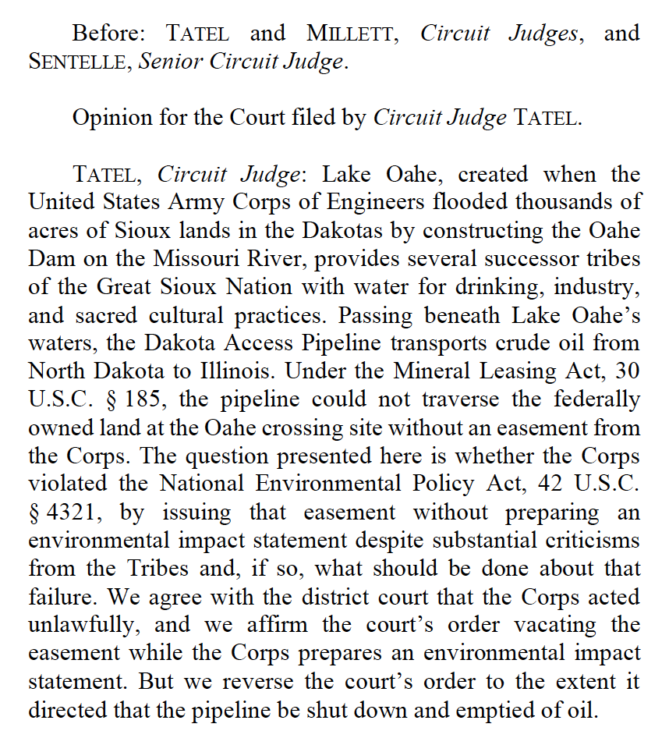
Dakota Access, LLC v. Standing Rock
Sioux Tribe, No. 21-560, cert denied February 22, 2022

Slide 26
No. 21-241, Monsanto Co. v. Hardeman, Cert. Denied June 21, 2022

Slide 27
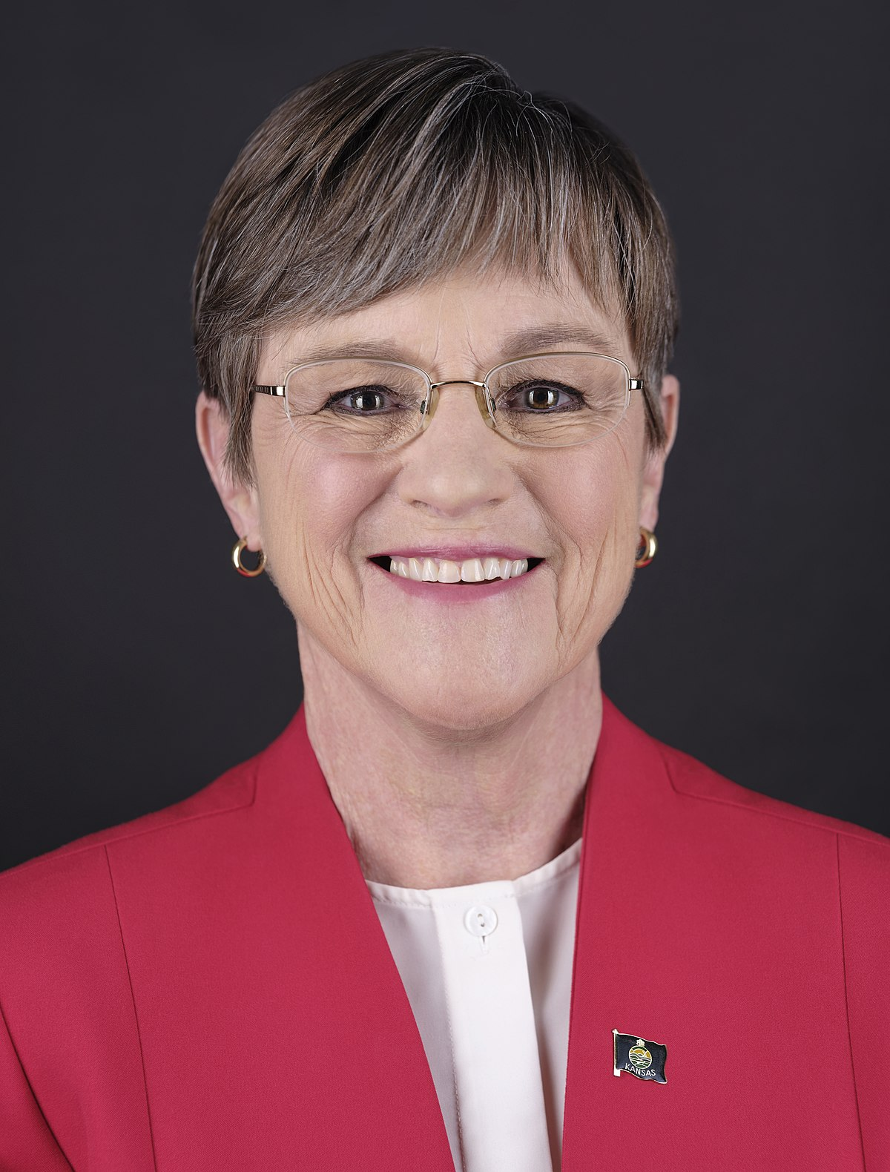
KELLY v. ANIMAL LEGAL DEFENSE FUND
Cert Denied April 25, 2022

Slide 28
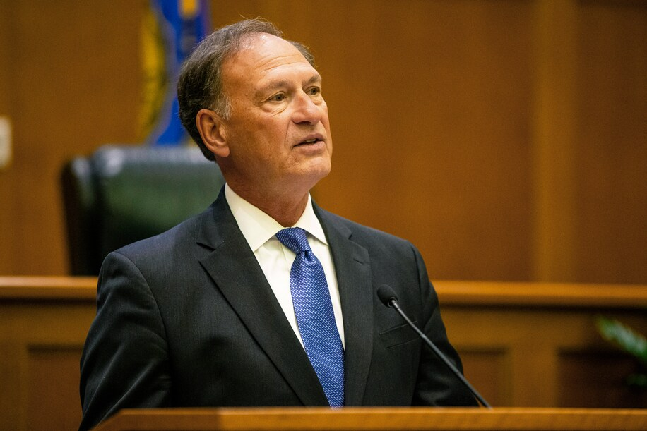
“The catchy and sinister term ‘shadow docket’ has been used to portray the court as having been captured by a dangerous cabal that resorts to sneaky and improper methods to get its ways. And this portrayal feeds unprecedented efforts to intimidate the court or damage it as an independent institution.”
CONTROVERSY OVER
THE COURT’S “SHADOW DOCKET”

Slide 29
