Slide 1
Don’t Look Up: Air Quality and Climate Change Issues
Texas Environmental Superconference
August 2022

Slide 2
West Virginia v. EPA
Status
In January 2021, the D.C. Circuit vacated the Trump administration’s Affordable Clean Energy Rule, which effectively brought the Obama-era Clean Power Plan (CPP) back into enforcement.
Next Steps
Consistent with the D.C. Circuit’s January 2021 decision, EPA will draft a new rule to regulate power plants.
West Virginia challenged the D.C. Circuit’s ruling, and the Supreme Court held in June 2022 that the CPP’s approach in regulating “beyond the fence line” of power plants exceeded EPA’s authority under Section 111(d) of the Clean Air Act under the Major Questions Doctrine.
More broadly, the Supreme Court’s adoption of the “Major Questions Doctrine” creates an additional hurdle to the extent that regulatory policy involves “extraordinary circumstances” “beyond what Congress could reasonably be understood to have granted.”

Slide 3
West Virginia v. EPA
EPA’s Possible Options
Heat rate improvements
Timing
EPA announced that it will release new rules regulating power plant emissions in
Broader Implications
Litigation over other EPA GHG rules
Fuel blending
Carbon capture and storage
March 2023.
Guardrails for EPA on new regulations
Cost benefit analysis?
Other agencies implicated – e.g., SEC, FERC?

Slide 4
Social Cost of Carbon and Methane
Interim Standards
The Technical Support Document released by the Biden administration’s Interagency Working Group in February 2021 set forth the interim standards that are currently in effect ($51/MT CO₂ and $1500/MT CH₄), and subject to ongoing litigation.
Next Steps
The Interagency Working Group is working to finalize these standards.
Timing
Although there is no deadline for action, it is widely expected the final standards will be issued by the end of the summer.

Slide 5
EPA’s Proposed Oil & Gas Methane Rule
Proposed Rule
EPA proposed in 2021 to add Subpart OOOOc to its New Source Performance Standards regulations.
What’s in it?
So far, we have only broad strokes of what the standards are but no proposed rule language – just a description of the standards for New Sources and the Emission Guidelines for Existing Sources.
If finalized, will expand emission reduction requirements for new, modified, and reconstructed oil and natural gas sources and would require States to reduce methane emissions from existing sources nationwide.
Focus on LDAR; zero-emitting equipment or controls with at least 95% destruction efficiency; preventing waste; cracking down on flaring.

Slide 6
EPA’s Proposed Oil & Gas Methane Rule
Environmental Justice
Equity concerns are driving a more robust public process.
Next Steps
EPA is expected to release and take comment on a supplemental proposal with regulatory
Timing
Supplemental rule is expected to be issued in October 2022, with a Final Rule expected in
May 2023.
EPA is considering potential use of advanced methane detection technologies and community-driven reporter of “super-emitters” based on “credible evidence.”
text.

Slide 7
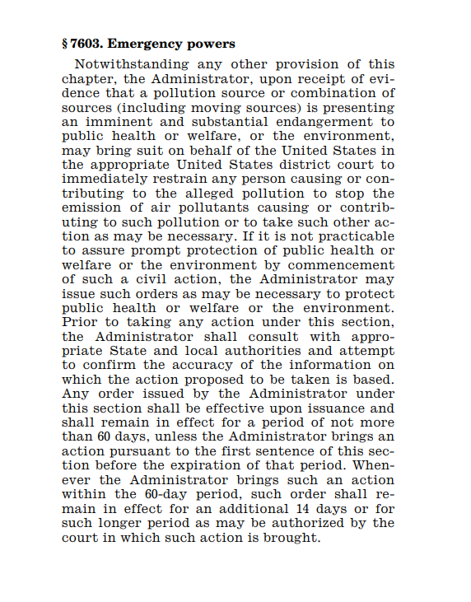
An Emerging EJ Enforcement Tool? Clean Air Act § 303
Section 303 of the Clean Air Act authorizes the EPA Administrator to bring an action for injunctive relief to abate imminent and substantial endangerments to the public health welfare, or the environment caused by emissions of air pollutants.
EPA is authorized to initiate a judicial action against, or issue an administrative order to, any person who is causing or contributing to the alleged pollution to stop the emissions or to take other action as necessary
If EPA issues a § 303 administrative order, the order remains effective for 60 days unless the government files a complaint seeking longer-term relief.

Slide 8
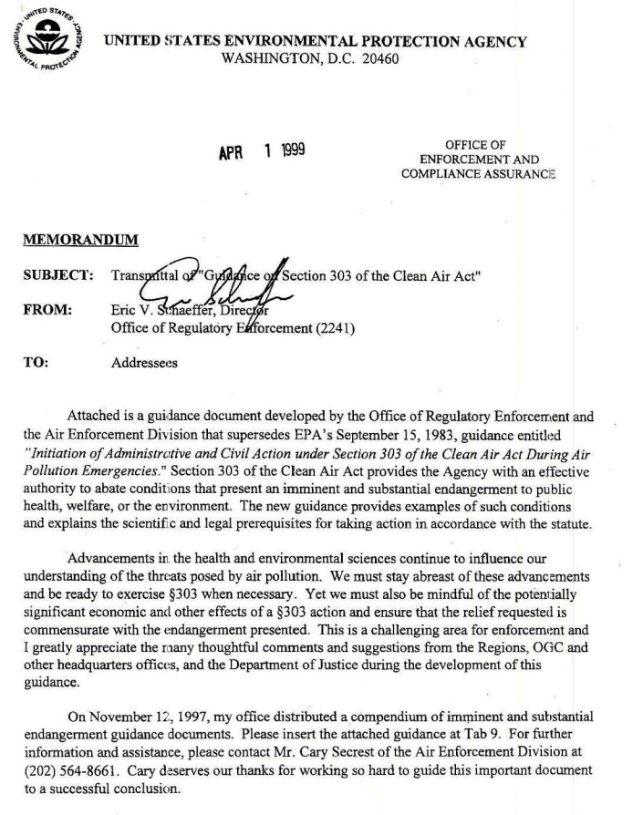
EPA Has Broadly Interpreted Its Section 303 Authority
EPA has broad discretion in determining when an imminent and substantial endangerment is present.
Long-standing EPA guidance incorporates concepts that could be used by EPA to support the use of § 303 orders to address long-term exposure risks.
The guidance provides that “endangerment” need not be an actual harm but can also include a “threatened or potential harm.”
The guidance also states that an endangerment is imminent if the conditions that give rise to it are present, “even though the harm might not be realized for years.”
EPA, Guidance on Section 303 of the Clean Air Act (Apr. 1, 1999)

Slide 9
EPA’s Recent Use of Section 303 Authority
Despite infrequently invoking its § 303 authority in the past, EPA has used its emergency power twice in the past year to address air pollution.
In both instances, longer-term relief was secured by the government through settlement vehicles (New Indy Catawba entered into a consent decree; Limetree Bay agreed to a joint stipulation).
Limetree Bay
New Indy Catawba
In a second May 2021 order, EPA invoked its § 303 authority to suspend operations at a U.S. Virgin Islands refinery that had experienced several incidents resulting in air pollution and oil releases. In addition to suspending operations, the order required the operator to arrange independent third-party audits to review the operator’s
In May 2021, EPA issued a § 303 order to reduce emissions of hydrogen sulfide from a pulp and paper mill in South Carolina. The order required the operator to
EHS program staffing;
CAA compliance; and
process area equipment
establish emission limits (measured as average concentrations at the facility fenceline);
develop and implement a remedial plan; and
install and operate three fenceline monitors, in addition to daily data reporting
Although EPA’s recent § 303 orders signal a willingness to more frequently invoke its emergency authority, neither order sought to address a long-term exposure risk.
Instead, the orders were issued following investigations of more contemporaneous impacts.
Issuing a § 303 order to address lifetime cancer risks would constitute a more expansive interpretation of EPA’s emergency authority.

Slide 10
Questions?
Brittany pemberton
Partner, Washington DC
T: +1.202.828.1708
Brittany.Pemberton@bracewell.com

